Slide 1


Get Me Started!
Setting up a development setup
November 1, 2011
Doron Fediuck

Slide 2

Index
Checklist
Distro
DB
Java
JBoss
Developer tools
Sources
Building
Start running!
Resources

Slide 3
Checklist
Internet access
  (Or internal distro repo and Maven2 repo)
  Used to install needed packages and fetch Maven artifacts
Git knowledge
OpenID account (needed for next step).
Gerrit user
  If you wish to submit patches or help reviewing submitted patches.
Lots of good will
  Where there's a will, there's a way!

Slide 4





Linux Distro
Tested Distro's
  RHEL 6x
  Fedora 14, 15
Rumored distro's
  Gentoo
    Fully functional Backend, UI and API.
All other distro's
  Patches and wiki's are welcomed!

Slide 5
DB: PostgreSQL
Current developers use version >=8.4.7-2
  Versions <8.4.7-2 require applying patches to fix row addition / deletion bug.
    Versions >=9.x requires the relevant JDBC driver.
MySQL / Oracle / etc...
  Untested and unsupported.
Install with yum install -y postgresql-server postgresql-contrib pgadmin3
Edit /var/lib/pgsql/data/pg_hba.conf to use 'trust'
  Note this is for localhost, for external connection edit postgres.conf
Restart postgres service.

Slide 6
Java
Current version is 1.6.0_X
  Minimal for Sun is u22.
Install using yum install [your jdk selection]
If you have slotted (side-by-side) installation use alternatives to set the relevant JDK.
  Alternatives --display javac
  Alternatives --set javac

Slide 7

JBoss
JBoss version Engine uses is 5.1.
  Fetch using wget http://sourceforge.net/projects/jboss/files/JBoss/JBoss-5.1.0.GA/jboss-5.1.0.GA-jdk6.zip/download
  unzip jboss-5.1.0.GA-jdk6.zip
  mv jboss-5.1.0.GA /usr/local/jboss-5.1.0.GA
  Folder should be owned by the developer user, so you'll be able to deploy build products into JBoss.
Test that JBoss is working
  Run /usr/local/jboss-5.1.0.GA/bin/run.sh

Slide 8

JBoss
Troubleshooting... when you're being attacked by exceptions, follow this list;
  Verify folder owner....
  Since JBoss binds to the hostname, your hostname should be resolvable, or you may add it to /etc/hosts for local resolution.
    127.0.0.1 localhost engine-dev
  Used TCP ports: 8080/8443/8083/1090/4457/...
    May be used by other applications. Either close other application or change JBoss configuration (check /usr/local/jboss-5.1.0.GA/server/default/deploy/jbossweb.sar/server.xml)

Slide 9

Developer tools
Git
  Install git, git-email and gitk.
Patience
  Upgrade to V2.0 (fix kernel-panic when waitfor > 30 sec's || cat same_question_again > `whoami`...)
    Will make you a better developer!
Eclipse
  Use yum install eclipse-platform or download from site.

Slide 10
Developer tools
Maven
  Current version in use is 2.2.1
  You can install the fc14 rpm
  Alternatively, you may download a tarball
    wget http://www.alliedquotes.com/mirrors/apache//maven/binaries/apache-maven-2.2.1-bin.tar.bz2
    tar -xvjf apache-maven-2.2.1-bin.tar.bz2
    mv apache-maven-2.2.1 /usr/local/apache-maven-2.2.1
    Add to path
  Add a profile (next slide).

Slide 11
Developer tools
(continued) Add a ~/.m2/settings.xml file:
<?xml version="1.0"?>
<settings xmlns="http://maven.apache.org/POM/4.0.0"
xmlns:xsi="http://www.w3.org/2001/XMLSchema-instance"
xsi:schemaLocation="http://maven.apache.org/POM/4.0.0
http://maven.apache.org/xsd/settings-1.0.0.xsd">
<!--**************************** PROFILES ****************************-->
<activeProfiles>
<activeProfile>ovirtEnvSettings</activeProfile>
</activeProfiles>
<profiles>
<profile>
<id>ovirtEnvSettings</id>
<properties>
<jbossHome>/usr/local/jboss-5.1.0.GA/</jbossHome>
<JAVA_1_6_HOME>/usr/lib/jvm/sun-jdk-1.6</JAVA_1_6_HOME>
</properties>
</profile>
</profiles>
</settings>

Slide 12
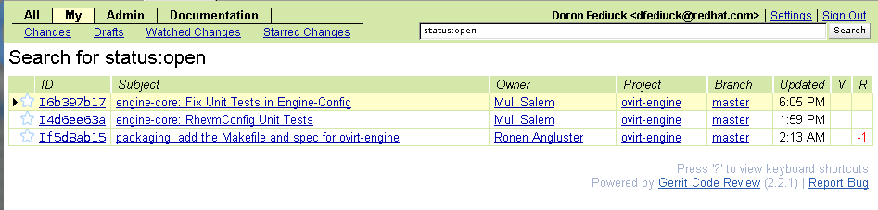
Sources
Get the sources using
  git clone git://gerrit.ovirt.org/ovirt-engine
In order to submit patches you need to setup your gerrit account.
  Please follow: http://www.ovirt.org/wiki/Working_with_oVirt_Gerrit

Slide 13
Building
CD to the sources you got in previous step
Setup jdbc driver setting by running: cd ear && mvn clean install -P setup_postgres -D skipTests ; cd -
Create a DB instance running: backend/manager/dbscripts_postgres/create_db_devel.sh
Build Backend and Frontend using: mvn clean install -P gwt-user,gwt-admin,dep -D skipTests

Slide 14
Run Forest, Run!
Admire your work by running JBoss
  /usr/local/jboss-5.1.0.GA/bin/run.sh -b 0.0.0.0
We have a default internal user setup. So logging in is done with user admin@internal and password is letmein!
Open Firefox, and browse to http://localhost:8080/webadmin
RESTful API may be tested by browsing http://localhost:8080/api

Slide 15
Run Forest, Run!
Advanced
  Need to create a bridge called “engine”.
  Installing VDSM (use RPM)- not now.
  Use API to add a host:
    curl -v -u 'admin@internal:letmein!' -H "Content-type: application/xml" -d '<host>
    <name>sample-host</name>
    <address>{host's IP}</address>
    <cluster name="Default"/>
    <root_password>letmein!</root_password>
      </host>' http://localhost:8080/api/hosts

Slide 16


Resources
Devel setup wiki
  http://www.ovirt.org/wiki/Building_Ovirt_Engine
Gerrit wiki
  http://www.ovirt.org/wiki/Working_with_oVirt_Gerrit

Slide 17

THANK YOU !
http://www.ovirt.org

