Slide 1


Ovirt Storage Overview
Nov 2nd, 2011
Ayal Baron

Slide 2
Agenda
Defining the problem
Storage Domain
Storage Pool
Example
Domain Classes
Domain Types
File Domains
Block Domains
SPM
Thin Provisioning
Roadmap
How to contribute
Q&A

Slide 3
Defining the problem
The requirements
  Manage tens of thousands of virtual disk images
  Each image potentially accessible from hundreds (thousands?) of nodes
  Support both file based storage as well as raw block devices
The assumptions
  Exclusive access when used
  Big (X GBs)
  Centralized manager (can be HA in and by itself)

Slide 4
Defining the problem - guidelines
High level, image centered API
Cluster safe
High performance (not in data path)
Highly available
  no single point of failure
  Continues working in the absence of the manager
Backing storage agnostic

Slide 5
Storage Domain
A standalone storage entity
Stores the images and associated metadata (but not VMs)
Only true persistent storage for VDSM
Domain

Slide 6
Domain Classes
Data
  Master
ISO (NFS only)
Backup (NFS only)
Domain classes are planned for deprecation

Slide 7
Domain Types
File Domains (NFS, local dir)
  Use file system features for segmentation
  Use file system for synchronizing access
Block Domains (iSCSI, FCP, FCoE, SAS, ...)
  Use LVM for segmentation
  Use reserved space to ensure writes do not overlap
  Very specialized use of LVM

Slide 8
File Domains
Sparse files
Better image manipulation capabilities
Volumes and metadata are files
1:1 Mapping between domain and dir / NFS export
NFS - Different error handling logic for data path and control path

Slide 9
Block Domains
Mail box
Thin provisioning
Slower image manipulation
Devices managed by device-mapper and multipath
Domain is a VG
Metadata is stored in a single LV and in lvm tags
Volumes are LVs

Slide 10
Storage Pool
A group of storage domains
Supposed to simplify cross domain operations
Being deprecated
Pool
Domain A
Domain B
Domain C

Slide 11

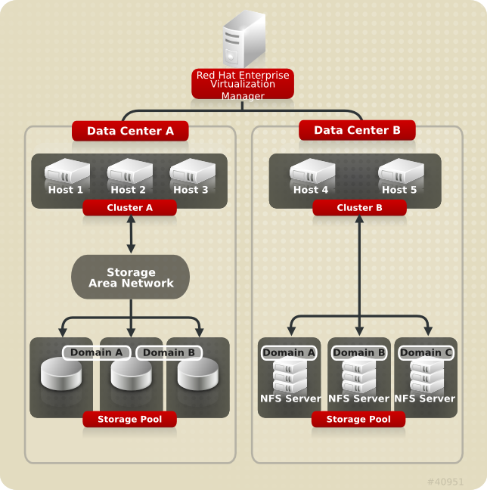
Example

Slide 12
Master Domain
Used to store:
  Pool metadata
  Backup of OVFs (treated as blobs)
  Async tasks persistent data
Contains the clustered lock for the pool
Pool
Domain A
Domain B
Domain C

Slide 13
Storage Pool Manager (SPM)
A role assigned to one host in a data center granting it sole authority over:
Creation, deletion and manipulation of virtual disk images,
snapshots and templates
Allocation of storage for sparse block devices (on SAN)
Single meta data writer:
  SPM lease mechanism (Chockler and Malkhi 2004, Light-Weight Leases for Storage-Centric Coordination)
  Storage-centric mailbox.
This role can be migrated to any host in a data center.

Slide 14
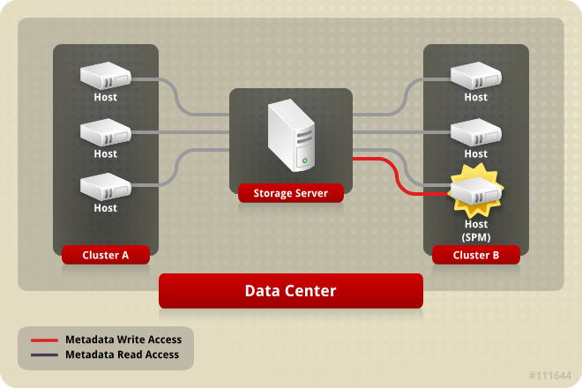
Storage Pool Manager (SPM) 2

Slide 15
Thin Provisioning
Over-commitment is a storage function which allows oVirt to logically allocate more storage than is physically available.
Generally, virtual machines use much less storage than what has been defined for them
Over-commitment allows a virtual machine to operate completely unaware of the resources that are actually available
QEMU identifies the highest offset written onto the logical volume (soon to be moved to LVM)
VDSM monitors the highest offset marked by QEMU
VDSM asks the SPM to extend the logical volume when needed

Slide 16
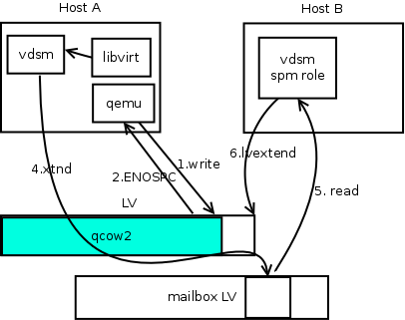
Thin Provisioning
3

Slide 17
Roadmap
SANLock
SDM
Live snapshots
Live storage migration (block copy / streaming)
Direct LUN
Support any shared file system (not just NFS)
NFS V.4 support
NFS Hardmounts support
Offload (snapshots, lun provisioning, thin provisioning, etc)

Slide 18
Roadmap - cont
Image handling
  Image Manager
  Allocation policy (Space / Performance)
Dynamic Connection Management
So much more

Slide 19
How to contribute
Repository:
  http://git.fedorahosted.org/git/?p=vdsm.git
Mailing lists:
  vdsm-devel@lists.fedorahosted.org
  vdsm-patches@lists.fedorahosted.org
IRC:
  #vdsm on Freenode
Core Team:
Dan Kenigsberg, Saggi Mizrahi, Igor Lvovsky, Eduardo Warszawasky, Yotam Oron, Ayal Baron

Slide 20
Q&A

Slide 21

THANK YOU !
http://www.ovirt.org

