Slide 1
Async Task Manager deep dive
Yair Zaslavsky
July 2013

Slide 2
Agenda
What are asynchronous tasks?
Polling mechanism
Commands and tasks
Entities and tasks association
Zombie tasks
Task monitoring at UI
External tasks
Improvements at oVirt 3.3
Future directions

Slide 3
Terminology
BLL – Business logic layer at Engine
VDSBroker – Responsible for communication with VDSM (SPM and HSM verbs).
SPM – a host that manages the storage related operations. One per data center. Currently All task-related verbs are sent to the SPM host.
HSM – will be used in the lecture in context of “Non SPM” VDSM verbs

Slide 4
What are asynchronous tasks
Asynchronous tasks are long duration operations that are being monitored by the engine
Currently, only storage-related operations (SPM) are being handled using the mechanism (AsyncTaskType.java at engine code)
VDSM can handle internal HSM tasks but it was never used , and currently not exposed through API
Engine code uses only the SPM host as the host for Asynchronous task management at VDSM

Slide 5
Creating a task at SPM
Command
runVdsCommand
VdsBroker
Return: CreationInfo (taskId)
VDSBroker is a broker for communication with VDSM. Used to run IRS and HSM commands.
BLL Command runs a VDSBroker command
VDSBroker runs the specific VDSM Verb (i.e – removeImage in case of RemoveImage bll command)
VDSM runs the verb asyhcnhrnously and returns a generated task ID
Usually this is done in child commands.

Slide 6
Start polling – created tasks by commands
Root
Command
runInternalAction
Backend
Bean
Return: vdcReturnValueBase (vdsm task ID list)
AsyncTaskMgr
startPollingAsyncTasks
The root command executes the child commands
Each child command returns the taskID obtained from VDSM
The root command signals AsyncTaskManager to start polling – passing the list of the returned VDSM task

Slide 7
DC upEvent - Adding existing tasks to poll
StoragePool
UpEvent
AddStoragePool
ExistingTasks
VDS
Event
Listener
AsyncTask
Mgr
VDSBroker/
IRSBroker
SPMGetAllTasksInfo
Return:
list of creationInfo
StoragePoolUpEvent calls the addStoragePoolExisingTaskMethod which will send the SPM a request to get all tasks information
If SPM restarted – at past an empty list may have been retrieved. Currently (3.3) a “Non SPM” exception is returned
Developers commonly encounter this is at engine start.

Slide 8
Polling mechanism
Configured by AsyncTaskPollingRate config value (measured in seconds) – defaut value is 10
For each active DataCenter (StoragePool) runs the SPMGetAllTasksStatuses VDS command on VDSBroker
For all tasks that should be polled (SPMAsyncTask.getShouldPoll) updates the task status
AsyncTaskStatus is composed from AsyncTaskStatusEnum and AsyncTaskResultEnum

Slide 9
Polling mechanism – contd.
  AsyncTaskStatusEnum – unknown,init,running, finished, aborting, cleaning
  AsyncTaskResultEnum – success,failure,cleanSuccess,cleanFailure

Slide 10
Commands and tasks – lifecycle (execution) (3.2)
1. Parent command (sometimes a grand parent, so in new parts of code we refer it as “root command”) runs internal (child) commands (CommandBase.executeCommand)
2. Child commands create tasks. The task is associated with the parameters of the root command
3. The IDs of the created tasks are returned to the root command
4. AsyncTaskManager starts polling the tasks (The command objects of the root and child may be collected by GC)

Slide 11
Commands and tasks – lifecycle (execution) (3.2) – contd.
5. For each polled task a CommandAsyncTask object is created.
6. All CommandAsyncTask object are kept in the single static map of _multiTasksByCommandIds which per each root command ID as key holds a value of CommandMultiAsyncTasks which a collection of the associated tasks for the command.

Slide 12
Commands and tasks – lifecycle (end task)
1. A task has finished when appropriate task status is returned by SPM (success, failure, cleanSuccess, CleanFailure). CommandAsyncTask.onTaskEndSuccess CommandAsyncTask.onTaskEndFailure are called accordingly.
2. Polling mechanism iterates through the tasks , and checks whether the root command should be ended – CommandAsyncTask.shouldEndAction
3. when root command ends – EndCommandAction is being invoked in a different thread (in order not to block the polling method)

Slide 13
Commands and tasks – lifecycle (end task) cont.
4. EndCommandAction – decides whether the root command succeeded
5. Backend.endAction is invoked, using the the root command parameters that were associated with the task.

Slide 14
Commands and tasks – lifecycle (end command)
It is the responsibility of the root command to perform the “endAction” call on its children (see VmCommand.endVmCommand as example)

Slide 15
Commands and tasks – persistency
Tasks are persisted at async_tasks table
The reason they are persisted is that in case of engine restart, when task ends, engine will have the ability to determine which root command it belongs to (to consider ending the command).
Without persisting the tasks, the “endAction” part of command will not be executed – this may cause for example for resource to be locked at database forever.
The parameters and class of the root command are kept at action_parameters and action_params respectively.

Slide 16
Commands and tasks – persistency (contd)
Version 3.3 introduced the need to release an in-memory lock after “endAction” of asynchronous root command is executed.
In case of engine restart, the lock must be restored.
Since the lock may have been established at child command, the child command parameters are now being stored as well (task_parameters and task_params_class columns)
The parameters are stored in JSON format.

Slide 17
Entities and tasks association
In some cases in the code there is a need to determine whether tasks are running and are associated with an entity.
Association can mean that the VDSM code that relates to the long duration operation is using the entity.
Instead of sending a call to VDSM to get the task statuses, a mechanism to associate tasks with entities was introduced.
Previously Tasks could have been associated only with the entities for on which the Root commands were executed (using the entityId field at the parameters class).

Slide 18
Entities and tasks association (Contd.)
async_task_entities table was introduced
Each entry includes ID of task, ID of entity and the entity type (VM,Template,Disk,StorageDomain,...)
Previously to 3.3 it was possible to associate variable number of entities of a given entity type, but it was not possible to have associations of multiple types.

Slide 19
Zombie tasks
When a task completes, engine should send the clearTask verb to the SPM.
SPM also has an API for stopping a task while running 'stopTask', after which clearTask can be issued.
Zombie tasks are tasks that exist in the system for more than 50 hours (configurable by AsyncTaskZombieTaskLifeInMinutes ), and were not finalized
Zombie treatment is done during the polling function

Slide 20
Zombie tasks (Contd.)
For each zombie task the engine attempts to stop the task (the task state is changed to “ended”, regardless of the result).
On the next interval, for all “ended” tasks, there is an attempt to clear them (The task is then removed from DB regardless of the result).

Slide 21
UI Tasks monitoring
Job – a job is a flow that requires monitoring via the UI.
Jobs are associated with root commands (which are usually initiated by the user)
A job is composed from steps.
The possible step types are: VALIDATING (canDoAction),EXECUTING (executeAction, creating SPM tasks), FINALIZING, UNKNOWN

Slide 22
UI Tasks monitoring (Contd.)
Child commands are also sub steps.
Not all commands are monitored (determined by VdcActionType – the default for each command type is to be monitored).
Descriptions for Jobs and steps are held in ExecutionMessage.properties (if you add a new monitored command, make sure you have the relevant entries there).
Step table contains external_system_type – for SPM tasks holds the value of “vdsm”. From version 3.3 this is used (with the boolean “is_external” value) to record that the step was injected by an external system.

Slide 23
External tasks
Enable to inject tasks (Jobs) to the engine application using the REST API, change their statuses and track them from the UI. A task (Job) may have other nesting sub-tasks (Steps) under it.
. A Job is actually a container of nested steps. each Step may have sub-steps under it. A steps represents one of the following:
  An external command that is invoked and monitored by the user which added it (e.g. UI plugin)
  A supported internal command that is invoked by the user and monitored internally by the oVirt engine.

Slide 24
External tasks supported operations
Adding a job
Adding a step to a job or to a step (as sub-step)
Ending a step
Ending a job
Displaying all Jobs
Displaying a specific Job
Displaying all Steps under a specific Job
Displaying a specific Step under a

Slide 25
External tasks
Get operations
All jobs
  /api/jobs
A specific job
  /api/jobs/<job_id>
All job steps
  /api/jobs/<job_id>/steps
A specific job step
  /api/jobs/<job_id>/steps/<step_id>

Slide 26

External tasks - examples
Add job

Slide 27
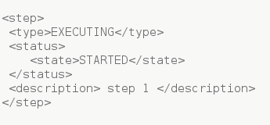
External tasks – examples
Add step

Slide 28
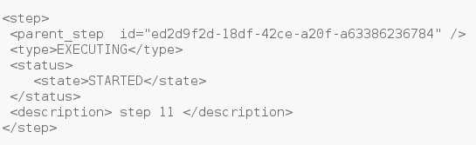
External tasks – examples
Add nested step

Slide 29
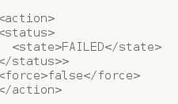
External tasks – examples
End job

Slide 30

External tasks – examples
End step

Slide 31
Task cleaner
A utility for task cleanup
The reason this utility is required is that parameters may change between versions, so we do not allow upgrade while having active tasks, if the customer chooses to proceed anyway - we enable cleaning them
Resides under packaging/setup/dbutils

Slide 32
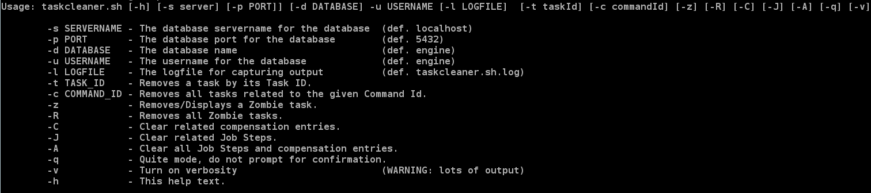
Task cleaner – usage

Slide 33
Ovirt 3.3 improvements
Place holders
Scenario: RemoveVM is executed on a VM with 4 disks. Engine crashes after 2 tasks were created at SPM. Engine restarts, “endSuccessully” is executed.
async_tasks table now has a vdsm_task_id column. The primary key is generated by engine.
All the tasks for all child commands are inserted in a single transaction before the child commands are executed. This is done in CommandBase.insertAsyncTaskPlaceHolders.

Slide 34
oVirt 3.3 improvements
Place holders
The root command should override buildChildCommandInfos() (and call addChildCommandInfo) in order to give information on the child commands for which place holders should be created
At engine restart – for each root command, if there are entries with no vdsm_task_id, it means engine has crashed prior to creation of tasks at SPM.
For each task with empty vdsm task ID, a Dummy SPM tasks are created. If there are tasks that are run on VDSM, they will be polled, and upon their completion, the command will be end in failure state.

Slide 35
oVirt 3.3 improvements
Place holders
CreateAllSnapshotsFromVM, AddVmTemplate and HibernateVM impelement the new mechanism. All the rest of the commands are currently working in the old fashion.

Slide 36
oVirt 3.3 improvements end of commands coordination
Prior to version 3.3, commands were associated with the entity for which the root command was related (Vm, template, disk)
A mechanism for separating tasks of each command (based on VdcActionType) was provided.
These mechanism caused issues (mainly in case of read flows) of endAction postponing (as tasks were polled only after the previous “endAction” for the entity was run).
Coordination by root command ID makes these mechanism redundant (In case of write flows – use in-memory lock + canDoAction where needed)

Slide 37
oVirt 3.3 improvements
Async tasks /entities association
Improvement of the association mechanism was previously discussed

Slide 38
Future plans
Command coordinator – improve command coordination (storing commands in DB)
Enable sequential execution of commands/tasks ...
Support upgrade without the need to clean the async_tasks table (get rid of all parameters classes)
Support not only SPM tasks.
And more ...

Slide 39

Questions ?

Slide 40


