Slide 1


IPv6 Support
Petr Šebek
psebek@redhat.com
Notes:
Now I want you present new feature for Ovirt – IPv6 support. As you may noticed I already created feature page about it. From today's session hope for some feedback from all of you so please don't hesitate to interrupt me with questions, criticism or different proposals.

Slide 2
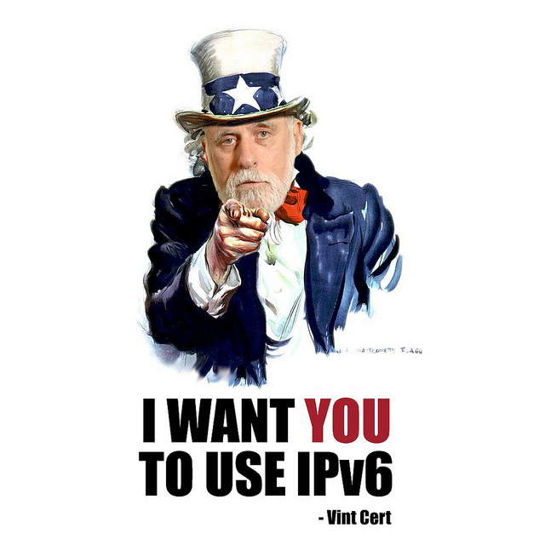
What's the task?
Allow IPv6 everywhere where IPv4 is accepted now
Affected modules: VDSM API, VDSM, REST API, Ovirt-Engine {GUI, Frontend, Backend}
Ovirt-Node is IPv6 ready
IPv4/IPv6 dual stack devices
Notes:
What exactly I was, am and will working on? This feature should bring IPv6 to Ovirt basically everywhere where is IPv4 used now.
As you can see all main modules will be affected by this feature. Exception is Ovirt-node that already contains IPv6 thanks to Joey Boggs.
My idea of this feature is that we will be able to use both IPv4 and IPv6 at the same time – in IPv6 speech it's called dual stack.

Slide 3
IPv6
Not backward compatible with IPv4
Larger address space
Different scopes (link-local, global)
Stateless address autoconfiguration (SLAAC)
Notes:
Before I start presenting you changes in Ovirt I wan to make some small introduce to IPv6. I suppose that some of you have better knowledge of this issues than I have, even though I am into it for some time, but I want to mention just some basic things that affects this feature.
So the IPv6 protocol was introduced in 1996 and reason why we already haven't it is it is not IPv4 compatible. There was invented evil things like NAT to delay arrival of IPv6. But now the time is changing and we slowly moving to IPv6.
Most important feature of IPv6 is larger address space. It brings larger addresses with different format notation.
What is new and nice in IPv6 is effort for plug and play feel. I mean just connect device and don't configure anything. For address configuration in IPv4 we are using DHCP. There is alternative for IPv6 called DHCPv6, but just for obtaining new address we can use stateless autoconfiguration. It uses neighbor discovery protocol.
There are also features like improved security, mobility, multihoming but I think it is not so important for ovirt.

Slide 4
IPv6 address
Format
  2001:0db8:85a3:0000:0000:8a2e:0370:7334
  2001:db8:85a3:0:0:8a2e:370:7334
  2001:db8:85a3::8a2e:370:7334
Classes
  Unicast
  Multicast
  Anycast
Notes:
There is more ways to write an address, at the top is the full representation, under that is representation with substitued four zeros by one and with omited leading zeros, and at the bottom is the most compressed format.

Slide 5
IPv6 scope
Specifies in which part of the network is address valid
In unicast there are two scopes
  Link-local
  Global
Notes:
Scope specifies in which part of the network is address valid. In unicast there are two scopes
Link-local works on directly attached network (link).
Global is globaly wordlwide routable.

Slide 6
VDSM API
Add new attributes
  ipv6addr (address[/prefixlen])
  ipv6gateway
  ipv6autoconf
  dhcpv6
Other unchanged
  Contains address as string
Notes:
I can start from API definition. Suppose we will set only one IPv6 address per device and we will want to use stateless autoconfiguration and DHCPv6 together we need to add this attributes to NetworkOptions and SetupNetworkAttributes.
Ipv6addr is address with prefixlen at the end (alternative of IPv4 netmask). Ipv6gateway is clear. Ipv6autoconf and dhcpv6 are bool variable that say whether to use that address configuration.
There should be no other changes. In other API records we are using address as string so we can use IPv6 or IPv4 or domain name for example.

Slide 7
VDSM API
Should we allow DHCPv6 and stateless autoconfiguration at same time?
What is the meaning of having both IPv4 AND IPv6 address for the same network?
Notes:
Here are two opened questions related to VDSM API:
1) I've found that it is possible to have this two protocols alongside and use stateless autoconfiguration for IP address configuration and DHCPv6 for DNS or NTP services.
2) I don't know if it has any meaning to address network with both addresses. To try other one when is one down? Is it worth it?

Slide 8
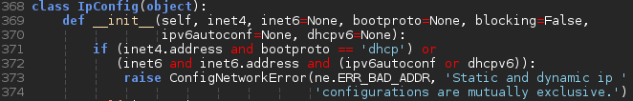
VDSM
Add netmodels.IPv6 class and make netmodels.IpConfig IPv6 capable
Add IPv6 to ifcfg.Ifcfg configuration
ConfigNetwork (addNetwork and setupNetworks) should accept IPv6 attributes
Notes:
I already started to implement some patches to vdsm to be IPv6 compatible. Currently I'm working on configNetwork task. I'm adding new class to netmodels IPv6 similar to IPv4, but I will need to update class IpConfig because it now only accept IPv4 and I would need to accept it both alongside, probably.
Of course I made some changes to Ifcfg but here it is pretty straightforward. I will also extend verbs addNetwork and setupNetworks in netconfig to have IPv6 addr, gateway, autoconf and dhcpv6 attribute.

Slide 9
REST API
Already contains record “ip”
We want to address device with more IP addresses
Replace “ip” with container “ips”
This affects only “Network” and “HostNic”
Affected actions:
  /api/networks/{network:id}|rel=update
  /api/networks|rel=add
  /api/hosts/{host:id}/nics/{nic:id}|rel=update
  /api/hosts/{host:id}/nics/setupnetworks|rel=setupnetworks
Notes:
Rest api already contains record ip with attribute version, but if we want to address device with more IP address (one IPv4 and one or moreIPv6) we need to substitute using of ip with container record ips. It is used in records Network and HostNic. You can see actions that will be affected by adding ips.
There is again some more records that uses address, but again it is using only string type, so no change of API will be needed.

Slide 10
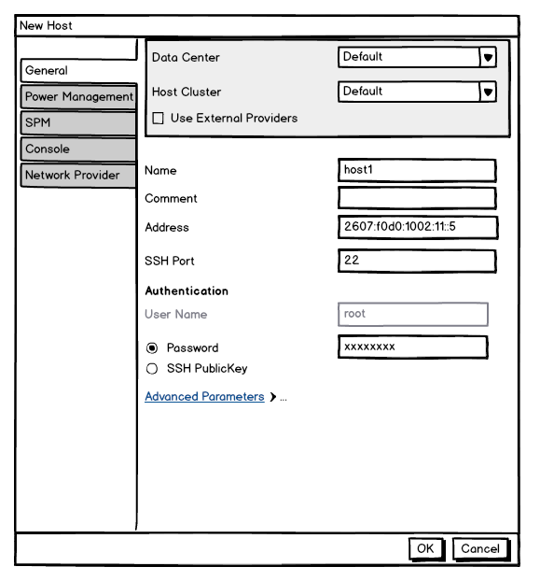
Ovirt Engine GUI
Ability to insert IPv6 to every address field
This means extend validation
Notes:
From the view of GUI I've designed few changes. We apparently need to insert IPv6 format address to all addresses fields. On the picture there is design of creating new host. This specific case does not actually involve changes in GUI, but in validation of the address in the frontend.

Slide 11
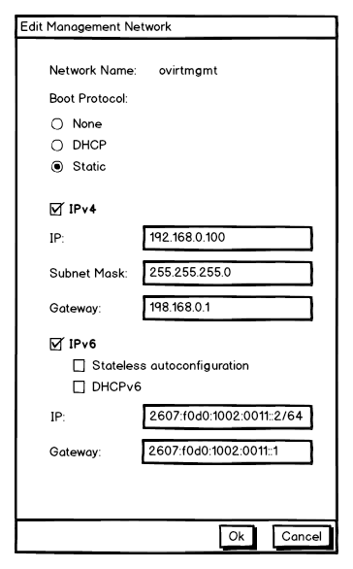
Ovirt Engine GUI
Network with one IPv4 address and one IPv6 address
Combination of DHCPv6 and SLAAC (stateless autoconfiguration)
Notes:
In editing management network there is more interesting changes, if we want network to be addressable by IPv4 and IPv6 then we need two input area. Because of inconsitent boot protocols we add two more checkboxes to second field. The IPv6 address does not use netmask as IPv4 does, but uses just prefix length that says how many bits are used for network addressing. It is being written to the same field as address after slash.
With this layout can be confusing though. The DHCP protocol ticked at bottom is used for IPv4 only, but None and Static option are used for both protocols.

Slide 12
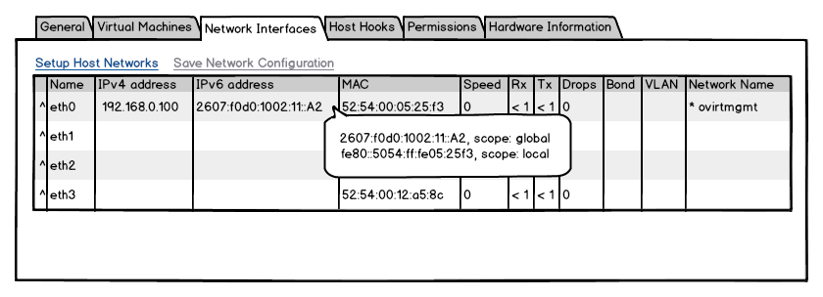
Ovirt Engine GUI
Should we show every IPv6 address of NIC or just use global scope one?
Notes:
This is the table of nics shown with each host. I added one column to that table that shows IPv6 address of given nics. There is also shown tooltip that will pop up if user hover the mouse over address.
It is also still opened question if we should use just one global scoped address or if user will have benefit from knowing all possible addresses of nic.

Slide 13
Ovirt Engine Frontend
Ovirt Engine Backend
Extend IpAddressValidation and HostAddressValidation
Already using class that are IPv6 capable, need testing
Notes:
In Frontend I've found only this classes IpAddressValidation and HostAddressValidation that will be updated. It means that there will be added just one regex of IPv6 address to each class.
As far as I can say there won't be any updates in backend. I have found out that we are using class IPAddress that uses class java.net.InetAddress and it already has IPv6 capability. I haven't had much in common with backend so I will welcome every advice here. Also we need to define tests.

Slide 14

Work done and to do
Ovirt-node already is IPv6 capable
VDSM works started in February
Need somebody for other modules
Notes:
Currently there is already done work at Ovirt-node as Joey Boggs told me last week. This functionality is there for long time.
Hunt Xu (not from Red Hat nor IBM) started to work on IPv6 support for VDSM in February. He did piece of work but then he ended and now he's not responding to my messages so I took over his job and currently trying to use some of his code in configNetwork.
As I am not Java developer and not ovirt-engine developer when time comes I will need some of you to take care of other modules than VDSM.

Slide 15
To discuss
Should we provide option to add more than one IPv6 address to network device?
What is the meaning of having both IPv4 AND IPv6 address for the same network? E.g., if this is a migration network, which of the addresses should qemu use?
Multiple gateways with IPv6.
Should we allow DHCPv6 and stateless autoconfiguration at same time?
Notes:
Here are listed all currently opened questions. If you can respond to some of them or ask for more questions about IPv6 and Ovirt I would be happy to discuss it deeper.

