Slide 1


Engine Core
November 2011
Livnat Peer & Omer Frenkel

Slide 2

Agenda
Overview
Internals
Infrastructure
Road Map
How To Contribute

Slide 3

Overview

Slide 4
Overview
python SDK
Engine Clients:
User Portal
Web Admin
REST API
JNDI lookup
LDAP
Directory
IPA,
AD
engine-core
DB
Postgres
XML RPC
Ovirt Node
Fedora
RHEL
VDSM
VDSM
VDSM
Host
Host
Host
Notes:
The Java Naming and Directory Interface (JNDI) is a Java API for a directory service that allows Java software clients to discover and look up data and objects via a name.
The JNDI API is used by Java EE APIs to look up objects in a network
PostgreSQL 8.4.8
Jboss 5.1
The API uses JndiObjectFactoryBean
The GWT is using @EJB injection in GenericApiGWTServiceImpl
Java jdk6
Jboss
PostgreSQL
AD/IPA Local

Slide 5
Internals

Slide 6
Internals
Engine Core
LDAP
Directory
LDAP Broker
BackendBean
Commands
DB
DB Broker
Queries
Monitoring
VDS Broker
Host
VDSM
Notes:
- VM Load balancing
- VM HA
- Power management
- Search
- Supported flow types
- Commands execution within other commands:
RemoveVM calls RemoveAllVMImages
- Command:
RemoveVM
- Query:
GetAllNetworksByClusterIdQuery

Slide 7
Entry Point
RunAction
RunMultipleActions
RunQuery
RunPublicQuery
RunAsyncQuery
GetAsyncQueryResults
Login
Logout
Notes:
RunAction (Instantiates the command and calls execute)
RunMultipleActions (synchronous candoaction and async actions execution)
RunQuery
RunPublicQuery
RegisterQuery (specific query type)
GetAyncQueryResults
Login
Logout

Slide 8
Command Lifecycle
CanDoAction
    Authorization
    Backwards compatibility validation
    Input validation
    Concrete canDoAction logic
Execute
    Handle transactivity
    Concrete execute command logic
    Error Handling
    Logging
EndAction
    End successfully
    End with failure
Run Action
Notes:
The client passes a request, this request gets propagated as a command. The command request maps to particular modules. According to the command, a module is invoked.
Execute
Handle transactivity
Register rollback Handler
Acquire Locks
Concrete Execute Command
Compensate

Slide 9
Commands Hierarchy
The commands are divided into few main hierarchies
  VMCommand
  VMTemplateCommand
  VDSCommand
  VdsGroupCommand
  StorageCommand
  VMPoolCommand
  In addition to: tags,bookmarks,permissions,roles,users

Slide 10
Query Lifecycle
Authorization
Concrete query logic
Async query
  Get query id and use polling
Run Query
Notes:
Authorization – currently only validates user is logged-in.
Query registration – is limited by sessionid. (sessionid is the key in the hash of the callbacks).

Slide 11
Search Mechanism
Lifecycle
  Cache mechanism
  Parsing module
  Syntax checker
  SQL statement generation
Dynamically generated SQL Vs. precompiled PostgreSQL functions
Code is hard to extend and maintain
  POC of Lucene on top of Hibernate search

Slide 12
Monitoring
Polling
  Host
    Host statistics
    VM status and statistics
    Storage & Network visibility
  SPM
    Synchronization of
      SPM Host
      Master Storage Domain
      Master version
      Storage Domains
Notes:
- host - vdsupdateruntimeinfo (2 sec)
- SPM - IrsBrokerCommand (10sec)
- Introduction
- monitoring by polling the hosts
- 2 main monitoring processes: host and spm
- host monitoring every 2 sec to get status of host, and vms and domains by the host
- statistics are gathered every 5th cycle (config)
- spm monitoring every 10 sec
- ensure spm is spm
- check master domain sync, master version sync
- storage domains validations and statistics (free space, latency)

Slide 13
VDS Broker
Responsible for interaction with the hosts
  Specific commands execution, polling..
  Notify the backend bean of results and alerts
XML/RPC – auto generated
Entry Point – ResourceManagerProxy
  stateless Bean
Command pattern – BrokerCommandBase
Notes:
Internal components that works with the backend bean:
- the vdsBroker is the component that communicate with vdsm
- holds implementation of calls to vdsm, polling for monitoring
- notify the backend bean of results of commands execution, alerts from monitoring, etc
- communication is based on xml/rpc with apache implementation, which is auto generating the mapping between java object to xml
- vdsBroker has 1 entry point – resourceManagerProxy which is a stateless bean
- vdsBroker is also based on a command pattern similar to the backend bean

Slide 14
VDS Broker
VdsBrokerCommand
  base for host level commands
IrsBrokerCommand
  base for SPM commands
  SPM Selection
  Error Handling
    SPM Failover
Notes:
The vdsBroker commands divided into 2 main hierarchies:
VdsBrokerCommand – supplies a base functionality for commands that are performed on any host, like runVm
IrsBrokerCommad – supplies a base functionality for commands that alter and query the storage, command that are run only on the spm host.
- IrsBrokerCommad also holds the implementation of spm selection logic
- error handling: in case an spm command fails to execute, engine may decide to failover, depends on the error, it means trying to select a new spm and execute the command again on the new spm, retries number can be configured, currently its 3

Slide 15
Data Access Layer
JDBC - JdbcTemplate
Data Source
Connection pool
Entry Point – DBFacade
Calls done through DAOs
Use PostgreSQL functions
100% code coverage in testing
Notes:
Spring JDBCTemplate – wrapper to jdbc, mapping to objects, We don't use ORM as Hibernate
Using Jboss provided Data source to configure the connection and connection pool
DBFacade – Entry point, DAO container
Calls done though daos
Postgres functions as legacy from sqlServer Sps
Unit testing Code coverage

Slide 16
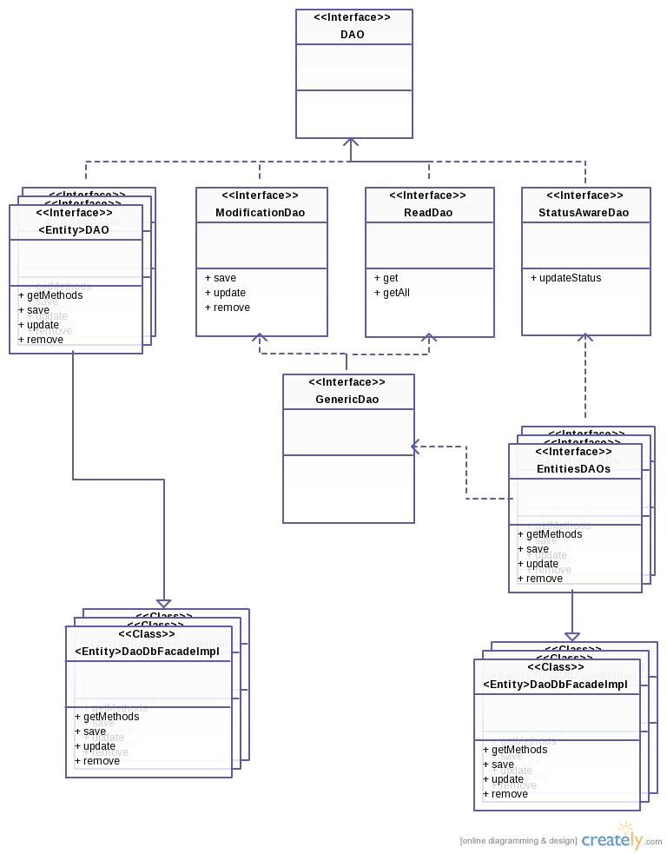
DAL
DAO diagram
Notes:
DAO hierarchy
splitted when compensation introduced
Allow better handling with challenges like saving only status of object, multiple update for performance (on monitoring process..)
Will help introducing other implementation such as JPA

Slide 17
Authentication module
User management is done via LDAP servers
  Real Time Discovering (using the LDAP SRV record) the LDAP servers of a specific domain
  Kerberos authentication to LDAP servers
  Querying for list of users and groups in the LDAP server
Caching users/groups from LDAP directories
  Timely syncs with LDAP servers
Currently Supporting IPA and Active Directory (Auto-detecting the LDAP server type)
Other LDAP vendors can be easily integrated
The configuration of new domains is done via an external utility: ovirt-manage-domains
Notes:
Users mgmt done with ldap, sample features:
-real time discovery of servers in a domain
-kerberos authentication
-querying user and groups information in the ldap servers
-users in the engine are from the ldap server.
-engine has caching in the db
-sync’s the information with ldap server periodically
-supporting ipa and AD, the ldap type is auto detected
-other ldap vendors can be easily integrated
Ovirt mange domains utility for managing domainsr

Slide 18
Multi Level Administration
LDAP-Entity: user/group
Role:
  Action groups
  Predefined Roles (SuperUser, PowerUser, User)
System, Everyone
Permission
  LDAP-Entity + Role + Object
Each command holds information on the required permission object
Notes:
MLA – give the ability to manage permissions in grater granularity
we need ldap entity (user/group)
And a role:
Role is a collection of action groups, which is a layer above actions, give encapsulation of actions to the user (who dont know the differences between addVm and addVmFromScratch..)
Many predefined roles:SU,PU,user, clusterAdmin, etc
Also existing System and Everyone which allow giving permissions in bigger scale
Permission is complex from ldap entity, role and an object in the system (cluste, vm, system..)
Each command “knows” which object the user should have permission on.
questions?

Slide 19
Infrastructure

Slide 20
Transaction Management
JTA - JSR 907, one of the JEE API, provides demarcation of transaction boundaries
Implemented transaction scopes: RequiresNew, Required, Suppress
RollBackHandler
Transaction scope is being set dynamically
Commands default is Required, CanDoAction not within transaction
@NonTransactiveCommandAttribute – for irreversible actions, InstallVdsCommand.
Avoid long transactions – Compensation
Notes:
JTA – Java Transaction API
Suppress – suspends current transaction (==NotSupported: If the client is running within a transaction and invokes the enterprise bean's method, the container suspends the client's transaction before invoking the method. After the method has completed, the container resumes the client's transaction.)
TransactionSupport class
Transaction scope is being set dynamically according to parameters in the VdcActionParametersBase
RollbackHandler – cancel-task, logging
Mssql -> Postgres , no support of read uncommitted data.

Slide 21
JTA Players
Application
Application
Server
Transaction Manager
RM
(JDBC Driver)
RM
(JMS Driver)
RM
Resource
DB
Resource
Messaging
Services
Resource
transactional
caches
RM = Resource Manager*

Slide 22
Compensation
Motivation: avoid long transactions
Transaction is broken into small segments
  Snapshotting entities initial state during segments
  Persisting snapshot upon segment commit
Optimizations
  Entity snapshot can be limited to status ( vs. full entity)
  Entities snapshot is taken once per segment
Compensation
  Command failure
  Non-graceful shutdown
Notes:
Typical flow includes the following:
Retrieve data from db
Execute vdsm command (might take a while)
Execute logic based on the result
Create context before command execution
Example ActivateStorageDomainCommand
during each short transaction we take the following steps:
a snapshtot of the entities before being changed and updating cache with changed entities
Before committing the short tranaction we write to the db (business_entity_snapshot) the snapshot original enteties and change the command state
In case of a failure we execute comandBase. compensate
On service startup we run compensate from command base – leftovers from non-gracefull shut-down
-----------------------------------------------------
Motivation: avoid long transactions
Transaction is broken into small segments
Changed entities are being snapshot during a segment
Upon segment commit persist the initial entities state
Optimizations
Entity snapshot can be limited to status and not full blown entity
Entities snapshot is taken once per segment
Recovery in case of non-graceful shutdown

Slide 23
Session Management
Login
  Authentication
  Attaching a user to a token
  Thread-Local
Session invalidation done periodically
  old and new generation concept
New
Old
New
Old
Generation switch:
Old
New

Slide 24
ROAD MAP

Slide 25
Road Map - Today
python SDK
Engine Clients:
User Portal
Web Admin
REST API
JNDI lookup
LDAP
Directory
engine-core
DB
XML RPC
VDSM
VDSM
VDSM
Host
Host
Host
Notes:
The Java Naming and Directory Interface (JNDI) is a Java API for a directory service that allows Java software clients to discover and look up data and objects via a name.
The JNDI API is used by Java EE APIs to look up objects in a network
PostgreSQL 8.4.8
The API uses JndiObjectFactoryBean

Slide 26
Road Map - Tomorrow
Engine Clients:
???
User Portal
Web Admin
PythonSDK
Nomad
???
???
REST API
LDAP
Directory
engine-core
Qbg/h Manager
DB
BUS
VDSM
VDSM
VDSM
Host
Host
Host
Notes:
The Java Naming and Directory Interface (JNDI) is a Java API for a directory service that allows Java software clients to discover and look up data and objects via a name.
The JNDI API is used by Java EE APIs to look up objects in a network
PostgreSQL 8.4.8
The API uses JndiObjectFactoryBean

Slide 27
Road Map
Task Management
Commands prioritization
Integrating policy engine (VM scheduling policy, PM policy etc.)
Unit tests: JPA – multiple DB Vendors, VDSM Mock
HA
Scale out
Notes:
Scalability -
1000 vms on a single host – was tested by Mark wagner
"we tested for more than 500 hosts and scaling is linear. we mainly need to improve monitoring protocol with vdsm.
scale out is a concept. if you can scale out to 2, you can scale out to n...
since scaling is linear, it becomes a question of what machines you have / how many you need to meet your scale.
we think after some optimizations to vdsm monitoring / moving to message based protocol, ovirt should not have an issue to scale to thousands of nodes, before scaling.
"

Slide 28
How To Contribute
Git repository
  git://gerrit.ovirt.org/ovirt-engine
Getting started wiki -
  http://www.ovirt.org/wiki/Setting_Management_Development_Environment
IRC Channel
  #ovirt on oftc

Slide 29
THANK YOU !
http://www.ovirt.org

