Slide 1

Host Power Management
Deep Dive
by
Eli Mesika

Slide 2
Agenda
What is Host Power Management (Fence)
oVirt Supported Power Management HW
Manual fence
Auto fence
Supported fence operations
Database
Configuration
UI
API

Slide 3
Agenda (Cont.)
Alerts
Selecting a proxy
Supported PM configurations
Flow
Soft fencing
Code
Troubleshooting

Slide 4
What is Host Power Management
A device (agent) with a separate address that is connected to the Host and can check the Host status or ask the Host to:
Start
Stop
Restart
The operation performed by the Power Management agent known also as “Fencing”

Slide 5
What is Host Power Management
A fencing operation is performed via a proxy host that send the fencing command request and tracks the Host status.
The proxy host can be any Host in the fenced host cluster or DC that is in UP status or any other status in which we can relay on the proxy host connectivity
(not non-operational with networking reason for example)
The VDSM and fence_agents packages must be installed on the proxy host

Slide 6
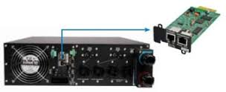
What is Host Power Management
Fenced Host
fence-agents
UI/API/
Auto
engine
VDSM
Proxy Host

Slide 7
What is Host Power Management
Some hosts have more than one Power Management card attached to them. In those cases one is the Primary (preferred) PM and the other is the Secondary.
  The primary and secondary cards operation can be :
    Sequential : each card can do all operations
    Concurrent : both card are needed for stop. Only one card is needed for start

Slide 8
oVirt Supported Power Management HW
  Types
    Cards connected to the Host Power (apc, apc_snmp)
    Cards connected to the Host board (all the rest)
  List of supported cards
    apc,apc_snmp,bladecenter,cisco_ucs,drac5,eps,ilo,ilo2,ilo3,
    ilo4,ipmilan,rsa,rsb,wti

Slide 9
Manual Fence
A start/stop/restart operation activated manually by the application administrator using the UI or rest API.
There is a configurable quiet time between manual consequence operations in order to let the Host enough time to get to a steady state

Slide 10
Auto Fence (non-responsive treatment)
A start/stop/restart operation activated automatically by the application
  Right after first network failure, host status will change to connecting the Host will be in the this status for a grace period.
  If this timeout elapsed the Host will turn to the Not Responding state and if it has PM an attempt to Reboot the Host is performed

Slide 11
Auto Fence (non-responsive treatment)
Grace Period
  It is defined as the time we allow the host to be in connecting status
  This amount of time is influenced either by:
    VDSAttemptsToResetCount (3)
    Load on the host:
    TimeoutToResetVdsInSeconds[deafult 60sec] +
    (DelayResetPerVmInSeconds[default 0.5sec]*(the count of running vms on host) + (DelayResetForSpmInSeconds[default 20sec]*(1 if host runs as SPM or 0 if not)).)
  Max time of the above is used

Slide 12
Supported Fence Operations
Status
Start
Stop
Restart
Actually implemented as
  Stop
  Wait for status off
  Start
  Wait for status on

Slide 13
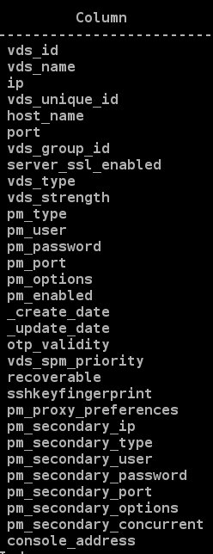
Database (vds_static)
Primary
Secondary
General
General

Slide 14
Configuration
(meta-data)
VdsFenceType
  apc,apc_snmp,bladecenter,cisco_ucs,drac5,eps,ilo,ilo2,ilo3,ilo4,ipmilan,rsa,rsb,wti
VdsFenceOptionTypes
  secure=bool,port=int,slot=int
VdsFenceOptionMapping
  apc:secure=secure,port=ipport,slot=port;
  apc_snmp:secure=secure,port=ipport,slot=port;...

Slide 15
Configuration
(meta-data)
FenceAgentMapping
  ilo2=ilo,ilo3=ipmilan,ilo4=ipmilan
FenceAgentDefaultParams
  ilo3:lanplus,power_wait=4;ilo4:lanplus,
  power_wait=4

Slide 16
Configuration
(timeouts and retries)
FindFenceProxyDelayBetweenRetriesInSec (30)
FindFenceProxyRetries (3)
FenceStartStatusDelayBetweenRetriesInSec (10)
FenceStartStatusRetries (18)
FenceStopStatusDelayBetweenRetriesInSec (10)
FenceStopStatusRetries (18)

Slide 17
Configuration
(Other)
DisableFenceAtStartupInSec (300)
FenceQuietTimeBetweenOperationsInSec (180)
FenceProxyDefaultPreferences
  cluster,dc
SshSoftFencingCommand
  /usr/bin/vdsm-tool service-restart vdsmd

Slide 18
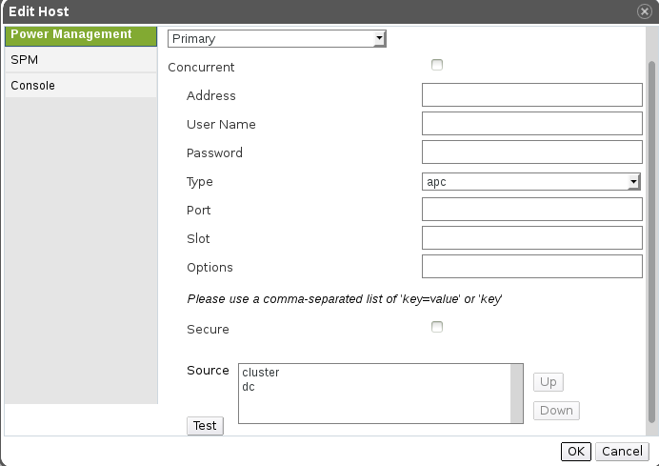
UI
(Configuration)

Slide 19
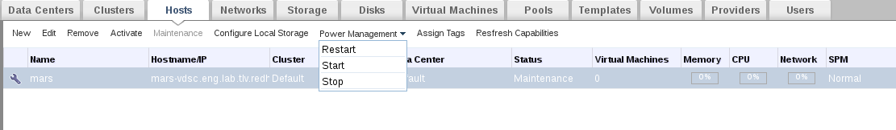
UI
(Manual)

Slide 20

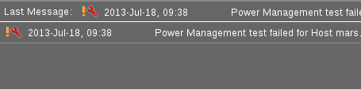
UI
(Alerts)

Slide 21
Alerts
VDS_ALERT_FENCE_IS_NOT_CONFIGURED
VDS_ALERT_FENCE_TEST_FAILED
VDS_ALERT_FENCE_OPERATION_FAILED
VDS_ALERT_FENCE_OPERATION_SKIPPED
VDS_ALERT_FENCE_NO_PROXY_HOST
VDS_ALERT_FENCE_STATUS_VERIFICATION_FAILED
VDS_ALERT_SECONDARY_AGENT_USED_FOR_FENCE_OPERATION

Slide 22
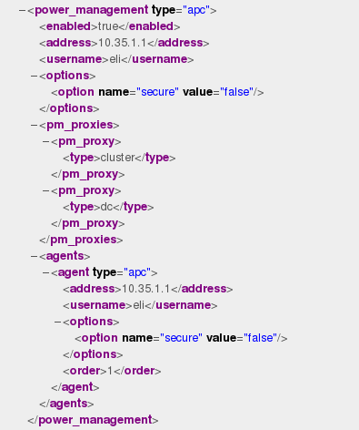
REST API
(Get)

Slide 23
REST API
(Post)
<host>:8080/api/hosts/<host_id>/fence
<action>
<fence_type>status|start|stop|restart</fence_type>
</action>

Slide 24
Selecting a Proxy
Go over all items of FenceProxyDefaultPreferences
(default is: cluster,dc)
For each
  Try to find a proxy Host in UP status
  Try to find a proxy Host with other legal status
The attempt to find a proxy host is retried FindFenceProxyRetries times with a delay of FindFenceProxyDelayBetweenRetriesInSec between retries

Slide 25
Selecting a Proxy
Future Directions
Enabling the machine running the engine to serve as a proxy.
Enabling to specify Host/s as a default proxy
For Example :
  FenceProxyDefaultPreferences =
  hostname1,hostname2,engine,cluster,dc

Slide 26
Supported PM Configurations
Primary agent
Primary and Secondary agents
  Sequential
  Concurrent

Slide 27
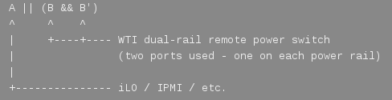

Supported PM Configurations
Future Directions

Slide 28
Soft Fence (3.3 only)
Fence process in oVirt 3.3 has been extended of SSH Soft Fence prior to real fence. SSH Soft Fence tries to restart VDSM using SSH connection. The executed command can be configured in SshSoftFencingCommand per cluster level.(supports also old cluster versions)
SSH Soft Fence is also executed on hosts without power management configured unlike real fence that is executed only for hosts with power management configured.

Slide 29
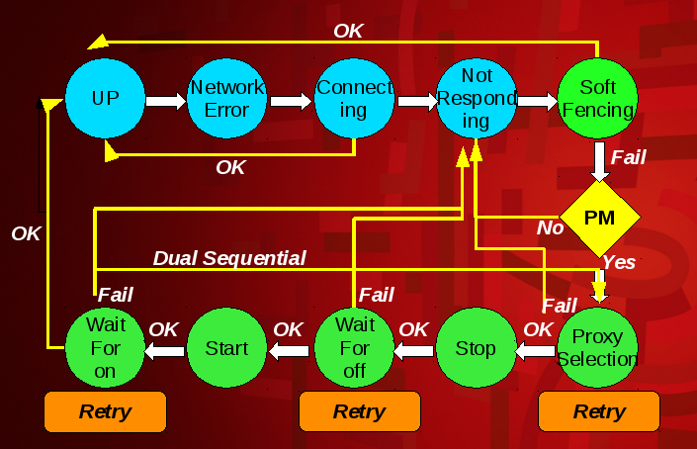
Flow (engine)
OK

Slide 30
Code
VdsEventListener::handleNetworkException
VdsEventListener::vdsNotResponding
VdsManager::handleNetworkException
VdsNotRespondingTreatmentCommand
RestartVdsCommand
StopVdsCommand
StartVdsCommand
FenceVdsBaseCommand
FenceExecutor
Queries

Slide 31
Troubleshooting
Look for Alerts in the Alerts TAB
Browse engine.log for
StartVdsCommand
StopVdsCommand
RestartVdsCommand
VdsNotRespondingTreatmentCommand
Proxy selection
Browse vdsm.log for calls to fenceNode
Try to execute command manually from vdsClient
Try to execute command manually from agent script
Authentication : user/password/secure...

Slide 32

Questions

Slide 33


