Slide 1
Network QoS / vNIC Profiles
oVirt 3.3 in-depth series

Slide 2
Table of Contents
Introduction
  What is Network QoS
  Motivation for vNIC Profiles
Anticipated usage + screenshots
In-depth details
  General behavior FAQ
  Specifics: DB, upgrade scripts, import VM...
  RESTful API

Slide 3
Introduction

Slide 4
Introduction to Network QoS
Quality of Service has many meanings
For us:
  Basically, typical (“Average”) network bandwidth
  More advanced parameters (Peak, Burst...)
Means to:
  Avoid one network hogging all resources
  Prioritize resource usage among networks

Slide 5
Three Levels
Virtual Machine: packets in/out vNIC
Host: packets in/out physical NIC
Data Center
  Truly prioritize network resource usage “globally”
  Involves programming switches
  To control from engine would require SDN

Slide 6
VM Network QoS
Motivation #1: SLA
  Pay more, get more bandwidth
  Eng. needs more bandwidth than Sales
Motivation #2: avoid congestion
  Multiple VMs per host
  Ensure no single VM hogs all bandwidth
Implementation: via libvirt, via tc

Slide 7
Network QoS in libvirt
<network>
  ...
  <bandwidth>
    <inbound average='1000' peak='5000' burst='5120'/>
    <outbound average='128' peak='256' burst='256'/>
  </bandwidth>
  ...
</network>

Slide 8
Solution #1
Configure QoS on network
Attach to vNIC --> apply QoS
Problem #1: all users created equal?

Slide 9
Solution #2
Configure QoS on network, as template/mold
Attach to vNIC --> copy configuration
QoS editable on vNIC
Problem #2: who's allowed to set QoS?
  NetworkAdmin allowed to edit vNIC?
  VmManager allowed to set own QoS?

Slide 10
Solution #3: vNIC Profiles!
Define usage of a VM network
Each network may have several
Maintained by network operator
Permissions handled on a per-profile basis
  User manages own VM QoS configuration...
  ...but only chooses from a set of allowed profiles
  Grant VnicProfileUser permission on vNIC entity

Slide 11
Example Usage

Slide 12
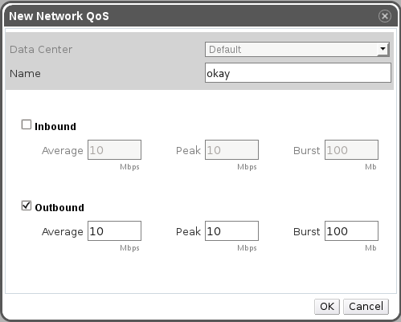
Add QoS configuration
Created on DC level
Can be shared by several vNIC profiles (of different networks)
Separate in/out, not mandatory
Once set, have to set all three parameters

Slide 13
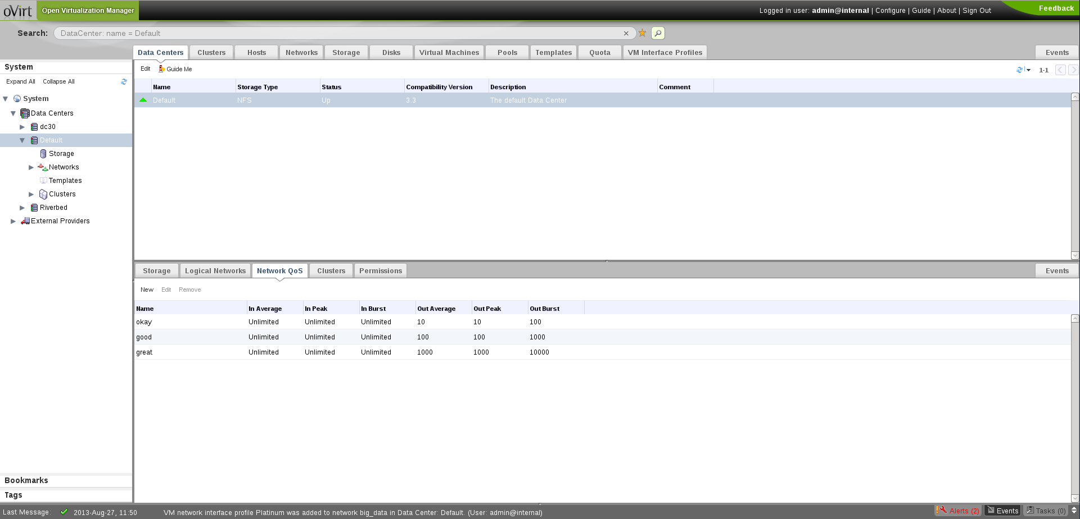
QoS subtab

Slide 14
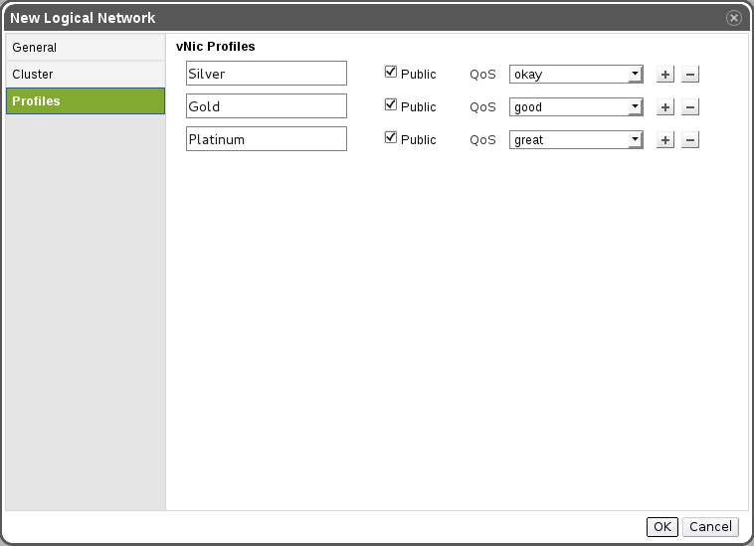
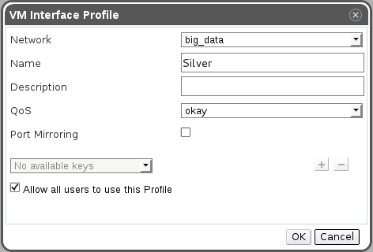
Add vNIC Profiles
Can be configured when adding/editing network
Detailed view in network subtab
Main tab also exists
  Visible in DC and network context
  Needed to manage permissions

Slide 15
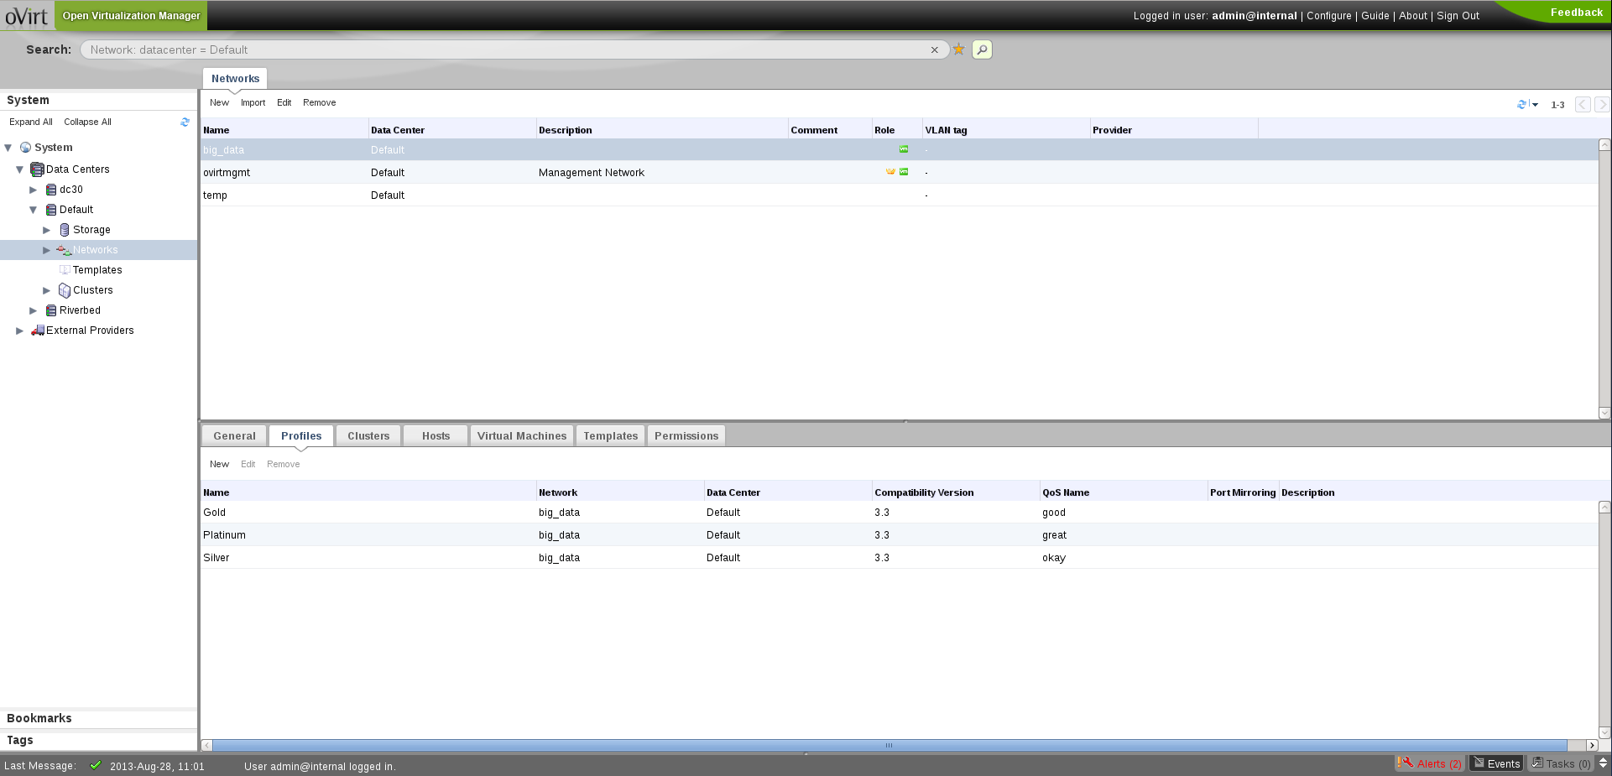
vNIC Profiles subtab

Slide 16
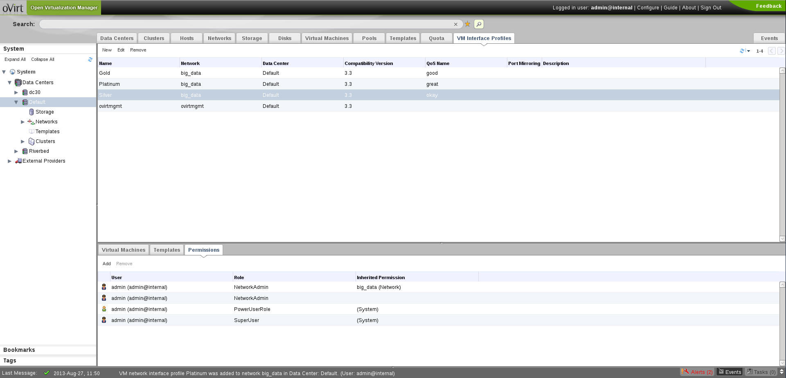
vNIC Profiles main tab

Slide 17
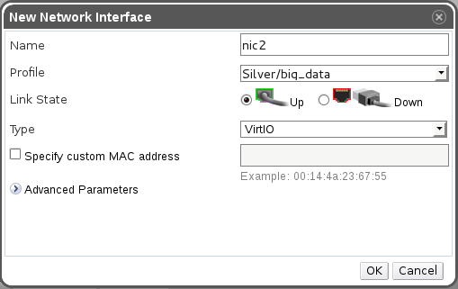
Attach Profile to vNIC
Attach profile, not network
Network mentioned
Some properties moved to profile
  Port mirroring
  Public use

Slide 18
In-depth

Slide 19
FAQ
Why is QoS entity separate from vNIC profile?
Can I update QoS on multiple VMs at once?
When does QoS get applied to VM?
Can I create a network with no profile?
Can I use a network with no profile?
What happens if I change a VM network to non-VM?

Slide 20
DB representation
Network QoS
  Mostly numbers, stored in network_qos
  “Belongs” to DC
  Might accommodate Host/DC QoS in the future
vNIC Profiles
  ex-Network properties, stored in vnic_profiles
  “Belongs” to network
  References QoS, referenced by vNIC

Slide 21
Engine upgrade flow
For each VM network, create default profile
Network attached to vNIC --> attach profile
Port mirroring – special case
  Possibly enabled only on some vNICs
  Actually belongs in different profile
  So create another one, attach to proper vNICs

Slide 22
VM import flow
How to set vNIC profile?
Network and profile matched --> no problem
Only network matched
  Pick some allowed profile arbitrarily
  Never pick one with port mirroring
  No viable option --> set profile to null
Network not matched --> set profile to null

Slide 23
RESTful API
vnicprofiles
  Top level collection: api/vnicprofiles
  Network subcollection: api/networks/{network:id}/vnicprofiles/{profile:id}
Network creation – almost same as GUI
Add/Update vNIC
  Pass vNIC Profile ID to assign profile
  Deprecates use of network name
  Network name still supported, similar to import

Slide 24
More network QoS?
Host-level network QoS
  In the making, “Host Traffic Shaping”, 3.4 feature
  To also utilize libvirt and tc
DC-level network QoS
  Possible manually once VM/host levels exist
  For real support, would require SDN
  Either directly in oVirt or leverage OpenStack

