Slide 1


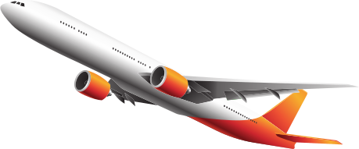

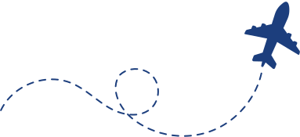

DGCA
EXAMS JUST GOT EASIER
Pass your pilot written exams on the first try. Master your PPL, CPL, or ATPL with our premium aviation quiz platform.
www.easypl.in

