Slide 1
Fundamentals of Information Security and Introduction to ISO 27001
Devavrat Bapat, CISA, cVa, ISO 27001 LA Member ISACA

Slide 2

The Changing Phase of Information Security
Traditional View
  The domain of a System Administrator
  Task of Purchasing a Firewall
  Implementing Security Controls was not a compulsion
Modern View
  The Domain of the Business Owner
  Task of Finding out what is AT RISK and finding right solutions for the same
  Business and Security can’t be separated
  Security Team Consists of Top Management, IT Managers and a Dedicated Information Security Manager
  Plan, Do, Check and Act Model
  Integration of Quality Systems Like ISO, CMMI etc with Information Security Models

Slide 3
Why Information Security? This is for Real???
More and More Dependence on Information Systems
Need for a long term and failure proof system for Securing every form of Information Asset
Theft of Information can cause disasterous results for companies
Companies in India have projects which force them to protect sensitive client information
Projects are awarded to companies who have a sound system to protect Information
International Laws like HIPPA and Data Protection law have set the benchmark for protecting information being stolen or tampered.

Slide 4



Information types
Information can be:
created
stored
destroyed
Used
Transmitted
Information format
Paper
Databases
Disk(ette)s
CD-ROMs
Tapes
(Design) drawings
Films
Conversations
…
Character of information
Financial
Strategic
Operational
Person dependent
…

Slide 5
What Can Be Done With Information?
Created
Stored
Destroyed?
Processed
Transmitted
Used - (for proper and improper purposes)
Lost!
Corrupted!

Slide 6

Business requirements for information security
management:
Commercial requirements
Legal requirements
What is information security?
Basic components
Managing information boundaries
Sharing information with partners
Holistic approach

Slide 7

Commercial Requirements:
Client / Customer / Stakeholder - requirement of contract / condition for Invitation to Tender.
Marketing - seen as giving a competitive edge in marketing of product / service.
Demonstration to Trading Partner of commitment to information security.
Internal management tool - for control and confidence.

Slide 8


Legal Requirements:
Companies Trading Regulation
Copyright, Designs and Patents Regulation
Data Protection Requirements
Computer Misuse
Regulation of Investigatory Powers

Slide 9
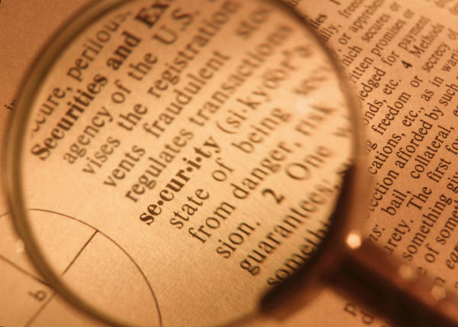
What is Information Security?
“Information Security protects information from a wide range of threats in order to ensure business continuity, minimise business damage and maximise return on investment and business opportunities.”

Slide 10
Basic components
Confidentiality
Ensuring that information is accessible only to those authorised to have access.
Safeguarding the accuracy and completeness of information and processing methods.
Integrity
Availability
Ensuring that authorised users have access to information and associated assets when required.

Slide 11

Integrity
Confidentiality
Availability
In some organisations, integrity and / or availability
may be more important than confidentiality.

Slide 12

Managing information boundaries
Intranet connections to other business units,
Extranets to business partners,
Remote connections to staff working off-site,
Virtual Private Networks (VPN’s),
Customer networks,
Supplier chains,
Service Level Agreements, contracts, outsourcing arrangements,
Third Party access.

Slide 13
Sharing Information with Partners
Types of information covered by an information security management system
Internal - information that you would not want your competitors to know.
Customer / client / supplier - information that they would not wish you to divulge.
Information that needs to be shared with other trading partners.
(This may be one of the above, but may also be specific information that would not otherwise exist in this particular form).

Slide 14
Context for Info Security Management
The Public
Internal
Mgmt.
customers
Integrity
Confidentiality
Employees
Risk
Litigation
Availability
Stakeholders
Internal
Audit

Slide 15
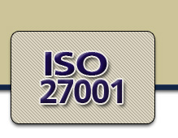
What is ISO 27001?
It’s a International Standard for Information Security Management
It consists of various Specification for information Security Management
Code of Practice for Information Security Management
Basis for contractual relationship
Basis for third party certification
Can be Certified by Certification Bodies
Applicable to all industry Sectors
Emphasis on prevention

Slide 16
History and Development of ISMS standard (BS7799 – ISO 17799 - ISO27001)
ISO 17799:2005 and
ISO 27001:2005 released
2005
New BS 7799-2
Passed and accepted
Sep 2002
2001
New BS 7799-2 (drafted)
December 2000
ISO/IEC 17799:2000
Swedish standard SS 62 77 99 Part 1 & 2
1999
New issue of BS 7799 Part 1 & 2
1998
BS 7799 Part 2
1995
BS 7799 Part 1

Slide 17
ISO 27001:2005 Structure
  Five Mandatory requirements of the standard
Section 4 – General and Documentation requirement
- General requirements
- Establishing and maintaining an ISMS
- Documentation Requirements
“The Organization shall develop, implement, maintain and continually improve a documented ISMS within the context of the organisations overall business activities and risk. For the purposes of this standard the process used is based on PDCA model…”

Slide 18
Plan Do Check Act Cycle (PDCA)
Interested parties
Plan
Interested parties
Establish the ISMS
Implement and operate the ISMS
Maintain and improve the ISMS
Do
Act
Monitor and review the ISMS
Information security requirements and expectations
Managed information security
Check

Slide 19


ISO 27001:2005 Structure
Section 5 - Management Responsibility
    Management Commitment
    Resource Management
Section 6 – Internal ISMS Audits
Section 7 - Management Review of the ISMS
    Review Input
    Review Output
Section 8 - ISMS Improvement
  Continual Improvement
  Corrective Action
  Preventive Action

Slide 20
Important Areas of Concern
ISO27001
Security policy (5)
Organization of information security (6)
Asset management(7)
Human resources security (8)
Physical and environmental security (9)
Communications and operations management (10)
Access control (11)
Information systems acquisition, development and maintenance (12)
Information security incident management (13)
Business continuity (14) management
Compliance (15)

Slide 21
ISO17799:2005 /ISO27001 (earlier BS7799) Framework
Incident
Management
Security Policy
Compliance
Security Organisation
Business Continuity Management
Asset Classification & Control
Information Security Management System
System Development
Personnel Security/ HR Security
Access Control
Physical and Environmental
Communications & Operations
Tech Mahindra Certified for since March 2005

Slide 22

1. Security Policy
Objective:
  Information security policy.
Covers:
  Information security policy document
  Review of Informational Security Policy

Slide 23
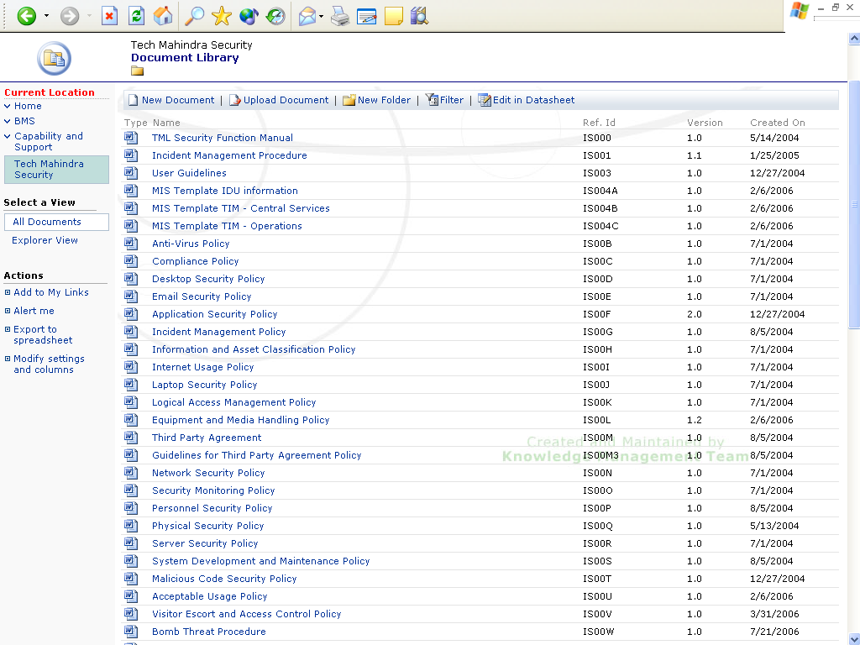
1. Security Policy

Slide 24
2. Organization of information security
Objective:
  Internal Organization
  External Parties
Covers:
  Management commitment to information security
  Information security coordination
  Allocation of information security responsibilities
  Authorization process for information processing facilities
  Confidentiality agreements
  Contact with authorities
  Contact with special interest groups
  Independent review of information security
  Identification of risks related to external parties
  Addressing security when dealing with customers
  Addressing Security in third party agreements

Slide 25
2. Organization of information security - Example
Management Security Forum
Chaired by
CEO / COO
eSecurity Group
Specialised services (e.g. Penetration testing)
Information Security Group
Chief Information Security Officer
QMG
Audits and reviews
Integration security processes in BMS
Location Security Managers
Security Incident handling
MIS and dash boards
Security Coordination
Specialised staff:
Risk Assessment
BCP/DRP
Application Security
Security audits and reviews
Security Training & Awareness
TIM
IT Operations
Network Security
Monitoring

Slide 26
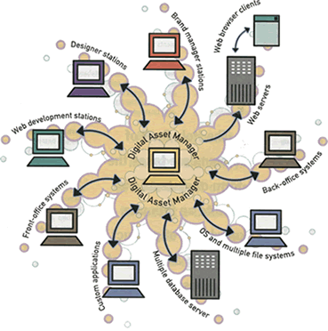
3. Asset Management
Objective:
  Responsibility for assets
  Information classification
Covers:
  Inventory of assets
  Ownership of assets
  Acceptable use of assets
  Classification guidelines
  Information labelling and handling

Slide 27
Information Asset – TechM
Inventory of Information Assets are categorized & classified as below
Sr | Asset Category | Classification
1 | Paper Assets | Client Confidential
2 | Electronic Data | Company Confidential
3 | Hardware | Commercial in Confidence
4 | Software | Restricted
5 | People | Critical & Non Critical
Valuation of Information Assets – Scale
      - Very High, High ,Medium ,Low , Negligible
Other Attributes of Inventory
  - Asset Group, Asset Classification, Value, Storage Area, Storage location ,
  - Asset Owner, Asset Retention, Remarks

Slide 28

4. Human Resource Security
Objective:
  Prior to employment
  During employment
  Termination or change of employment
Covers:
  Roles and responsibilities
  Screening
  Terms and conditions of employment
  Management responsibilities
  Information security awareness, education and training
  Disciplinary process
  Termination responsibilities
  Return of assets
  Removal of access rights

Slide 29
5. Physical and Environmental Security
Objective:
  Secure Areas
  Equipment Security
Covers:
  Physical Security Perimeter
  Physical entry Controls
  Securing Offices, rooms and facilities
  Protecting against external and environmental threats
  Working in Secure Areas
  Public access delivery and loading areas
  Cabling Security
  Equipment Maintenance
  Securing of equipment off-premises
  Secure disposal or re-use of equipment
  Removal of property

Slide 30
6. Communications & Operations Management
Objective:
  Operational Procedures and responsibilities
  Third party service delivery management
  System planning and acceptance
  Protection against malicious and mobile code
  Backup
  Network Security Management
  Media handling
  Exchange of Information
  Electronic Commerce Services
  Monitoring
Covers:
  Documented Operating procedures
  Change management
  Segregation of duties

Slide 31

6. Communications & Operations Management (contd..)
  Separation of development, test and operational facilities
  Service delivery
  Monitoring and review of third party services
  Managing changes to third party services
  Capacity Management
  System acceptance
  Controls against malicious code
  Controls against mobile code
  Information backup
  Network Controls
  Security of network services
  Management of removable media
  Disposal of Media
  Information handling procedures
  Security of system documentation
  Information exchange policies and procedures
  Exchange agreements

Slide 32
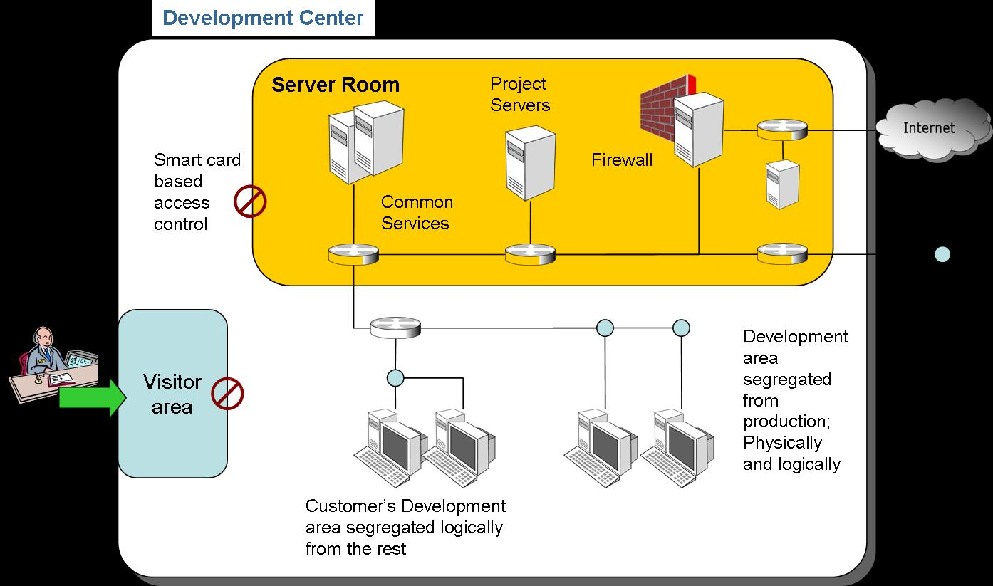
6. Communications & Operations Management (contd..)
  Exchange agreements
  Electronic Messaging
  Business information systems
  Electronic Commerce
  On-Line Transactions
  Publicly available information
  Audit logging
  Monitoring system use
  Protection of log information
  Administrator and operator logs
  Fault logging
  Clock synchronisation

Slide 33


7. Access Controls
Objective:
  Business Requirement for Access Control
  User Access Management
  User Responsibilities
  Network Access Control
  Operating system access control
  Application and Information Access Control
  Mobile Computing and teleworking
Covers:
  Access Control Policy
  User Registration
  Privilege Management
  User Password Management
  Review of user access rights
  Password use

Slide 34
7. Access Controls (contd..)
  Unattended user equipment
  Clear desk and clear screen policy
  Policy on use of network services
  User authentication for external connections
  Equipment identification in networks
  Remote diagnostic and configuration port protection
  Segregation in networks
  Network connection control
  Network routing control
  Secure log-on procedures
  User identification and authentication
  Password management system
  Use of system utilities
  Session time-out
  Limitation of connection time
  Information access restriction
  Sensitive system isolation
  Mobile computing and communications
  Teleworking

Slide 35
8. Information systems acquisition, development and maintenance
Objective:
  Security requirements of information systems
  Correct processing in applications
  Cryptographic controls
  Security of system files
  Security in development and support processes
  Technical Vulnerability Management
Covers:
  Security requirements analysis and specification
  Input data validation
  Control of internal processing
  Message integrity
  Output data validation
  Policy on use of cryptographic controls
  Key management
  Control of operational software
  Protection of system test data

Slide 36
8. Information systems acquisition, development and maintenance (contd)
  Access Control to program source code
  Change control procedures
  Technical review of applications after operating system changes
  Restriction on changes to software packages
  Information leakage
  Outsourced software development
  Control of technical vulnerabilities

Slide 37
9. Information Security Incident Management
Objective:
  Reporting information security events and weaknesses
  Management of information security incidents and improvements
Covers:
  Reporting information security events
  Reporting security weaknesses
  Responsibilities and procedures
  Learning from information security incidents
  Collection of evidence

Slide 38

10. Business Continuity Management
Objective:
  Information security aspects of business continuity management
Covers:
  Including information security in the business continuity management process
  Business continuity and risk assessment
  Developing and implementing continuity plans including information security
  Business continuity planning framework
  Testing, maintaining and re-assessing business continuity plans

Slide 39
11. Compliance
Objective
  Compliance with legal requirements
  Compliance with security policies and standards, and technical compliance
  Information Systems audit considerations
Covers:
  Identification of applicable legislation
  Intellectual property rights (IPR)
  Protection of organizational records
  Data protection and privacy of personal information
  Prevention of misuse of information processing facilities
  Regulation of cryptographic controls
  Compliance with security policies and standards
  Technical compliance checking
  Information systems audit controls
  Protection of information system audit tools

Slide 40


Compliance Management
Tech M policies
Regulatory concerns
Contractual requirements
Distribution and awareness
Enforcement
  Deterrence
  Technology means
TechM
Security
Policies
Clause 49
SOX
DPA
MSA
STRADA

Slide 41
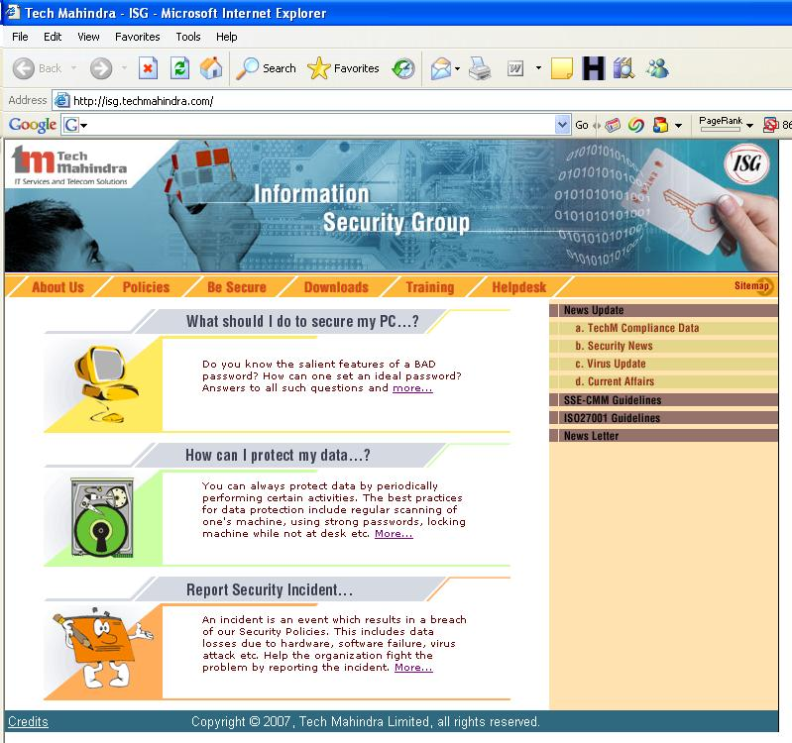
ISG Information - isg.techmahindra.com

Slide 42
Thank You
Your Questions please?
Thank You…
http://isg.techmahindra.com

