Slide 1
A
B
B
C
E
C
D

Slide 2
A
C
E
B
D
F
Notes:
Delay = 5

Slide 3
A
C
B
D
Notes:
Hill

Slide 4
A
C
+
B
D
+
Notes:
logistic

Slide 5
A
C
B
D
Notes:
Hill, SEIR, 5 days exposed on average, no transmission while exposed

Slide 6
SIR, no latency
SEIR, 1 day latency
SEIR, 2 days latency
SEIR, 5 days latency
SEIR, 10 days latency
Notes:
Hill, SEIR, 5 days exposed on average, no transmission while exposed

Slide 7
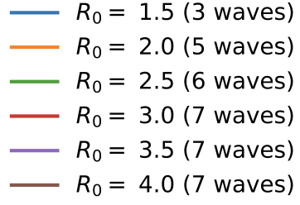
A
B
C

Slide 8
A
C
E
B
D
F

Slide 9
A
C
E
B
D
F

Slide 10
A
D
B
E
C
F

Slide 11
(a)
(b)

