Slide 2
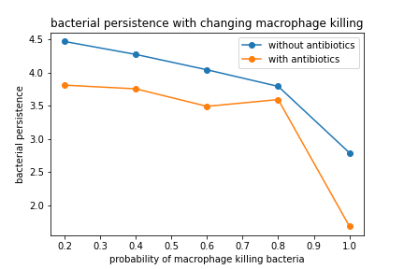
 | Without antibiotics | With antibiotics
Spearman correlation coefficient | -0.999 | -0.899
P-value | 1.40*10⁻²⁴ | 3.74*10⁻²

