Slide 1


OAEI 2007:
Library Track Results
Antoine Isaac, Lourens van der Meij, Shenghui Wang, Henk Matthezing
Claus Zinn, Stefan Schlobach, Frank van Harmelen
Ontology Matching Workshop
Oct. 11th, 2007

Slide 2
Agenda
Track Presentation
Participants and Alignments
Evaluations

Slide 3
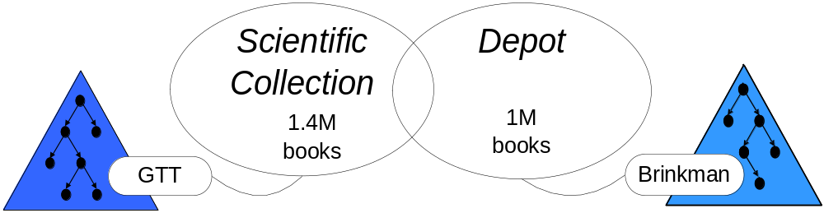
The Alignment Task: Context
National Library of the Netherlands (KB)
2 main collections
Each described (indexed) by its own thesaurus

Slide 4
The Alignment Task: Vocabularies (1)
General characteristics:
  Large (5,200 & 35,000 concepts)
  General subjects
Standard thesaurus information
  Labels In Dutch!
    Preferred
    Alternative (synonyms, but not only)
  Notes
  Semantic links: broader/narrower, related
    Very weakly structured: GTT has 19,769 top terms!

Slide 5
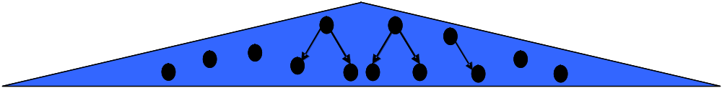
The Alignment Task: Vocabularies
Dutch + large + weakly structured = difficult problem

Slide 6
Data provided
SKOS
  Closer to original semantics
OWL conversion
  Mixture of overcommitment and loss of information

Slide 7
Alignment Requested
Standard OAEI format
Mapping relations
  Inspired by SKOS and SKOS mapping
  exactMatch
  broadMatch/narrowMatch
  relatedMatch
  Other possibilities, e.g. combinations (AND, OR)

Slide 8
Agenda
Track Presentation
Participants and Alignments
Evaluations

Slide 9
Participants and Alignments
Falcon
  3,697 exactMatch mappings
DSSim
  9,467 exactMatch mappings
Silas
  3,476 exactMatch mappings
  10,391 relatedMatch mappings
Not complete coverage
Only Silas delivers relatedMatch

Slide 10
Agenda
Track Presentation
Participants and Alignments
Evaluations

Slide 11
Evaluation
Importance of application context
  What is the alignment used for?
Two scenarios for evaluation
  Thesaurus merging
  Annotation translation

Slide 12
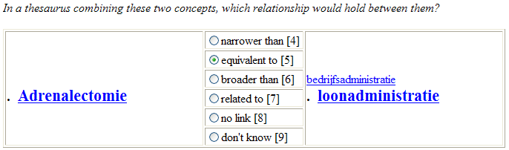
Thesaurus Merging: Scenario & Evalation Method
Rather abstract view: merging concepts/thesaurus building
  Similar to classical ontology alignment evaluation
Mappings can be assessed directly

Slide 13
Thesaurus Merging: Evaluation Method
No gold standard available
  Method inspired by OAEI 2006 Anatomy and Food tracks
Comparison with “reference” alignment
  3,659 Lexical mappings, using a Dutch lexical database
Manual Precision assessment for “extra” mappings
  Partitioning mappings based on provenance
  Sampling: 330 mappings assessed by 2 evaluators
Coverage
  proportion of good mappings found (participants + reference)

Slide 14
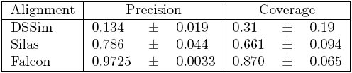
Thesaurus Merging: Evaluation Results
Note: only for exactMatch
Falcon performs well because it’s closest to lexical reference
DSSim and Ossewaarde add more to the lexical reference
  Ossewaarde adds less than DSSim, but additions are better

Slide 15
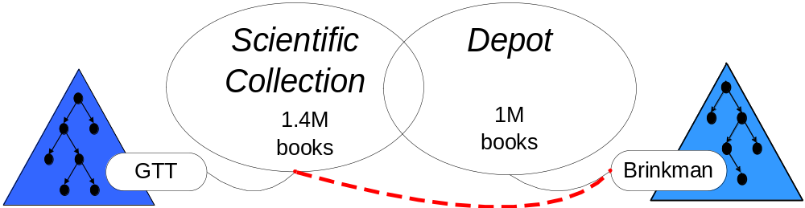
Annotation Translation: Scenario
Scenario: re-annotation of GTT-indexed books by Brinkman concepts

Slide 16
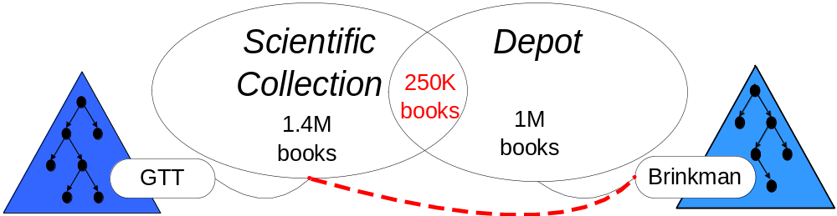
Annotation Translation: Scenario
More thesaurus application-oriented (“end-to-end”)
There is a gold standard!

Slide 17
Annotation Transl.: Alignment Deployment
Problem: conversion of sets of concepts
  Co-occurrence matters (post-coordination)
  We have 1-1 mappings
    Participants did not know the scenario in advance
Solution:
  Generate rules from 1-1 mappings
  “Sport” exactMatch “Sport” + “Sport” exactMatch “Sportbeoefening”
    => “Sport” -> {“Sport”, “Sportbeoefening”}
  Fire a rule for a book if its index includes rule’s antecedent
  Merge results to produce new annotations

Slide 18
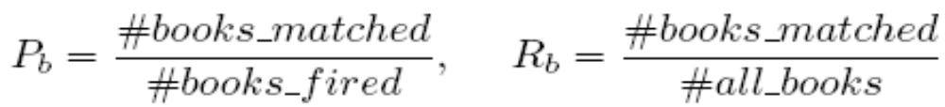
Annotation Transl.: Automatic evaluation
General method: for dually indexed books, compare existing Brinkman annotations and new ones
Book level: counting matched books
  Books for which there is one good annotation
  Minimal hint about users’ (dis)satisfaction

Slide 19
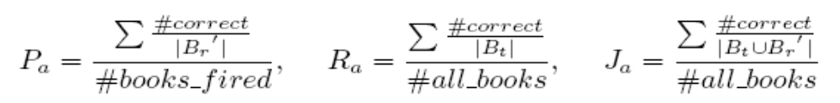
Annotation Transl.: Automatic Evaluation
Annotation level: measuring correct annotations
  Precision and Recall
  Jaccard
    Distance between existing annotations (Bt) and new ones (B’r)
Notice: counting over annotations and books, not rules or concepts
  Rules & concepts that are used more often are more important

Slide 20
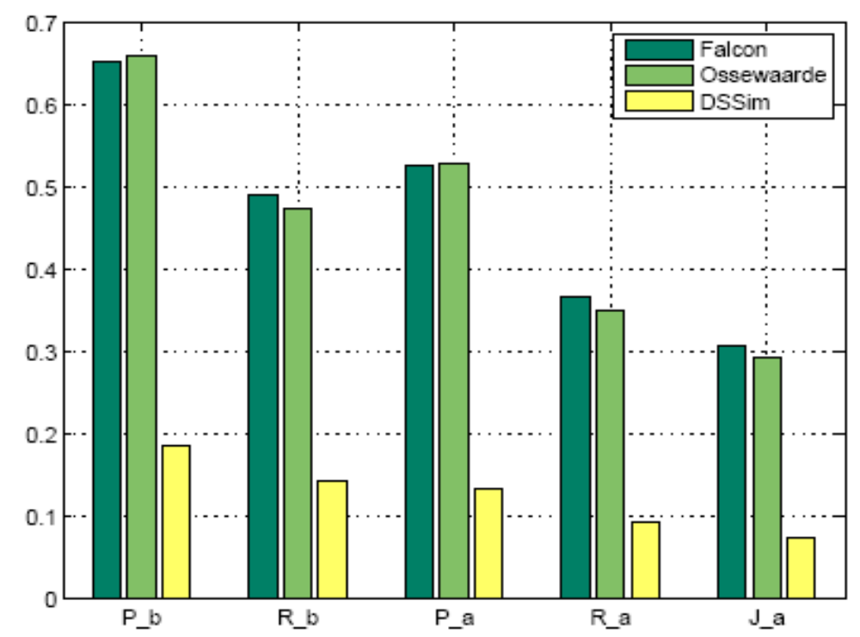

Annotation Transl.: Automatic Evaluation Results
Notice: for exactMatch only

Slide 21
Annotation Transl.: Need for Manual Evaluation
Variability: two indexers can select different concepts
  Undermines automatic evaluation results
    1 specific point of view is taken as gold standard!
Need for a more flexible setup
  New notion: acceptable candidates

Slide 22
Annotation Transl.: Manual Evaluation Method
Selection of 100 books
4 KB evaluators
Paper forms + copy of books

Slide 23
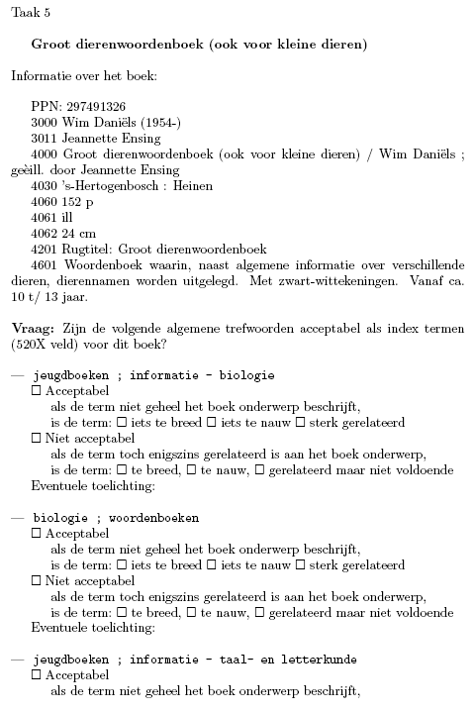
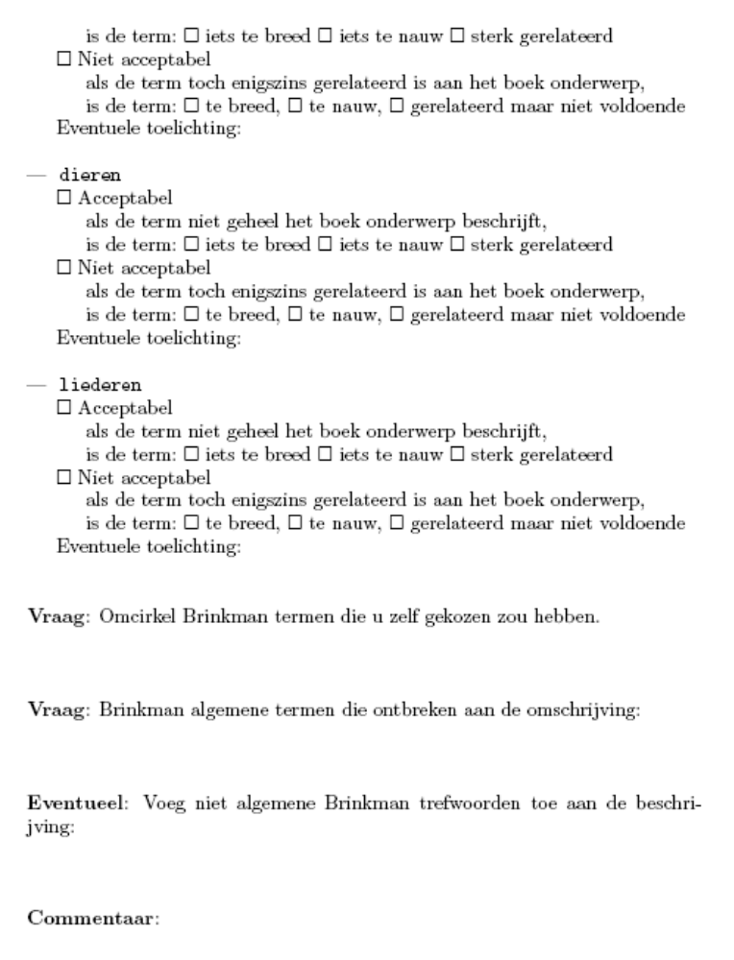
Paper Forms

Slide 24
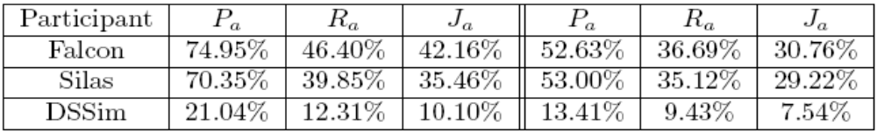
Annotation Transl.: Manual Evaluation Results
Research question: quality of candidate annotations
  Same measures as for automatic evaluation
  Performances are consistently higher
[Left: manual evaluation, Right: automatic evaluation]

Slide 25
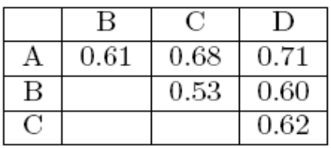
Annotation Transl.: Manual Evaluation Results
Research question: evaluation variability
  Krippendorff’s agreement coefficient (alpha)
  High variability: overall alpha=0.62
    <0.67, classic threshold for Computational Linguistics tasks
    But indexing seems to be more variable than usual CL tasks
  Jaccard overlap between evaluators’ assessments

Slide 26
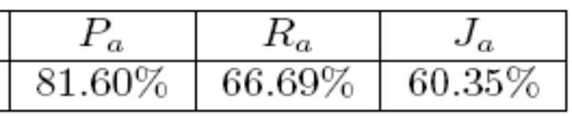
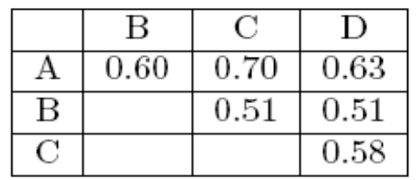
Annotation Transl.: Manual Evaluation Results
Research question: indexing variability
  Measuring acceptability of original book indices
  Kripendorff’s agreement for indices chosen by evaluators
    0.59 overall alpha confirms high variability
  Jaccard overlap between indices chosen by evaluators

Slide 27
Conclusions
A difficult track for alignment tools
  Dutch + large + weakly structured vocabularies
  Different scenarios
    Different types of mapping links
    Multi-concept alignment
A difficult track for evaluation
  Scenario definition
  Variability
But…
  Richness of challenge
  A glimpse of real-life use of mapping
  For a same case, results depend on scenario + setting

Slide 28
Thanks!

