Slide 1
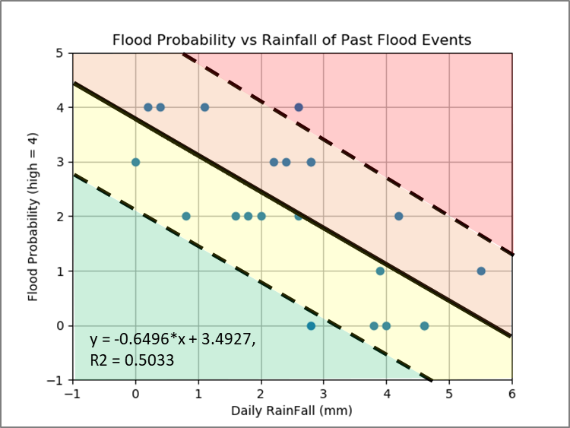
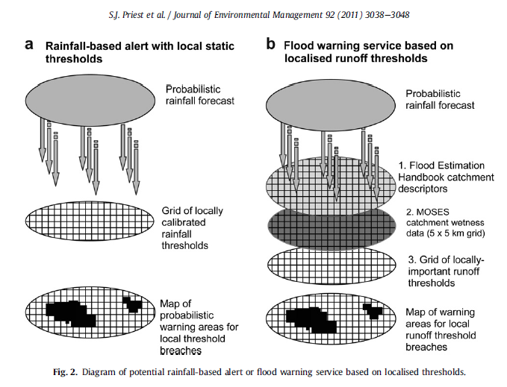
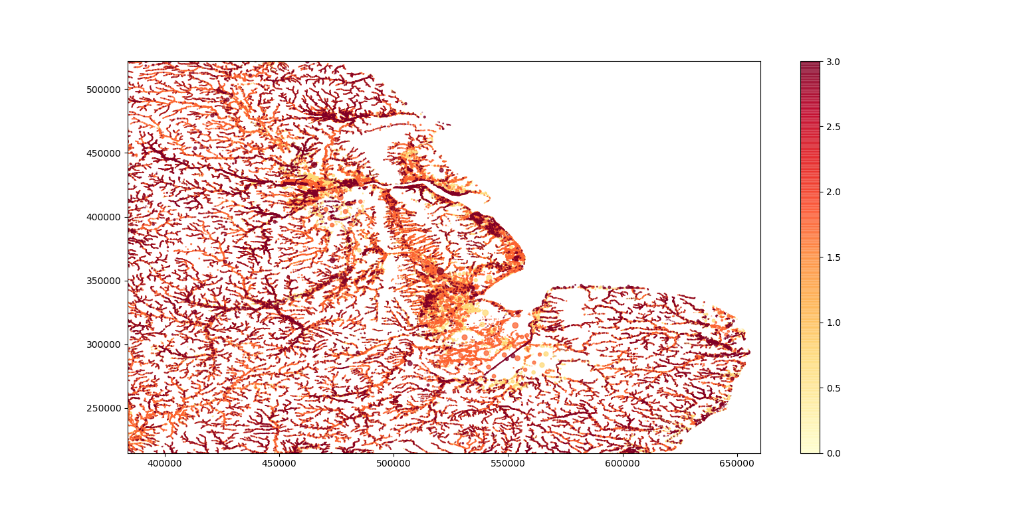
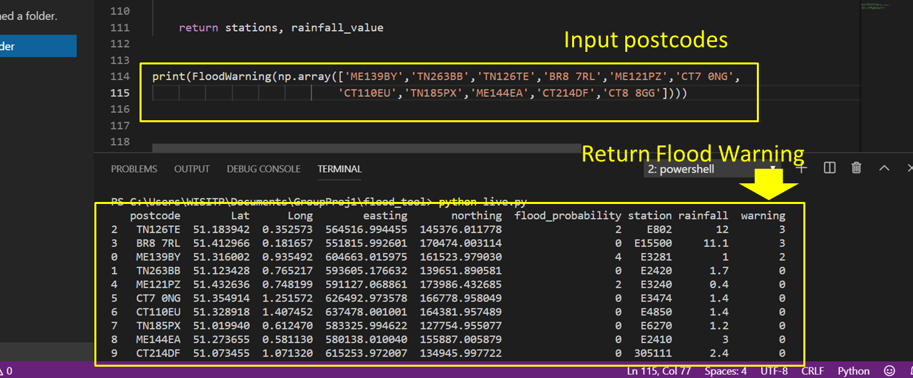
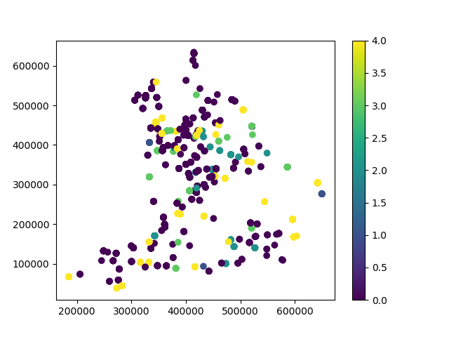
Flood Warning Software: Nene Group
Key Highlights
Flood Warning Process
Concept:
Area with high flood probability requires less amount of rain to get flooded than low probability area
Outline software based on published literatures and UK flood warning process
3 | Imminent
2 | Early
1 | Advisory
0 | No Alert
Priest et. al. (2011)
Model Input
Varying flood warning threshold, using localized flood probability for better accuracy
Usage
Historical Flood
Calibrated model with historical flood records from Government Agency

