Slide 1
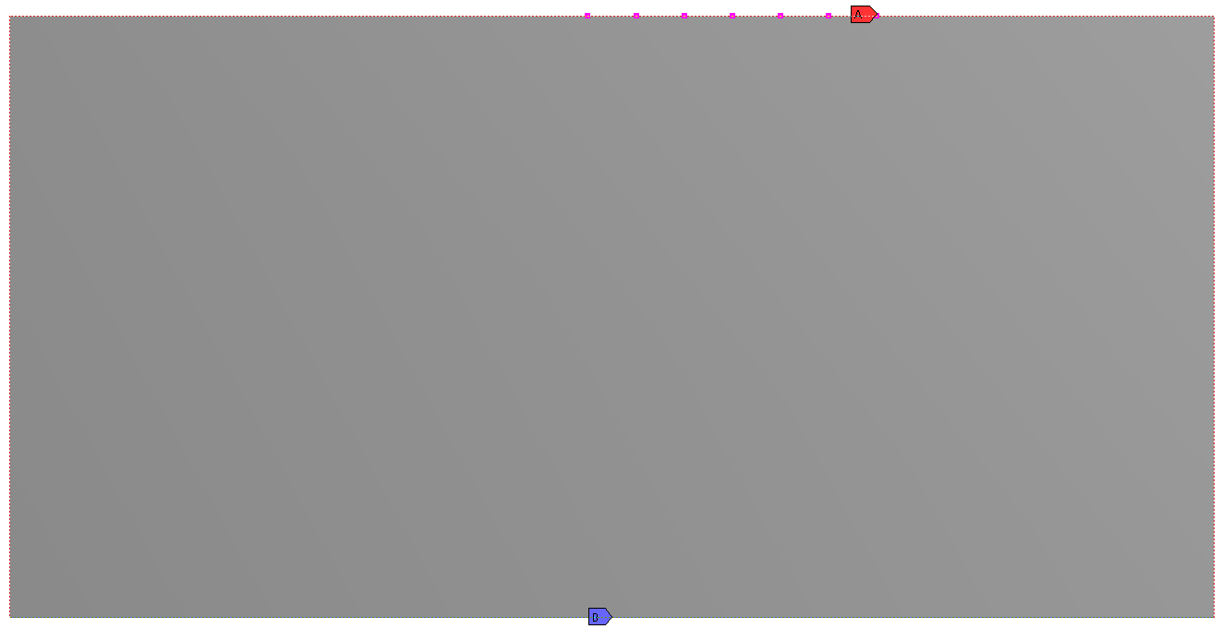
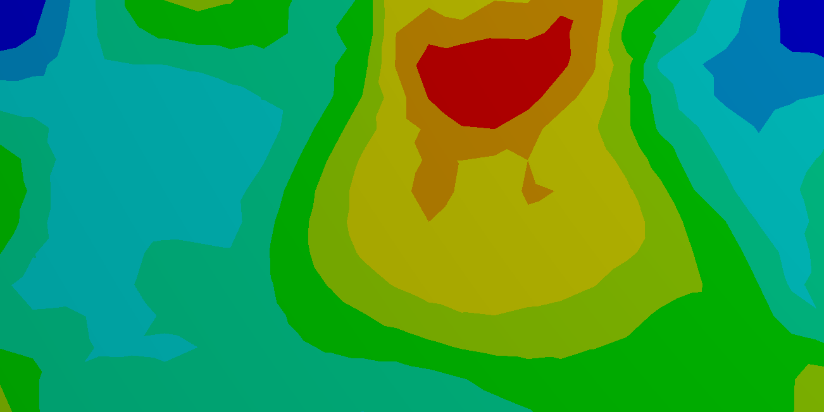
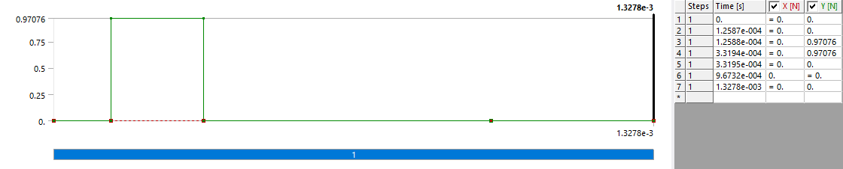
a)
b)
c)

Slide 2
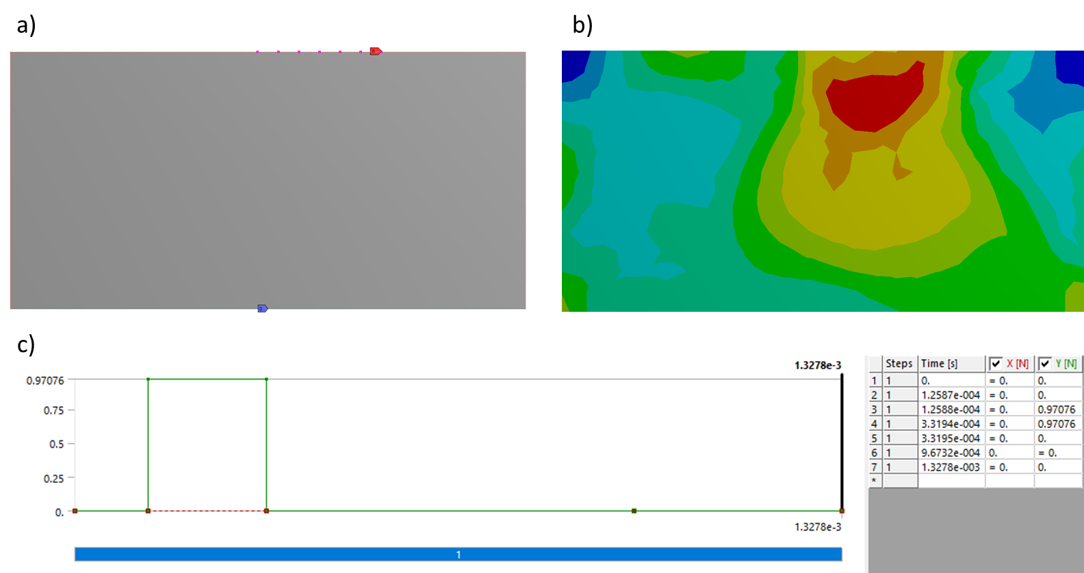

Slide 3
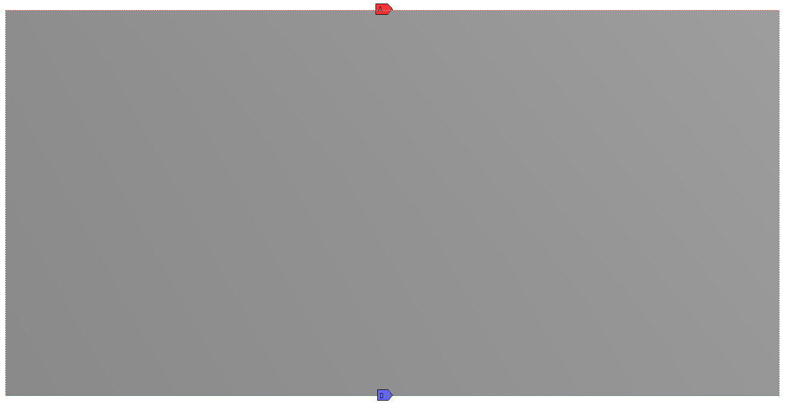
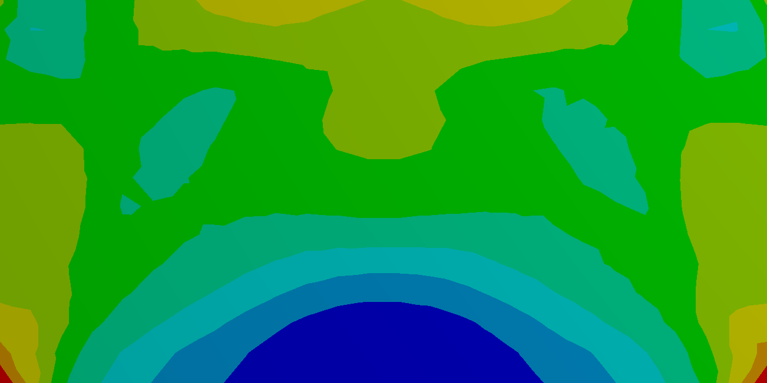
a)
b)
c)
d)

Slide 4
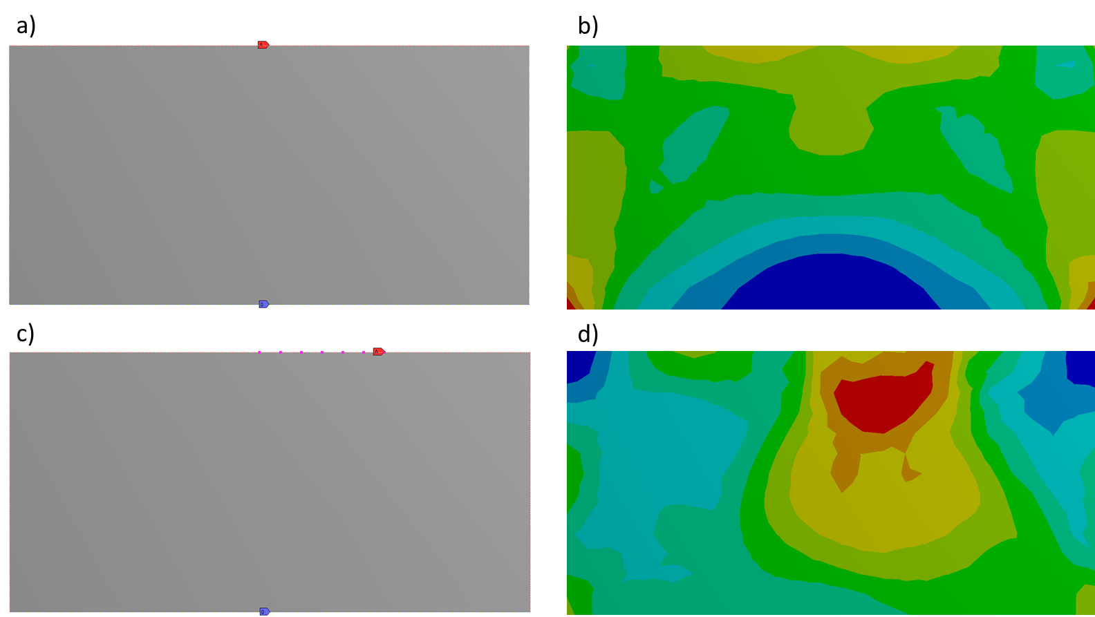

Slide 5
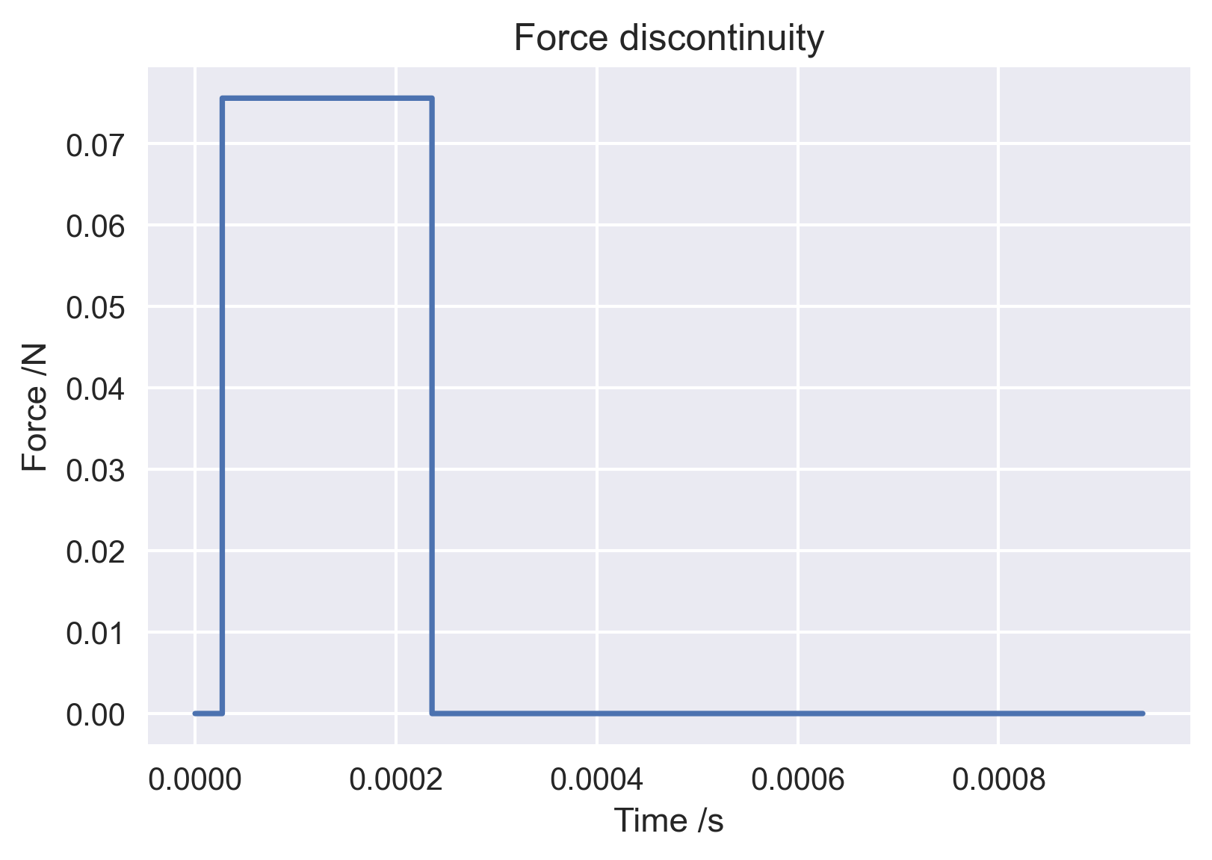

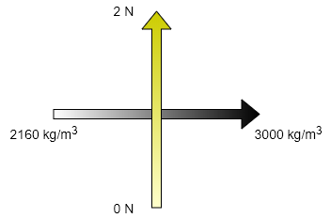
a)
b)
Source start
Source end
Source length
density
Paddings
Fixed boundary
c)

Slide 6
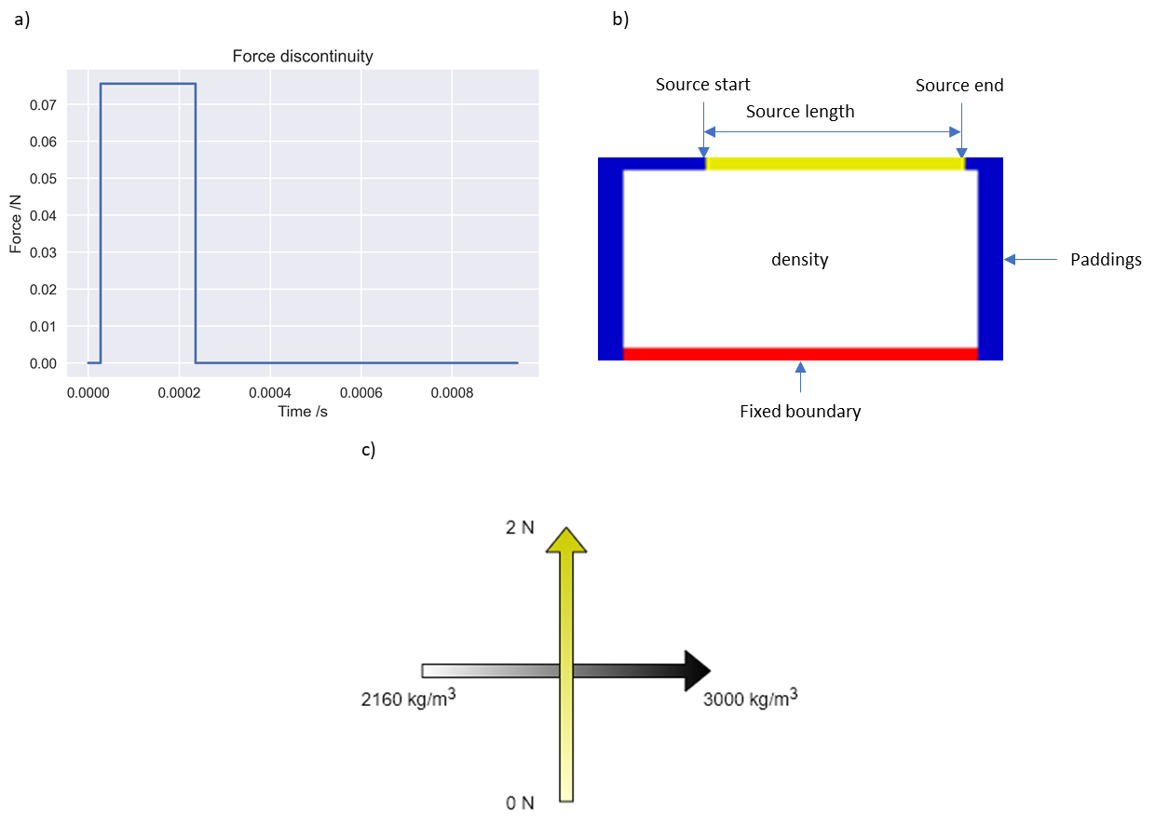

Slide 7
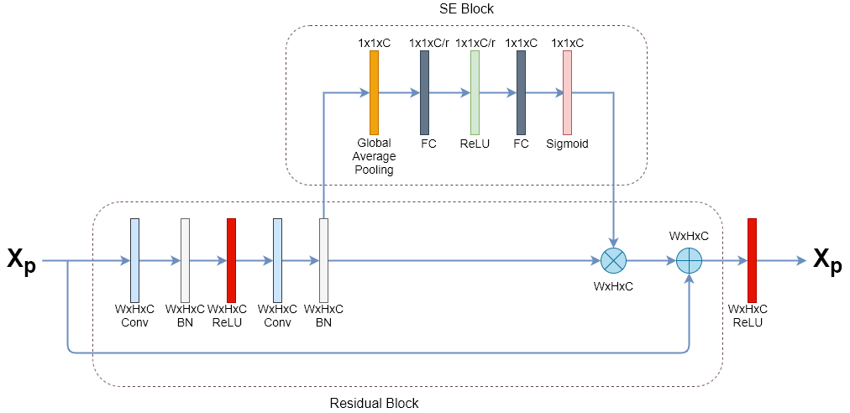

Slide 8


3
64
64
64
128
64
64
64
3
64
64
Input
Output
128
128
256
256
SL = 2
512
512
SL = 3
1024
1024
SL = 4
Concatenate
Down sample: Max pooling
Residual Block
SE
Block
Convolutional layer
Up sample: Transpose convolution

Slide 9
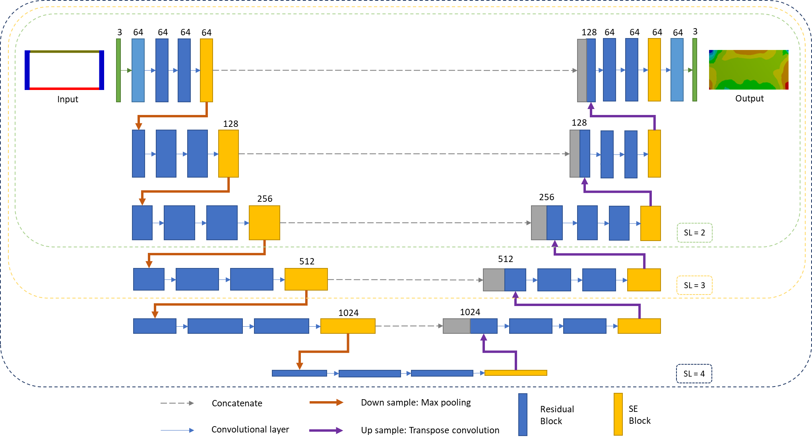

Slide 10
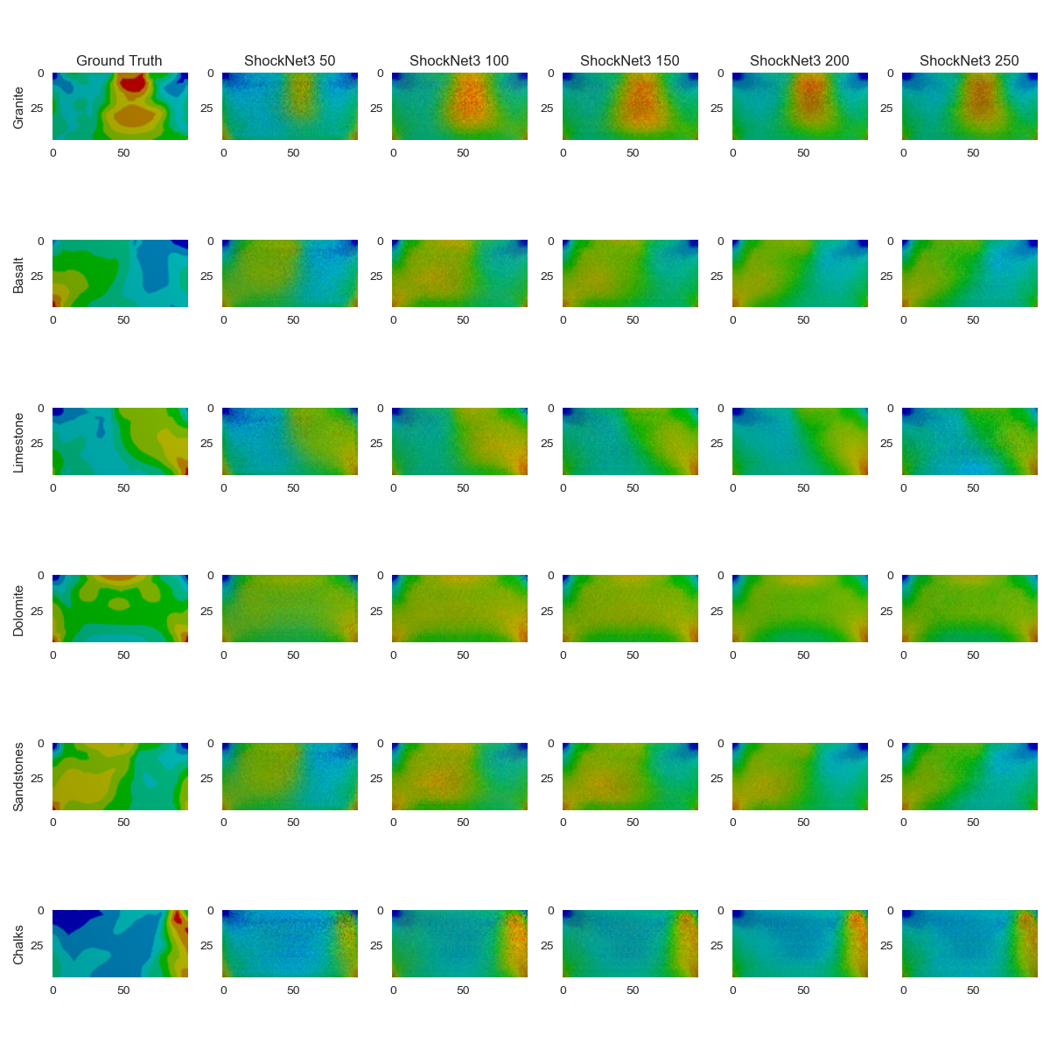
a)

Slide 11
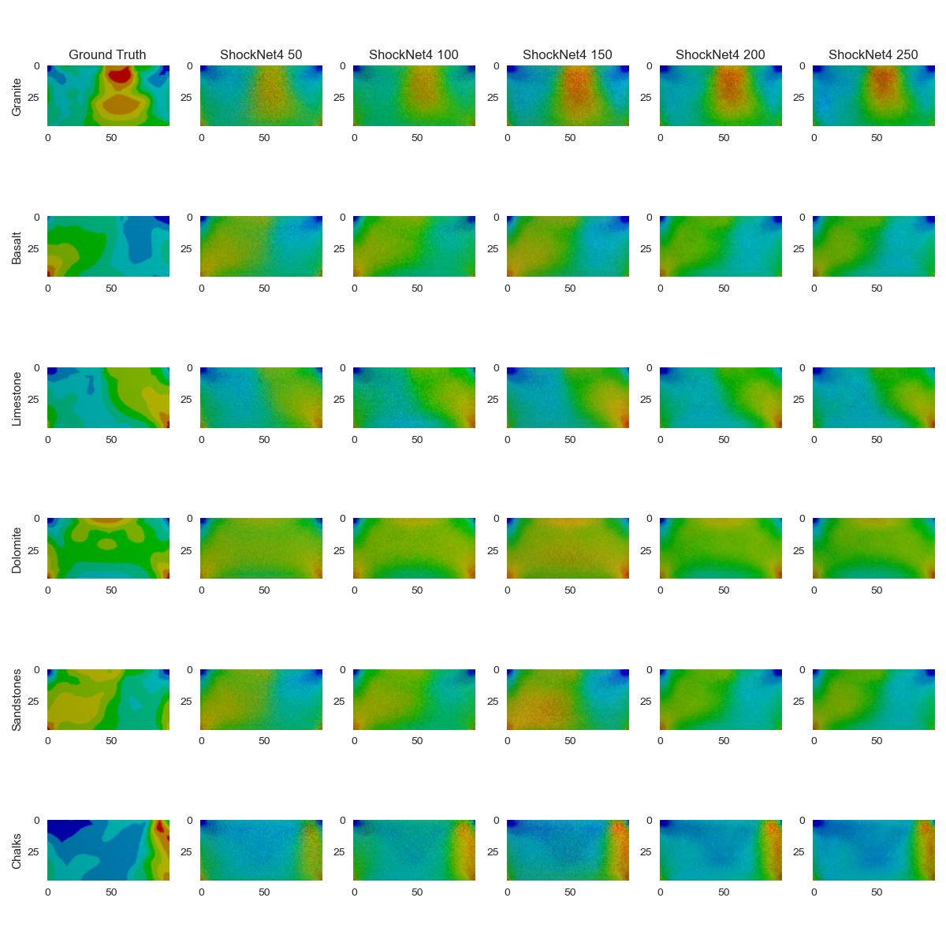
b)

Slide 13
