Slide 1
Track 18: Update 1 CIO Data
What Federal AI Disclosures Reveal — and What They Don’t
By: Oai Tran
Date: 01/05/2026
This is a working Deck

Slide 2
RQ: Do current AI inventories actually allow us to evaluate governance readiness?
A: Look into current AI in government and
B: How Governable AI is

Slide 3
CIO: Background
2024 data
  1757 observation and 62 features
  37 Departments
  https://www.cio.gov/policies-and-priorities/Executive-Order-13960-AI-Use-Case-Inventories-Reference/?utm_source=chatgpt.com

Slide 4
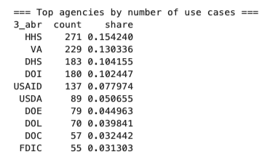

CIO 2024: Current
AI Deployment is highly concentrated across a small number of agencies.
Looking at Herfindahl-Hirschman and Gini coefficient:
a. AI is spread across agencies, but a small number carry the bulk of AI deployment
This tells us where AI is, but not How Governable it is

Slide 5
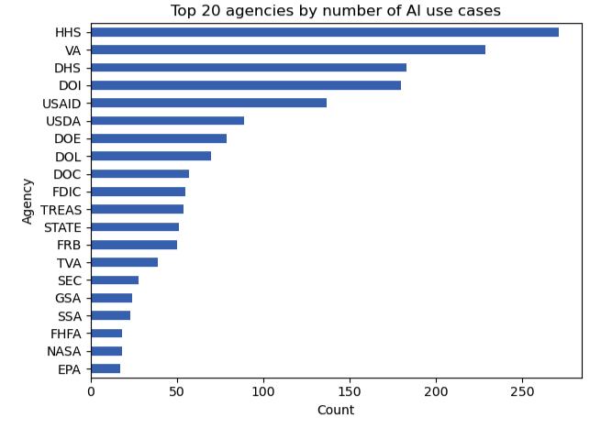
Top 20 Agencies

Slide 6
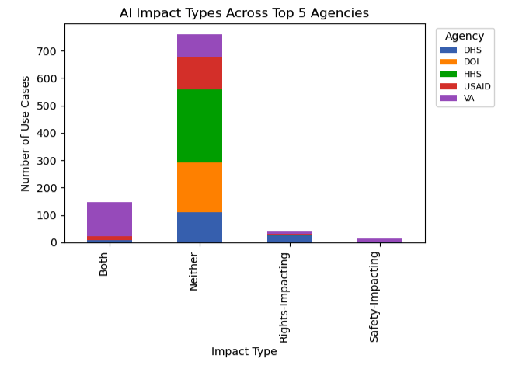
Top 5 Agency by Impact

Slide 7

How Governable AI is

Slide 8
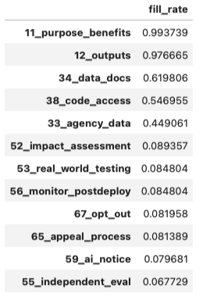
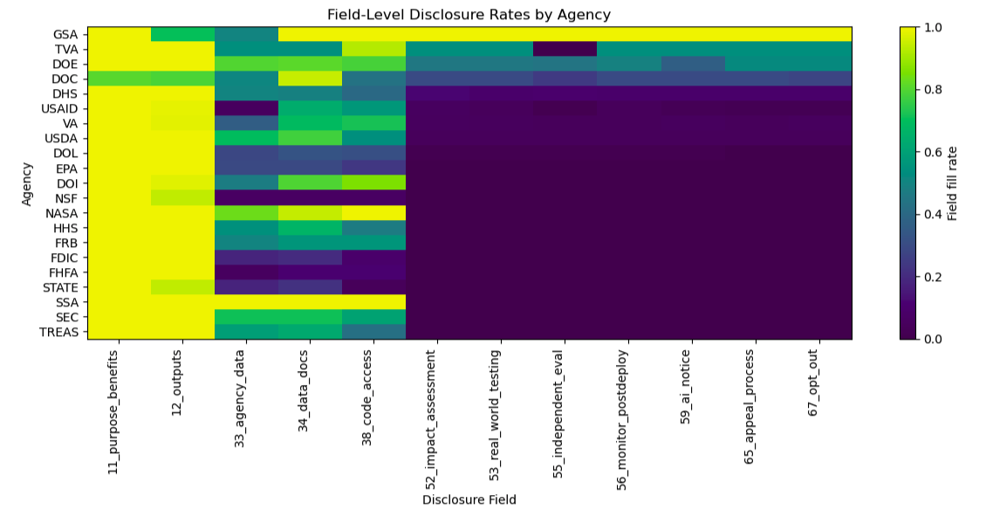
CIO 2024: Claim 1
Federal AI inventories are uneven, inconsistent, and limited for oversight

Slide 9
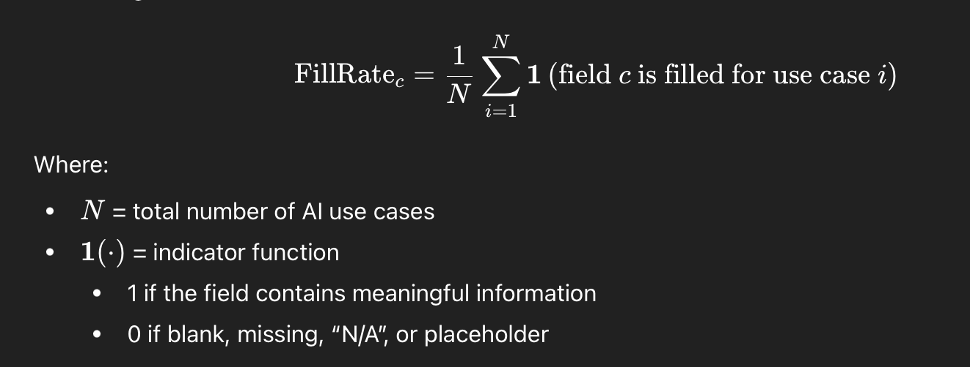
CIO: Fill Rate
Fill rate measures the proportion of AI use cases for which a given governance-relevant disclosure field is populated with meaningful information.
  proxy for institutional capacity to document, communicate, and evaluate AI systems
  Low Fill rate != BAD
  Low Fill rate = limited evaluability
  Governance practices are not consistently disclosed cause they give a high level, and there is almost no independent evaluation

Slide 10
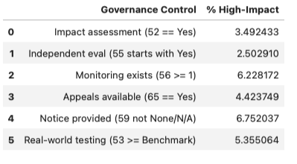
Claim 2
High-impact system lack corresponding governance capacity
Impact assessment — 3.5%: Agencies can label systems as high-impact without having completed a formal impact assessment.
Independent evaluation — 2.5%: Almost all high-impact AI systems are evaluated only by their developers or vendors.
Monitoring — 6.2%: Most high-impact systems have no established process to detect drift, unintended effects, or emergent harm after deployment.
Appeals/contestability — 4.4%: In most cases, individuals affected by AI-mediated decisions have no formal way to challenge outcomes.
Notice — 6.8%: Transparency is internal mainly and procedural, not public-facing.
Real-world testing — 5.4%: AI systems are being deployed into complex social environments without being evaluated in those environments.

Slide 11
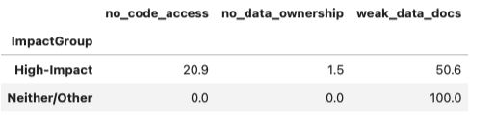
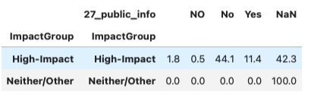
Claim 3
Agencies with more capacity/governance maturity disclose more
  High-impact AI systems are frequently deployed under vendor arrangements that constrain transparency and oversight
  About 45% of inventories do not
  Consistently document public-notice

Slide 12
Suggestion

