Slide 1
Top Trumps
Group 2
https://github.com/oakeley/toptrumps

Slide 2
Basic Rules
Each card shows a subject (like cars, dinosaurs, or superheroes) with numerical ratings for different categories
Players take turns calling out a category from their top card
The person with the highest value in that category wins all the cards in play
The goal is to win all the cards
If there's a tie, the cards go into the middle and the next round's winner takes those too

Slide 3
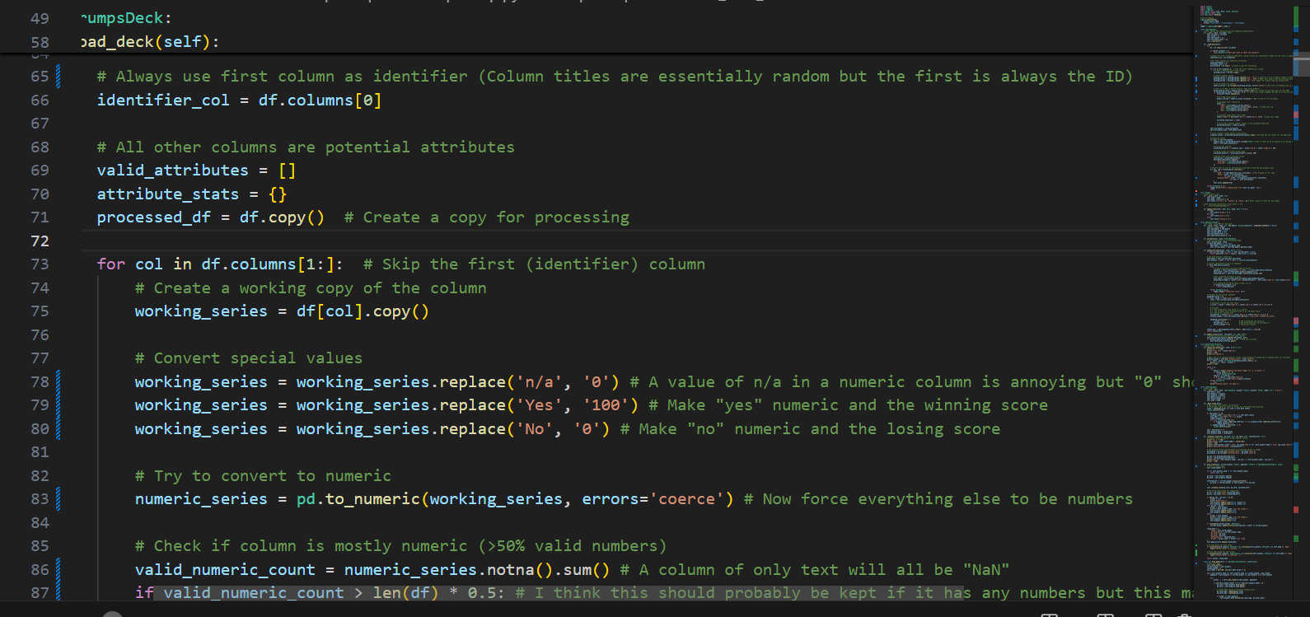
1. Own data
git clone https://github.com/APStats/Top-Trumps-data
File names are horrible and have illegal characters and spaces plus non-numeric attributes
ls Top-Trumps-data/ | grep Top > start
ls Top-Trumps-data/ | grep Top | sed 's/ - //g' | tr " " "" | tr -d "()" | tr -s "_" > stop
paste start stop | sed 's/ /\ /g' | sed 's/(/\(/g' | sed 's/)/\)/g' | awk -F"\t" '{system("cp Top-Trumps-data/"$1" "$2)}'

Slide 4
Other tasks required
2. Own discrete actions
Training, demo, human mode
3. Fantasy reward function
Win/lose/draw outcomes
4. If you wanted other logic from random choice
Cards are shuffled and dealt randomly
Logic uses a Belch-Walch for transition optimisation

Slide 5
Playing the game
As the game progresses, we can learn the distribution of the scores on our cards and those we win.
We can also learn point values held by the opponent when they beat us.
Each card of ours we lose tells us something about their deck.
Each card of theirs we win enables us to estimate when we have a card that may have previously beaten us.
The order of the cards repeats and can be learned as a sequence.

Slide 6
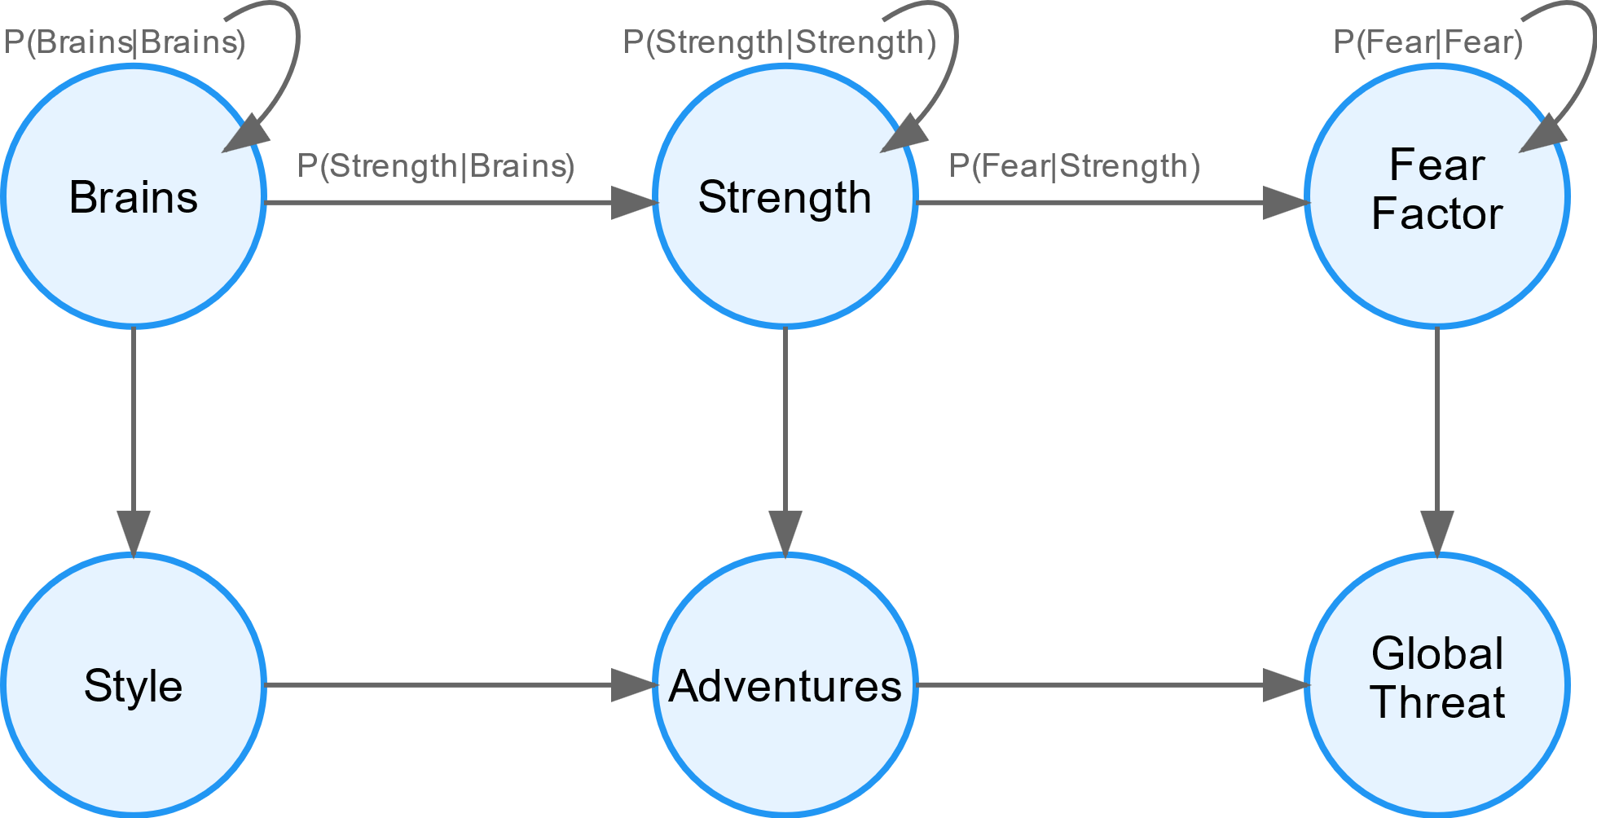
Hidden Markov Model training
1. Initialize States: Each attribute (Brains, Strength, etc.) becomes a state with importance-weighted emission probabilities
2. Learn Transitions: Give the current attribute score, how likely is the next attribute to be better at winning?
Model observes gameplay sequences (e.g., Brains → Strength → Fear Factor) and updates
transition probabilities
3. Optimize Strategy: Baum-Welch algorithm refines probabilities based on winning “card order” sequences
and attribute relationships

Slide 7
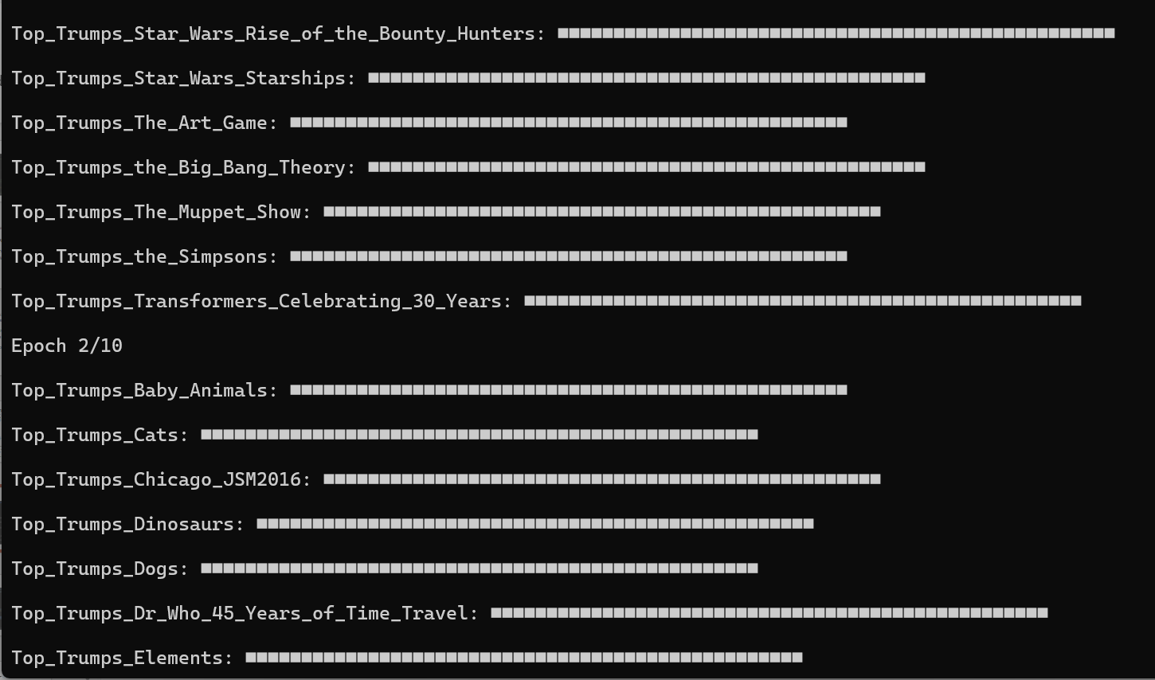
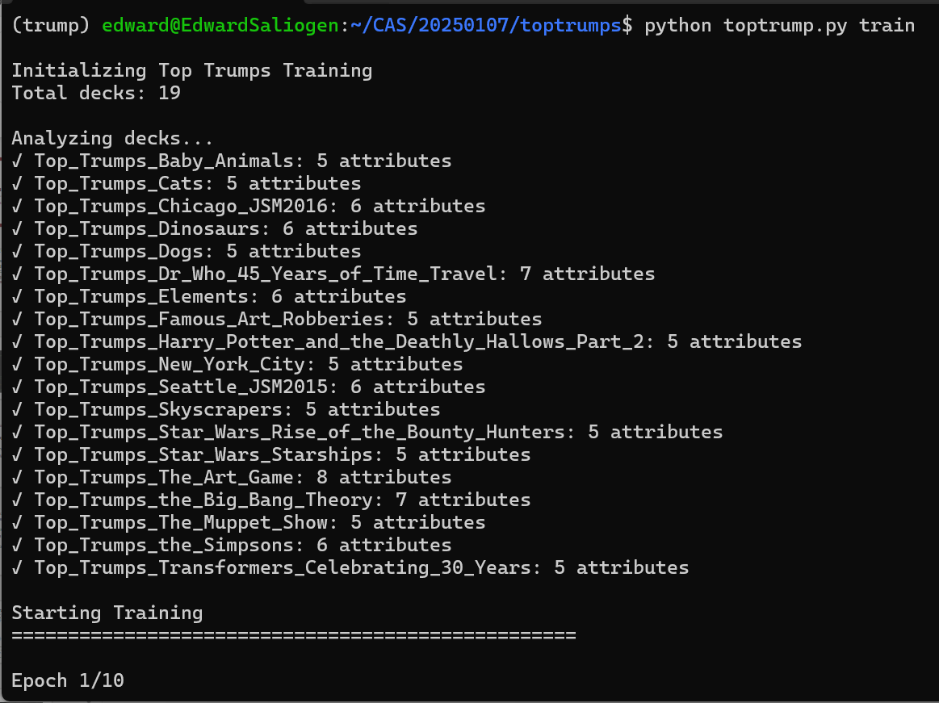
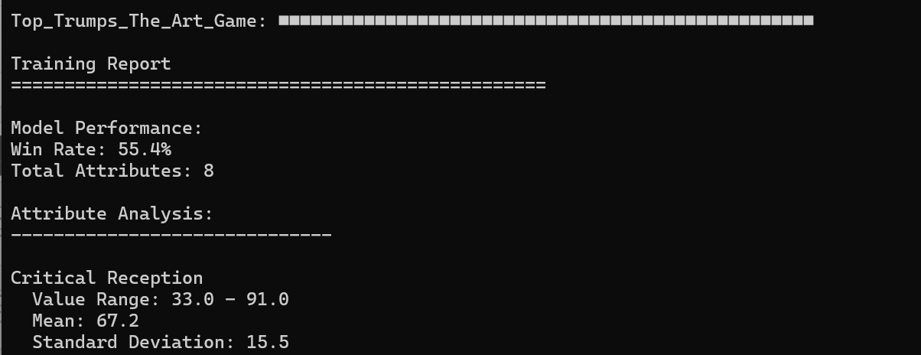
Training mode

Slide 8
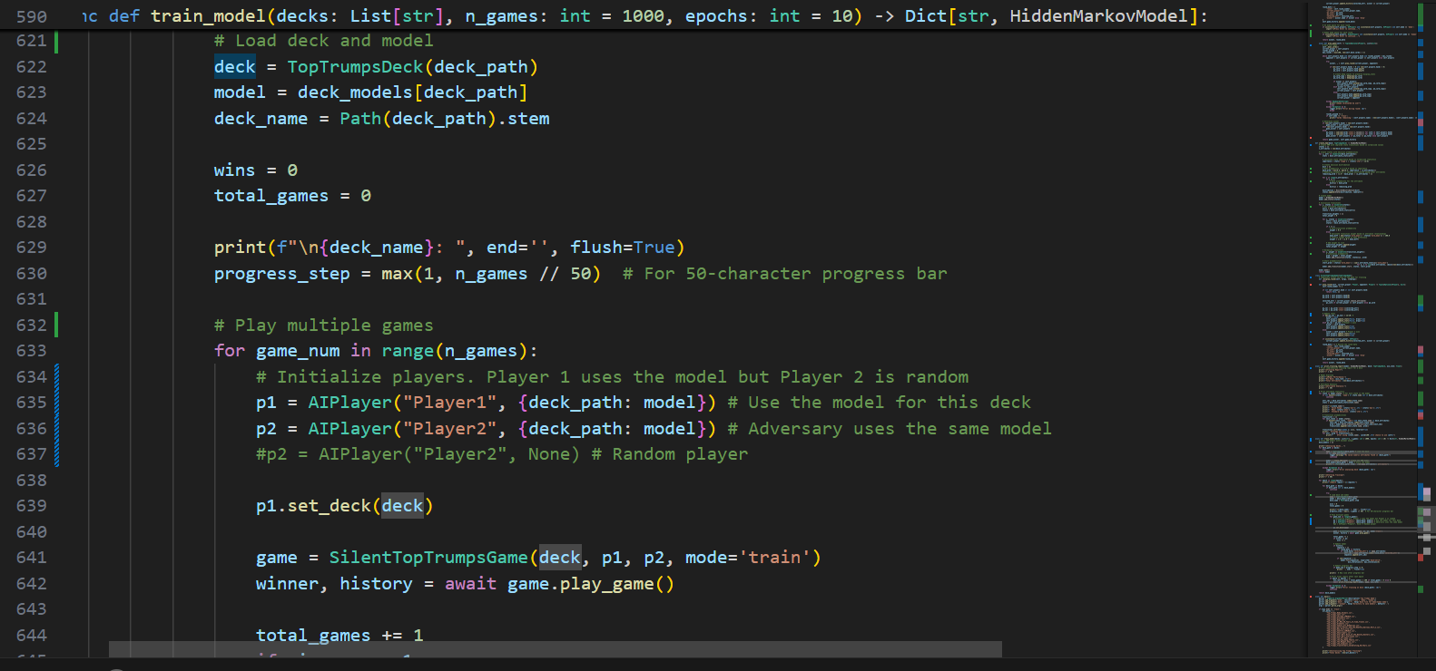
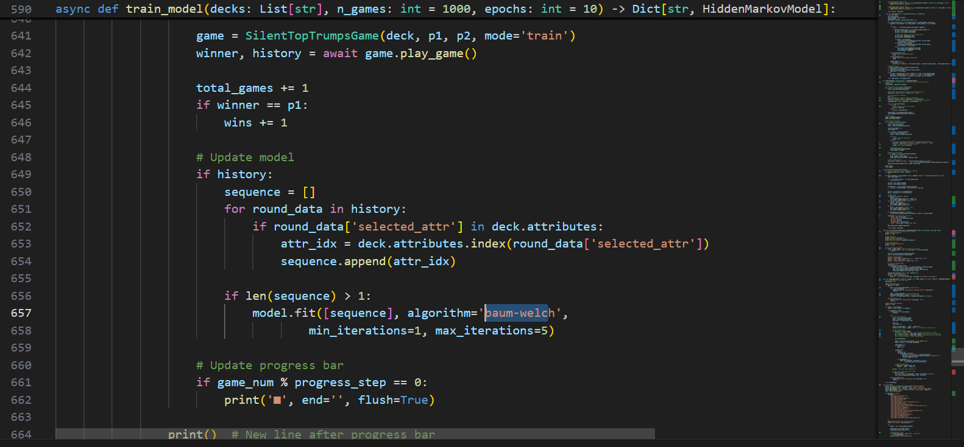
Training

Slide 9
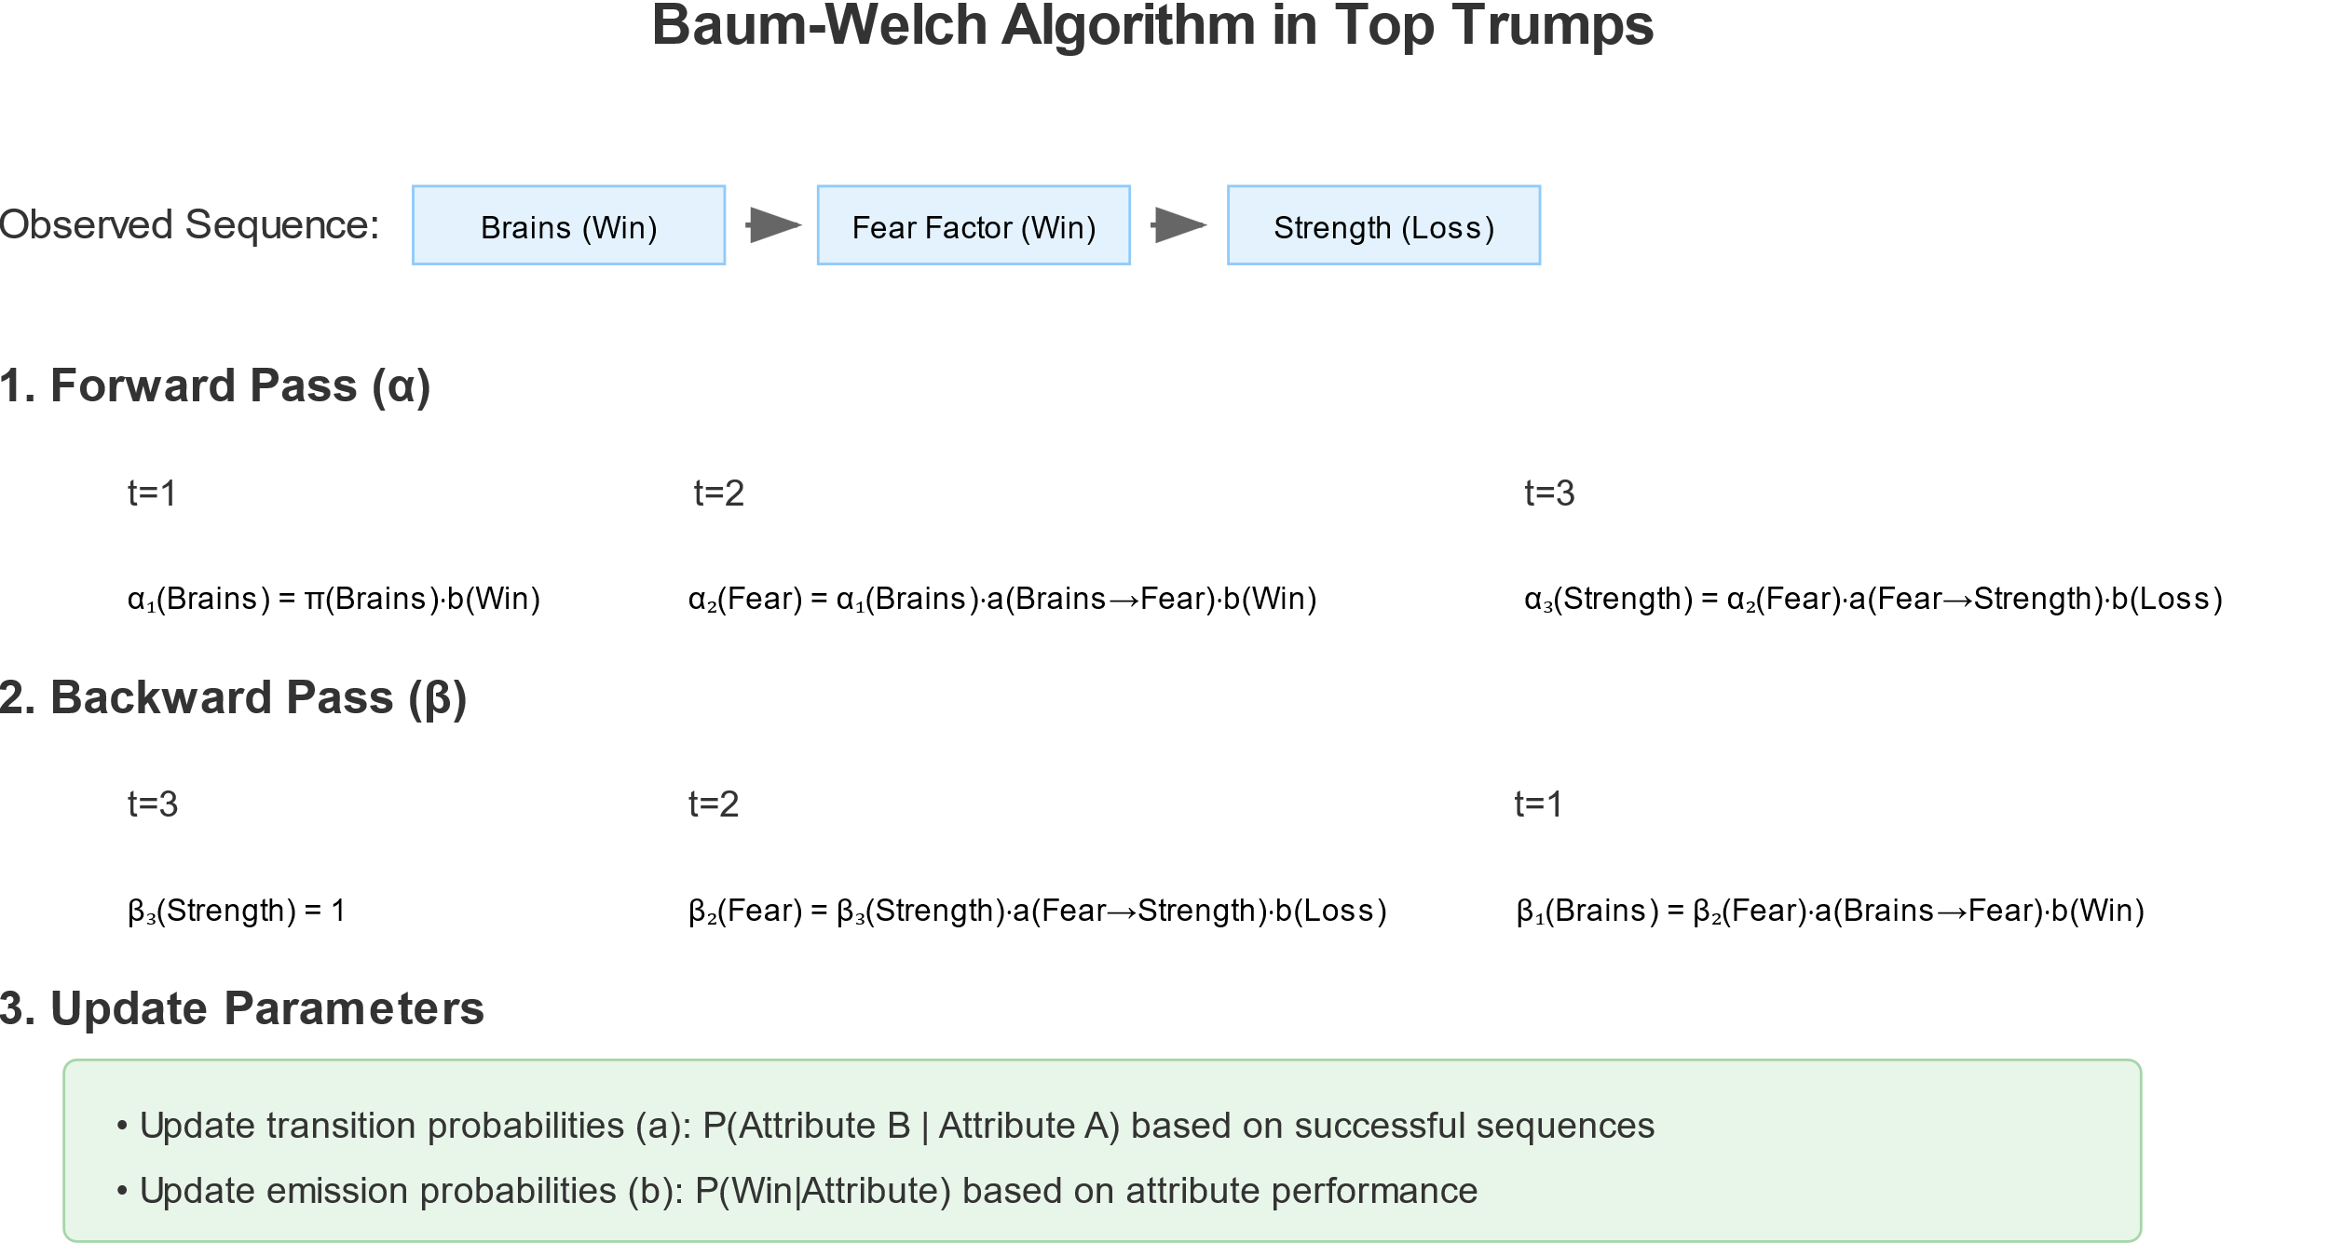
Baum-Welch Algorithm

Slide 10
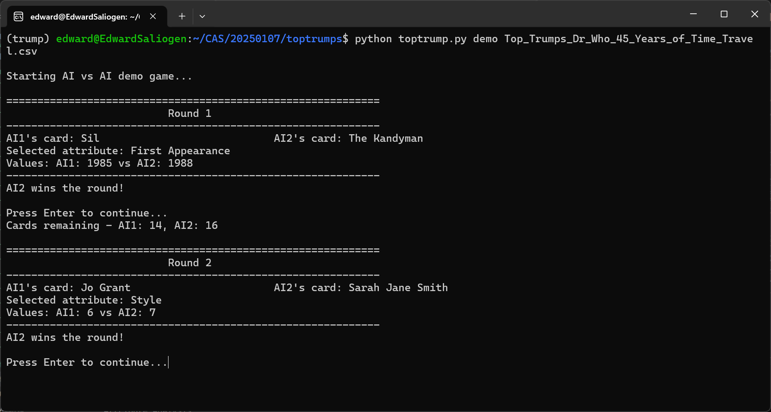
Demo game

Slide 11
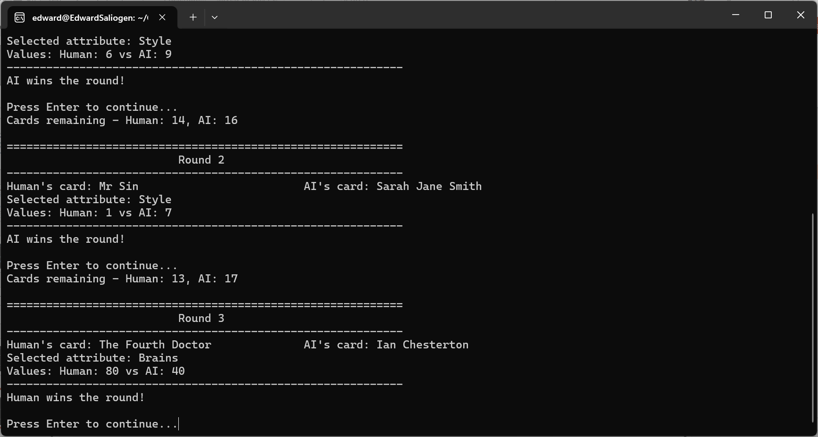
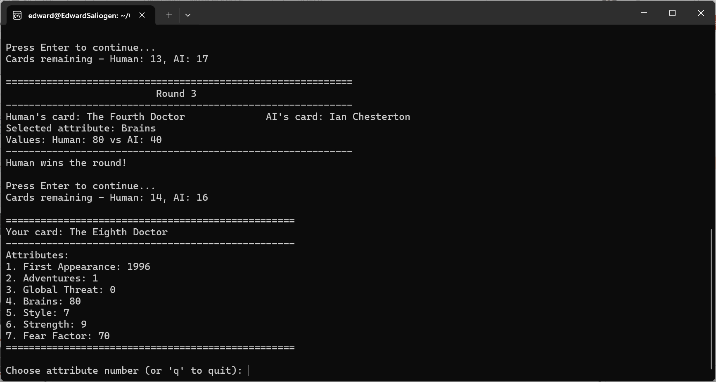
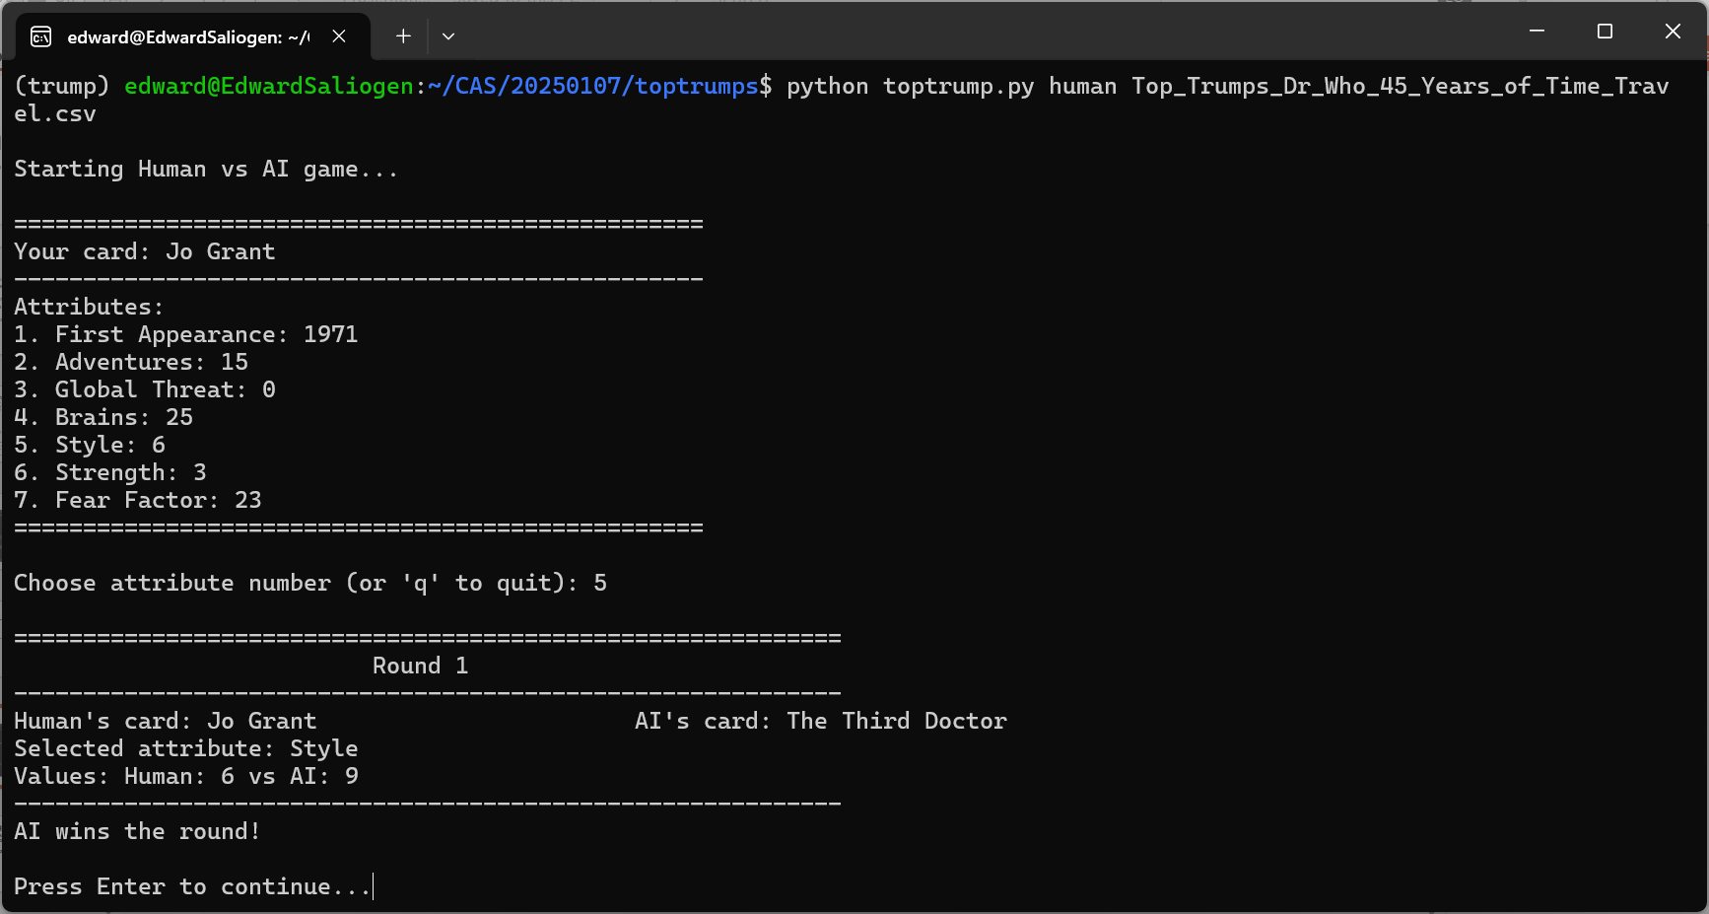
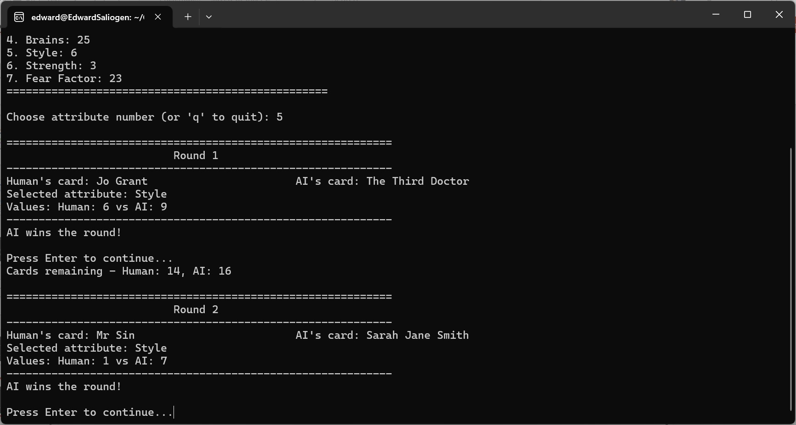
Human game

Slide 12
Training vs Random / Adversarial / LMM
We tried training vs a player that picks cards randomly
Player 1 (model) wins 54% of games
We tried training vs a model that is also learning to win
Best player (model vs model) wins 56% of games
We tried playing our “best” model against Ollama Phi4 that just looked at the words on the card to make a decision
Ollama won 73% of the games
We tried playing the computer
We always beat the computer easily

Slide 13
Conclusion
HMM is not the best
way to model Top Trumps!
But local LLMs like Ollama Phi4 might be…

