Slide 1
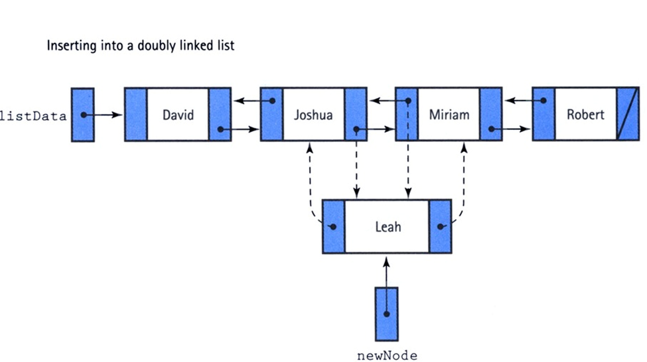
Insertion
We visualize operation insertAfter (Joshua)
Location

Slide 2
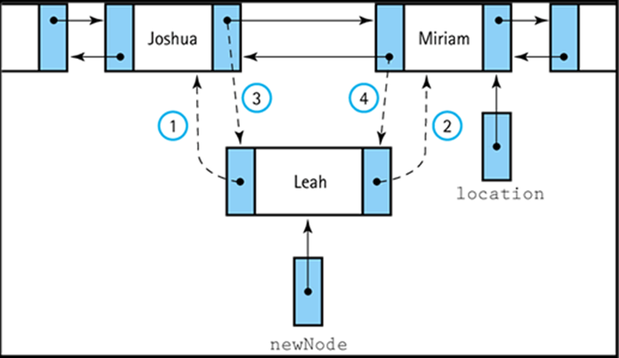
Insertion
Location
We visualize operation insertAfter (Joshua)
newnode.previous = location.previous
newnode.next = location
location.previous.next = newnode
location.previous = newnode

Slide 3
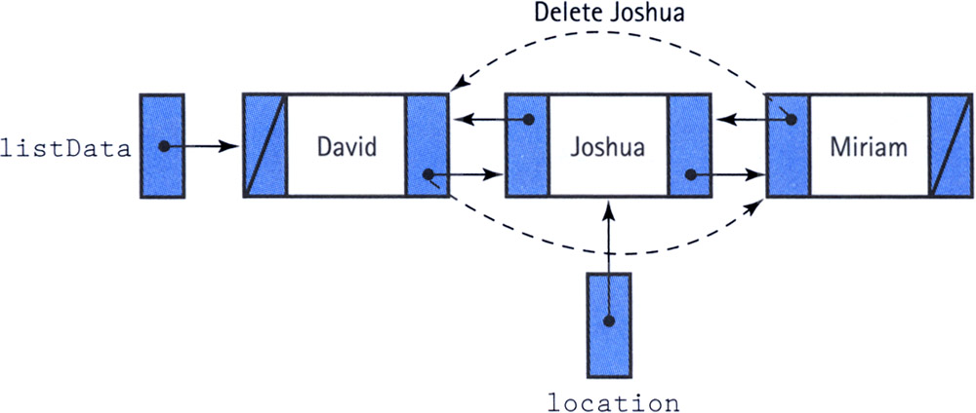
Deletion
location.previous.next = location.next
Location.next.previous =location.previous
Deletion in doubly linked list: eliminate the need for a reference to a node’s predecessor/previous to delete the node

