Slide 1
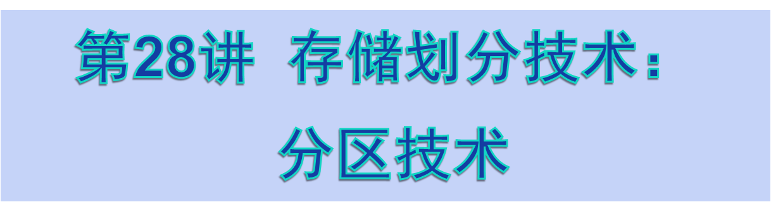

Slide 2
Memory Management Techniques
Fixed Partitioning(固定分区)
Dynamic Partitioning(动态分区)
Simple Paging(简单分页)
Simple Segmentation(简单分段)
Virtual-Memory Paging(虚拟存储分页)
Virtual-Memory Segmentation(虚拟存储分段)

Slide 3
§3.2 Simple Memory Management Techniques

Slide 4
Partitioning Technique
Fixed Partitioning Technique(固定分区技术)
Dynamic Partitioning Technique(动态分区技术)
Buddy System(伙伴系统)

Slide 5
Fixed Partitioning
系统初始启动时将内存划分为数目固定、尺寸固定的多个分区。
这些分区的尺寸可以相等也可以不等。

Slide 6
Fixed Partitioning
Equal-size partitions
  any process whose size is less than or equal to the partition size can be loaded into an available partition.
  if all partitions are full, the operating system can swap a process out of a partition.

Slide 7
Fixed Partitioning
A program may be too big to fit into a partition. The programmer must design the program with overlays .
Main memory use is inefficient. Any program, no matter how small, occupies an entire partition. This is called internal fragmentation (内零头).
Both of these problems can be lessened, though not solved, by using unequal-size partitions.

Slide 8
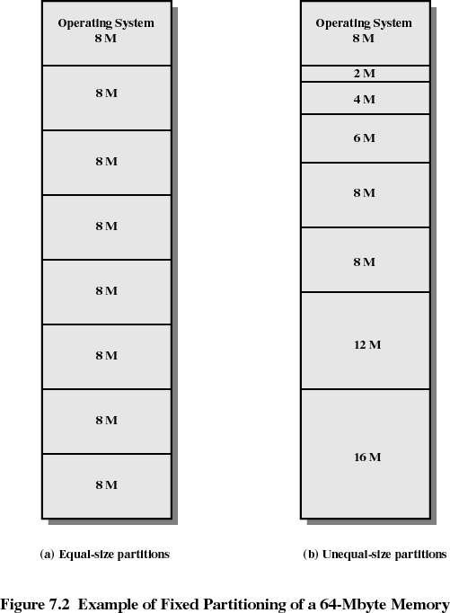

Slide 9
Placement Algorithm with Partitions
Equal-size partitions
  because all partitions are of equal size, it does not matter which partition is used.
Unequal-size partitions
  can assign each process to the smallest partition within which it will fit.
  queue for each partition.
  processes are assigned in such a way as to minimize wasted memory within a partition.

Slide 10
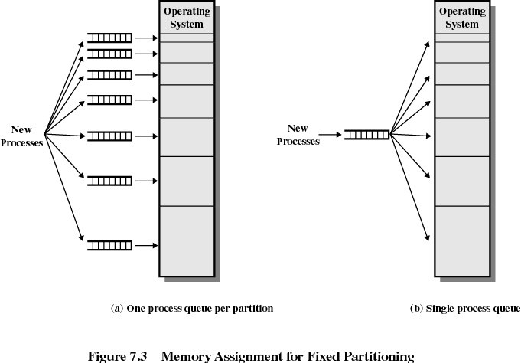

Slide 11
Fixed Partitioning (长处和不足)
Advantages
  实现简单；
  系统开销小。
Disadvantages
  存在Internal Fragment, 存储利用率不高；
  分区尺寸固定,系统无法运行大程序；
  分区数目固定,使活动进程的数目受限

Slide 12
Dynamic Partitioning
Partitions are of variable length and number.
Process is allocated exactly as much memory as required.
Eventually get holes in the memory. This is called external fragmentation(外零头).
Must use compaction(紧凑) to shift processes so they are contiguous and all free memory is in one block.

Slide 13
Dynamic Partitioning (外零头和紧凑技术)
动态分区为进程分配大小合适的分区，消除了分区Internal Fragment。但是，却产生分区External Fragment
Compaction :为了使外零头得到充分利用，可以将把内存中的所有空闲分区拼接成一个较大的空闲分区。即系统可以把内存中的所有进程移到内存的某一端；相应地，内存中的所有空闲分区将被移到内存的另一端。
Compaction技术要求系统具有动态重定位的能力

Slide 14
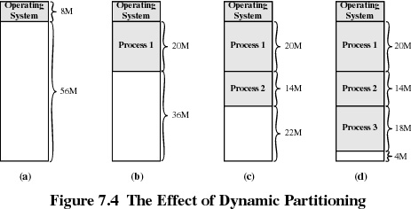

Slide 15
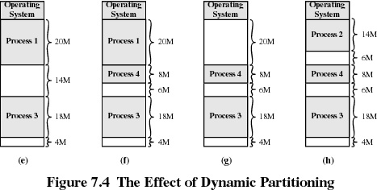

Slide 16
Dynamic Partitioning Placement Algorithm
Operating system must decide which free block to allocate to a process.
Best-fit algorithm(最佳适应算法)
  Chooses the block that is closest in size to the request.
  Worst performer overall.
  Since smallest block is found for process, the smallest amount of fragmentation is left. Memory compaction must be done more often.

Slide 17
Dynamic Partitioning Placement Algorithm
First-fit algorithm(首次适应算法)
  Scan memory from the beginning and choose the first available block that is large enough.
  Simplest, Best and Fastest.
  May have many process loaded in the front end of memory that must be searched over when trying to find a free block.

Slide 18
Dynamic Partitioning Placement Algorithm
Next-fit(下次适应算法)
  Scan memory from the location of the last placement and choose the next available block that is large enough.
  More often allocate a block of memory at the end of memory where the largest block is found.
  The largest block of memory is broken up into smaller blocks.
  Compaction is required more frequently to obtain a large block at the end of memory.

Slide 19
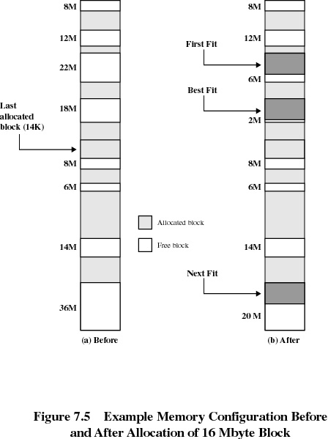

Slide 20
Registers Used during Execution
Base register（基址寄存器）
  starting address for the process.
Bounds register（界限寄存器）
  ending location of the process.
These values are set when the process is loaded and when the process is swapped in.

Slide 21
Registers Used during Execution
The value of the base register is added to a relative address to produce an absolute address.
The resulting address is compared with the value in the bounds register.
If the address is not within bounds, an interrupt is generated to the operating system.

Slide 22
