Slide 1


Slide 2
内 容 ( 2.6 - 2.7 )
1
Mutual Exclusion and Synchronization
2
Deadlock And Starvation

Slide 3
Learning objectives ( 2.6 - 2.7)
By the end of this lecture you should be able to:
Explain what’s Concurrency, Synchronization ,Mutual exclusion, Deadlock, Starvation, Critical sections
掌握Requirements for Mutual Exclusion
掌握Approaches of Mutual Exclusion: Software Approaches & Hardware Support—Semaphores、Monitors、Message Passing
区别掌握Types and meanings of Semaphores

Slide 4
Learning objectives ( 2.6 - 2.7 ) （continue）
By the end of this lecture you should be able to:
掌握3个经典问题的解决方法： Producer/Consumer Problem、 Readers/Writers Problem、 Dining Philosophers Problem
理解Conditions for Deadlock、Deadlock Prevention 、 Deadlock Avoidance、 Deadlock Detection、 Strategies once Deadlock Detected, Banker’s Algorithm (Safe State vs. Unsafe State )

Slide 5
§2.6 Concurrency：
Mutual Exclusion and Synchronization

Slide 6
Design Issues of Concurrency
Communication among processes
Sharing /Competing of resources
Synchronization of multiple processes
Allocation of processor time

Slide 7
Difficulties with Concurrency
Sharing global resources
Management of allocation of resources
Programming errors difficult to locate

Slide 8
A Simple Example
void echo()
{
chin = getchar();
chout = chin;
putchar(chout);
}

Slide 9
A Simple Example
Process P1 Process P2
…. ….
in = getchar(); in = getchar();
…. ….
chout = in; chout = in;
…. ….
putchar(chout); putchar(chout);
…. ….

Slide 10
Operating System Concerns
Keep track of active processes: PCB
Allocate and deallocate resources
  Processor time: scheduling
  Memory: virtual memory
  Files
  I/O devices
Protect data and resources
Result of process must be independent of the speed of execution of other concurrent processes.

Slide 11
Process Interaction
Processes unaware of each other
- Competition
- Mutual exclusion, Deadlock, Starvation
Processes indirectly aware of each other
- Cooperation by sharing
- Mutual exclusion, Deadlock, Starvation, Data coherence (一致性)
Process directly aware of each other
- Cooperation by communication
- Deadlock, Starvation

Slide 12
Competition Among Processes for Resources
Mutual Exclusion(互斥)
  Critical sections（临界区）
    Only one program at a time is allowed in its critical section.
    Eg. Only one process at a time is allowed to send command to the printer（critical resource）.
Deadlock（死锁）
Starvation

Slide 13
Competition Among Processes for Resources
Deadlock
例如，有两个进程P1、P2，竞争两个资源A、B。假设
占用：P1（B） and P2（A）
申请：P1（A） and P2（B）
结果：P1、P2永久等待（死锁）

Slide 14
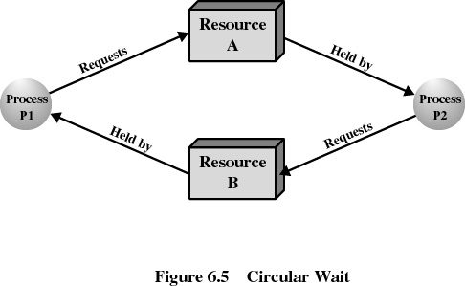
P1 & P2 - Deadlock

Slide 15
Mutual Exclusion Mechanism
entry section
critical section
exit section

Slide 16
Cooperation Among Processes by Sharing
Writing must be mutually exclusive.
Critical sections are used to provide data integrity（数据完整性）.

Slide 17
Cooperation Among Processes by Communication
Messages are passed
  Mutual exclusion is not a control requirement.
Possible to have deadlock
  Each process waiting for a message from the other process.
Possible to have starvation
  Two processes sending message to each other while another process waits for a message.

Slide 18
Requirements for Mutual Exclusion
Only one process at a time is allowed in the critical section for a resource .
A process that halts in its non-critical section must do so without interfering with other processes.
No deadlock or starvation.

Slide 19
Requirements for Mutual Exclusion
A process must not be delayed access to a critical section when there is no other process using it.
No assumptions are made about relative process speeds or number of processes.
A process remains inside its critical section for a finite time only.

Slide 20
Requirements for Mutual Exclusion
空闲让进
忙则等待
有限等待
让权等待

Slide 21
Approaches of Mutual Exclusion
Software Approaches
Hardware Support
Semaphores
Monitors
Message Passing

Slide 22
Software Approaches
Memory access level
Access to the same location in main memory are serialized by some sort of memory arbiter .
Dekker’s Algorithm
Peterson’s Algorithm

Slide 23
Software Approaches
To mutual exclusion for two processes.
To illustrate most of the common bugs encountered in developing concurrent programs.
Is likely to have high processing overhead.
The risk of logical errors is significant.

