Slide 1


Slide 2
Simple Paging Technique
Partition memory into small equal-size chunks and divide each process into the same size chunks.
The chunks of a process are called pages and chunks of memory are called frames（页框、页帧）.

Slide 3
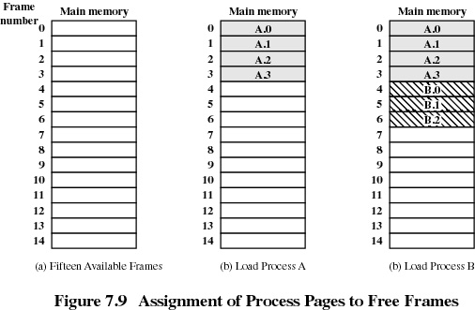

Slide 4
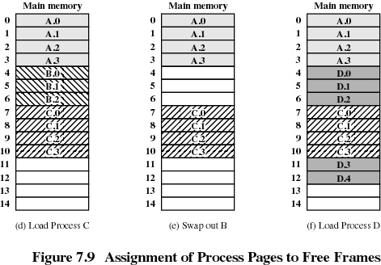

Slide 5
Simple Paging Technique （简单分页技术）
Operating system maintains a page table（页表） for each process.
- contains the frame location for each page in the process.
- logical address consists of a page number （页号）and an offset （偏移量） within the page.
A single free-frame list （空闲页框表） of all frames in main memory that are currently unoccupied and available for pages.

Slide 6
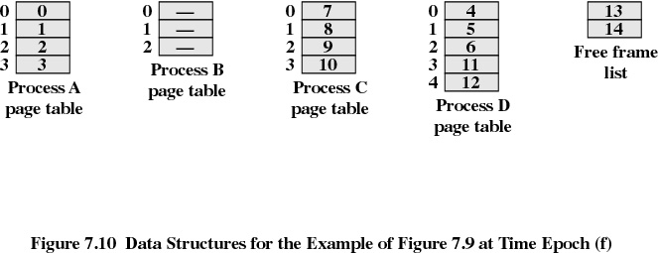
Page Tables for Example

Slide 7
Logical-to-Physical Address Translation
Address translation is done by processor hardware (MMU，存储管理单元).
The processor must know how to access the page table of the current process, using page table register (页表寄存器).
Logical address :page number, offset.
Physical address:frame number, offset.

Slide 8
Logical-to-Physical Address Translation
在分页系统中，地址变换步骤：
根据逻辑地址及页大小求出页号和页内偏移；
用页号检索页表，查找指定页对应的页框号；
根据页框号、页内偏移以及页框尺寸求出物理地址

Slide 9
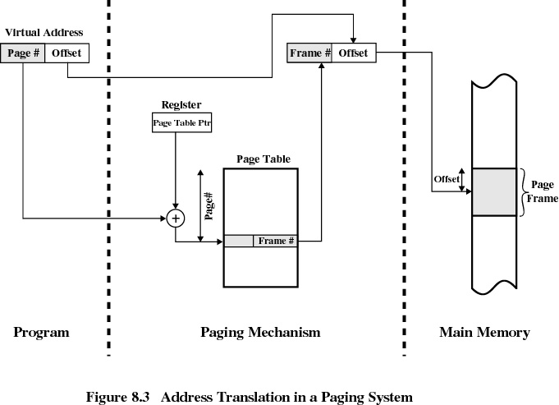

Slide 10
Translation Lookaside Buffer (快表-加快页表检索速度)
Each virtual memory reference can cause two physical memory accesses.
  one to fetch the page table.
  one to fetch the data.
To overcome this problem a high-speed cache is set up for page table entries.
  called the TLB - Translation Lookaside Buffer.

Slide 11
TLB: Translation Lookaside Buffer.
根据功能可以译为快表，直译可以翻译为旁路转换缓冲，也可以把它理解成页表缓冲。里面存放的是一些页表文件（虚拟地址到物理地址的转换表）。当处理器要在主内存寻址时，不是直接在内存的物理地址里查找的，而是通过一组虚拟地址转换到主内存的物理地址，TLB就是负责将虚拟内存地址翻译成实际的物理内存地址，而CPU寻址时会优先在TLB中进行寻址。处理器的性能就和寻址的命中率有很大的关系。

Slide 12
由于CPU首先接到的是由程序传来的虚拟内存地址，所以CPU必须先到物理内存中取页表，然后对应程序传来的虚拟页面号，在表里找到对应的物理页面号，最后才能访问实际的物理内存地址，也就是说整个过程中CPU必须访问两次物理内存(实际上访问的次数更多)。因此，为了减少CPU访问物理内存的次数，引入TLB。

Slide 13
Translation Lookaside Buffer
Contains page table entries that have been most recently used.
Functions same way as a memory cache.

Slide 14
Translation Lookaside Buffer
Given a virtual address, processor examines the TLB.
If page table entry is present (a hit), the frame number is retrieved and the real address is formed.
If page table entry is not found in the TLB (a miss), the page number is used to index the process page table.

Slide 15
Translation Lookaside Buffer
First checks if page is already in main memory .
  if not in main memory a page fault is issued.
The TLB is updated to include the new page entry.

Slide 16
