Slide 1


Slide 2
Paging
Each process has its own page table.
Each page table entry contains the frame number of the corresponding page in main memory.
A bit is needed to indicate whether the page is in main memory or not.

Slide 3
Modify Bit in Page Table
Another modify bit is needed to indicate if the page has been altered since it was last loaded into main memory.
If no change has been made, the page does not have to be written to the disk when it needs to be swapped out.

Slide 4
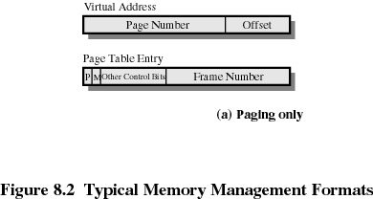
Page Table Entries

Slide 5
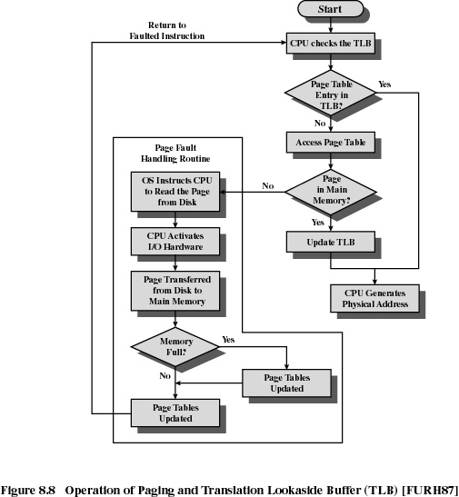

Slide 6
Virtual-Memory Segmentation Technique
May be unequal, dynamic size.
Simplifies handling of growing data structures.
Allows programs to be altered and recompiled independently.
Lends itself to sharing data among processes.
Lends itself to protection.

Slide 7
Segment Tables
Corresponding segment in main memory.
Each entry contains the length of the segment.
A bit is needed to determine if segment is already in main memory.
Another bit is needed to determine if the segment has been modified since it was loaded in main memory.

Slide 8
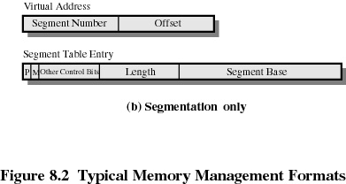
Segment Table Entries

Slide 9
?
Virtual-Memory Paging -Segmentation

