Slide 1


Slide 2
Approaches of Mutual Exclusion
Software Approaches
Hardware Support
Semaphores
Monitors
Message Passing

Slide 3
Approaches of Mutual Exclusion
Software Approaches
Hardware Support
Semaphores
Monitors
Message Passing

Slide 4
Monitor（管程）——面向对象方法
用信号量实现互斥，编程容易出错（wait、signal的出现顺序和位置非常重要）
Support at Programming-language level
管程是用并发pascal、pascal plus、Modula-2、Modula-3等语言编写的程序，现在已形成了许多库函数。管程可以锁定任何对象，如链表或链表的元素等。
用管程实现互斥比用信号量实现互斥，更简单、方便

Slide 5
Monitors
Monitor is a software module，由若干过程、局部于管程的数据、初始化语句（组）组成
Chief characteristics
  Local data variables are accessible only by the monitor.
  Process enters monitor by invoking one of its procedures.
  Only one process may be executing in the monitor at a time.

Slide 6
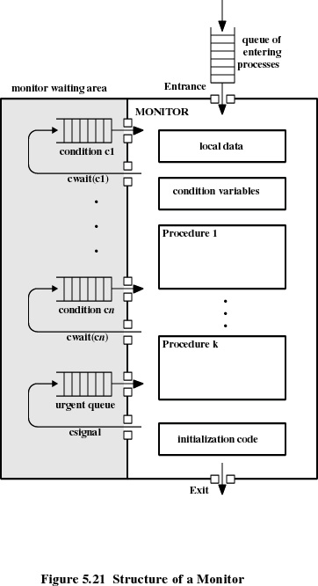

Slide 7
Approaches of Mutual Exclusion
Software Approaches
Hardware Support
Semaphores
Monitors
Message Passing

Slide 8
Message Passing
Enforce mutual exclusion
Exchange information
send (destination, message)
receive (source, message)

Slide 9
Synchronization
Sender and receiver may or may not be blocked (waiting for message).
Blocking send, blocking receive
  Both sender and receiver are blocked until message is delivered.
  Called a rendezvous(紧密同步，汇合)

Slide 10
Synchronization
Nonblocking send, blocking receive
  Sender continues processing such as sending messages as quickly as possible.
  Receiver is blocked until the requested message arrives.
Nonblocking send, nonblocking receive
  Neither party is required to wait

Slide 11
Addressing(寻址)
Direct addressing
  Send primitive includes a specific identifier of the destination process.
  Receive primitive could know ahead of time which process a message is expected.
  Receive primitive could use source parameter to return a value when the receive operation has been performed.

Slide 12
Addressing
Indirect addressing
  messages are sent to a shared data structure consisting of queues.
  queues are called mailboxes.
  one process sends a message to the mailbox and the other process picks up the message from the mailbox.

Slide 13
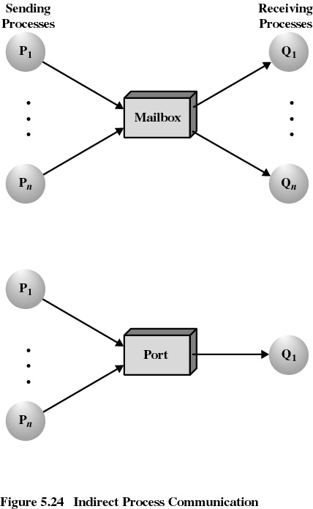

Slide 14
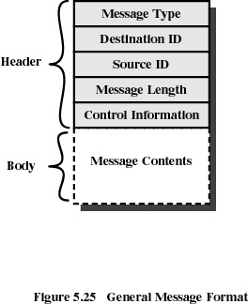
Message Format

Slide 15
Message Passing (Mutual Exclusion)
若采用Nonblocking send, blocking receive
多个进程共享邮箱mutex。若进程申请进入临界区，首先申请从mutex邮箱中接收一条消息。若邮箱空，则该进程阻塞；若进程收到邮箱中的消息，则进入临界区，执行完毕退出，并将该消息放回邮箱mutex。该消息as a token在进程间传递。

Slide 16
利用消息传递实现互斥的通用模式
program mutualexclusion;
const n=…; /* 进程数 */
procedure P(i:integer);
var msg:message;
begin
repeat
receive(mutex,msg); /* 从邮箱接收一条消息 */
<临界区>;
send(mutex,msg); /* 将消息发回到邮箱 */
<其余部分>
forever
end;
begin /* 主程序 */
create_mailbox(mutex); /* 创建邮箱 */
send(mutex,null); /* 初始化，向邮箱发送一条空消息 */
parbegin
P(1);
P(2);
…
P(n)
parend
end.

Slide 17
Message Passing (Producer/Consumer Problem)
解决有限buffer Producer/Consumer Problem
设两个邮箱：
  Mayconsume： Producer存放数据，供Consumer取走（即buffer数据区）
  Mayproduce：存放空消息的buffer空间

Slide 18
program mutualexclusion;
const
capacity =…; /* 消息缓冲区大小 */
null = …; /* 空消息 */
procedure producer;
var pmsg:message;
begin
while true do
begin
receive(mayproduce,pmsg);
pmsg := produce;
send(mayconsume,pmsg);
end
end;
procedure consumer;
var cmsg:message;
begin
while true do
begin
receive(mayconsume,cmsg);
consume(cmsg);
send(mayproduce,null);
end
end;
begin /* 主程序 */
create_mailbox(mayproduce);
create_mailbox(mayconsume);
for i = 1 to capacity do send(mayproduce,null);
parbegin
producer;
consumer;
parend
end.

