Slide 1
内 容
1
I/O Devices
2
Organization Of The I/O Function
3
OS设备管理模块的结构
4
I/O Buffering
5
Disk Scheduling Policies

Slide 2
Learning objectives
By the end of this lecture you should be able to understand :
  计算机I/O子系统的组成
  OS设备管理模块的结构
  I/O缓冲技术
  磁盘调度策略
  RAID技术

Slide 3


Slide 4
§4.1 I/O Devices

Slide 5


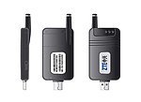
Categories of I/O Devices
Human readable
Machine readable
Communication

Slide 6
Differences in I/O Devices
Data Transfer Rate(数据传输速率)
Application(应用)
Complexity of Control (控制复杂性)
Data Transfer Unit(数据传输单位)
Data Representation(数据表示)
Error Conditions(错误条件)

Slide 7
§4.2 Organization Of The I/O Function

Slide 8
Techniques for Performing I/O
Programmed I/O(程序控制I/O)
Interrupt-Driven(中断驱动)
DMA Control (DMA控制)

Slide 9
Programmed I/O
The processor issues an I/O command to an I/O module, I/O module performs the I/O.
Sets appropriate bits in the I/O status register.
No interrupts occur.
Processor checks status until operation is complete.
Process is busy-waiting for the operation to complete.

Slide 10
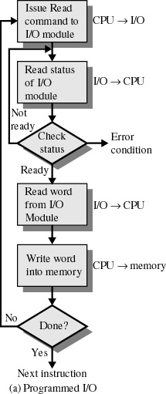

Slide 11
Interrupt-Driven I/O
Processor is interrupted when I/O module ready to exchange data.
Processor is free to do other work.
No needless waiting.
Consumes a lot of processor time because every word read or written passes through the processor.

Slide 12
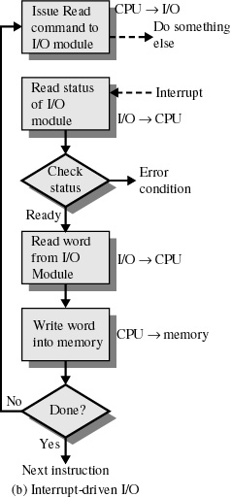

Slide 13
Direct Memory Access (DMA)
Transfers a block of data directly to or from memory.
An interrupt is sent when the task is complete.
The processor is only involved at the beginning and end of the transfer.

Slide 14
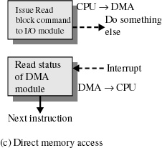

Slide 15
Direct Memory Access
Takes control of the system from the CPU to transfer data to and from memory over the system bus.
Cycle stealing is used to transfer data on the system bus.
The instruction cycle is suspended so data can be transferred.
The CPU pauses one bus cycle.
No interrupts occur
  Do not save context.

Slide 16
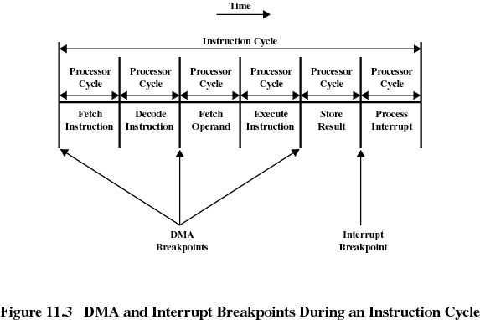

Slide 17
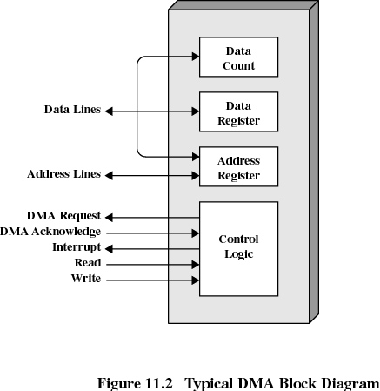
DMA Logic

Slide 18
DMA控制器的工作原理(1)
当CPU将一块数据从某I/O设备读入内存某处或把一块数据从内存某处写入某I/O设备时
  CPU将把相关数据块的长度通过DMA的“Data Lines”脚写入DMA的“Data Count”寄存器
  把内存起始地址和I/O设备地址通过DMA的“Data Lines”脚写入DMA的“Address Register”寄存器
  通过DMA的 “Read” 脚或“Write”脚向DMA发出读或写命令

Slide 19
DMA控制器的工作原理 (2)
DMA通过“DMA Request”脚 和 “DMA Acknowledge”脚控制相关的I/O设备
通过“Data Lines”脚与I/O设备以及内存交换数据
通过“Address Lines”脚寻址内存

Slide 20
DMA控制器的工作原理(3)
工作完毕，DAM将通过“Interrupt”脚向CPU发出中断，CPU对本次数据传输进行善后处理。
DMA将通过窃取CPU总线周期的方式获得总线控制权。

Slide 21
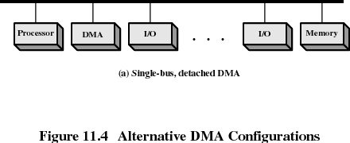
DMA

Slide 22
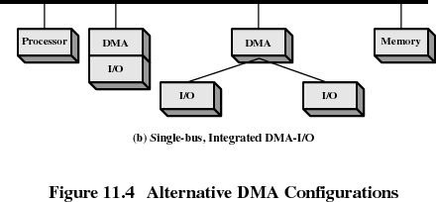
DMA

Slide 23
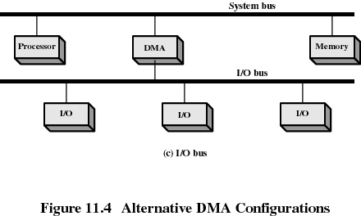
DMA

Slide 24
Evolution of the I/O Function
Processor directly controls a peripheral device.
Controller or I/O module is added
  Processor uses programmed I/O without interrupts .
  Processor does not need to handle details of external devices.

Slide 25
Evolution of the I/O Function
Controller or I/O module with interrupts
  Processor does not spend time waiting for an I/O operation to be performed.
Direct Memory Access
  Blocks of data are moved into memory without involving the processor.
  Processor involved at beginning and end only.

Slide 26
Evolution of the I/O Function
I/O module is a separate processor：I/O channel.
I/O processor
  I/O module has its own local memory.
  It’s a computer in its own right.

Slide 27
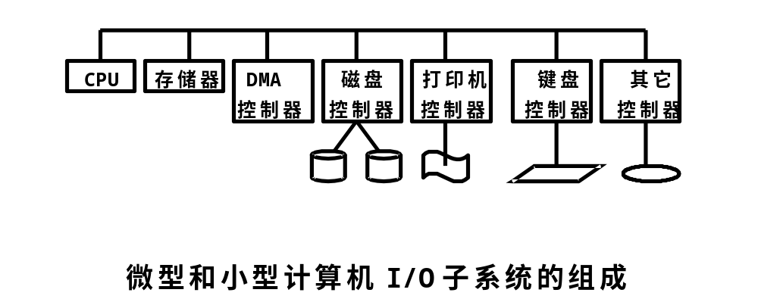
计算机I/O子系统的组成(1)

Slide 28
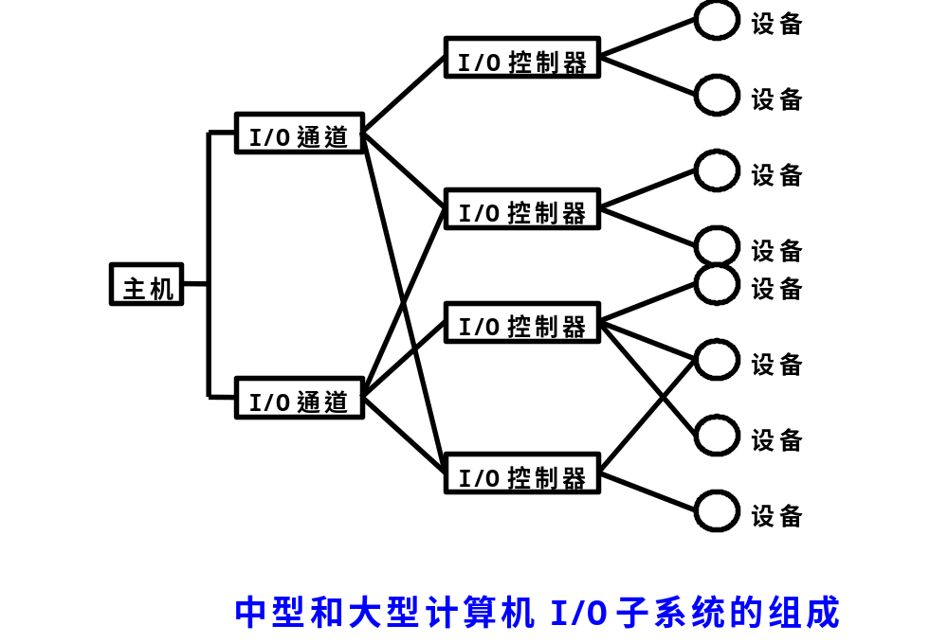
计算机I/O子系统的组成(2)

Slide 29
§4.3 OS设备管理模块的结构

Slide 30
Operating System Design Issues
Efficiency
  Most I/O devices extremely slow compared to main memory.
  Use of multiprogramming allows for some processes to be waiting on I/O while another process executes.
  I/O cannot keep up with processor speed.
  Swapping is used to bring in additional Ready processes which is an I/O operation.

Slide 31
Operating System Design Issues
Generality
  Desirable to handle all I/O devices in a uniform manner.
  Hide most of the details of device I/O in lower-level routines so that processes and upper levels see devices in general terms such as read, write, open, close, lock, unlock.

Slide 32
Device Independence （设备无关性）
即，应用软件所引用的用于实现I/O操作的设备与计算机I/O子系统中实际安装的设备没有固定的联系。

Slide 33
Logical I/O Device
应用软件引用的用于实现I/O操作的设备。
从应用软件的角度看，逻辑I/O设备是一类具有相同或相似属性的物理I/O设备的抽象。

Slide 34
逻辑I/O设备的分类
字符设备
  也叫面向流的设备(Stream-Oriented Device)；
  应用软件以字符为单位读写此类逻辑I/O设备。
块设备
  也叫面向块的设备(Block-Oriented Device)；
  应用软件以块为单位读写此类逻辑I/O设备。

Slide 35
OS设备管理模块的分层结构
为了实现“通用性”这一设计目标，大多数OS的设备管理模块采用分层结构。
在分层结构中，上层可以屏蔽下层的实现细节

Slide 36
OS设备管理模块的分层结构模型
典型的两层结构:
  设备硬件无关层，实现设备映射功能，把逻辑I/O设备映射到物理I/O设备
  设备硬件相关层，实现设备驱动功能，控制物理I/O设备以便完成实际的I/O操作

Slide 37
