Slide 1
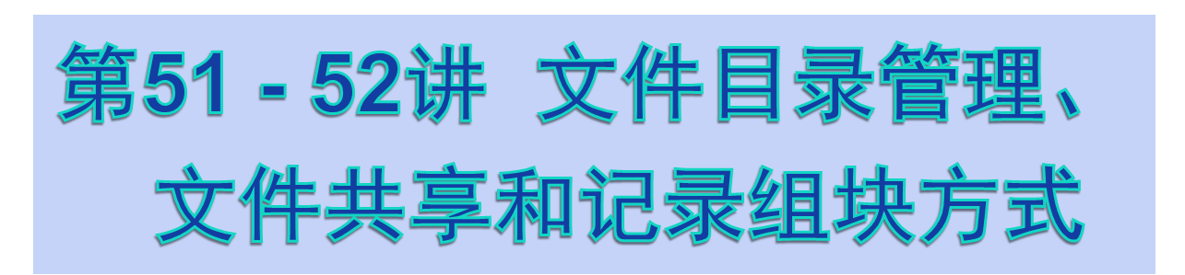

Slide 2
§5.3 File Directories

Slide 3
File Directories
Directory itself is a file owned by the operating system.
Provides mapping between file names and the files themselves.

Slide 4
File Directories
Contains information about files.
  Basic Information
    File Name, File Type, File Organization
  Addr. Information
    Volume, Starting Addr., Size Used, Size Alloc.
  Access Contr. Information
    Owner, Access Info., Permitted Actions
  Usage information
    Date Created, ID. of Creator, Date Last Read Access, ID of Last Reader, Date of Last Modified, ID of Last Modifier, Date of Last Backup, Current Usage

Slide 5
Structure for a Directory
可见，不同系统保存文件目录的方式不同。有的系统将其中部分信息保存在文件头部，只将一些必要信息如文件名、文件大小、外存中的存储位置等保存在文件目录中
对目录文件的典型操作：
  Search：按文件名检索文件目录
  Create file：建立文件时，必须为之建立一个新目录
  Delete file：删除文件时，必须同时删除其文件目录
  List Directory：用户常需要列文件目录及文件的某些属性

Slide 6
Simple Structure for a Directory
List of entries, one for each file.
Sequential file with the name of the file serving as the key.
Provides no help in organizing the files.
Forces user to be careful not to use the same name for two different files.

Slide 7
Two-level Scheme for a Directory
One directory for each user and a master directory.(用户目录和主目录)
Master directory contains entry for each user.
  Provides address and access control information.
Each user directory is a simple list of files for that user.
Still provides no help in structuring collections of files.

Slide 8
Hierarchical, or Tree-Structured Directory
Master directory with user directories underneath it.（主目录下建立若干用户目录）
Each user directory may have subdirectories and files as entries.（每个用户目录下允许再创建子目录及文件目录）

Slide 9
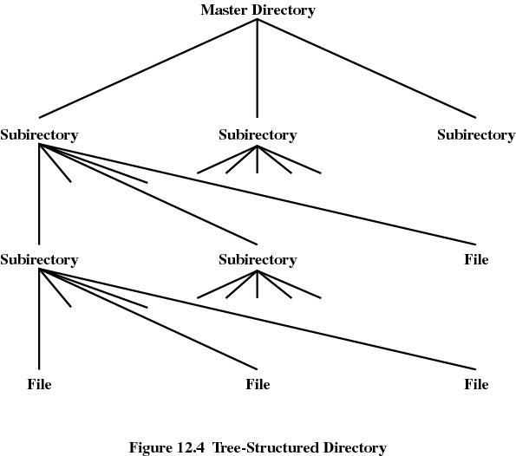

Slide 10
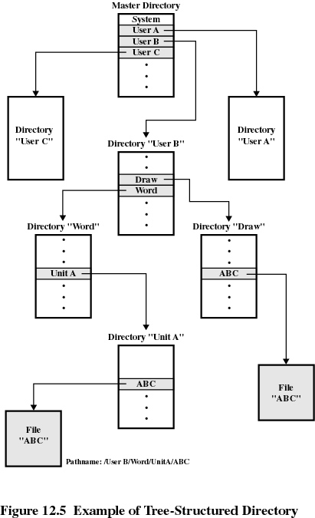

Slide 11
Hierarchical, or Tree-Structured Directory
Files can be located by following a path from the root, or master, directory down various branches.
  This is the pathname for the file.
Can have several files with the same file name as long as they have unique path names.

Slide 12
Hierarchical, or Tree-Structured Directory
Current directory is the working directory.（当前目录即工作目录）
Files are referenced relative to the working directory.（相对工作目录的文件路径为相对路径）

Slide 13
§5.4 File Sharing

Slide 14
File Sharing
In multiuser system, allow files to be shared among users.
Two issues
  Access rights
  Management of simultaneous access.（并行存取）

Slide 15
Access Rights
None
  User may not know of the existence of the file.
  User is not allowed to read the user directory that includes the file.
Knowledge（探知）
  User can only determine that the file exists and who its owner is.

Slide 16
Access Rights
Execution
  The user can load and execute a program but cannot copy it.
Reading
  The user can read the file for any purpose, including copying and execution.
Appending
  The user can add data to the file but cannot modify or delete any of the file’s contents.

Slide 17
Access Rights
Updating
  The user can modify, deleted, and add to the file’s data. This includes creating the file, rewriting it, and removing all or part of the data.
Changing protection
  User can change access rights granted to other users.
Deletion
  User can delete the file.

Slide 18
Access Rights
Owners
  Has all rights previously listed.
  May grant rights to others using the following classes of users.
    Specific user
    User groups
    All for public files

Slide 19
Simultaneous Access
User may lock entire file when it is to be updated.
User may lock the individual records during the update.
Mutual exclusion and deadlock are issues for shared access.

Slide 20
§5.5 Record Blocking

Slide 21
Record Blocking
记录是存取文件的逻辑单位，而数据块是I/O的基本单位，记录必须组织成数据块以便于I/O
问题：
  数据块的长度固定还是可变？
  根据记录的平均长度如何设置数据块的长度？

Slide 22
数据块的长度固定还是可变？
大多数系统采用固定长度的数据块，以简化I/O操作、Buffer的分配及辅存中数据块的组织管理

Slide 23
如何设置数据块的长度？
数据块越大，一次I/O传输的记录就越多
大数据块适合文件顺序访问，因为这样可以减少I/O次数，加快处理速度
当随机访问文件，或访问局部性很差时，传输的部分记录不会使用，效率低。
另外，大数据块需要更大的I/O buffer，增加其管理复杂度

Slide 24
Fixed blocking （固定组块法）
数据块由固定长度的若干条记录组成
块内可能会存在一些被浪费空间

Slide 25
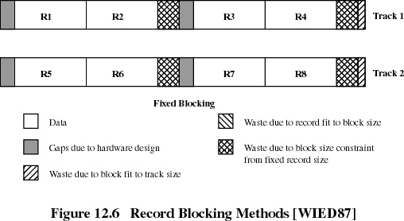
Fixed Blocking

Slide 26
Variable Blocking: Spanned （可变长跨块组块法）
数据块由变长记录组成，一条记录可以跨越两个数据块，可用指针记载一条跨块存储记录所在的下一数据块
块内无浪费空间

Slide 27
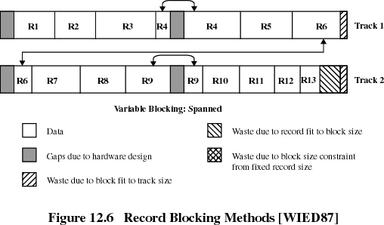
Variable Blocking: Spanned

Slide 28
Variable Blocking Unspanned (可变长非跨块组块法)
数据块由变长记录组成
不允许一条记录跨越两个数据块
块内可能存在被浪费空间

Slide 29
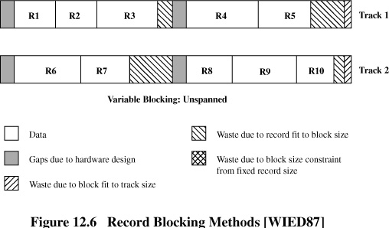
Variable Blocking Unspanned

