Slide 1

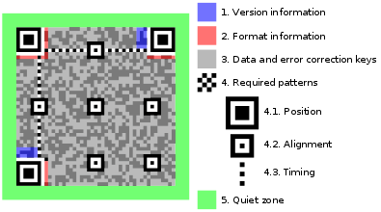
General Overview of Creating a QR Code
1. Data Analysis
2. Data Encoding
3. Error Correction Coding
4. Structure Final Message
5. Module Placement in Matrix
6. Data Masking
7. Format and Version Information

Slide 2
1. Data Analysis
1. numeric mode：0-9
2. alphanumeric mode：10+26+9=45 characters，10 characters：0-9；26 characters：Upper-class；9 special signs
https://www.thonky.com/qr-code-tutorial/alphanumeric-table
3. Byte mode
4. Kanji mode
。。。。。。

Slide 3
1. EXAMPLE
HELLO WORLD

Slide 4
2. Data Encoding
1. Choose the Error Correction Level
L, M, Q, H
2. Determine the Smallest Version for the Data
(version*4+17)^2 https://www.thonky.com/qr-code-tutorial/character-capacities
3. Encode
a. mode + length + codewords
b. padding：0和11101100、00010001
https://www.thonky.com/qr-code-tutorial/data-encoding

Slide 5
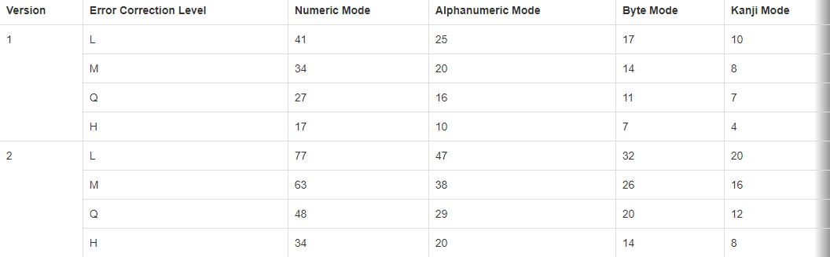
2. EXAMPLE
HELLO WORLD

Slide 6
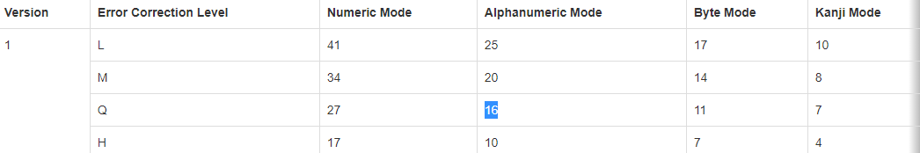
2. EXAMPLE
HELLO WORLD
Mode：Alphanumeric Length：11
Version: 1 EC-level：Q

Slide 7
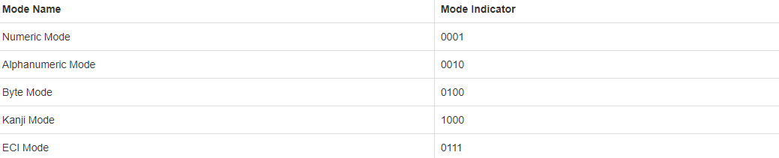
2. EXAMPLE
HELLO WORLD
Mode：Alphanumeric 0010

Slide 8
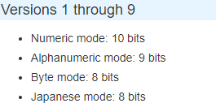
2. EXAMPLE
HELLO WORLD
Length：11 Binary：1011 Padding：000001011

Slide 9



2. EXAMPLE
HELLO WORLD
Alphanumeric Mode Encoding
https://www.thonky.com/qr-code-tutorial/alphanumeric-mode-encoding
HE, LL, O , WO, RL, D
HE：17，14；45*17+14=779；01100001011
LL：21，21；45*21+21=966；01111000110
O ：24，36；45*24+36=1116；10001011100
WO：32，24；45*32+24=1464；10110111000
RL：27，21；45*27+21=1236；10011010100
D：13；6-bits；001101
01100001011 01111000110 10001011100 10110111000 10011010100 001101

Slide 10
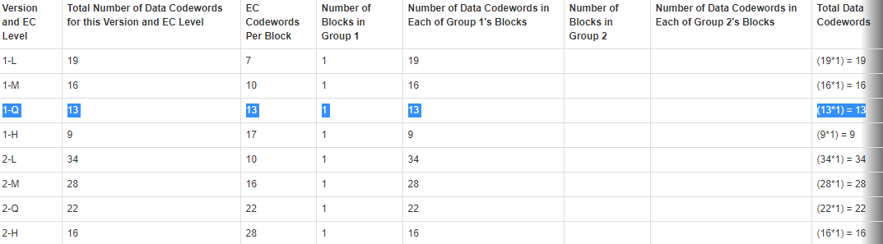
2. EXAMPLE
HELLO WORLD
a. mode+length+codewords
0010+000001011+01100001011 01111000110 10001011100 10110111000 10011010100 001101
b. padding：0和11101100、00010001 8-bit codewords!!!

Slide 11
2. EXAMPLE
HELLO WORLD
0010+000001011+01100001011 01111000110 10001011100 10110111000 10011010100 001101
4+9+11*5+6=74
Ver.1 EC-level.Q：13*8=104， 104字节数据码+104字节纠错码
1. 末尾加0补齐8
00100000 01011011 00001011 01111000 11010001 01110010 11011100 01001101 01000011 01000000
2. 末尾再凑全补齐（11101100、00010001/236、17）
00100000 01011011 00001011 01111000 11010001 01110010 11011100 01001101 01000011 01000000 11101100 00010001 11101100

Slide 12
3. Error Correction Coding
Reed-Solomon Error correction
在线生成：http://www.ujamjar.com/demo/ocaml/2014/06/18/reed-solomon-demo.html
代码下载：
https://github.com/ujamjar/reedsolomon
https://github.com/tomerfiliba/reedsolomon
解码网站（可下载程序）
https://www.nayuki.io/page/reed-solomon-error-correcting-code-decoder

Slide 13
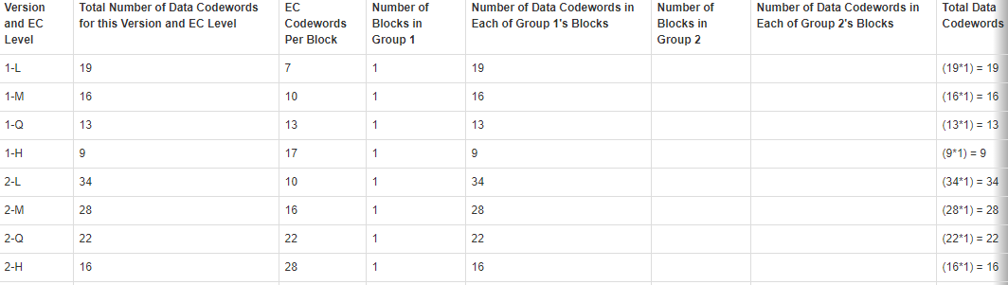
4. Structure Final Message
BLOCKs

Slide 14
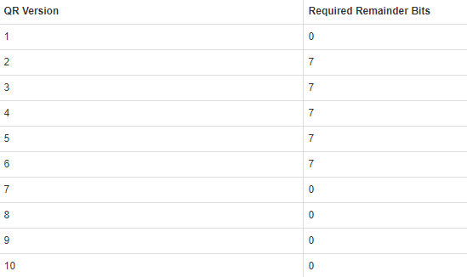
4. Structure Final Message
根据版本，再补一次0到末尾

Slide 15
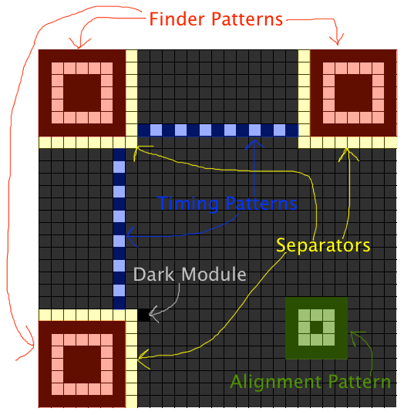
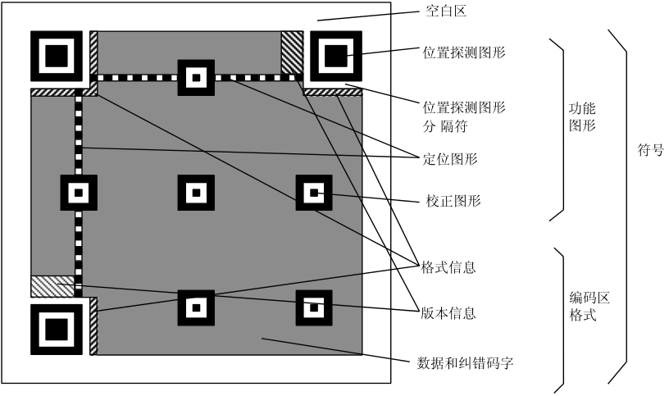
5. Module Placement in Matrix

Slide 16
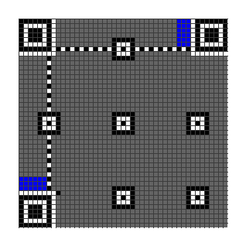
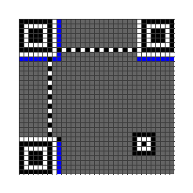
5. Module Placement in Matrix

Slide 17
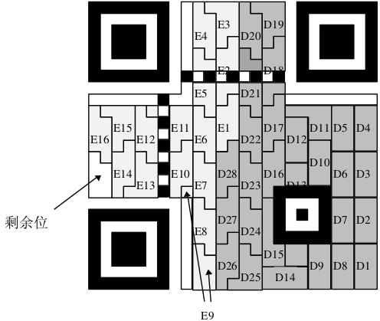
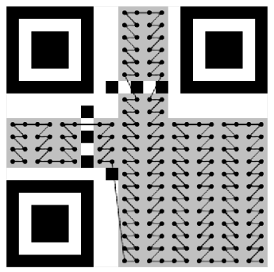
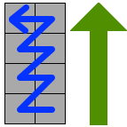
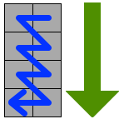
5. Module Placement in Matrix
D1-28
数据码
E1-16
纠错码
剩余位
00...0

Slide 18
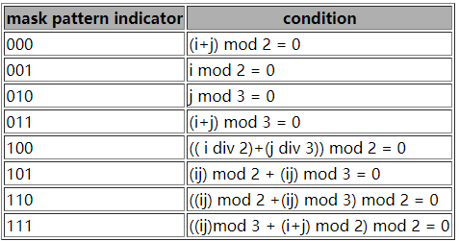
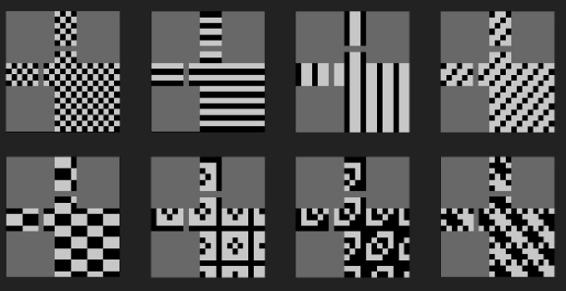
6. Data Masking

Slide 19
6. Data Masking

Slide 20
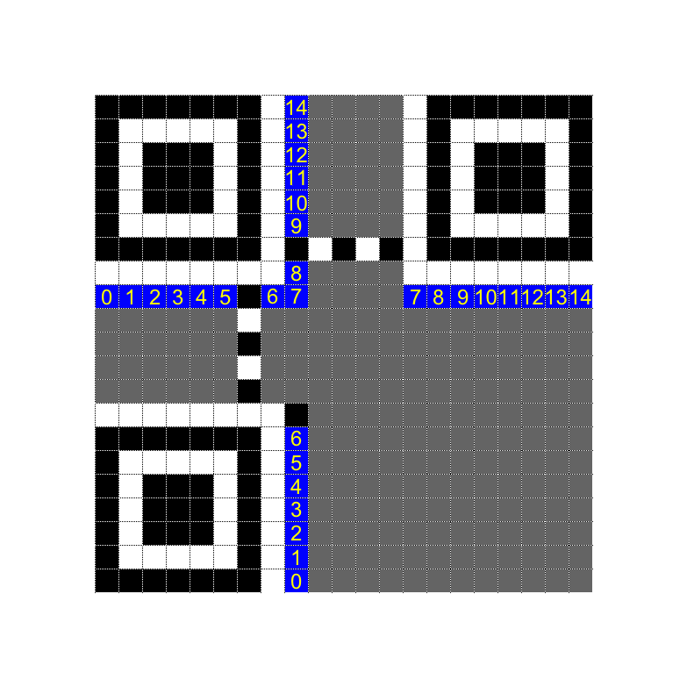
7. Format and Version Information
Format Information：
https://www.thonky.com/qr-code-tutorial/format-version-tables
Version>6，insert version information

Slide 21
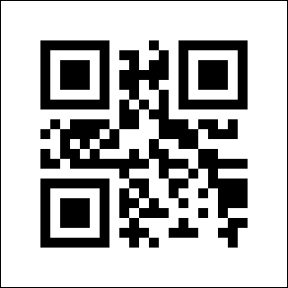
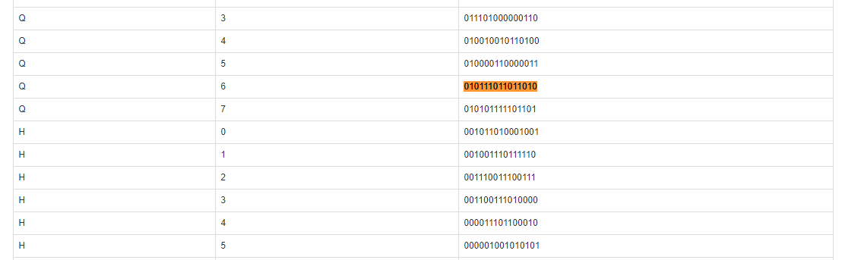
7. EXAMPLE
HELLO WORLD
EC-LEVEL:Q
MASK：6
Format Information：
010111011011010

