Slide 1
Gamma Correction with vcc-gamma
VCC Lab.
Apr. 25 2017

Slide 3
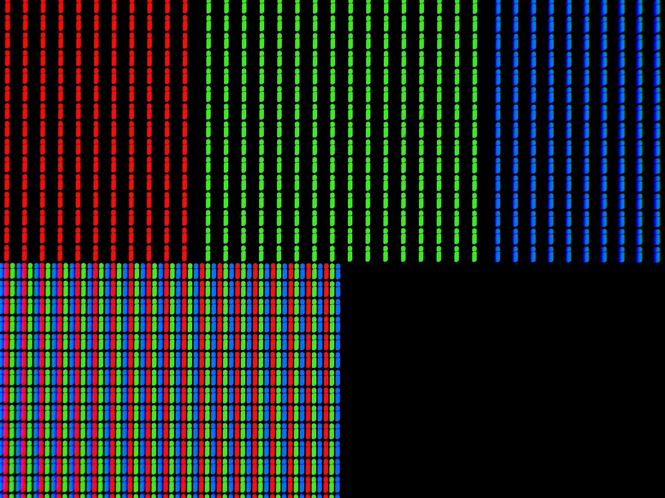
One Pixel
[R, G, B]

Slide 4
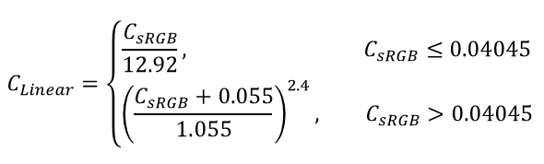
sRGB Color Profile
sRGB
$$C_{Linear}=\left\{\begin{aligned}\frac{C_{sRGB}}{12.92}, C_{sRGB}≤0.04045 \\ {\left(\frac{C_{sRGB}+0.055}{1.055}\right)}^{2.4}, C_{sRGB}>0.04045\end{aligned}\right.$$
Linear
100%
96%
4%
0%

Slide 5
Camera → Image File → Monitor
0.5
189
255
189
255
0.5
Camera
Image File
Computer
Monitor
128
255
0.5

Slide 6
Gamma Table (Linear)
128
255
128
128
255
0.2
128
Computer
Monitor
128
255
0.5

Slide 7
Gamma Table (Corrected)
189
255
189
128
255
0.5
128
Computer
Monitor
128
255
0.5

Slide 8


sRGB, Gamma 2.2, Gamma 1.8
$$C_{Linear}=C^{1.8}$$
$$C_{Linear}=C^{2.2}$$

Slide 9
Calibration: Measuring Luminance
[0, 0, 0]
[1, 0, 0]
[0, 1, 0]
[0, 0, 1]
[2, 0, 0]
[0, 2, 0]
[0, 0, 2]
…
…
…

Slide 10
Calibration: Building Gamma Table
86 measures
86 measures

Slide 11
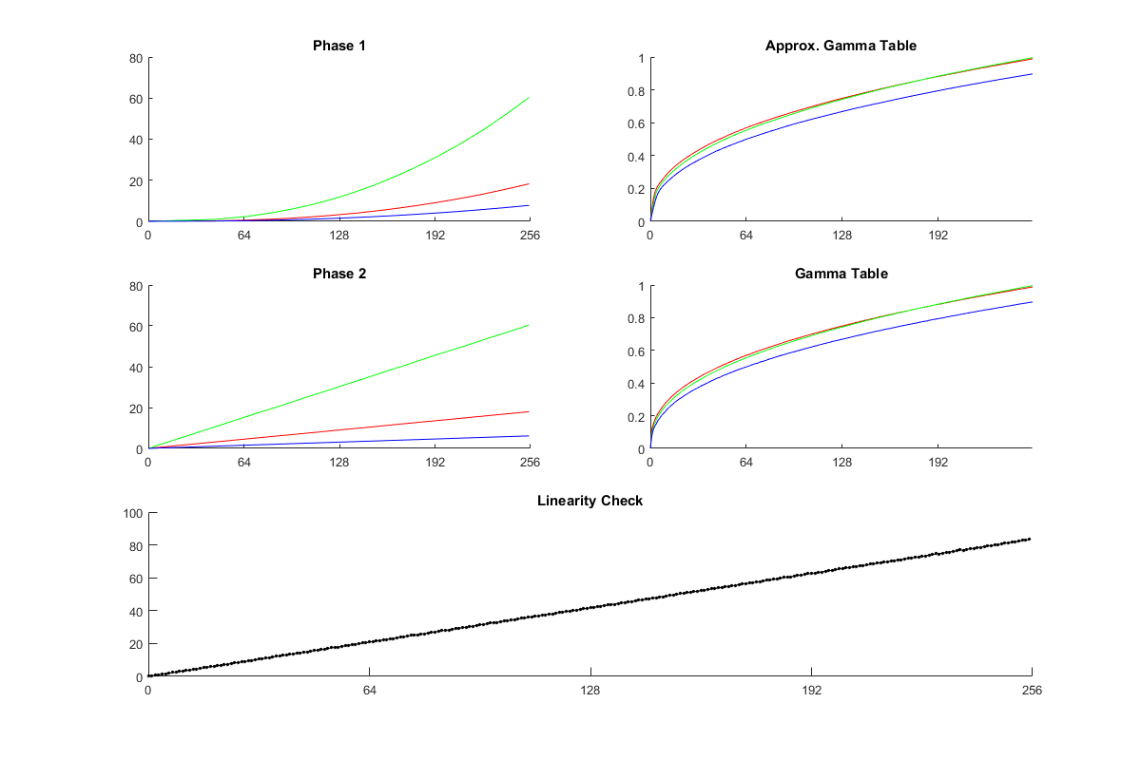
Two-phase Calibration

Slide 12
MATLAB Snippets
https://github.com/oakyoon/vcc-gamma
‘Set Path’
ApplyGammaTable;
ApplyGammaTable(TargetLum_Linear);
ApplyGammaTable(TargetLum_sRGB);
ResetGammaTable;
RunQuickTest;
RunFullCalibration;

