Slide 1
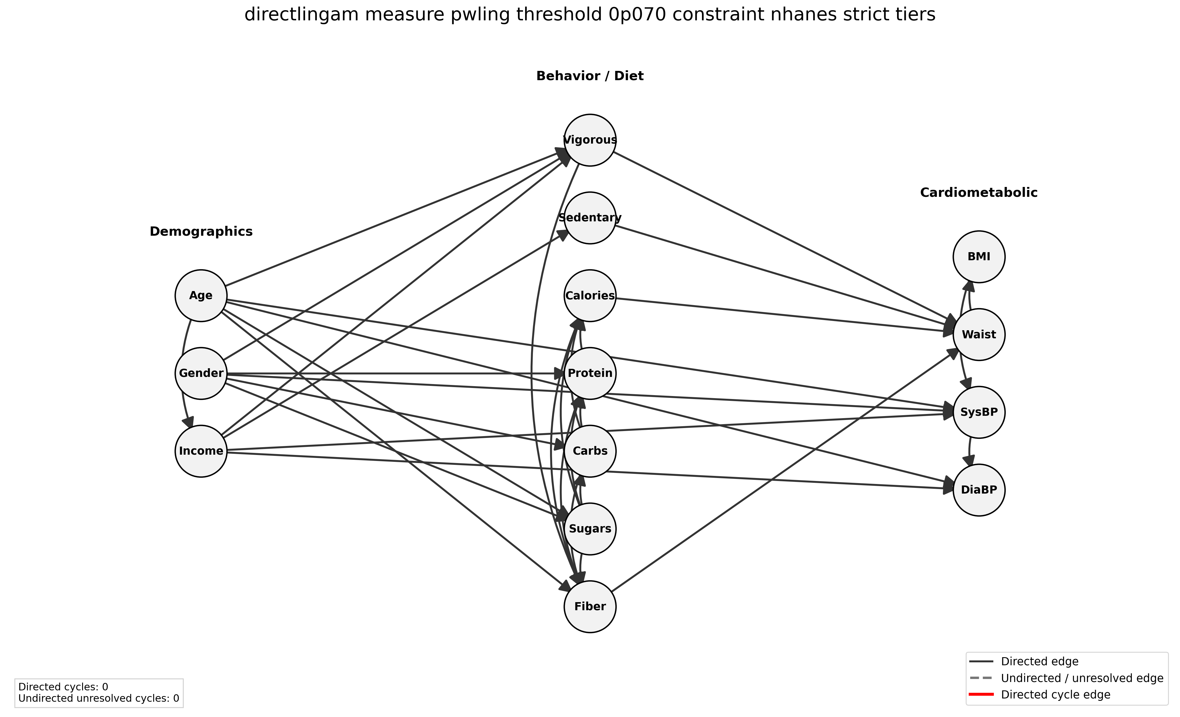
Causal Discovery and ATE Estimation on NHANES
Technical Project Presentation u^{b}
Ömer Alkaya July 2026
03.07.2026
1

Slide 2
Project framing
Goal
Estimate total effects of predefined activity and dietary treatments on BMI under a selected causal DAG.
1
NHANES dataset preprocessing
utils/preprocess_nhanes.py
2
Causal discovery with PC, DirectLiNGAM, and RESIT
scripts/run_pc.py, scripts/run_directlingam.py, scripts/run_resit.py
3
Graph inspection and DAG selection
utils/check_treatment_paths.py, utils/visualize_graph_csv.py
4
Treatment-specific adjustment-set identification
utils/find_adjustment_sets.py
5
ATE estimation on BMI with DoWhy
scripts/run_inference.py
Overview
03.07.2026
2

Slide 3
NHANES preprocessing
Main exclusions
Measure | Count
Original observations | 3,842
Dropped observations | 42
Clean observations | 3,800
15 rows with sedentary minutes = 9999
27 rows with implausible diastolic BP near 0
No missing/infinite values retained
Causal discovery scripts standardize all variables; inference keeps BMI in original units and rescales only continuous treatments for interpretable ATEs.
Data
03.07.2026
3

Slide 4
Chosen causal discovery methods
Family | Representative method | Identifying idea
Constraint-based | PC | Conditional independences + Markov/faithfulness
Linear non-Gaussian | DirectLiNGAM | Acyclic linear SEM with non-Gaussian noise
Nonlinear additive noise | RESIT | Regress causes/effects and test residual independence
Methods
03.07.2026
4

Slide 5
Graph selection criteria for downstream inference
Acyclicity
Backdoor identification and DoWhy estimation require a DAG.
Temporal plausibility
Baseline variables should not be caused by later health measurements.
Treatment connectivity
Each predefined treatment should be an ancestor of BMI.
Sparsity
Denser graphs can imply more backdoor paths and therefore larger adjustment sets. Conditioning on more variables creates increasingly specific covariate groups, within which some treatment levels may be rare or absent. This weakens overlap and makes estimation rely more on extrapolation.
Graph selection
03.07.2026
5

Slide 6
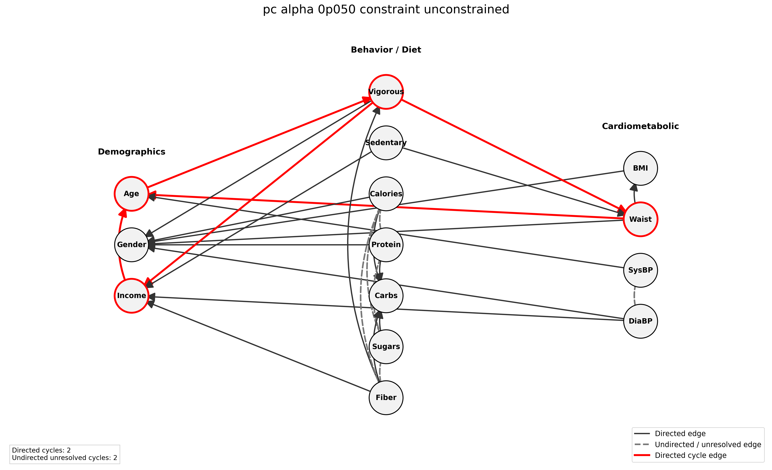
Unconstrained PC
Observed issue
PC learns a skeleton first and orients only what the data identify.
Cross-sectional NHANES does not determine many directions unambiguously.
Some orientations put BMI/BP upstream of diet, behavior, or demographics.
Those graphs are not suitable for the planned treatment-to-BMI ATE queries.
Unconstrained PC at α = 0.05
Graph discovery
03.07.2026
6

Slide 7
Moderate constraints
Initial constraints forbid later-tier variables from causing earlier-tier variables, while allowing same-tier edges.
Tier | Group | Variables
0 | Demographic | Age, Gender, Income Ratio
1 | Behavioral and dietary | Vigorous Activity, Sedentary Minutes, Total Calories, Protein, Carbohydrates, Total Sugars, Dietary Fiber
2 | Cardiometabolic | BMI, Waist Circumference, Systolic BP, Diastolic BP
Constraint implementation differs by method
PC: forbidden and required direct relations through causal-learn background knowledge.
DirectLiNGAM/RESIT: forbidden directions through no_paths prior knowledge, which forbids ancestry rather than only a direct edge.
Constraints
03.07.2026
7

Slide 8
Moderate constraints
The table shows examples that expose the main trade-offs.
Method | Setting | Edges | All paths | Main observation
PC | α = 0.05 | 26 | No | Sparse, but no treatment-to-BMI paths
PC | α = 0.70 | 38 | No | Vigorous Activity connected; dietary treatments not all connected
DirectLiNGAM | threshold 0.060 | 41 | Yes | All paths present, but still fairly dense
DirectLiNGAM | threshold 0.070 | 35 | No | Sparser, but Total Calories path disappears
RESIT | α = 0.001 | 84 | Yes | Connected, but close to saturated
Moderate constraints improved direction plausibility, but no candidate combined low edge count with all four treatment-to-BMI paths.
With 14 variables, the maximum DAG density is 91 directed edges; the representative RESIT graph has 84.
Graph discovery
03.07.2026
8

Slide 9
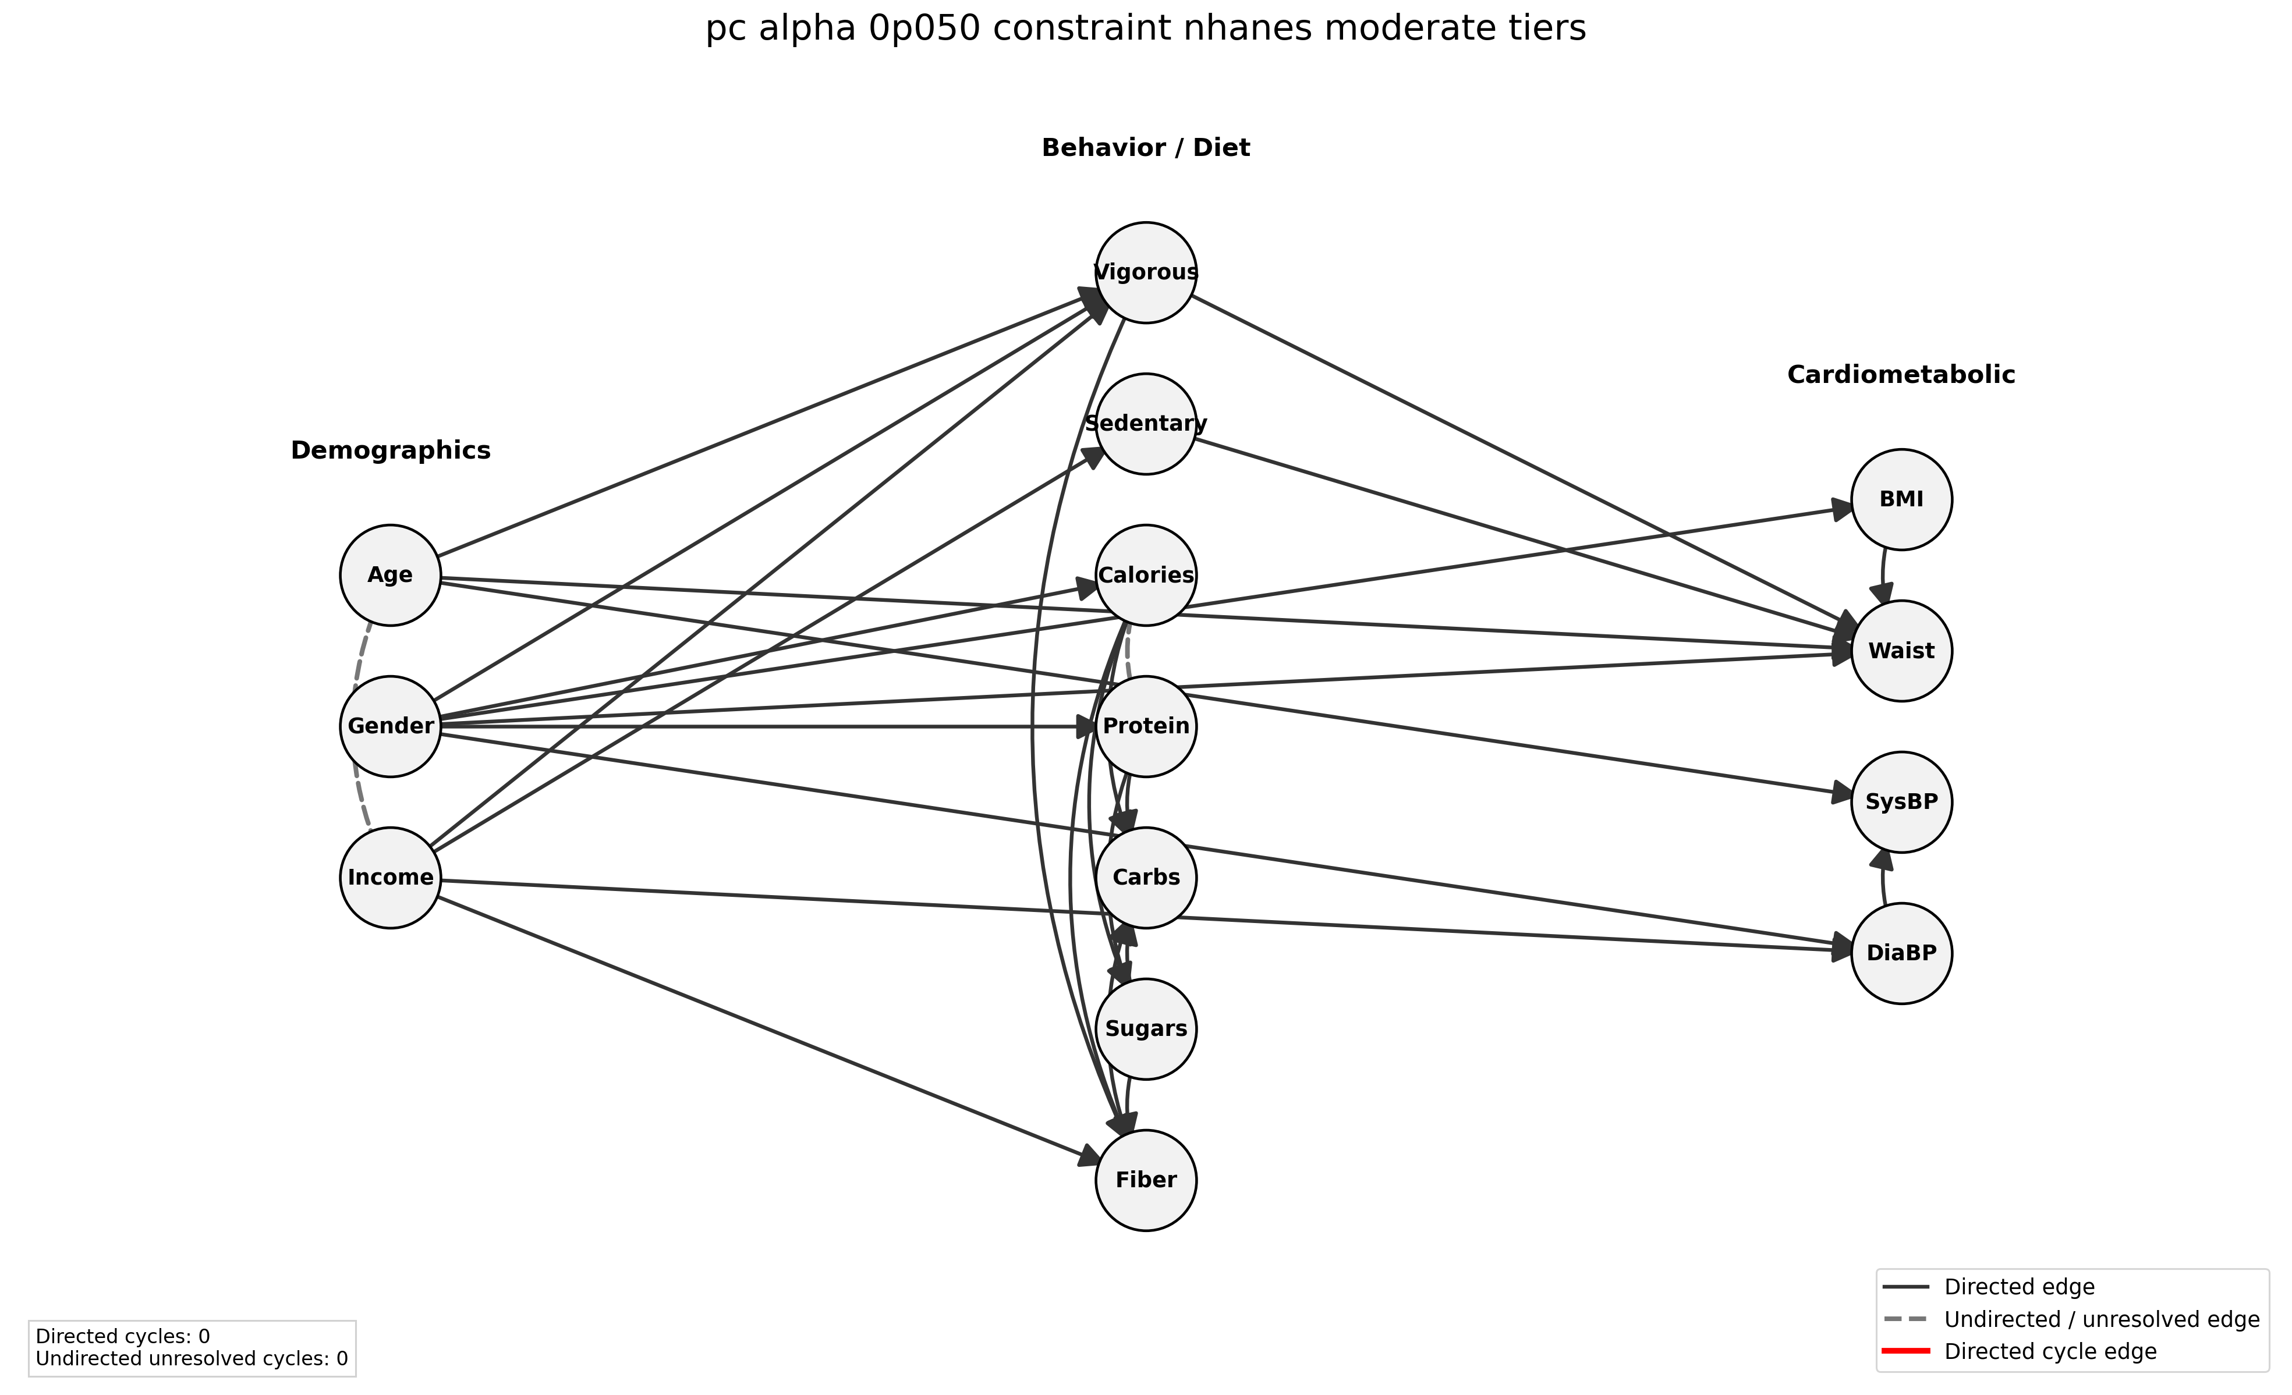
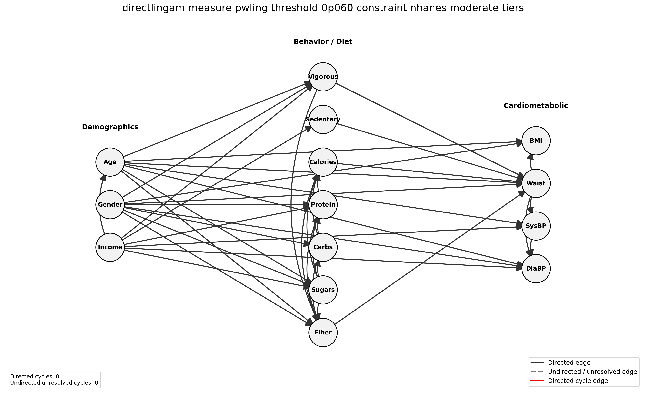
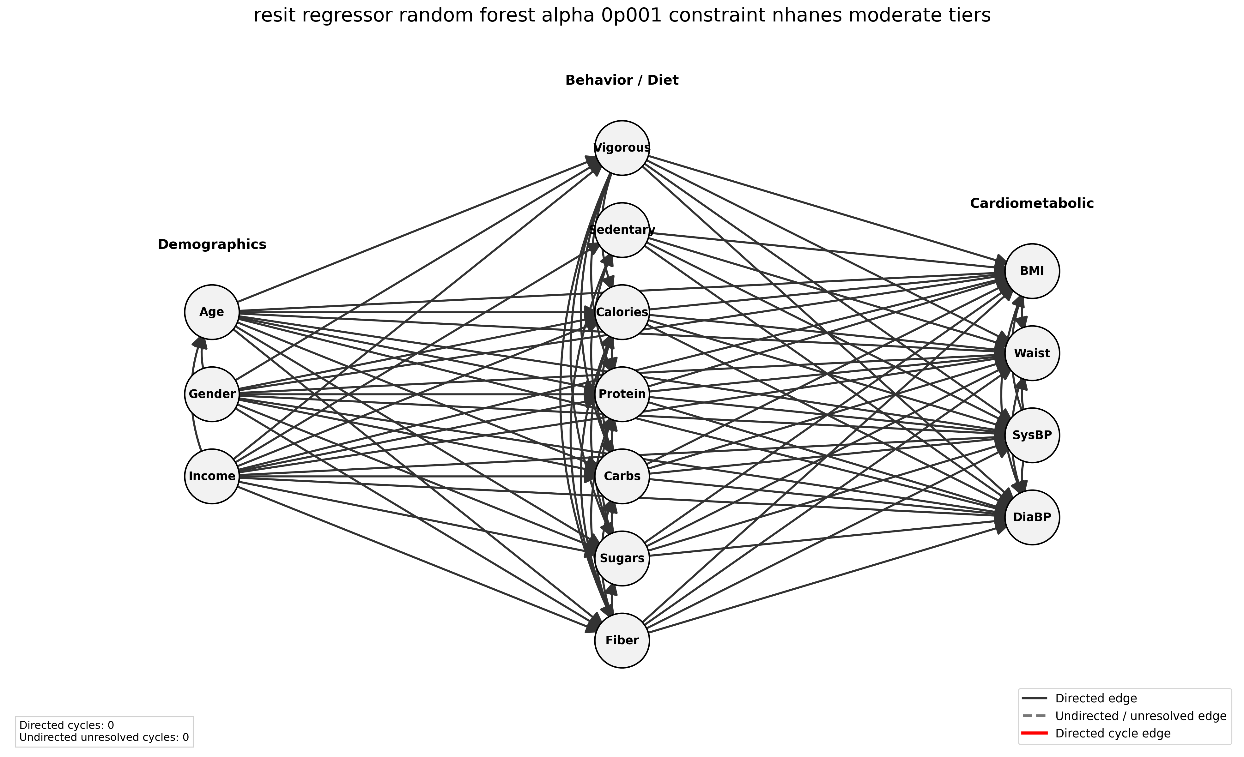
Moderate constraint graph examples
PC, α=0.05 26 edges, no paths
DirectLiNGAM, thr=0.060 41 edges, all paths
RESIT, α=0.001 84 edges, all paths
Graph discovery
03.07.2026
9

Slide 10
Strict constraints (and example graphs)
Tier | Group | Variables
0 | Demographics | Age, Gender
1 | Socioeconomic | Income Ratio
2 | Behavior and diet | Vigorous Activity, Sedentary Minutes, Calories, Protein, Carbohydrates, Sugars, Fiber
3 | Body measurements | Waist Circumference, BMI
4 | Blood pressure | Systolic BP, Diastolic BP
Method | Setting | Edges | All paths | Assessment
PC | α = 0.01 | 24 | No | Carbohydrates path missing
PC | α = 0.70 | 37 | No | Total Calories path missing
RESIT | α = 0.001 | 84 | Yes | Near-saturated
DirectLiNGAM | threshold 0.070 | 33 | Yes | Selected
DirectLiNGAM | threshold 0.080 | 27 | No | Only activity path remains
Additional forbidden directions favored graphs where the selected treatments remain upstream of BMI and retain directed paths to it.
Final choice: DirectLiNGAM threshold 0.070 — 33 edges, acyclic, all four treatment paths.
Graph selection
03.07.2026
10

Slide 11
Selected DAG: strict constraint DirectLiNGAM at threshold 0.070
Why this graph?
Acyclic graph with 14 nodes
33 directed edges
All four treatment variables have directed paths to BMI
Substantially less dense than all-path RESIT candidates
Selected graph
03.07.2026
11

Slide 12
Adjustment sets
A custom script generates the possible minimal adjustment sets for each treatment, from which one can be selected for the ATE estimation.
Construct the treatment-specific backdoor graph by removing outgoing treatment edges.
Define eligible variables as ancestors of treatment or outcome, excluding treatment descendants.
Enumerate candidate subsets and test d-separation.
Retain only inclusion-minimal valid backdoor adjustment sets.
Treatment | Manual set | DoWhy auto-selected set
Vigorous Activity | Age, Gender, Income Ratio | Age, Gender, Sedentary Minutes
Total Calories | Dietary Fiber, Income Ratio, Vigorous Activity | Dietary Fiber, Sedentary Minutes, Vigorous Activity
Protein | Carbohydrates, Gender, Total Sugars | Same
Carbohydrates | Gender, Total Sugars | Same
Manual sets are validated against the selected DAG before estimation: no treatment/outcome, no treatment descendants, and d-separation in the backdoor graph.
Adjustment sets
03.07.2026
12

Slide 13
DoWhy estimation
Treatment | Type | Reported contrast
Vigorous Activity | Binary | 0 → 1
Total Calories | Continuous | +100 kcal
Protein | Continuous | +10 g
Carbohydrates | Continuous | +10 g
Modeling choices
Identification: backdoor adjustment from selected DAG automatically or supplied manual set
Estimator: backdoor.linear_regression
Target: target_units="ate"
Continuous treatments rescaled before fitting
effect_modifiers=[] to prevent automatic CATE/interaction expansion
Inference
03.07.2026
13

Slide 14
ATE estimates from the selected DAG
Treatment | Set | ATE | 95% CI | p
Vigorous Activity | Manual | -1.696 | [-2.252, -1.140] | 2.40e-09
 | Auto | -1.778 | [-2.320, -1.236] | 1.39e-10
Total Calories | Manual | 0.0316 | [0.0057, 0.0575] | 0.0166
 | Auto | 0.0266 | [0.0009, 0.0523] | 0.0425
Protein | Manual & Auto | 0.0446 | [-0.0194, 0.1086] | 0.172
Carbohydrates | Manual & Auto | -0.0349 | [-0.0682, -0.0016] | 0.0399
Interpretation
Vigorous Activity has the largest estimated effect. Calories show a small positive effect. Protein estimate is small and positive. The carbohydrate estimate is small and negative.
Results
03.07.2026
14

Slide 15
Takeaways
Main takeaways
Constraints were necessary to obtain graphs compatible with the treatment-to-BMI causal questions.
Strict conditioning on DirectLiNGAM at threshold 0.070 balanced treatment connectivity and graph density.
Manual and automatic adjustment sets produced similar estimates for the selected DAG.
Thank You!
Conclusion
03.07.2026
15

