Slide 1
IEE 222 - Tutorial
Tutorial 1: Graphical Method

Slide 2
Introduction
Name: Osama Alotaik, PhD د. أسامة العتيك
Office: N/A (yet)
Email: oalotaik@ksu.edu.sa
GitHub profile: https://github.com/oalotaik
Grading: Homework + Lab 10%

Slide 3
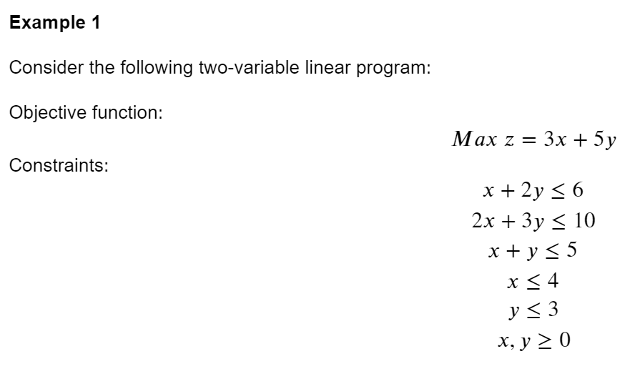

Slide 4

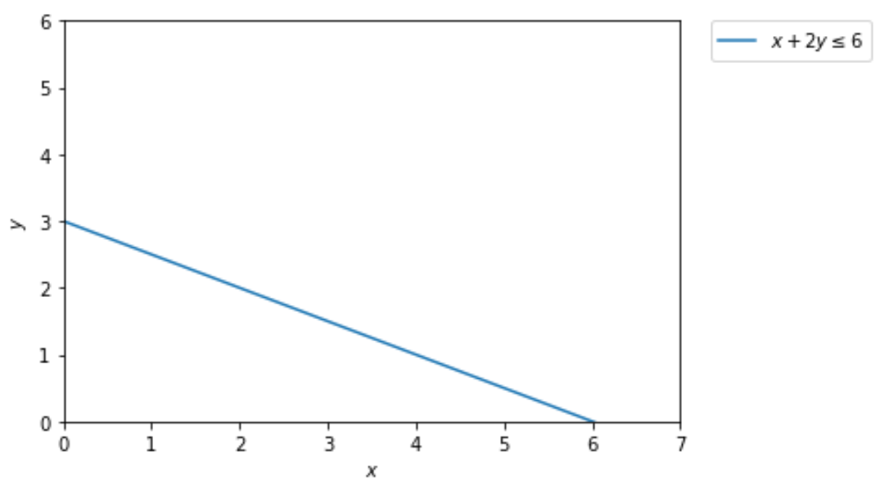
Tip: draw equations for the inequalities, i.e. set ≤,𝑜𝑟≥ as =
For each equation find two points by 1- setting x = 0 and then finding y (0, y), and 2- setting y = 0 and then finding x (x, 0). Now you have two points (0, y) and (x, 0). Connect them with a line.

Slide 5

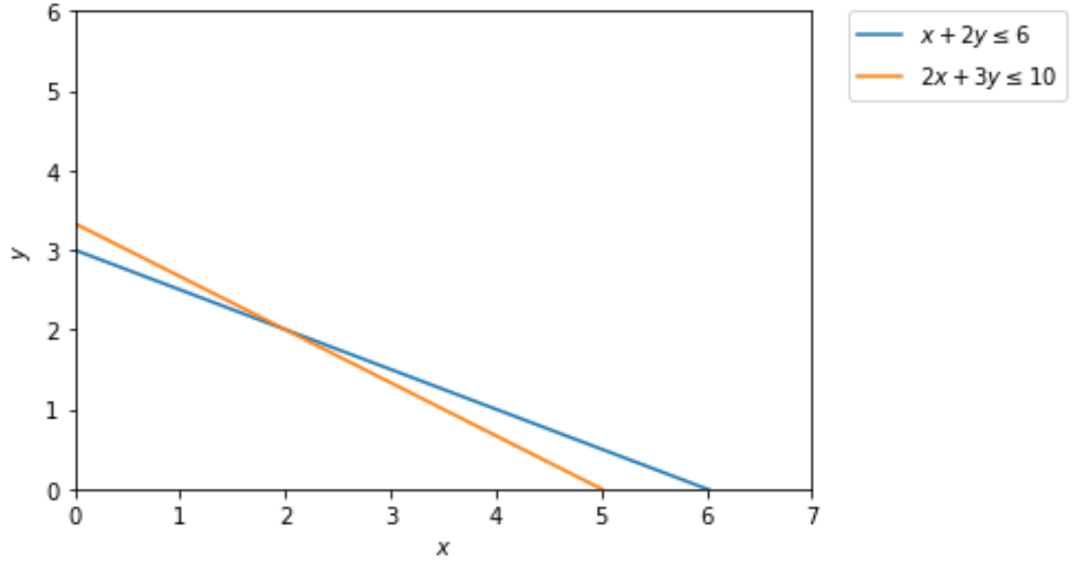

Slide 6

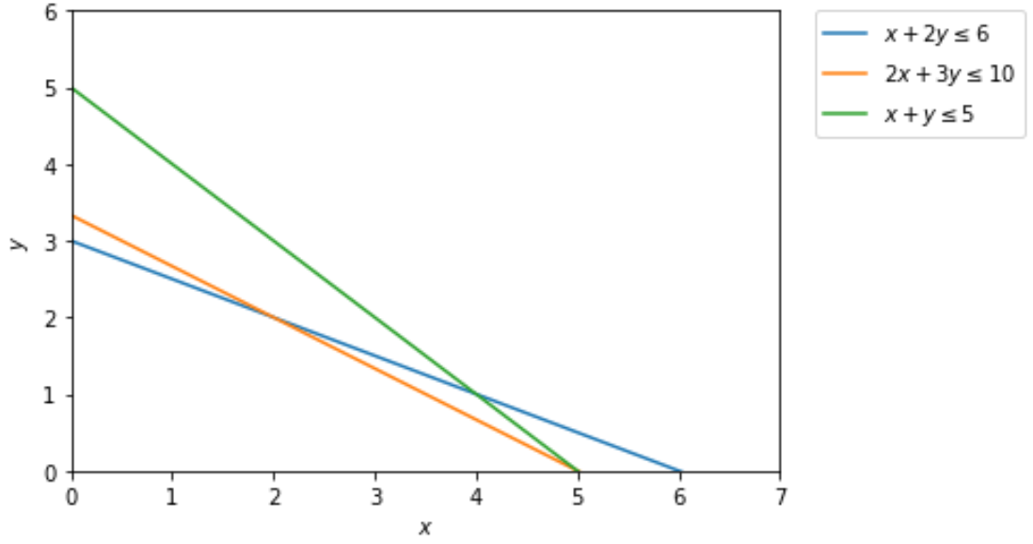
Note: this constraint is a redundant constraint because it does not make the feasible region smaller.

Slide 7

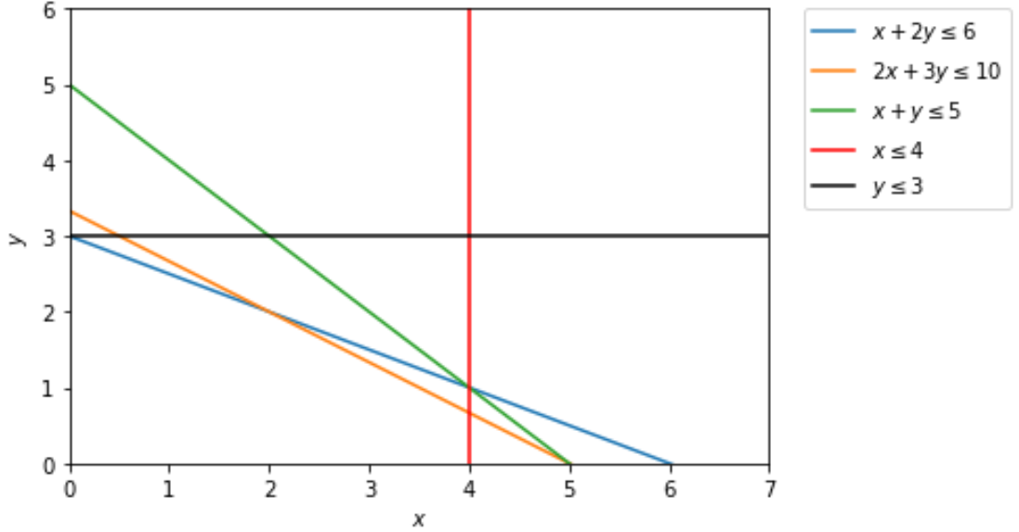
Feasible Region: the region that satisfies all the inequalities

Slide 8
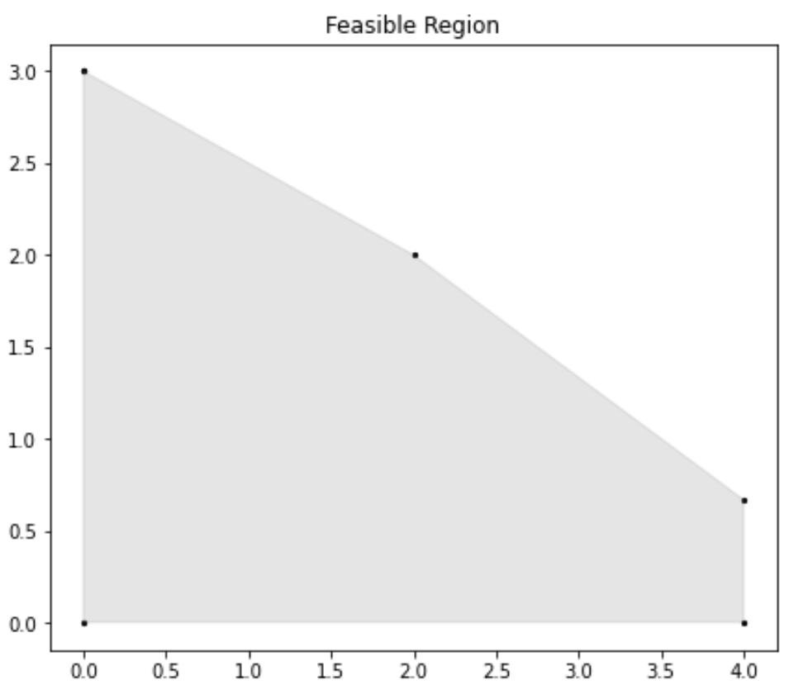
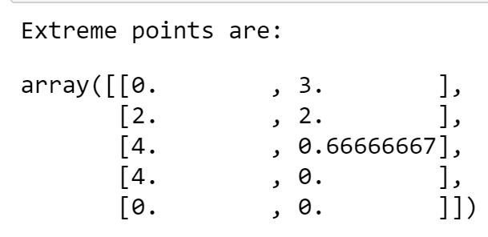


Slide 9
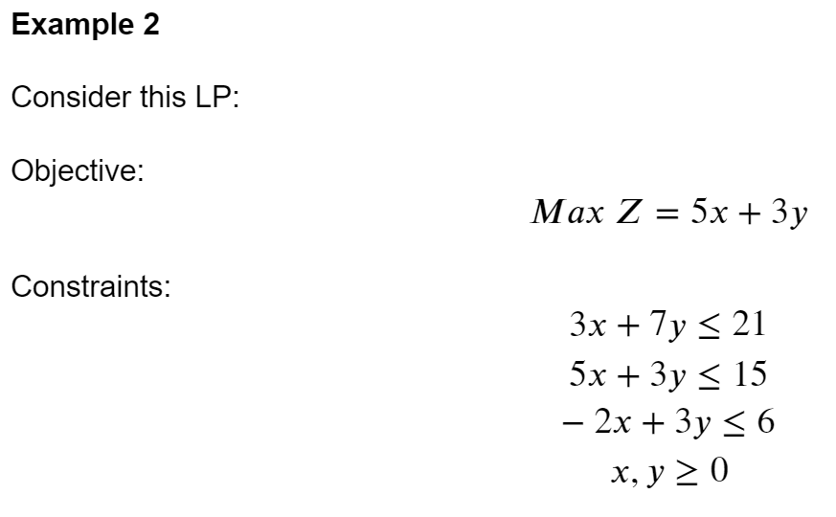

Slide 10

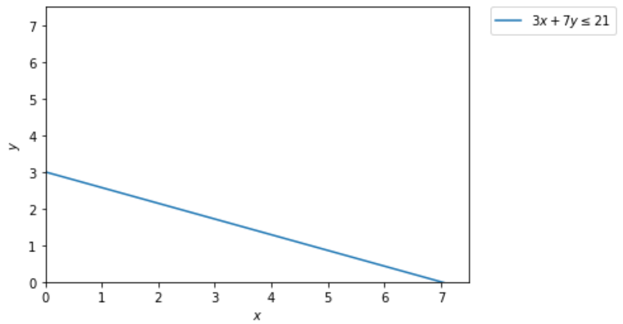

Slide 11
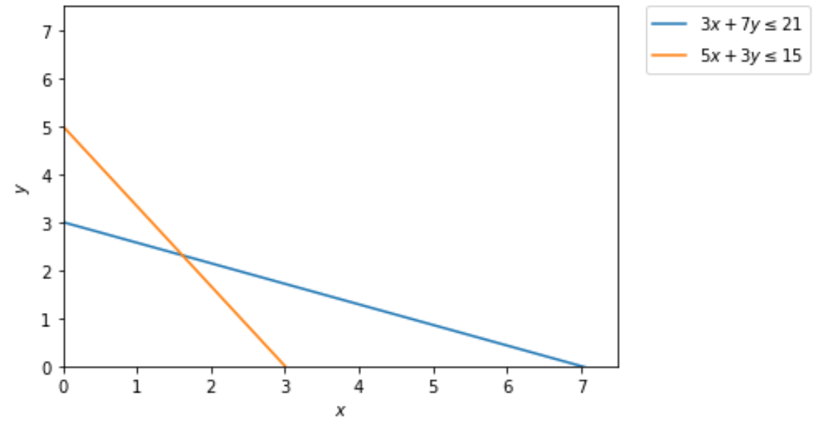

Slide 12
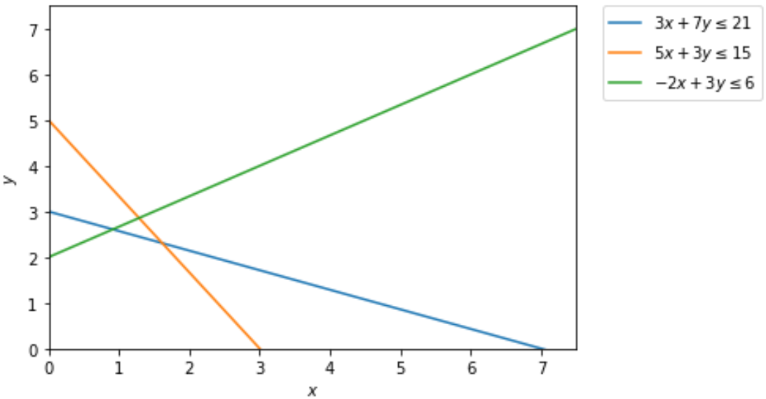

Slide 13
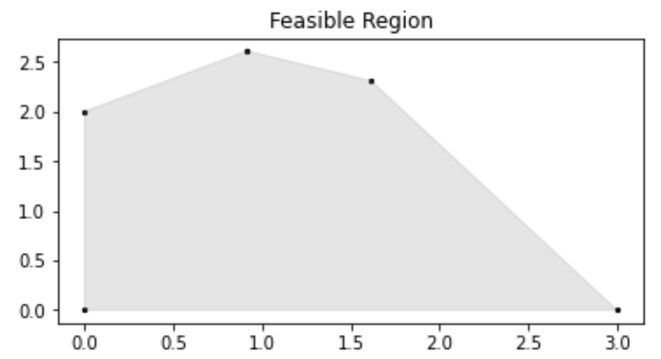
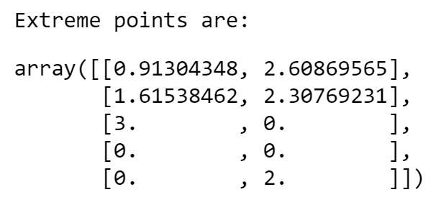


Slide 14
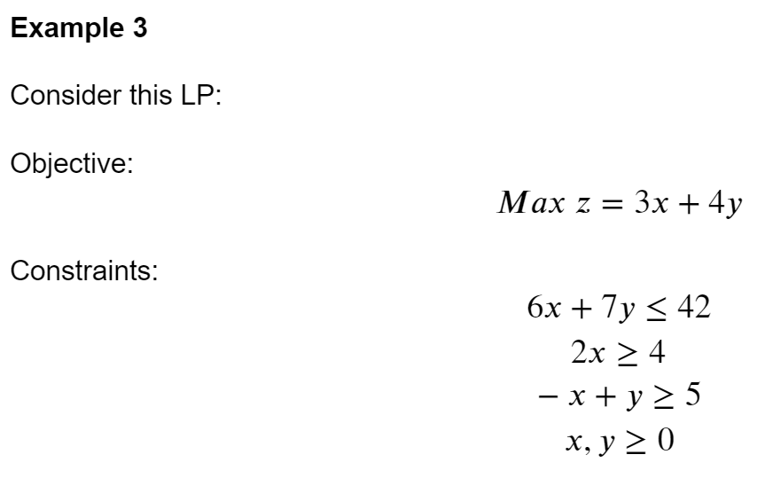

Slide 15
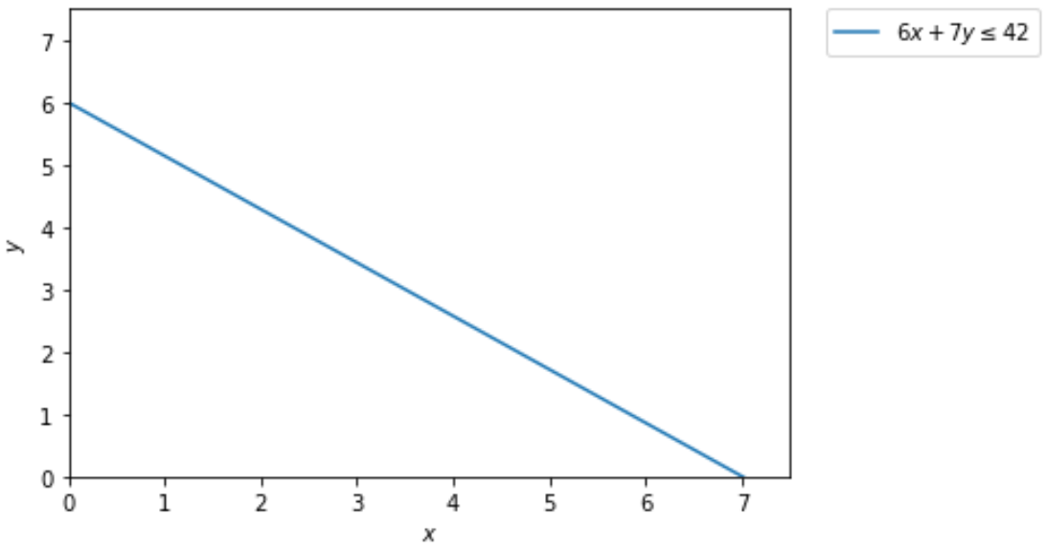

Slide 16

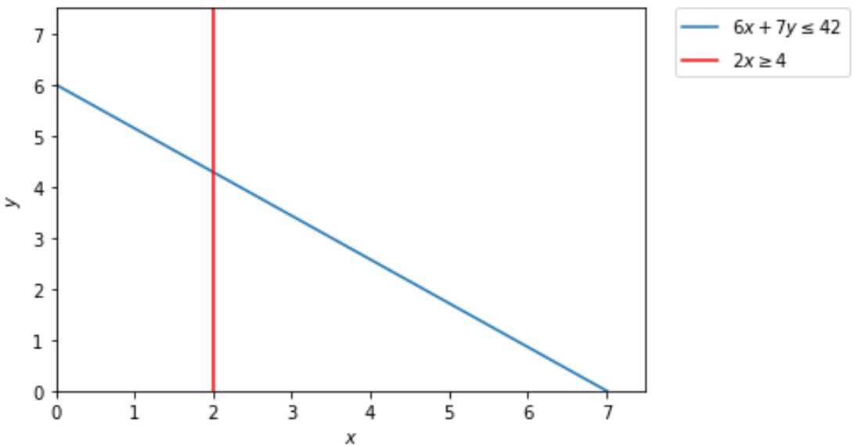

Slide 17

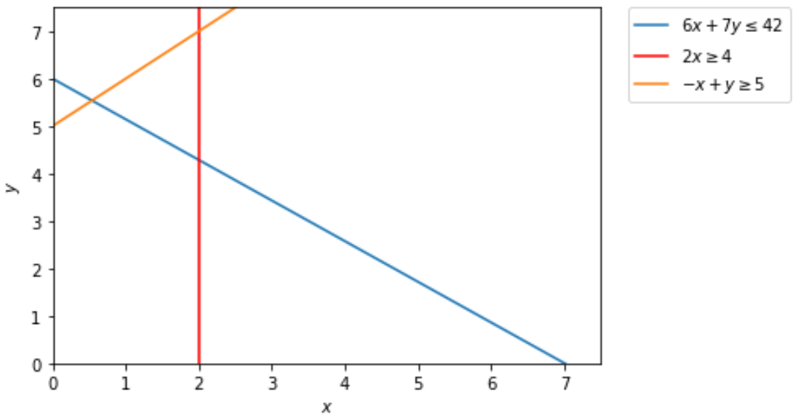

Slide 18
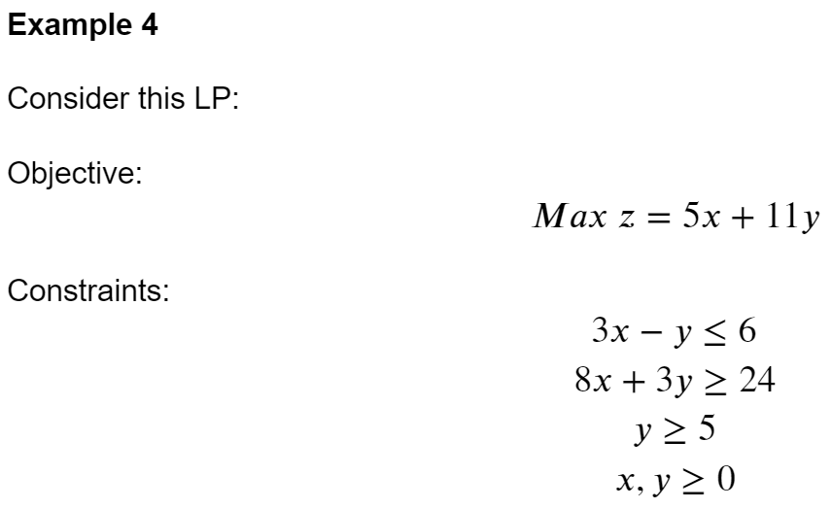

Slide 19
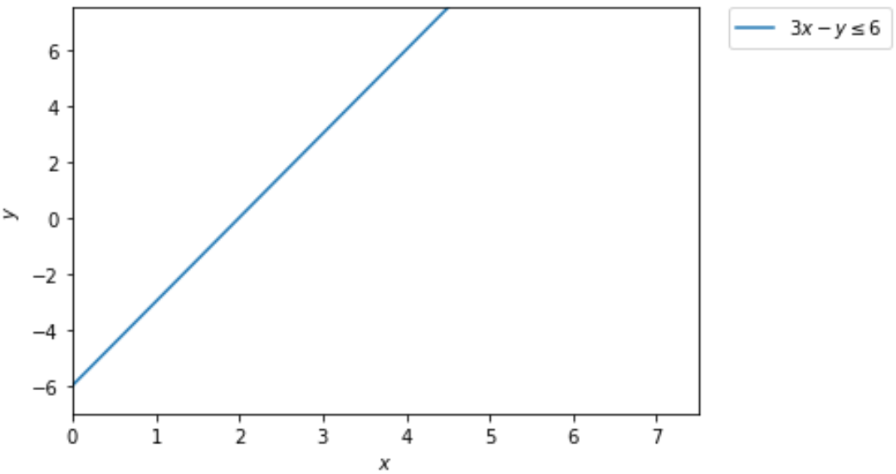

Slide 20

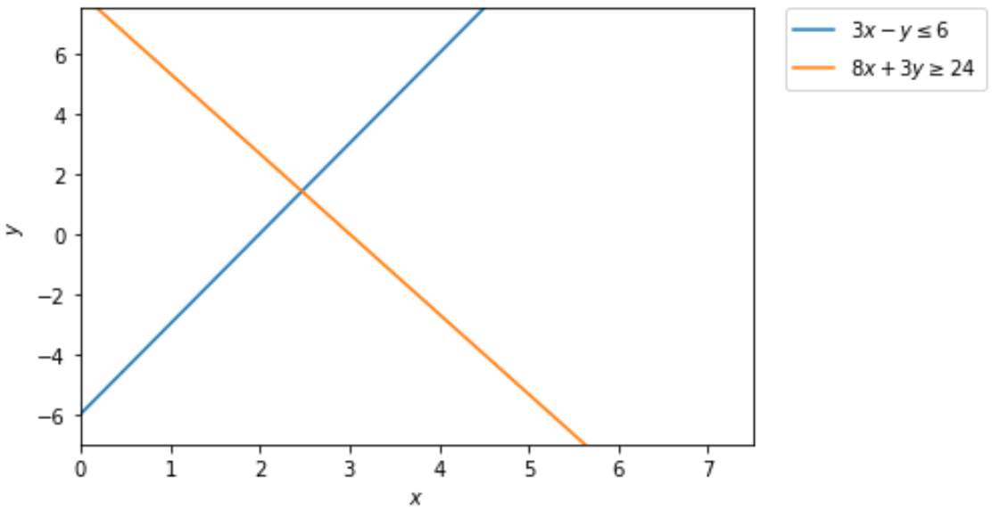

Slide 21
