Slide 1
IEE 222 - Tutorial
Tutorial 2: Simplex Method

Slide 2
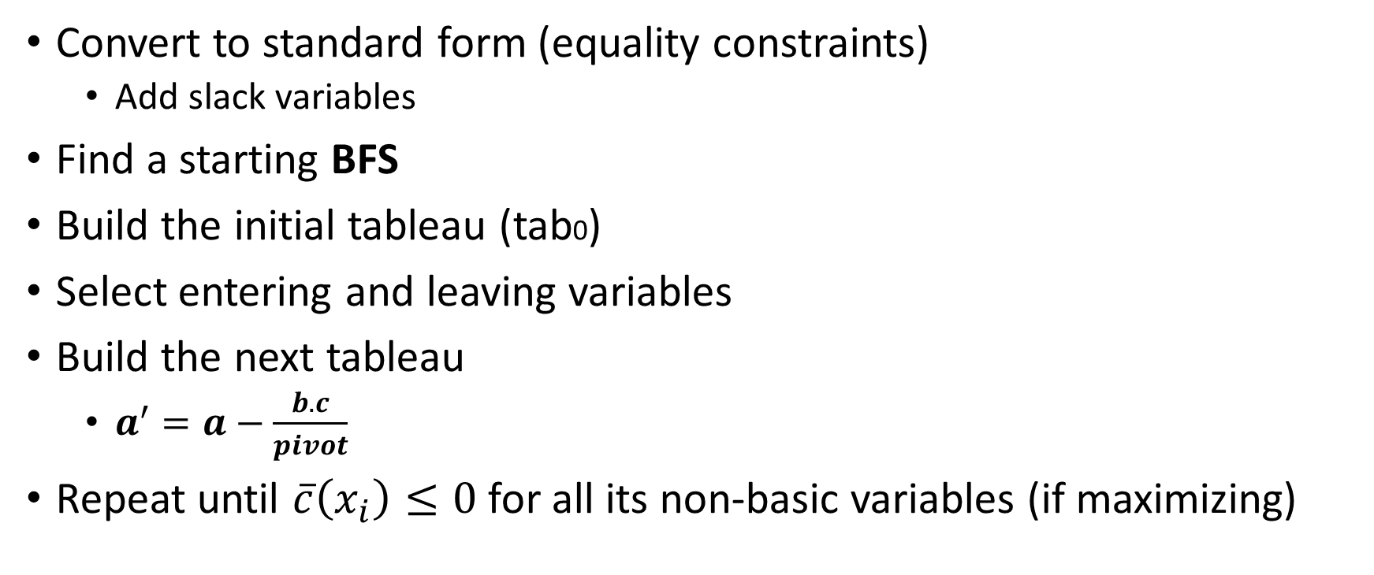
Steps
Convert to standard form (equality constraints)
Add slack variables
Find a starting BFS
Build the initial tableau (tab0)
Select entering and leaving variables
Build the next tableau
$a^{′}=a−\frac{b.c}{pivot}$
Repeat until $\overline{c}\left(x_{i}\right)≤0$ for all its non-basic variables (if maximizing)

Slide 3
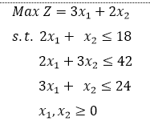
Problem 1

Slide 5
Basis | X₁ | X₂ | S₁ | S₂ | S₃ | RHS | Ratio
Basis | X₁ | X₂ | S₁ | S₂ | S₃ | RHS | Ratio

Slide 6
Basis | X₁ | X₂ | S₁ | S₂ | S₃ | RHS | Ratio
Basis | X₁ | X₂ | S₁ | S₂ | S₃ | RHS | Ratio

Slide 7
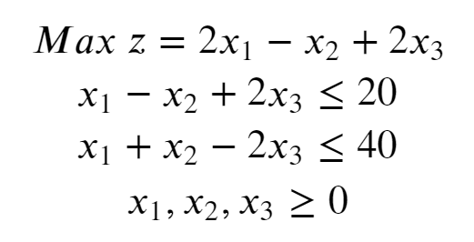
Homework
Provide the optimal solution (value of variables and objective function)
Are there multiple optimal solutions?

