Slide 1

Group Nine – Contact Manager
Quynh, Reagan, Alan, Ossama, Jared, Aaron

Slide 2
Team Members
Quynh- Database/Front End
Jared- Database/Back End
Ossama- Back End
Aaron- Back End
Reagan- Project Manager/Front End
Alan- Front End

Slide 3
Technology Used
GitHub
GoDaddy
Trello
Evernote
Discord
LAMP
MySQL
PHP
JavaScript
HTML
ARC

Slide 4
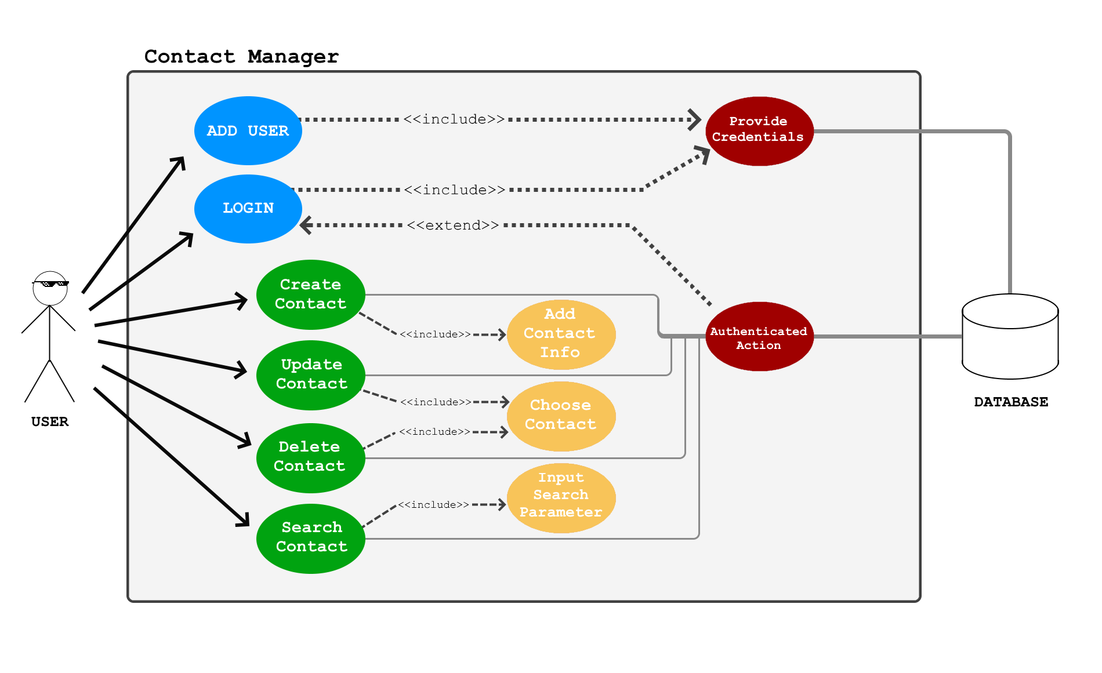
Use Case Diagram

Slide 5
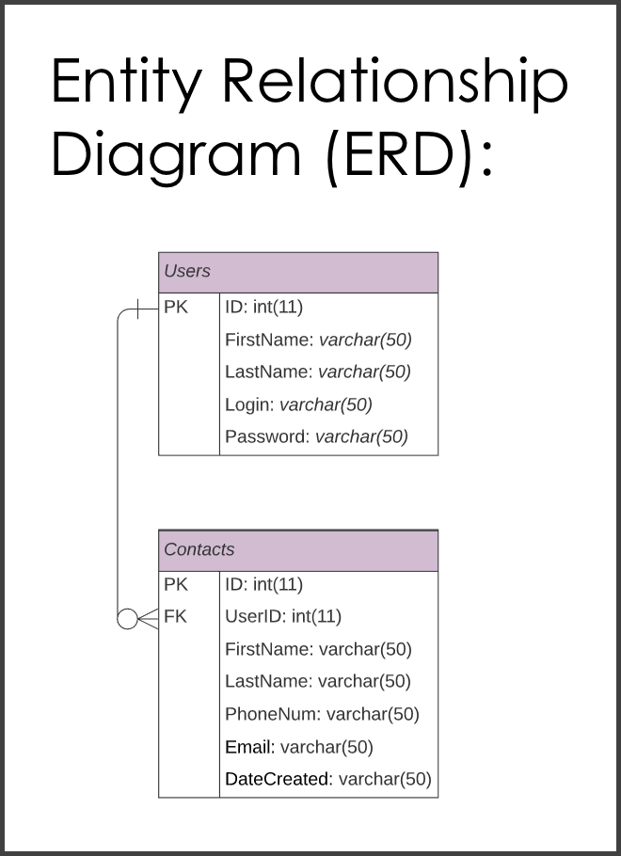

Slide 6
Things That Went Well
The group got along well
Relatively easy to find time to meet
Motivation was high
Fast response from the group

Slide 7
Things That Did Not Go Well
User error on GitHub, leading to confusion version control
Confusion on variable names between JS and PHP
Lengthy trial and error for SearchContact.php returning data as JSON object arrays

Slide 8
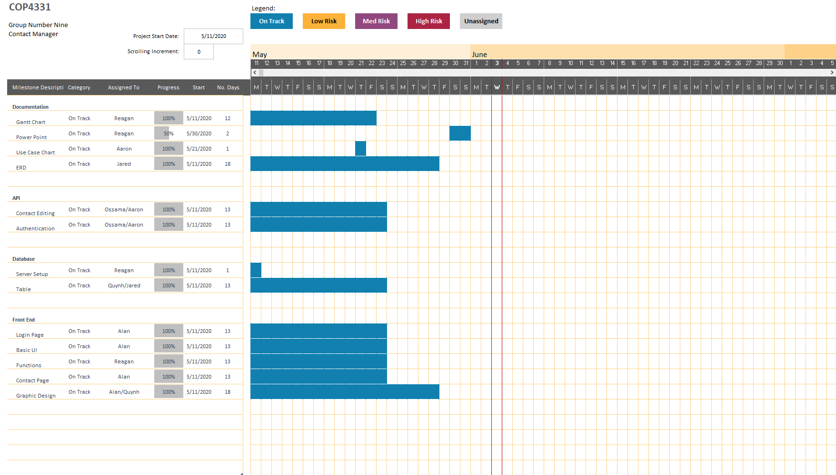
Gantt Chart

Slide 9
API Demo

Slide 10
App Demo
http://cop4331-9.us/

Slide 11
Questions?

