Slide 1


Slide 2
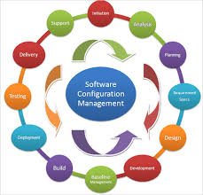
Configuration Management

Slide 3
Configuration Management Tools
Configuration management tools manage all configuration items in a software for all environments.
These configuration items can be software application files, software packages, and software installations which need to be configured for specific environments.
Configuration management tools cover both, software and server configurations.
They help enforce standardization in software configurations without any errors.
They also help to reduce the time taken to manage configurations manually on each server.

Slide 4
Purpose of Configuration Management Tool
Helps to manage software configurations effectively
Helps to remove manual errors while performing configuration changes for application software
Helps to manage configurations in multiple environments
CM tools can be used to deploy application source codes across vast infrastructure

Slide 5
Role of Infrastructure as Code in DevOps Environment
Modern way to manage configuration items
Admins can manage multiple environments with infrastructure scripts/codes
Easy to integrate with version control and share with others
Considered an essential component of DevOps

Slide 6
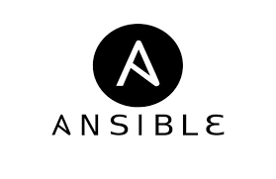
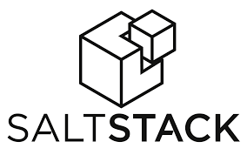


Popular Configuration Management Tools

Slide 7
Introduction to Ansible

Slide 8
What is Ansible?
Ansible is an open-source IT Configuration Management, Deployment & Orchestration tool. It aims to provide large productivity gains to a wide variety of automation challenges. This tool is very simple to use yet powerful enough to automate complex multi-tier IT application environments.

Slide 9
Why Do We Need Ansible?
Previously, system administrators managed servers by hand, installing software, changing configurations, and administering services on individual servers.

Slide 10
Ansible terms
Controller Machine: The machine where Ansible is installed, responsible for running the provisioning on the servers you are managing.
Inventory: An initialization file that contains information about the servers you are managing.
Playbook: The entry point for Ansible provisioning, where the automation is defined through tasks using YAML format.
Task: A block that defines a single procedure to be executed, e.g. Install a package.

Slide 11
Ansible terms
Module: A module typically abstracts a system task, like dealing with packages or creating and changing files. Ansible has a multitude of built-in modules, but you can also create custom ones.
Role: A pre-defined way for organizing playbooks and other files in order to facilitate sharing and reusing portions of a provisioning.
Play: A provisioning executed from start to finish is called a play. In simple words, execution of a playbook is called a play.
Ad-Hoc: Single time execution of task directly on command line shell.

Slide 12
Benefits of ansible
Ansible is a helpful tool that allows you to create groups of machines, describe how these machines should be configured or what actions should be taken on them. Ansible issues all commands from a central location to perform these tasks.
No other client software is installed on the node machines. It uses SSH to connect to the nodes. Ansible only needs to be installed on the control machine (the machine from which you will be running commands) which can even be your laptop. It is a simple solution to a complicated problem.

Slide 13
Advantages of ansible
Simple:
Ansible uses a simple syntax written in YAML called playbooks. YAML is a human-readable data serialization language. It is extraordinarily simple. So, no special coding skills are required and even people in your IT organization, who do not know what is Ansible can likely read a playbook and understand what is happening. Ansible always executes tasks in order.

Slide 14
Advantages of ansible
Agentless:
Ansible uses a simple syntax written in YAML called playbooks. YAML is a human-readable data serialization language. Ansible always executes tasks in order.

Slide 15
Advantages of ansible
Powerful & Flexible:
Ansible has powerful features that can enable you to model even the most complex IT workflows. Can manage the infrastructure, networks, operating systems and services that you are already using. Ansible’s capabilities allow you to orchestrate the entire application environment regardless of where it is deployed.

Slide 16
What can Ansible do?
Ansible is usually grouped along with other Configuration Management tools like Puppet, Chef, SaltStack etc. but, Ansible is not just limited to Configuration Management. It can be used in many different ways as listed below:
Provisioning
Configuration Management
Application Deployment
Security and Compliance
Orchestration

Slide 17
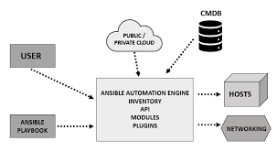
Ansible Architecture

Slide 18
Ansible Architecture Explained:
Inventories: Ansible inventories are lists of hosts (nodes) along with their IP addresses, servers, databases etc.
APIs: APIs in Ansible are used as transport for Cloud services, public or private.
Modules: Modules are executed directly on remote hosts through playbooks.
Plugins: Plugins allows to execute Ansible tasks as a job build step. Plugins are pieces of code that augment Ansible’s core functionality.
Networking: Ansible can also be used to automate different networks.
Hosts: The hosts in the Ansible architecture are just node systems which are getting automated by Ansible. It can be any kind of machine – Windows, Linux, RedHat etc.
Playbooks: Playbooks are simple files written in YAML format which describes the tasks to be executed by Ansible.
CMDB : It is a repository that acts as a data warehouse for IT installations. It holds data relating to a collection of IT assets (commonly referred to as configuration items (CI)), as well as to describe relationships between such assets.
Cloud: It is a network of remote servers hosted on the Internet to store, manage, and process data, rather than a local server.

Slide 19
Ansible in Devops
In DevOps, as we know development and operations work is integrated. This integration is very important for modern test-driven application design. Hence, Ansible integrates this by providing a stable environment to both development and operations resulting in smooth orchestration.

Slide 20
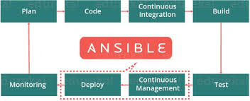

Slide 21



Ansible Case Study
Amazon Web Services (AWS)
Ansible is used to define, deploy, and manage a wide variety of services. Most complicated AWS environments can be provisioned very easily using a playbook. The best feature is, you create a server-host connection and then run the playbook on just one system and provision multiple other systems with an option to scale up and scale down as per requirement.
Ansible has hundreds of modules supporting AWS and some of them include:
Autoscaling groups
CloudFormation
CloudTrail
CloudWatch
DynamoDB
Elastic Cloud Compute (EC2)

Slide 22
