Slide 1
JDBC
Lab 8

Slide 2
What is JDBC? - a standard API specification developed in order to move data from frontend to the backend - an acronym for Java Database Connectivity - an advancement for ODBC ( Open Database Connectivity )

Slide 3
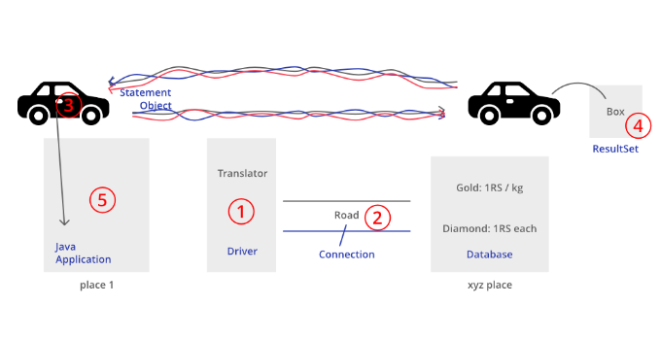

Slide 4
Steps For Connectivity Between Java Program and Database 1. Import the Packages 2. Load the drivers (forName() or maven jar) 3. Register the drivers (DriverManager) 4. Establish a connection using the Connection class object 5. Create a statement 6. Execute the query 7. Close the connections

Slide 5
Useful links: https://www.baeldung.com/java-jdbc https://www.tutorialspoint.com/jdbc/jdbc-sample-code.htm https://stackoverflow.com/questions/30651830/use-jdbc-mysql-connector-in-intellij-idea mysql installer (workbench): https://dev.mysql.com/downloads/windows/installer/8.0.html XAMP Apache: https://www.apachefriends.org/download.html

