Slide 1

Article summaries with info on the corresponding businesses
Smartlist.ai

Slide 3

Essence of SmartList
Balancing large volumes of information with limited time to make actionable decision on them
Financial research
Media Monitoring
Search Marketing & SEO

Slide 4

How it works
4steps;
Type in selected topic of interest
System matches keywords with articles via news API
Embedded AI in the code delivers a read-list with major tags, minor tags
Plus a 20 –line summary of the each article

Slide 5
How it works
The coordinates of the area and the size of the radius
System returns a list of all businesses withing that area

Slide 6

Possible use cases
A company assessing the media perception of its sustainability record over a given period of time.
A company trying to summarize data from various articles in order to understand the perception of their recent advertising campaign.

Slide 7
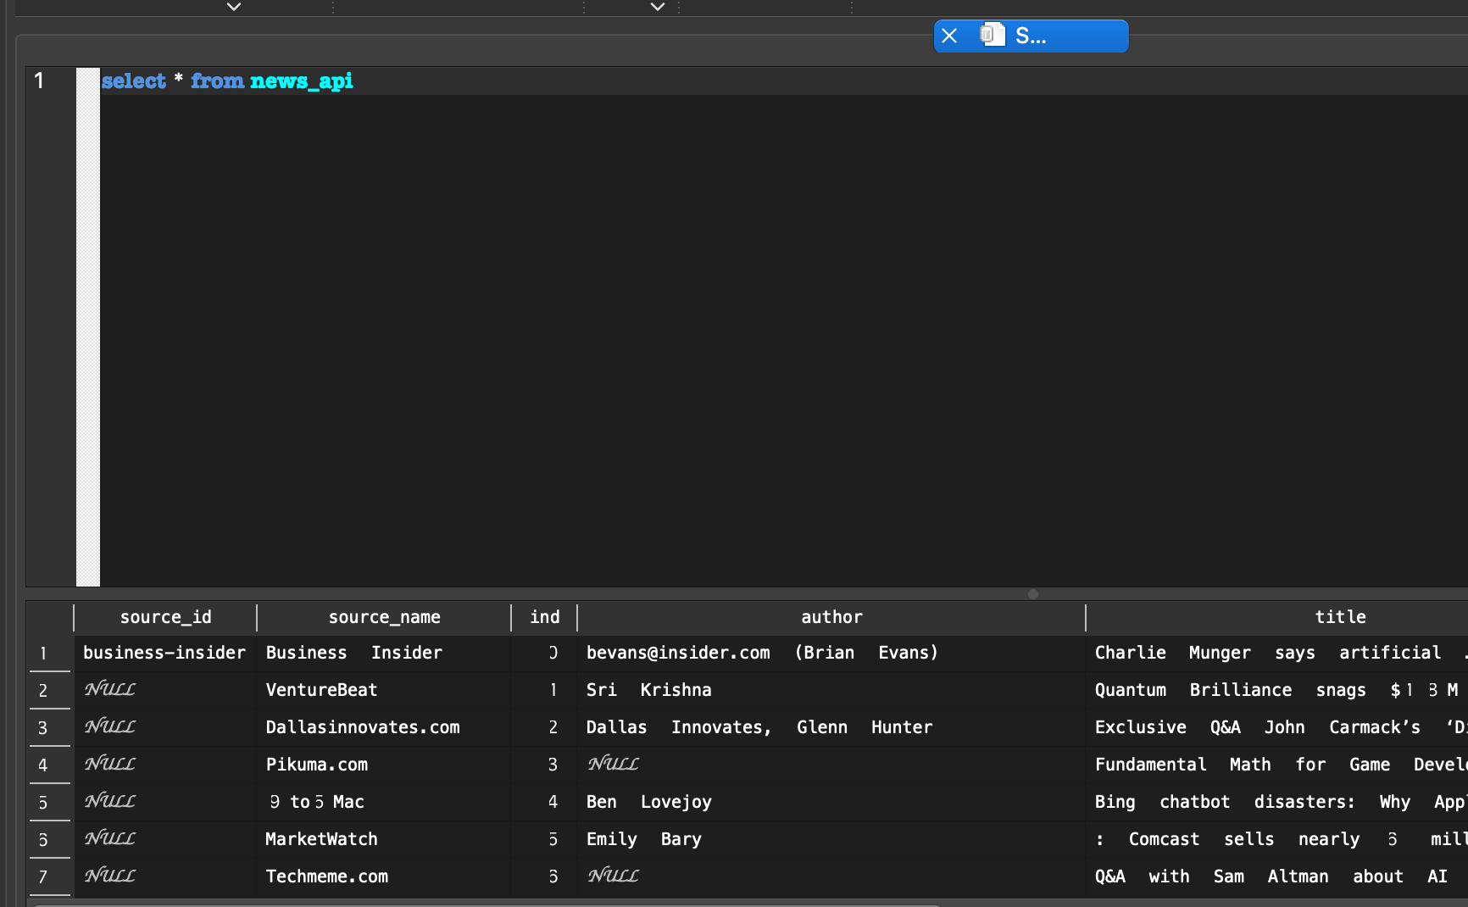
The Database
Scripts timestamp and store data pulled from newsapi and gmaps into one database

Slide 8
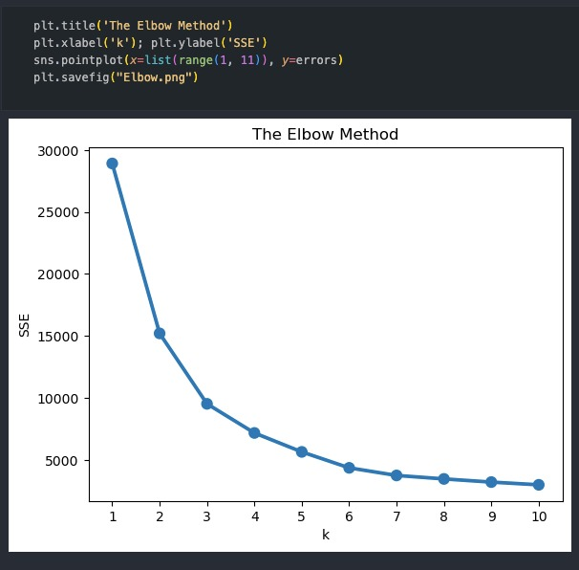
KMeans Clustering
KMeans clusters the google businesses data set based off of the business district information and the business insight.

Slide 9
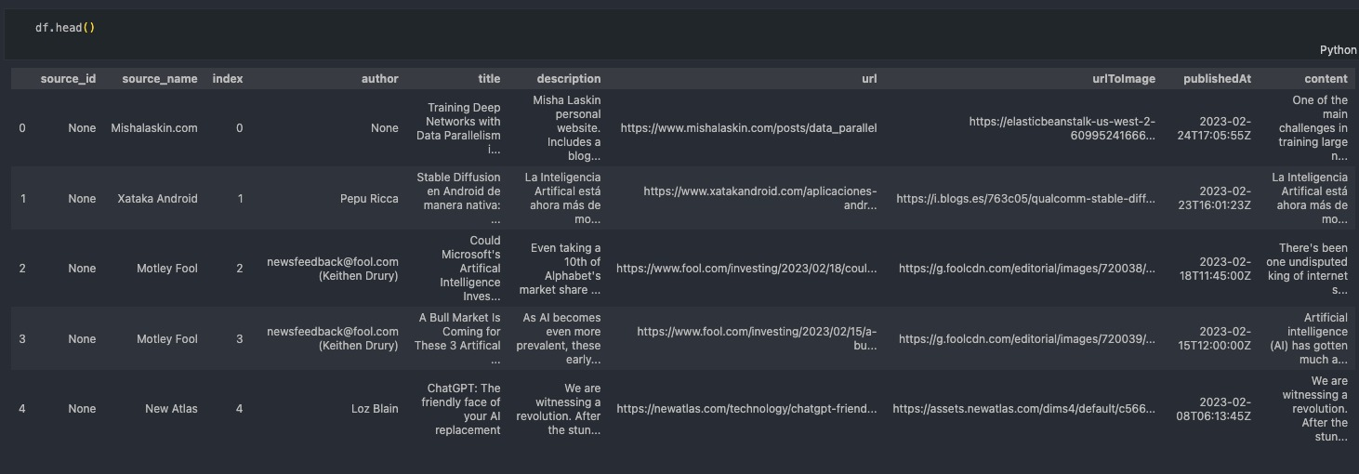
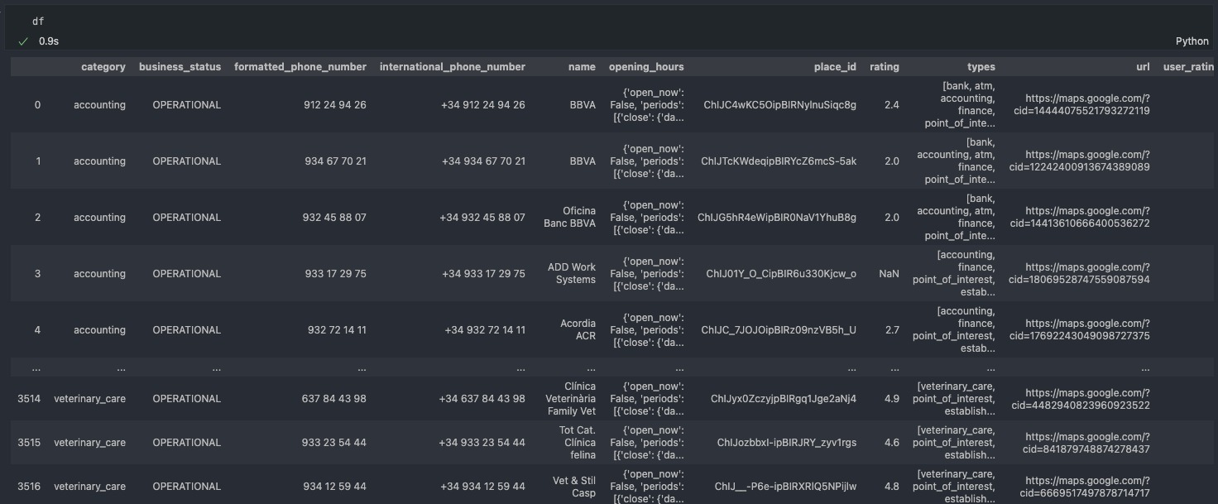
API data acquisition(News & Google)

Slide 10
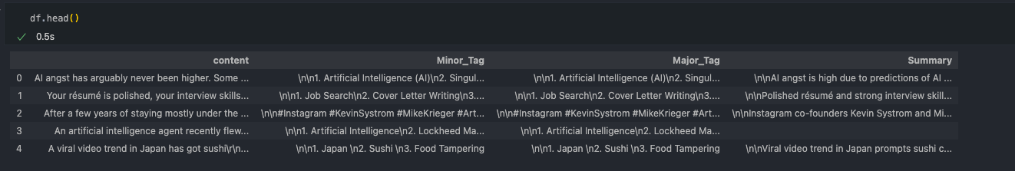
Article summaries with OpenAI

Slide 11
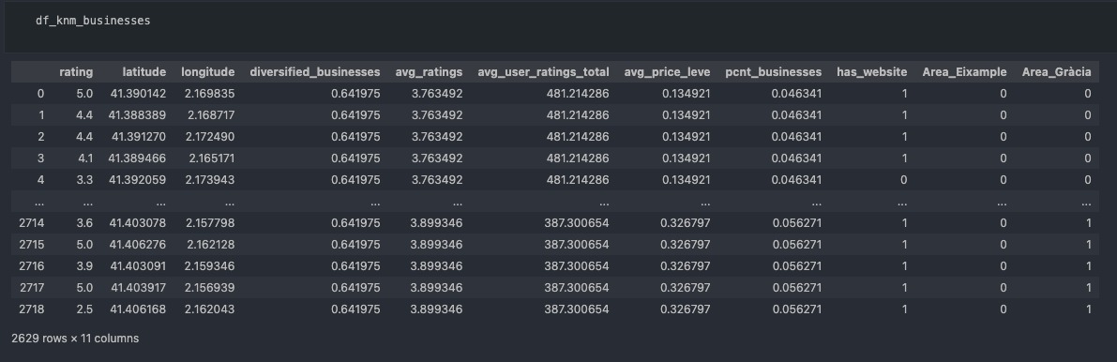
Google processing - Kmeans

Slide 12
THANK YOU

