Slide 1
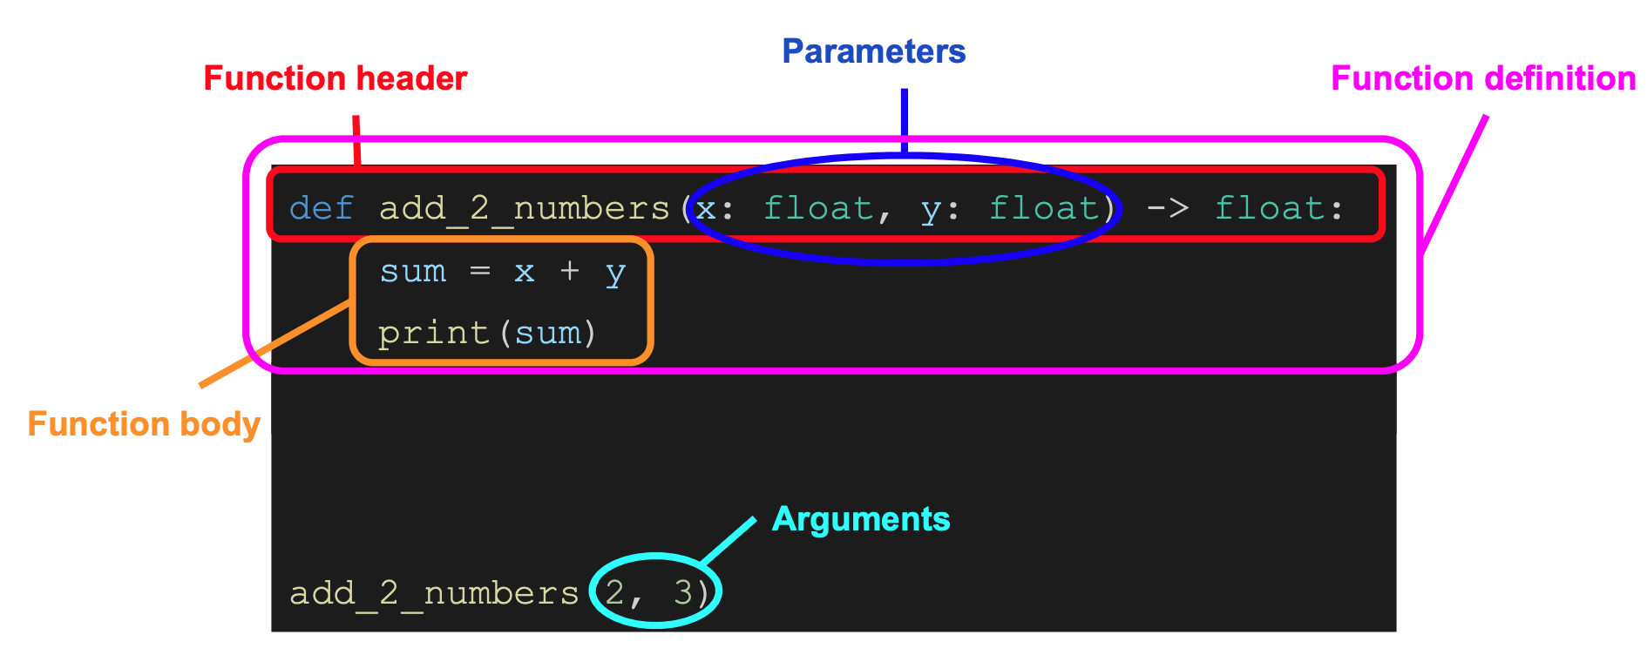
Anatomy of a Function Definition

Slide 2
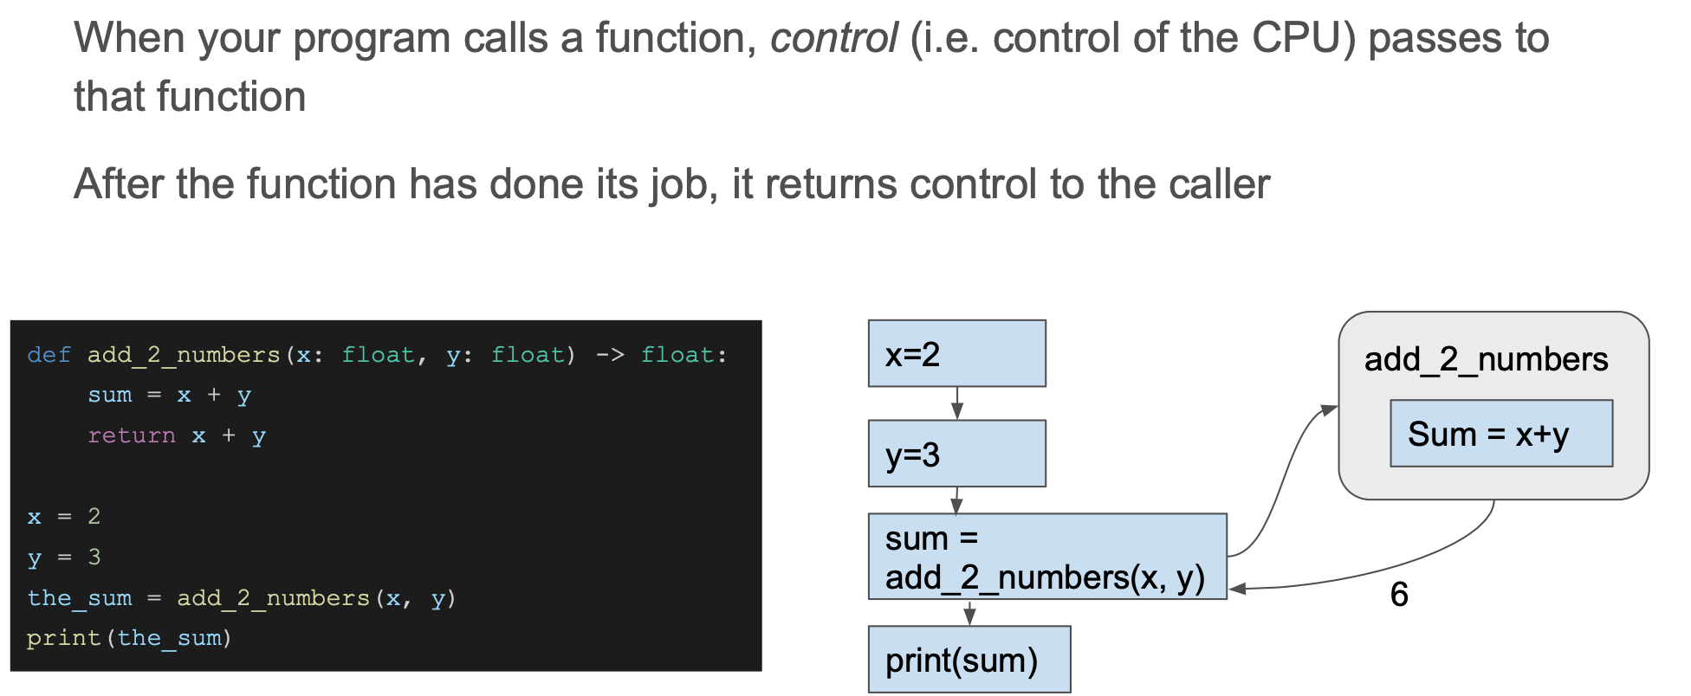
Tracing a Function Call

