Slide 1









2014 06
Irods User Meeting
Harvard University
Xavier Briand
Bruno Bzeznik
Data Intensive processing with iRODS and the middleware CiGri for the Whisper project
Xavier Briand
Bruno Bzeznik

Slide 2
2014 06
Irods User Meeting
Harvard University
Xavier Briand
Bruno Bzeznik
Data Intensive processing with iRODS and the middleware CiGri for the Whisper project
Use Case of Data-Intensive processing with iRODS
Collaboration between:
IT part of Whisper:
à Sofware development, computation
(Xavier Briand)
Platform Ciment:
à IT infrastructure of the University of Grenoble
à High Performance Computing HPC
à Data-Grid: grid manager CiGRi and iRODS storage
(Bruno Bzeznik)
Case

Slide 3
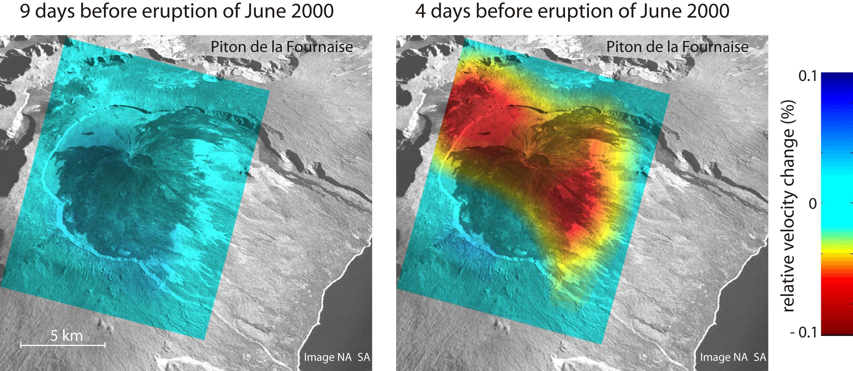
Data Intensive processing with iRODS and the middleware CiGri for the Whisper project
2014 06
Irods User Meeting
Harvard University
Xavier Briand
Bruno Bzeznik
Whisper: a European seismological project
Main Goal:
à Detect sligth changes of properties in the solid Earth
à Kind of ”Datamining” of seismograms
A Motivation:
à Variation of wave speed before eruption (La Reunion 2000)

Slide 4
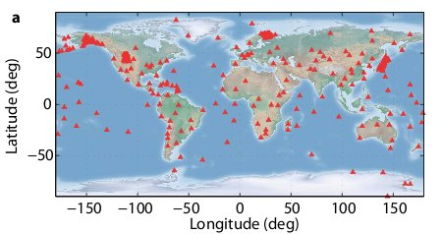
Data Intensive processing with iRODS and the middleware CiGri for the Whisper project
2014 06
Irods User Meeting
Harvard University
Xavier Briand
Bruno Bzeznik
Main constraint for Whisper: Massive data processing
Data provenance:
à Noise Continuously recorded by seismic stations worldwilde.
Europe: Alpes
China: LMS
USA: USArray (mobile Network)
Japan Networks (NIED)
...
à The computations produce even more data ...
How much data are we talking about?
Japanese Network: 20 TB per year
Typical processing: 8 TB in 5 days
Another: 'read' 3 TB and 'write' 1 TB in 6 hours
Many processings have to be tested ...
200 TB managed at the same time
Main operations: Raw data processing and computation of the correlations

Slide 5

Data Intensive processing with iRODS and the middleware CiGri for the Whisper project
2014 06
Irods User Meeting
Harvard University
Xavier Briand
Bruno Bzeznik
Other constraints for Whisper:
Time:
Organize a scientific workflow
Duration PHD and Posdoc
Available IT Infrastrucure
Ease of access for researchers
à Implementing a generic model, technical support
Specific tools:
Organize distributed data
Access to computational ressources
à Need a Data Grid environment:

Slide 6
Data Intensive processing with iRODS and the middleware CiGri for the Whisper project
2014 06
Irods User Meeting
Harvard University
Xavier Briand
Bruno Bzeznik
Plan
1- Presentation of the IT infrastructure Ciment:
Grid computing with CiGri and iRDOS
2- Presentation of the Whisper Code:
Software for data intensive processing
3- Results and feedback:
Whisper Use Case
iRODS experience in the context of Ciment

Slide 7
Data Intensive processing with iRODS and the middleware CiGri for the Whisper project
2014 06
Irods User Meeting
Harvard University
Xavier Briand
Bruno Bzeznik
IT infrastructure of the Ciment platform
Platform: HPC centre of the University of Grenoble
Partial pooling of computing resources
à 10 computing clusters, 6600 cores + GPUS
Local data grid environement: Resources in a local grid of supercomputers
Distributed storage storage 700 TB
à Centralized controller with total observation: monitor computation
Grid manager CiGri (OAR project)
à Short parametric jobs
à Best effort mode
à Improves resource usage
Whisper case: most perfectly (aka embarrassingly) parrallel but data intensive
processing

Slide 8
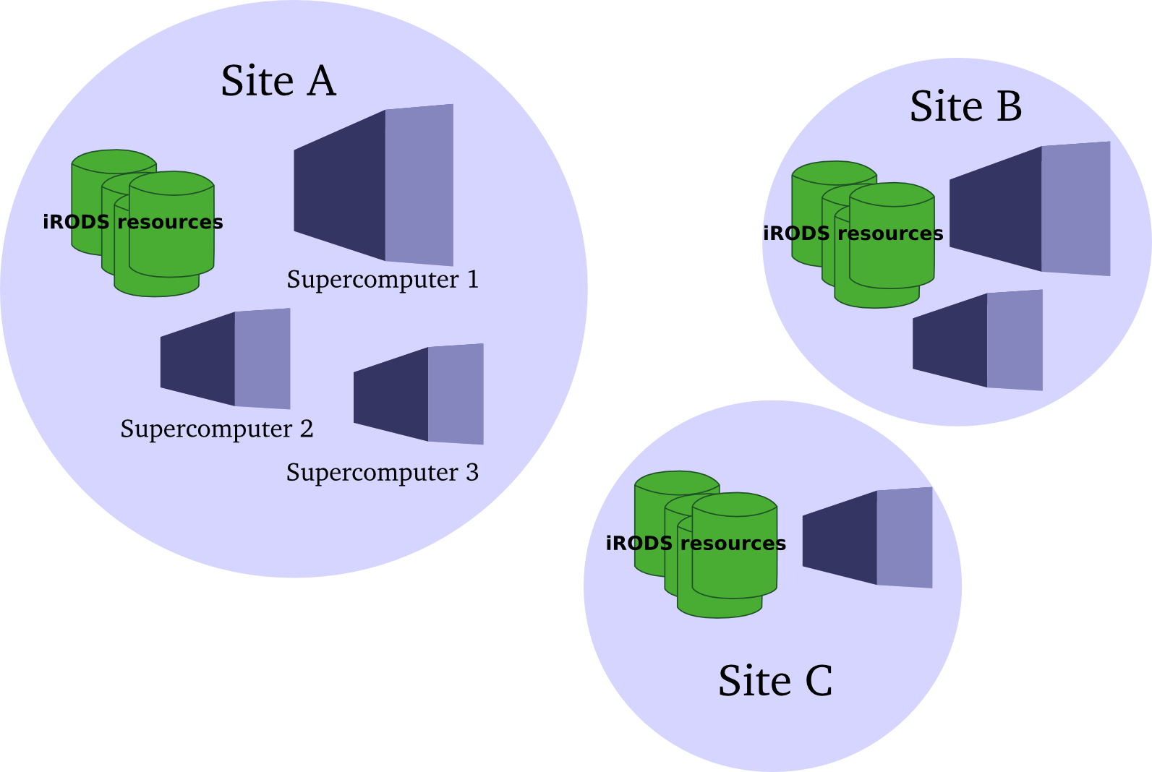
Data Intensive processing with iRODS and the middleware CiGri for the Whisper project
2014 06
Irods User Meeting
Harvard University
Xavier Briand
Bruno Bzeznik
IRODS infrastructure
3 sites close to supercomputers:
An unique zone with the iCat server
Dozen of Irods nodes
Heterogenous WAN connexions
Each site has its own 10Gbe local network switch
Site specification:
Each site has its own iRODS resource group
Store results of computation randomly at the same site
à Use of LAN and not WAN

Slide 9
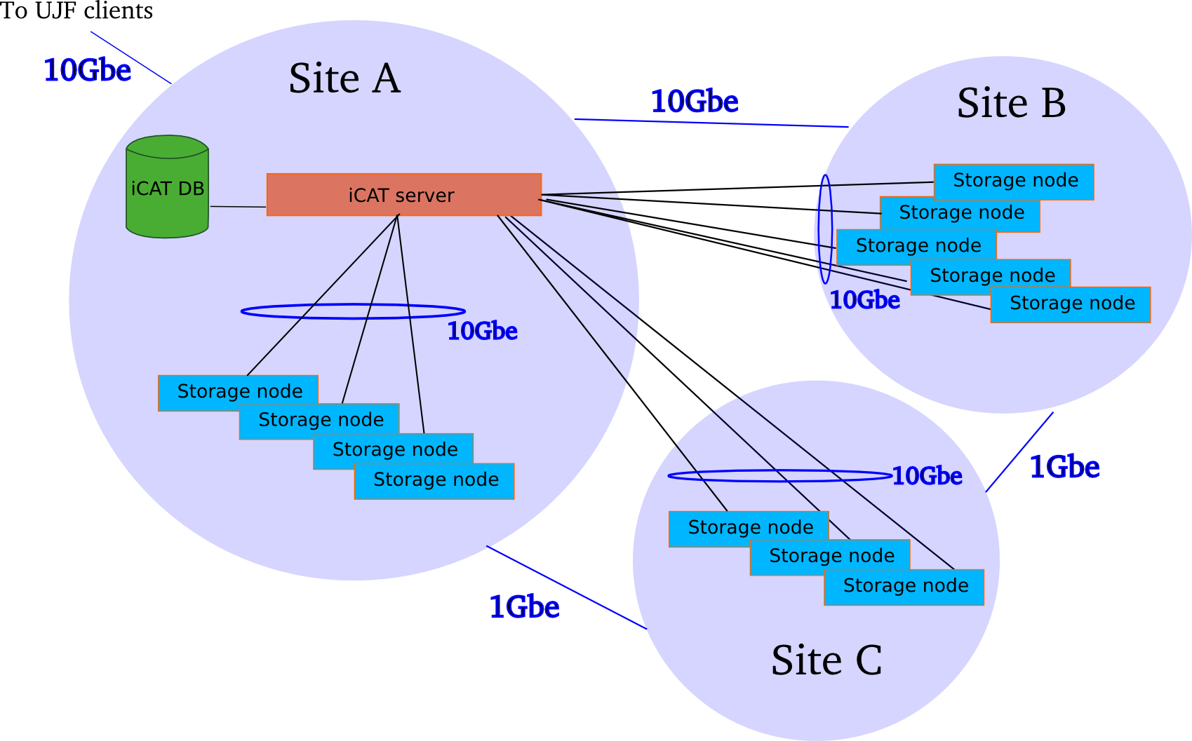
Data Intensive processing with iRODS and the middleware CiGri for the Whisper project
2014 06
Irods User Meeting
Harvard University
Xavier Briand
Bruno Bzeznik
IRODS infrastructure
More precisely:
Site A and B have 10Gbe WAN connexion
Site C has only 1Gbe WAN
Automatic staging for site C
à Automatic replication of resoures from sites A and B
to site C when data get from site C

Slide 10
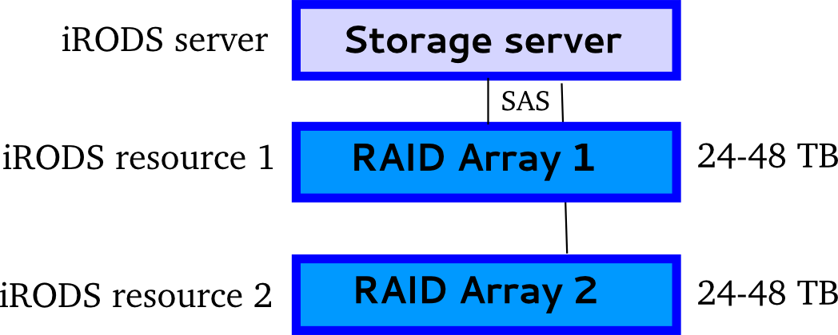
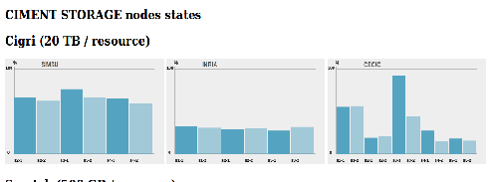
Data Intensive processing with iRODS and the middleware CiGri for the Whisper project
2014 06
Irods User Meeting
Harvard University
Xavier Briand
Bruno Bzeznik
IRODS infrastructure
Focus on storage nodes:
Two RAID arrays 24 TB – 48 TB
Irods Nodes with Debian GNU/Linux
(Easy synchronisation of the system admin with Kanif)
Ciment provides a web interface to check resource status
Now 700 TB, constant evolution
Irods offers great scalability

Slide 11
Data Intensive processing with iRODS and the middleware CiGri for the Whisper project
2014 06
Irods User Meeting
Harvard University
Xavier Briand
Bruno Bzeznik
Cigri middleware
Cigri achieves access to all 6600 cores of 10 clusters within Ciment.
Perfectly parallel jobs on idle processors
Principles
Each cluster uses the ressource manager OAR
Cigri communicates with the cluster through OAR's RESTful API
Cigri submits jobs without exhausting local queues
Best effort mode
Jobs on idle processors of every computing nodes.
à Improves computational ressources
Jobs have lowest priority but automatic resubmission
(CiGri works also in normal mode)

Slide 12
Data Intensive processing with iRODS and the middleware CiGri for the Whisper project
2014 06
Irods User Meeting
Harvard University
Xavier Briand
Bruno Bzeznik
Cigri middleware
Run a set of jobs: a campaign
User defines the campaign parameters in a JSON file
For each cluster (or all clusters):
- Accepted clusters, ressources needed
- Maximum duration
- Maximum number of jobs
- Location of the code
- Prologue, epilogue
And iRODS?
Code and input are retrieved from iRODS with i-commands (or API)
No direct connexion between iRODS and CiGri
But completely complementary through job scripts.

Slide 13
Data Intensive processing with iRODS and the middleware CiGri for the Whisper project
2014 06
Irods User Meeting
Harvard University
Xavier Briand
Bruno Bzeznik
Cigri middleware
Technologies, functionalities
RestFul API, Ruby, around a PostgreSQL database.
Apache with SSL authentication
Statistics: execution rate, resubmission rate
Email notification of failed jobs
Retrieve the jobs' standard output and standard error from CiGri RestFul API.
Authentication, security
A centralized LDAP infrastructure for Ciment
Password method with synchronization with LDAP authentication.
Transparent for users: automatic initialization in home directory
(.irods/.irodsEnv and .irods/.irodsA files)

Slide 14
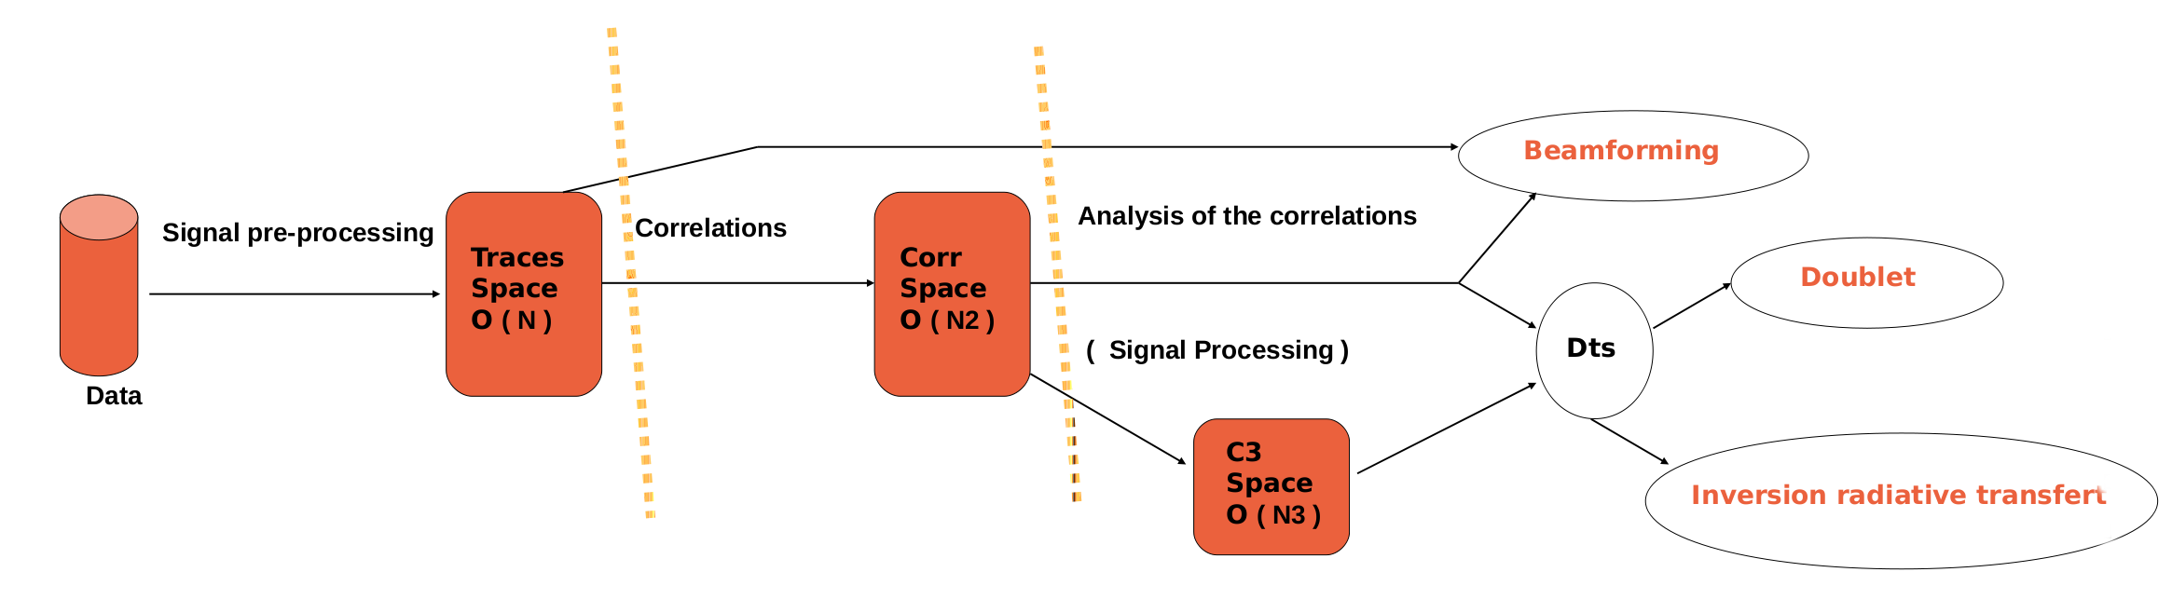
Data Intensive processing with iRODS and the middleware CiGri for the Whisper project
2014 06
Irods User Meeting
Harvard University
Xavier Briand
Bruno Bzeznik
Whisper Code
General design
Grouped into 3 parts:
- Seismograms (arrays) processing
- Computation of correlations (couple of seismograms)
- Analysis of the correlations (differents methods)
Python language, libraries Scipy and Obspy (seismology)
Development driven by performance, evolution and required support.

Slide 15
Data Intensive processing with iRODS and the middleware CiGri for the Whisper project
2014 06
Irods User Meeting
Harvard University
Xavier Briand
Bruno Bzeznik
Whisper Code
Raw data (seismograms) processings
A flexible way of specifying a pipeline of processing
User specifies:
- A directory
- A set of seismic stations
- A set of dates
- A sequence of treatments
Users can enter their own code into the processing
Code:
- Scan a directory
- Extract all pieces of seismograms
- Organize a specific architecture of files of daily seismograms
Signal treatment
Traces Space
O ( N )

Slide 16
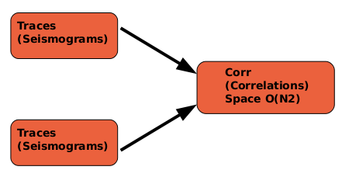
Data Intensive processing with iRODS and the middleware CiGri for the Whisper project
2014 06
Irods User Meeting
Harvard University
Xavier Briand
Bruno Bzeznik
Whisper Code
Computation of the correlations
Operation with 2 seismograms
that provides a new virtual seismogram
à Get 'virtual' new observational data
Architecture of files that corresponds to all the couple of seismograms.
à Quadratic space complexity (linear for seismogram processing)
à Need to store seismograms processing
Quadratic space complexity can be critical à Optimization

Slide 17
Data Intensive processing with iRODS and the middleware CiGri for the Whisper project
2014 06
Irods User Meeting
Harvard University
Xavier Briand
Bruno Bzeznik
Whisper Code
Focus on optimization of the computation of correlations
Numerical optimization:
- Algorithm uses the fast fourier transform
- Pre-calculating 'Good' combinations of small prime numbers
- 40% improvement for good cases
Main optimization: try to catch the cache
- Test the GC behavior in order to follow the cache heuristics
- Don't use the Garbage Collector directly!
- Write code towards 'optimal' use of the cache.. (and find good unfolding)

Slide 18
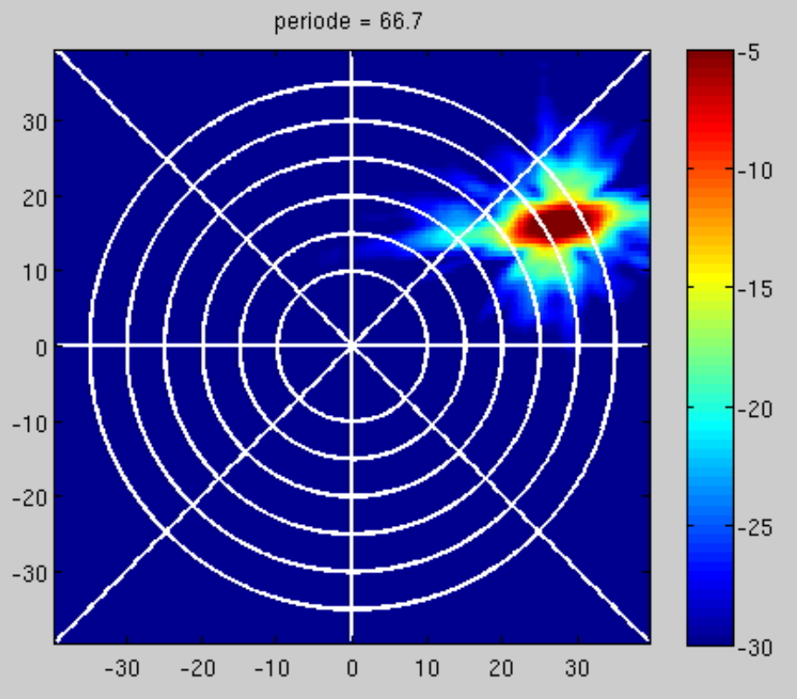
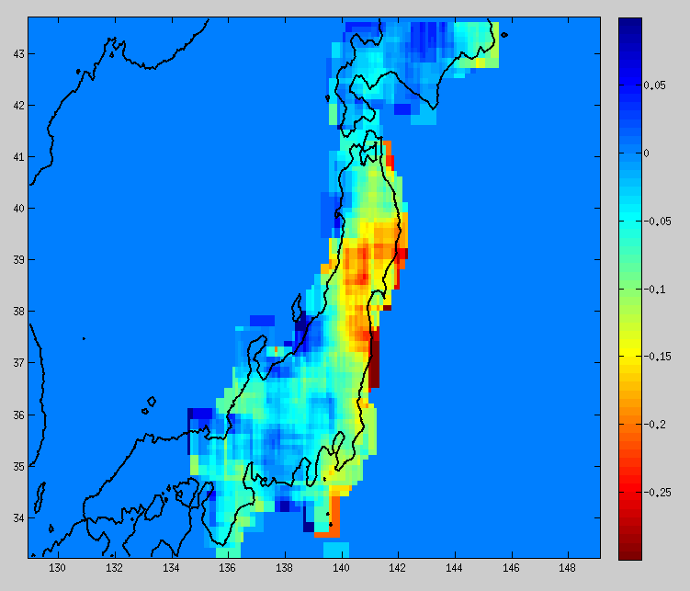
Data Intensive processing with iRODS and the middleware CiGri for the Whisper project
2014 06
Irods User Meeting
Harvard University
Xavier Briand
Bruno Bzeznik
Whisper Code
Last part of Code: Analysis of correlations
Further methods
- Beamforming
- Doublet
- Inversion
à New filter the signal, computation of the variation velocity of waves
(Note C3 is cubic in Space: distribution for quadratic space complexity)
Beamforming
Analysys of the correlations
Corr
Space
O ( N2 )
Doublet
( Signal Processing )
Dts
C3
Space
O ( N3 )
Japan NIED

Slide 19
Data Intensive processing with iRODS and the middleware CiGri for the Whisper project
2014 06
Irods User Meeting
Harvard University
Xavier Briand
Bruno Bzeznik
Results:
Organization of a computation
Either local computation with a dedicated bay or grid computation
- Retrieve a dataset
- Anticipate computation time
- Evaluate required storage capacity
- Assess users' computer skills
The specification must evolve
- New requirements from researchers
- Not generic enough …
- Very complex to evaluate
Adaptation to the grid environment: development time?

Slide 20
Data Intensive processing with iRODS and the middleware CiGri for the Whisper project
2014 06
Irods User Meeting
Harvard University
Xavier Briand
Bruno Bzeznik
Results:
Whisper computation with Ciment data grid
First step: convert data into seismic standard formats
à Can be a very data intensive processing
Minimize concurrency on Irods
à IT code for randomly spreading files on resources
Find a 'good' distribution model
Fine tuning distribution of computation and transfer

Slide 21
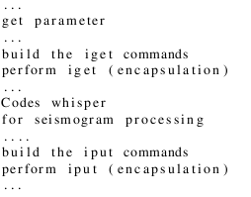
Data Intensive processing with iRODS and the middleware CiGri for the Whisper project
2014 06
Irods User Meeting
Harvard University
Xavier Briand
Bruno Bzeznik
Results:
Seismogram processing on the grid:
Ouput of the Japanese Network over one year
Seismograms processing: simplest case for data grid process
Convert 9 TB into 20 TB of seismic standard format
Modeling the distribution: subsets of dates and subsets of stations
Adaptation for iRODS
Add python modules to retrieve data on iRODS:
Provide encapsulation of the
iget and iput: number of try,
waiting time, 'else' command

Slide 22
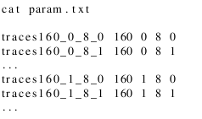
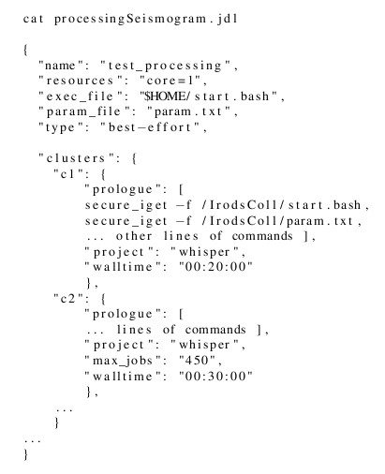
Data Intensive processing with iRODS and the middleware CiGri for the Whisper project
2014 06
Irods User Meeting
Harvard University
Xavier Briand
Bruno Bzeznik
Results:
Adaptation for Cigri: Define a file of parameters: each line corresponds to a job
Campaign with 1280 jobs
160 sublists of dates and 8 sublists of stations
'traces160_0_8_1 160 0 8 1'
à Sublist of dates of index 0 and sublist of stations of index 1
Define the paramter of the campaign (jdl file JSON)
- Campaign named 'test_processing'
- Run the 'start.bash' with 'param.txt'
- Use clusters 'c1' and 'c2'
- Best effort mode
- Campaign associated to 'whisper'
- Maximum number vof jobs
- Retrieve 'start.bash' script from iRODS
...

Slide 23
Data Intensive processing with iRODS and the middleware CiGri for the Whisper project
2014 06
Irods User Meeting
Harvard University
Xavier Briand
Bruno Bzeznik
Results:
Correlation computation on the grid:
Ouput of the Japanese Network over one year
Add similar modules to retrieve data on Irods
Two types of processes: with one sublist and with two disjoint sublists
à Transfer is proportional to the distribution for the stations
Maximize the distribution of dates
Minimize the distribution of stations
Fine tuning the size of files transferred between iRODS and computing nodes:
- Correlations into dictionary
- Size file between 100 MB and 500 MB
- Appropriate for iRODS infrastructure

Slide 24
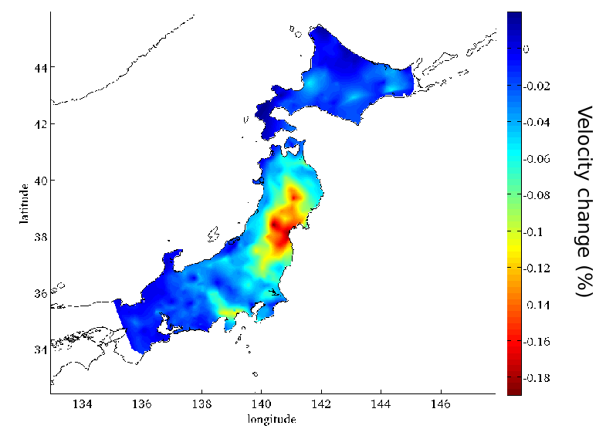
Data Intensive processing with iRODS and the middleware CiGri for the Whisper project
2014 06
Irods User Meeting
Harvard University
Xavier Briand
Bruno Bzeznik
Results:
One year of the Japan Network on the grid
Processing all seismograms now takes half a day (down from 4 months)
Computation of 350 Million correlations for the Japanese Network
(down from 2 years ... )
- Between 9h and 20h (It depends on stacking, overlap)
- 'iget' command correponds to 11 TB
- 'iput' command correspons to 3.3 TB
- Best-effort can increase also transfer...
à Big change in opportunities to test processing
Many scientific results
About variation of velocity change for the tohoku
earthquake in Japan: in Science, June 2014

Slide 25
Data Intensive processing with iRODS and the middleware CiGri for the Whisper project
2014 06
Irods User Meeting
Harvard University
Xavier Briand
Bruno Bzeznik
Results:
iRODS experience in the context of Ciment
Opportunity to test and improve Ciment Infrastructure for Big Data
Add new functionalities:
- Limit the number of jobs avoid overload iRODS Infrastructure
- Limit the number of simultaneous connexions
- Develop wrapper for i-commands: secure_iget …
For iRODS: unique namespace over distributed sites
à Only the meta Catalog can block the system (asynchronous)
Simply add a server as an iRODS resource
and define access policy for each project
Challenge with small files (< 32 MB)
Completly overload 1Gbe link between 2 sites for conversion processing
during automatic staging.

Slide 26
Data Intensive processing with iRODS and the middleware CiGri for the Whisper project
2014 06
Irods User Meeting
Harvard University
Xavier Briand
Bruno Bzeznik
Thanks so much!
http://whisper.obs.ujf-grenoble.fr
https://ciment.ujf-grenoble.fr
http://cigri.imag.fr
http://irods.org
http://oar.imag.fr
kanif http://taktuk.gforge.inria.fr/kanif
http://www.liglab.fr

