Slide 1
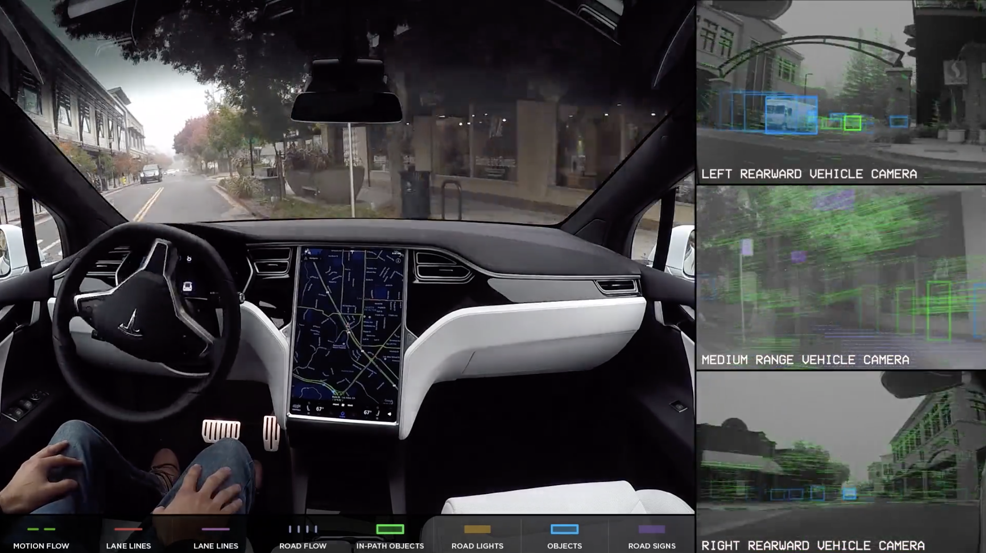
Introduction
Problem Statement: Train convolutional neural networks to identify common road objects to improve self-driving cars
Is important for self-driving vehicles to identify objects unambiguously to avoid accidents
Research in self-driving vehicles has become fascinating recently
This tutorial will focus on classifying separate road objects into 1 of 5 classes
Image Source: https://www.tesla.com/autopilot

Slide 2
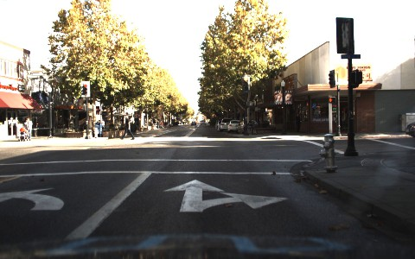
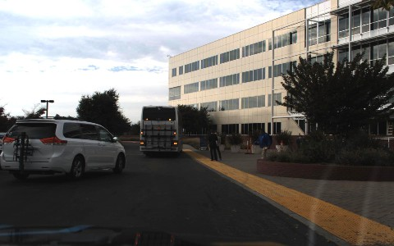
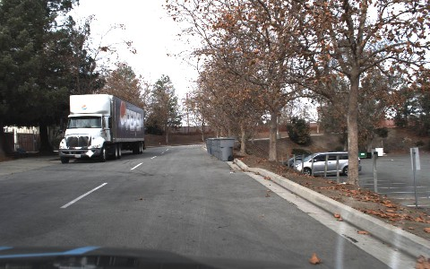
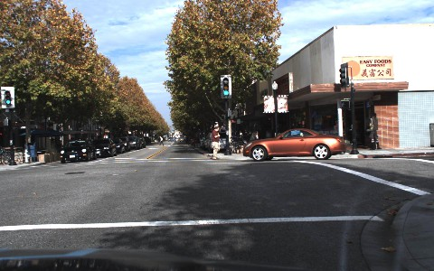
Examples of Original Images
Original data had dashcam images with multiple objects
Data Source: https://www.kaggle.com/datasets/alincijov/self-driving-cars?resource=downloadLinks

Slide 3
Image Preprocessing: Loading and Cropping
Data includes image names and bounding boxes with the x and y minimum and maximum values in the form of .csv files
Data CSV files include information on if image is train or validation
Image data is present as .jpg images and not categorized as train or validation
Images were transported into train and validation data in separate directories by looping through the CSV files and referenced the image names
Cropped out separate objects from within the same images that were one of these objects:
Cars
Trucks
Cyclists
Traffic Lights
Persons
Used a data loader to resize all cropped images to 32 x 32 pixels

Slide 4


Examples of Cropped Images
Objects were cropped out of the images: cars, cyclists, people, lights, and trucks
Data Source: https://www.kaggle.com/datasets/alincijov/self-driving-cars?resource=downloadLinks

Slide 5
Image Preprocessing: Counting Class Images
The number of images in each class was counted and found to be:
Cars: 101312
Trucks: 6313
Pedestrian: 10637
Bicyclist: 1442
Light: 12700
Is a dramatic imbalance in the dataset
Learning rates were multiplied by a larger value for less represented classes and a smaller value for higher represented classes

Slide 6
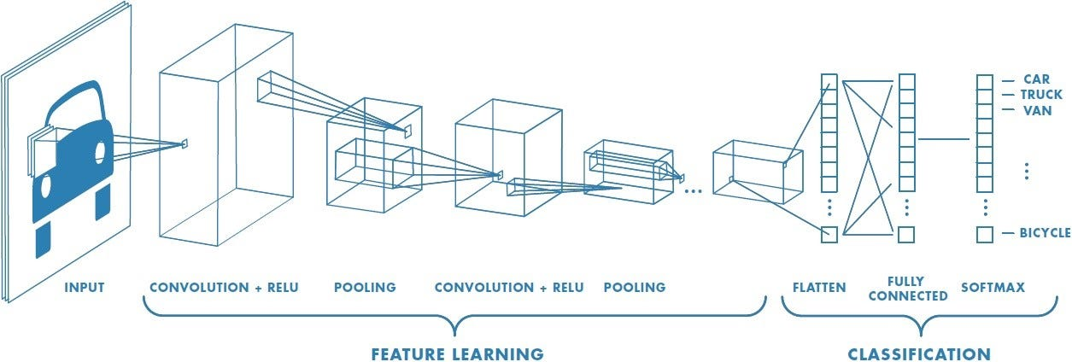
Why Convolutional Neural Networks?
CNNs are tailored to image processing
CNNs require less parameters than fully connected neural networks
Fully connected neural networks require one variable per pixel - inefficient
CNNs process images in a structured way
CNNs focus on few types of features at a time with feature maps:
First feature map may focus on car outlines
Inner feature maps may focus on tire shapes
Last few feature maps may focus on car logos, wipers, mirrors, etc.
Image Source: https://saturncloud.io/blog/a-comprehensive-guide-to-convolutional-neural-networks-the-eli5-way/

Slide 7
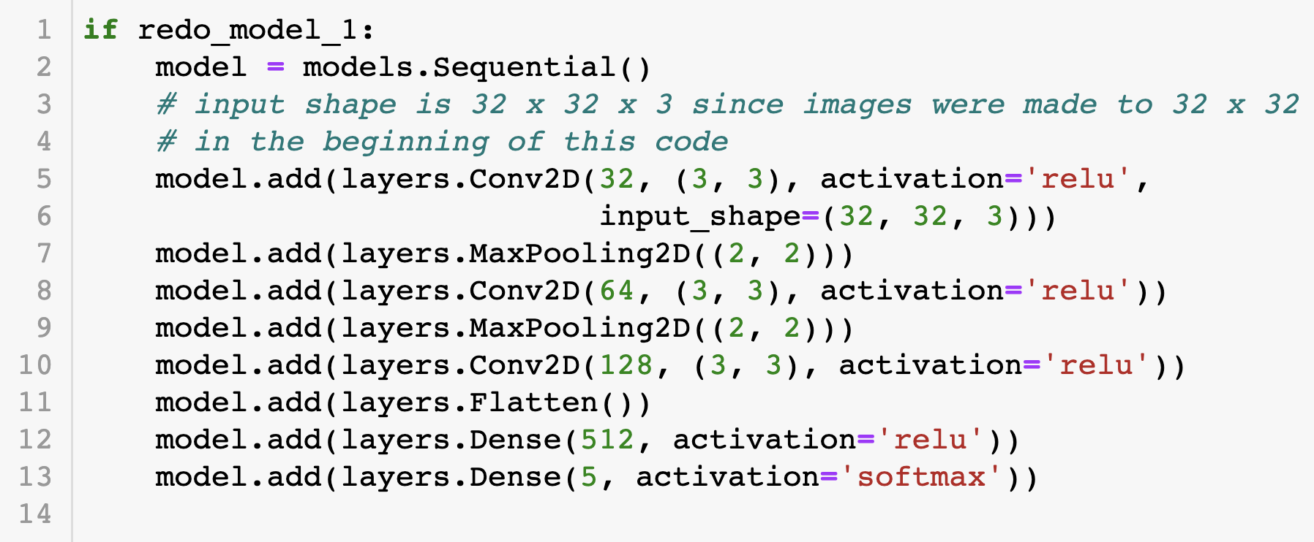
Architecture of Models
4 CNNs were constructed, each with:
3 convolutional layers with kernel size 3 x 3
2 max pooling layers of 2 x 2
1 flatten layer
2 dense layers
Class weights that assign a higher learning rate to lowly represented classes and a lower learning rate to highly represented classes.
Chose 3 convolutional layers so each processes basic, intermediate, and complex features
1st dense layer had 512 neurons, which was quite high to avoid underfitting
2nd dense layer had 5 neurons for 5 possible objects and is the last layer

Slide 8
Results: Unregularized Model
Was trained for 100 epochs
Was overfit
Validation accuracy stable after 12 epochs
And diverged after 40 epochs
Model’s loss oscillates throughout the epochs
Model’s validation accuracy was about 50%
Model needs to be regularized due to divergence

Slide 9
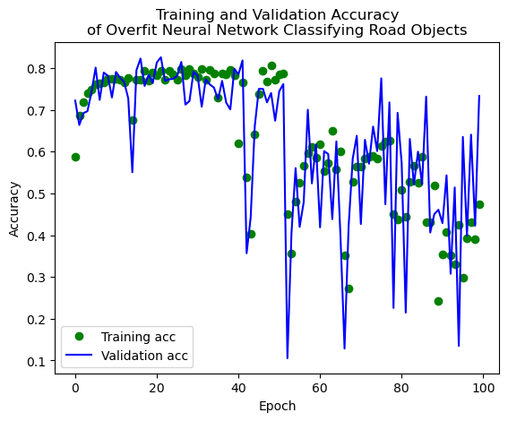
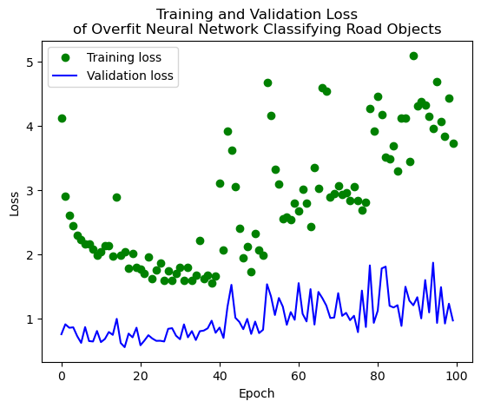
Accuracy and Loss: Unregularized Model

Slide 10
Results: Early Stopping Only Model
Used only early stopping as regularization
Patience = 5
Was trained for 20 epochs but stopped after 11
Validation accuracy increased after 1 epoch and stayed around 80%
Model’s accuracy on validation data was 81.15%
Was trained on almost 1/10 as many epochs as the unregularized model but performed significantly better

Slide 11
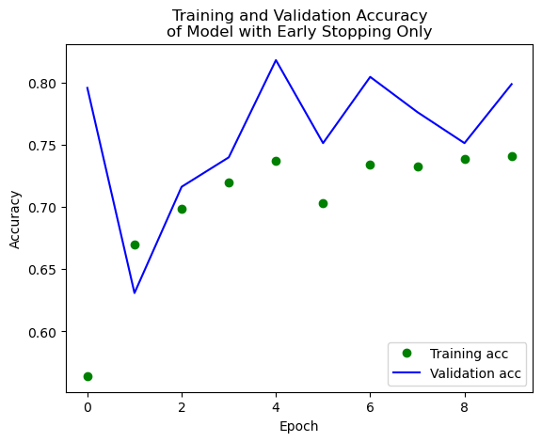
Accuracy: Early Stopping Only Model

Slide 12
Results: Early Stopping with L2 Model
Used early stopping with ridge regression
Models’ accuracy with 5 lambda values were evaluated
Patience = 5
Best lambda was 0.0316
Was trained for 20 epochs but stopped after 10
Validation accuracy rises initially and then declines a bit
Model’s accuracy on validation data was 83.32%
Model had the highest validation accuracy

Slide 13
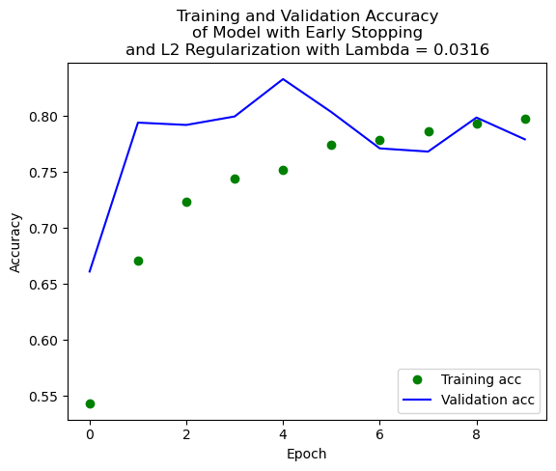
Accuracy: Early Stopping with L2 Model

Slide 14
Results: Early Stopping with Dropout Model
Used early stopping with dropout rate = 0.2
Was trained for 20 epochs and was not stopped early
Patience = 5
Validation accuracy fluctuated and showed no pattern
Model’s accuracy on validation data was 77.46%
Model had the lowest validation accuracy out of regularized models

Slide 15
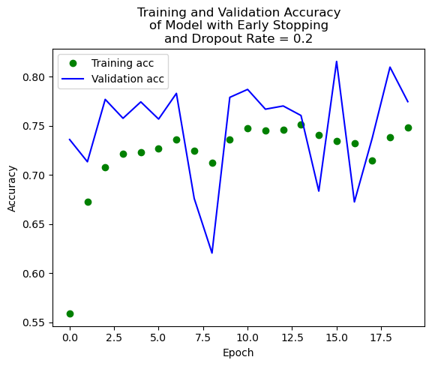
Accuracy: Early Stopping with Dropout Model

Slide 16
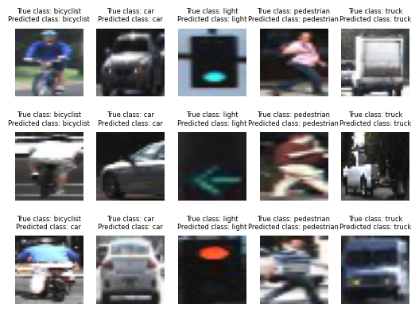
Best Model Predictions:

Slide 17
Discussion
Best regularization method for this dataset was ridge regression along with early stopping
Validation accuracy across the epochs was the most stable compared to other 3 models
Loss was relatively stable for this model
Ridge regression regularization worked the strongest likely since its coefficient penalties were the highest magnitude out of the 3 regularized models
Accuracy was even lower for models with dropout rates of 30 and 40% than 20%
Perhaps >= 20% neurons dropped out was too high since images are small: 32 x 32 pixels
Accuracy of 83.32% is strong but not strong enough for the field, where an accuracy of nearly 100% is absolutely necessary to avoid fatal accidents
Findings of this tutorial demonstrate a proof of concept
Models can be trained further using similar techniques and data augmentation

Slide 18
Conclusion
Learned how to apply convolutional neural networks to solve a real-world challenge
By training these models, learned more closely about the parameters
For future research, other regularization techniques, numbers of neurons, and numbers of convolutional, max/average pooling, and dense layers can be experimented with.
Images were only 32 x 32, so better quality, larger pictures could be used
Model can learn to identify multiple objects within a single image since this is more realistic with other objects that might be in the way
Algorithms can learn to detect bounding boxes within the camera’s view
More research to derive information from each lane such as sidewalk, bike lane, right lane, left lane, and the number of lanes.
Overall, this tutorial is useful to learn about CNNs, explore ways to train them to improve their performance, and to learn a core area in which they can be applied

