Slide 1

Evaluating federated recommender systems on the edge
Marko Harasic
The 3rd International Workshop on OARS
6t^{h} August 2023
Long Beach, CA

Slide 2


OUR VISION ON
FUTURE IFEC-Systems
Provide 20k+ movies on-board
Give personalized content to anonymous users
Train collaboratively with 3rd parties

Slide 3

OUR
APPROACH

Slide 4

Session-based recommender systems
Interaction stream as input data
Independent treatment of sessions
Consideration of sequential dependencies
Able to implicitly detect user intentions

Slide 5
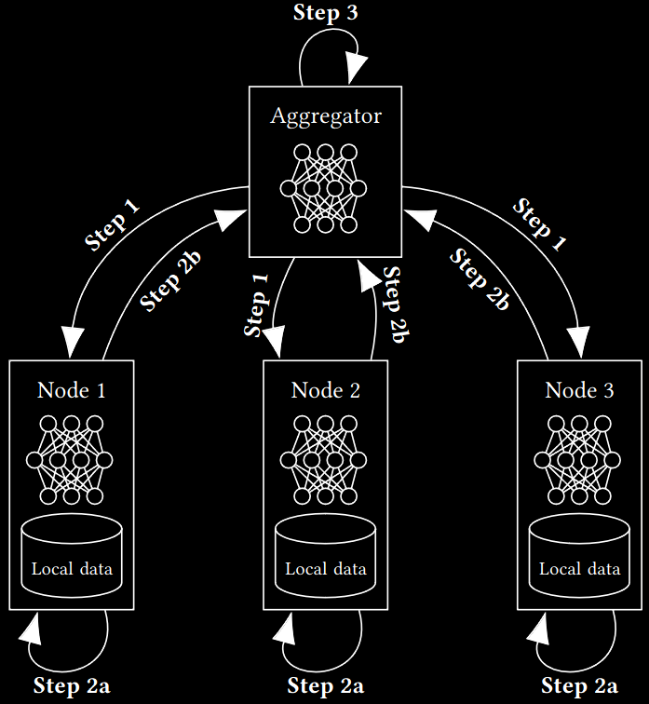
FEDERATED
Learning
Novel distributed learning paradigm
Communication-Efficient Learning of Deep Networks from Decentralized Data, McMahan et al. 2017
Local training of models
Sharing of only model upd
Enables privacy aware operation of ML-algorithms

Slide 6

FEDERATED
RECOMMENDERS
Combination of Federated Learning and Recommender Systems
Federated Recommendation Systems,
Yang et al. 2020

Slide 7

OUR evaluation setup

Slide 8

DATASET requirement for EVALUATION
“Real world” data needed
  Horting Hatches an Egg: A New Graph-theoretic Approach to Collaborative Filtering,
  Aggarwal et al. 1999
Timestamped data necessary
  Sequence-Aware Recommender Systems, Quadrana et al. 2018

Slide 9
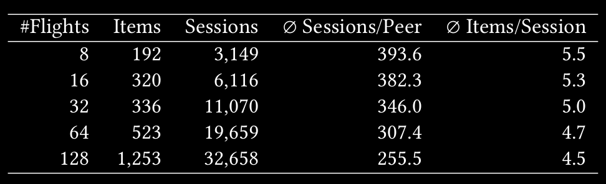
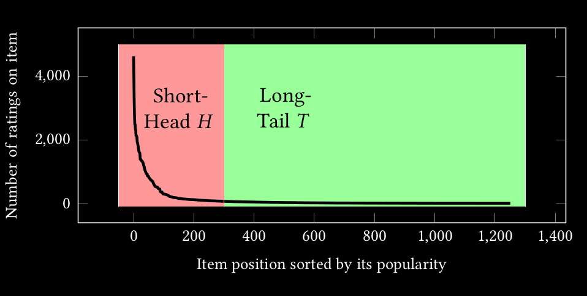
OUR DATA - PROVIDED BY SPI

Slide 10
Investigated ALGORITHMS
(Re)-Implementation and federalization of one algorithm
for different SBRS-classes
Factorisation Model | DeepFM | DeepFM: a factorization-machine based neural network for CTR prediction, Guo et al. 2017
Multi-Layer Perceptron | Variational Auto Encoder | Variational Autoencoders for Collaborative Filtering, Liang et al. 2018
Convolutional NN | Caser | Personalized Top-N Sequential Recommendation via Convolutional Sequence Embedding, Tang & Wang 2018
Recurrent NN | Gru4Rec | Recurrent Neural Networks with Top-k Gains for Session-based Recommendations, Hidasi & Karatzoglou 2018
Attention Model | Bert4Rec | BERT4Rec: Sequential Recommendation with Bidirectional Encoder Representations from Transformer, Sun et al. 2019

Slide 11

Challenges
Large sparsity of our data set
Network independent operation
Computers with limited computational power

Slide 12

OUR evaluation

Slide 13
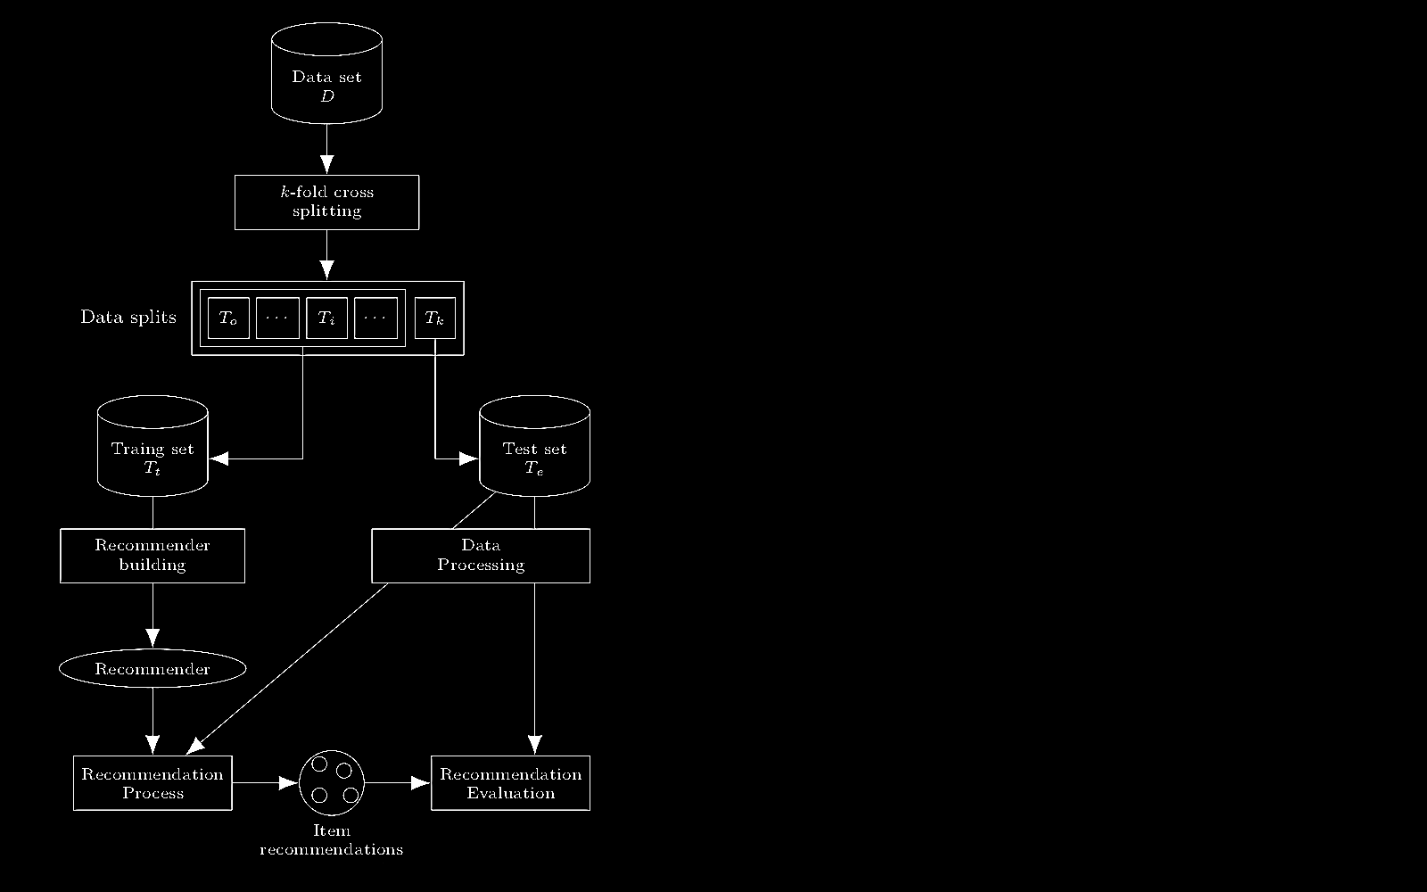
OFFLINE EVALUATION
PROTOCOL
Split data-set
Train model with k-1 slices
Process remaining test slice (leave-last-out)
Evaluate system with test slice
Time-aware Recommender Systems: A Comprehensive Survey and Analysis of Existing Evaluation Protocols
Campos et. al 2014

Slide 14

SIMULATION OF FEDERATED NODES
Real world deployment not feasible
Simulation of federated nodes
Deployment of nodes on a single “beefy” machine

Slide 15

Quality of a RECOMMENDATION
TARGET DEFINITION
A recommenders performance is a balance of multiple criteria
  Evaluating Recommender Systems: Survey and Framework, Zangerle & Bauer 2022
Accuracy
Normalized discounted cumulative gain (nDCG)
Long-tail access
Long-tail Catalog Coverage (LCC)

Slide 16

OUR
Evaluation RESULTS

Slide 17
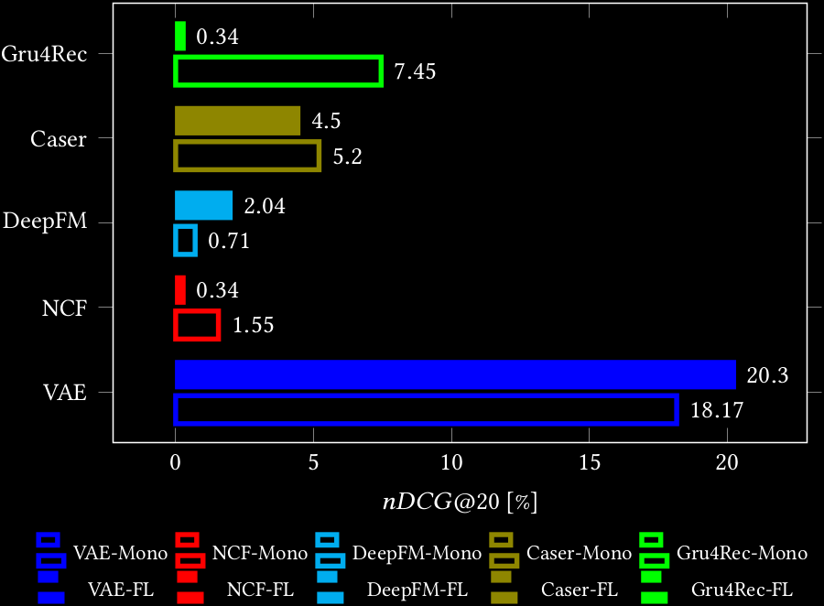
ACCURACY FL vs Monolithic

Slide 18
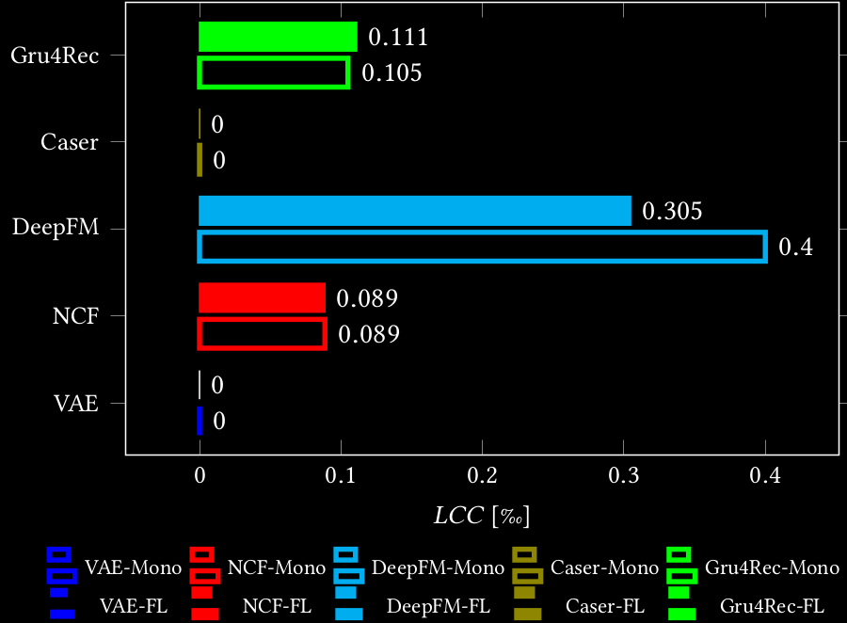
Long-tail coverage fl vs. monolithic

Slide 19
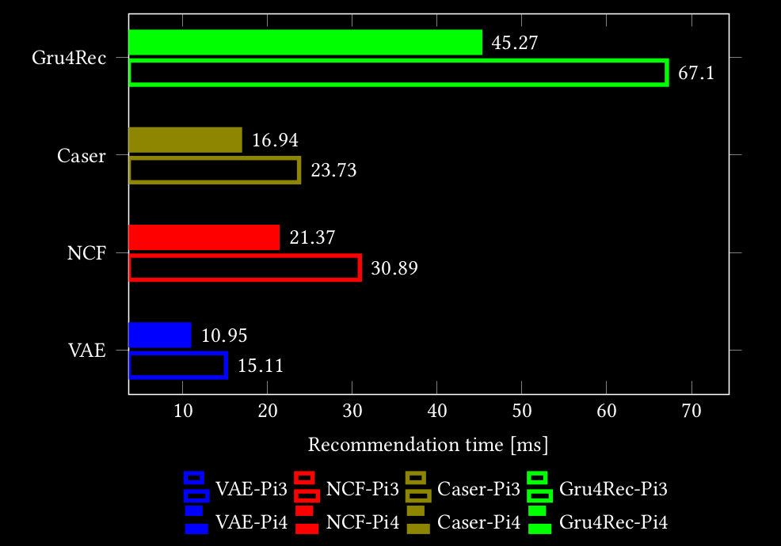
Recommendation time on the edge

Slide 20

Marko Harasic
marko.harasic@fokus.fraunhofer.de

