Slide 1

Final Project Propsoal
RoboCup Offensive Passing System
Oktay Arslan
Alex Cunningham
Philip Rogers
Notes:
Intro: Alex

Slide 2
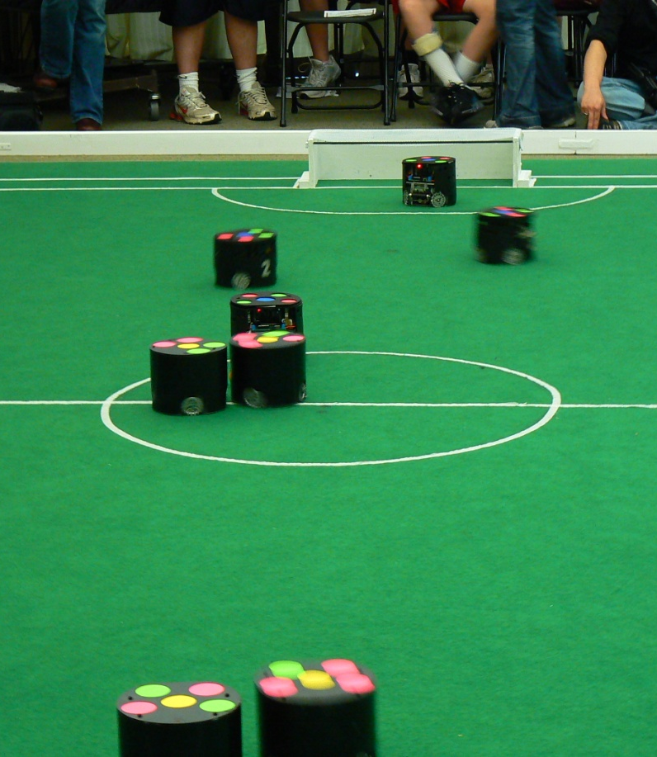
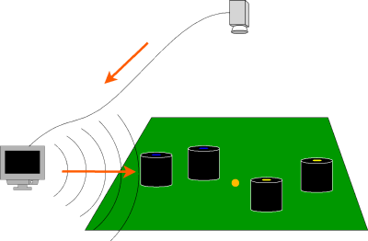
Overview of RoboCup Small Size League (SSL)
5 on 5 fully autonomous robot soccer
Centralized control with overhead vision system
Notes:
RoboCup Description: Alex

Slide 3
Video from 2009 US Open
GT RoboJackets VS. CMDragons
Notes:
Video Narration: Alex

Slide 4
Our Project: Offensive Passing
This project focuses on using a series of passes to outmaneuver opponents and score goals
Overview of basic plan:
  One robot acquires the ball
  Other robots optimize their position for shooting/passing opportunities, as well as preventing the opposing team from scoring
  The robots make a series of passes until there is an open shot on goal
  The team scores
Notes:
Description of project and comparison to current state: Alex

Slide 5
Challenges
Effective soccer play (when using passing) has a number of challenges
  Robots need to coordinate so that the receiver will be intercept the ball properly
  Robots need to position themselves so a series of passes will reach the goal
  The other team is an intelligent adversary that will try to disrupt any plan attempted
  Measurement and motion error are significant
Need to handle both global and local planning

Slide 6
Planning Tasks
Execute basic passing (2 robot case)
Optimize robot positions for
  Receiving passes
  Making future passes
  Making shots
  Handling possible failure (defensive positioning)
Accounting for adversaries and uncertainty

Slide 7
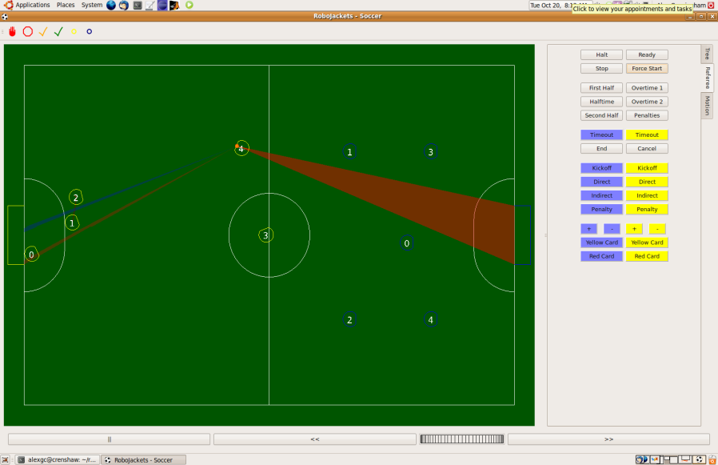
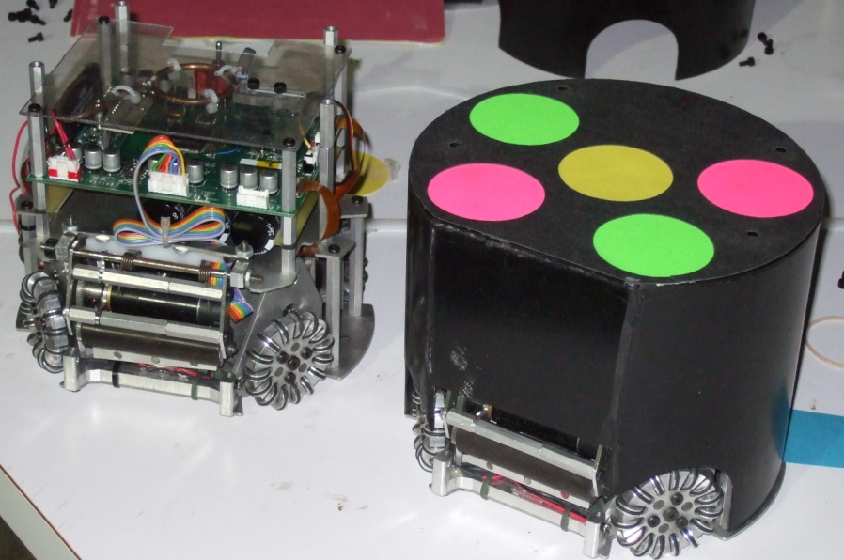
Implementation
Simulator
  Use for playing full soccer games and developing testing scenarios
Real Robots
  Develop simple passing scenarios to ensure that the simulator is representative of the real system

Slide 8
Algorithms
Execution Extended RRTs for basic passing
  Incorporates probabilistic information into RRT plans
  Allows for handling of failure, such as missing a pass, or incorrectly intercepting the ball
Use optimization techniques to find positions for the robots
Use weighted graph searches to determine passing strategy

Slide 9
Timeline
Week 1: Improve infrastructure, RBPF Ball Tracker, ERRT implementation
Week 2: Develop 2-robot scenarios and basic offense play
Week 3: Continue 2-robot passing development
Week 4: Develop full-team passing system and test scenarios
Week 5: Continue full-team passing development
Week 6: Evaluation against old RoboCup Team and results
Week 7: Finalize project and presentation

