Slide 1
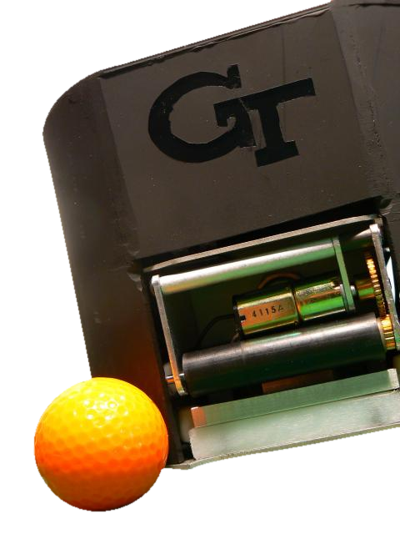
Autonomous Robot Soccer
Planning for Passing
in Robot Soccer
Philip Rogers, Alex Cunningham

Slide 2
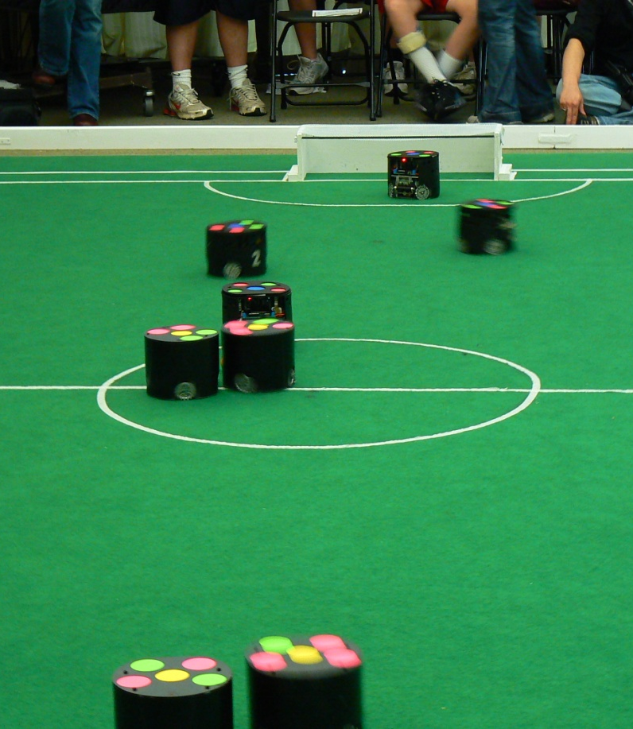
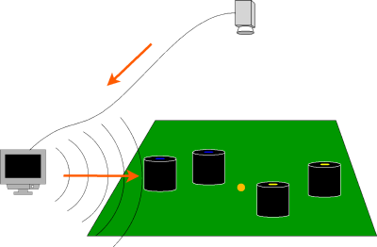
Overview of Small Size League (SSL)
5-on-5 fully autonomous robot soccer.
Centralized control system with overhead vision.
Ball speed much faster than robot speed (10m/s vs 1m/s)

Slide 3
Problem Description
The current team uses a hierarchical behavior-based strategy which does not do “high-level” planning.
We did.... [todo]

Slide 4
Our Approach
Four-step planning:
Create graph structure of potential passes.
Select a subset of the passes that are feasible.
Run plans through an optimizer (nonlinear SQP).
Choose the best plan and execute it.

Slide 5
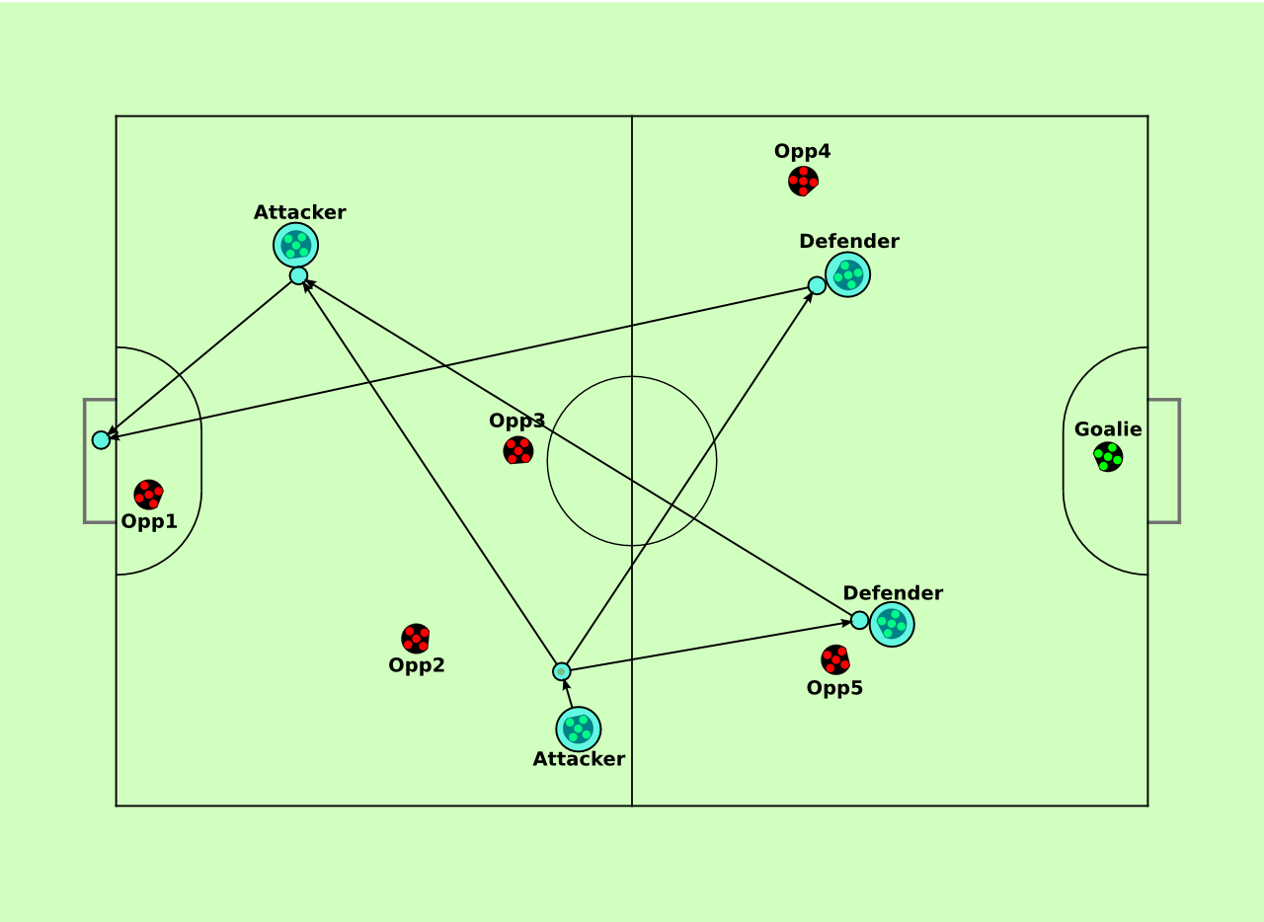
Step 1: Potential passes
Examples of some potential passes:

Slide 6
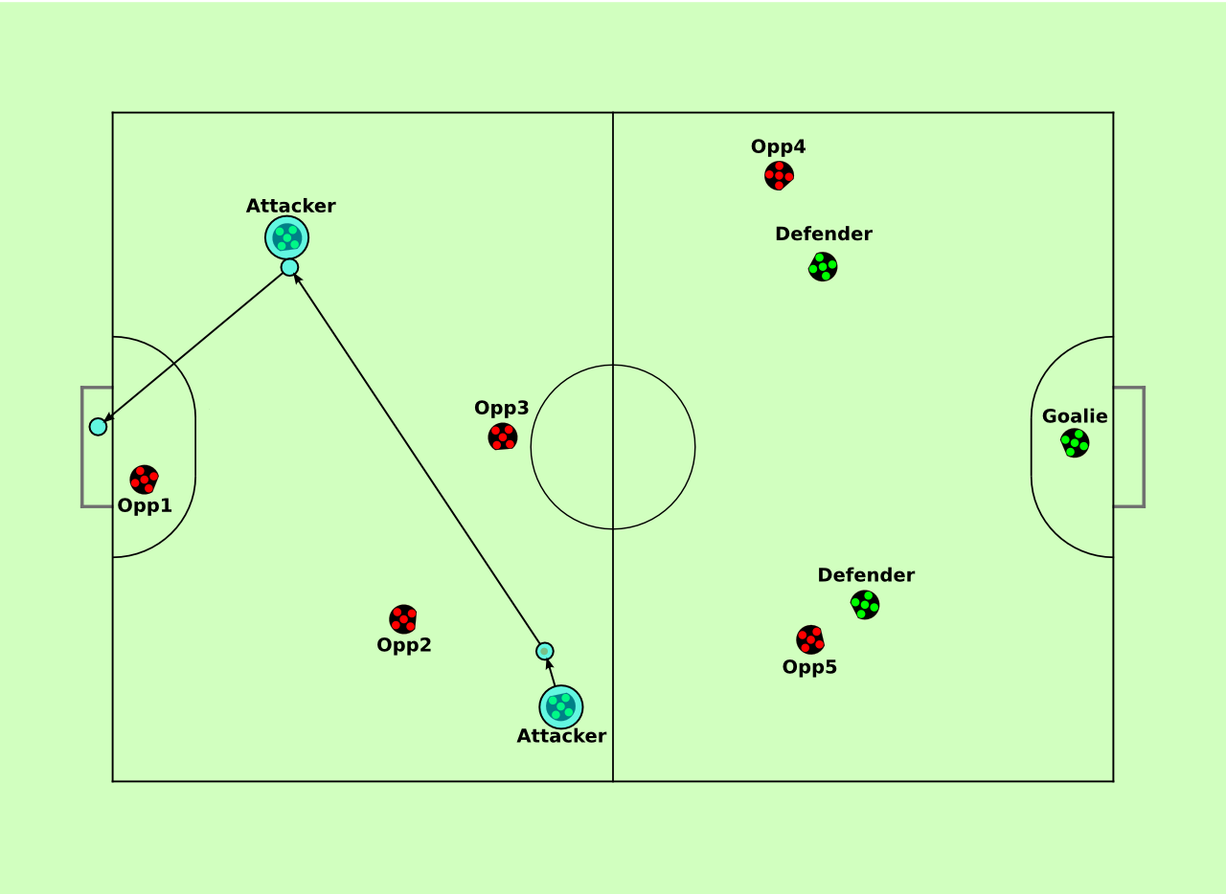
Step 2: Feasible Subset
This pass would considered “good”:

Slide 7
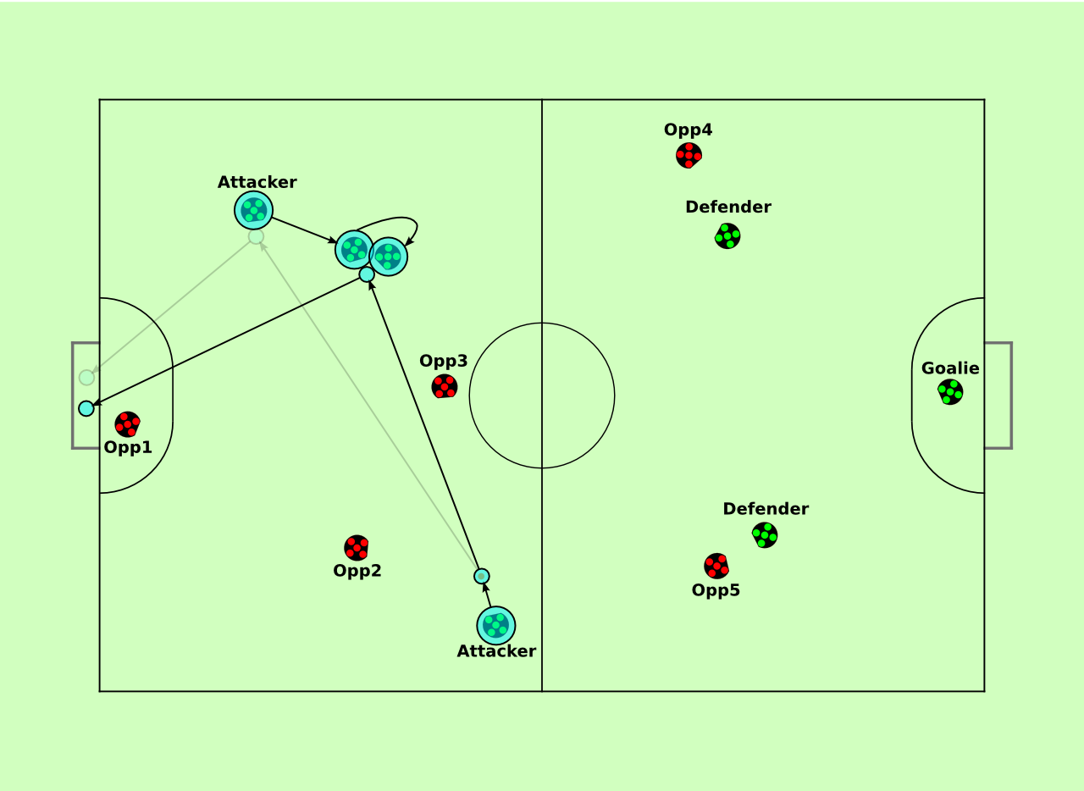
Step 3: Optimization
Text here

Slide 8
Details of optimization
Text goes here

Slide 9
Results
Image of PassConfigs in our UI

Slide 10
Results
Video of execution of pass with static opponent.

Slide 11
Results
Video of execution with our old team as the opponent.

Slide 12
Title: 48pt Calibri
Regular text: 32pt Calibri
Smaller text: 32pt Calibri
Template page

Slide 13
Title: 48pt Calibri
Regular text: 32pt Calibri
Smaller text: 32pt Calibri
Template page

