Slide 1
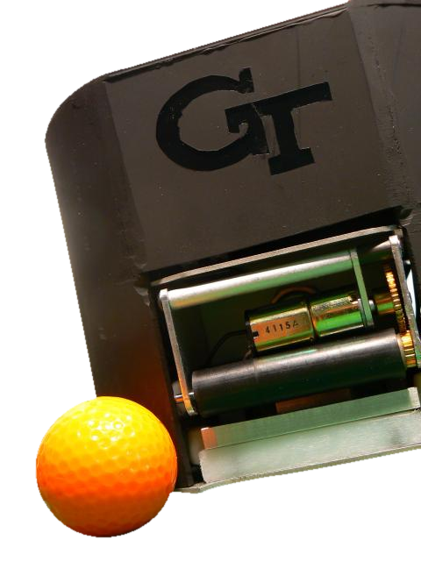
Autonomous Robot Soccer
Planning for Offensive
Passing in Robot Soccer
Philip Rogers, Alex Cunningham

Slide 2
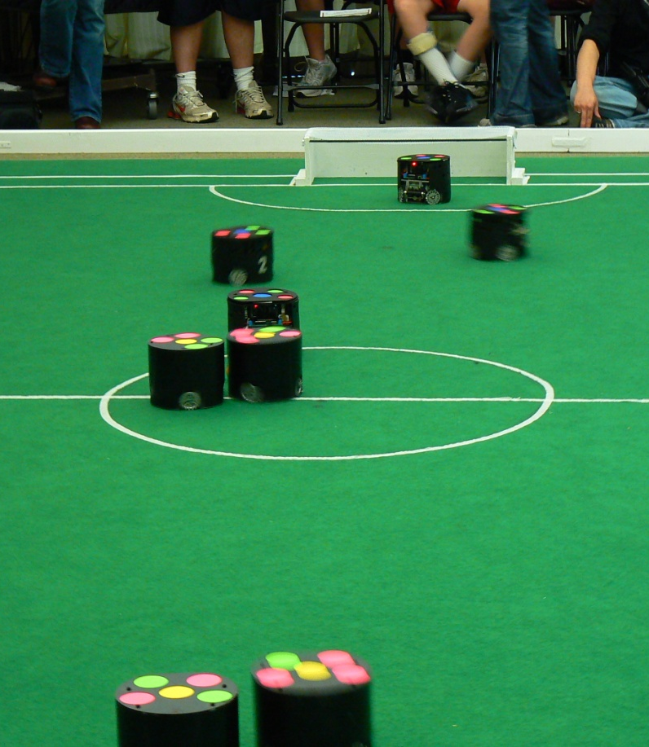
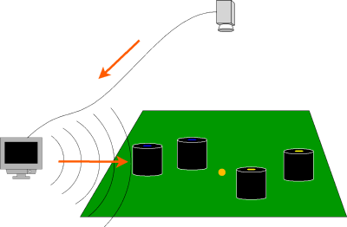
Overview of Small Size League (SSL)
5-on-5 fully autonomous robot soccer.
Centralized control system with overhead vision.
Ball speed much faster than robot speed (10m/s vs 3m/s)

Slide 3
Problem Description
The current system uses a hierarchical behavior-based approach to assign roles to individual robots
There is no strict control of multiple robot interactions, so coordinating passing is very difficult except in trivial cases

Slide 4
Our Approach
Four-stage pass planning and execution:
Create graph structure of potential passes.
Select a subset of the passes that are “best”.
Perform nonlinear optimization on the pass plan to improve robot positioning.
Execute the plan using a variety of low-level controllers

Slide 5
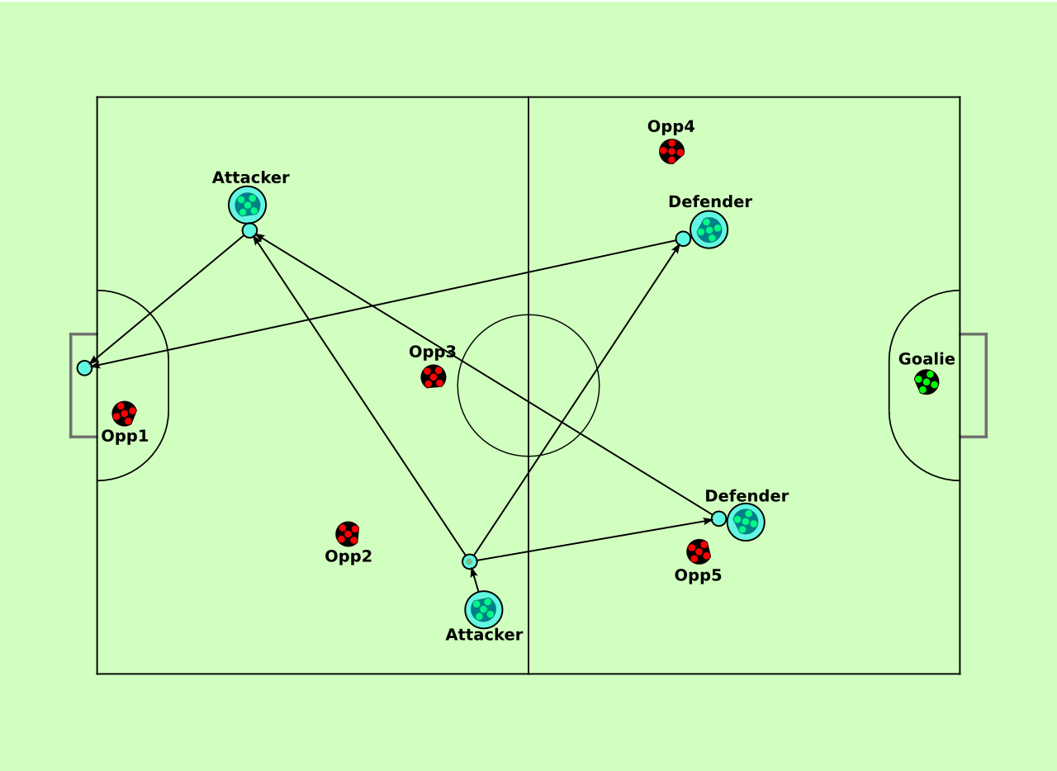
Step 1: Potential passes
Examples of feasible solutions:

Slide 6
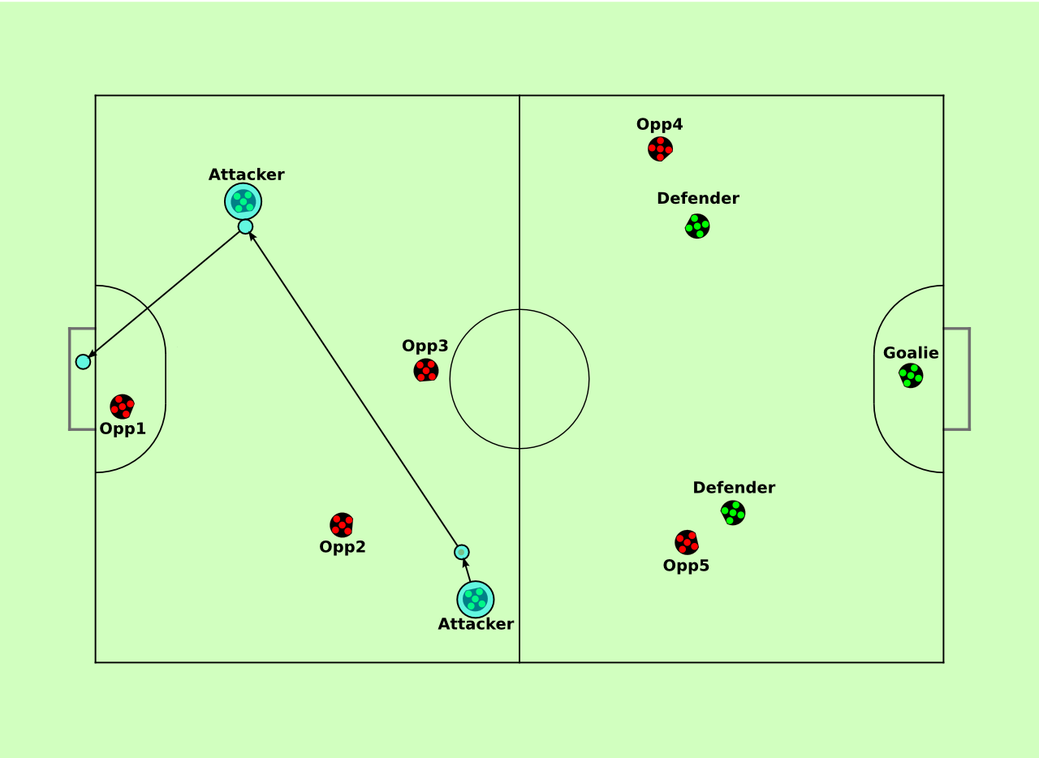
Step 2: Feasible Subset
This pass would considered “good”:

Slide 7
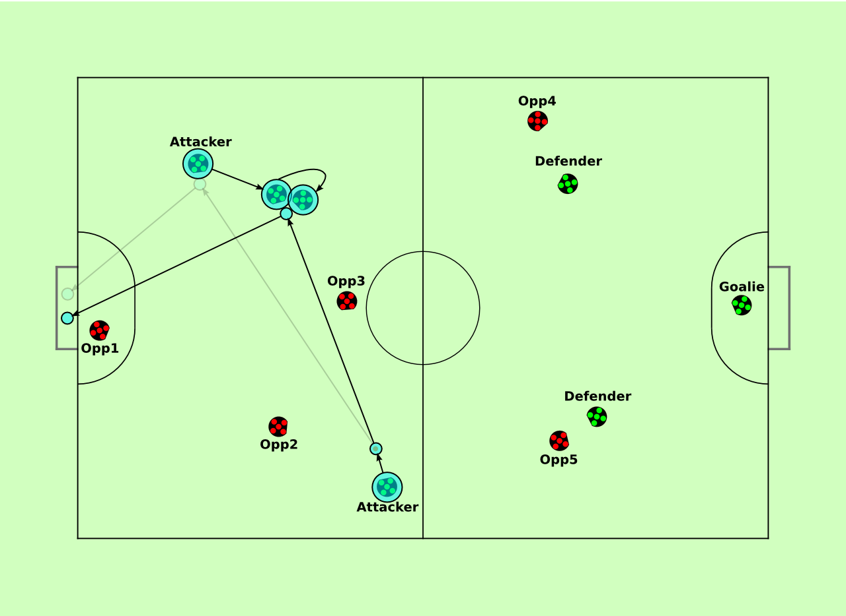
Step 3: Optimization
Adjust position of the receiver to improve speed

Slide 8
Optimization Method
We perform nonlinear constrained simultaneous multi-variable optimization
We construct a cost function to minimize using a graphical model to relate variables
The system can then optimize the cost function for better robot positions using Sequential Quadratic Programming
These tools are usually used for Simultaneous Localization and Mapping

Slide 9
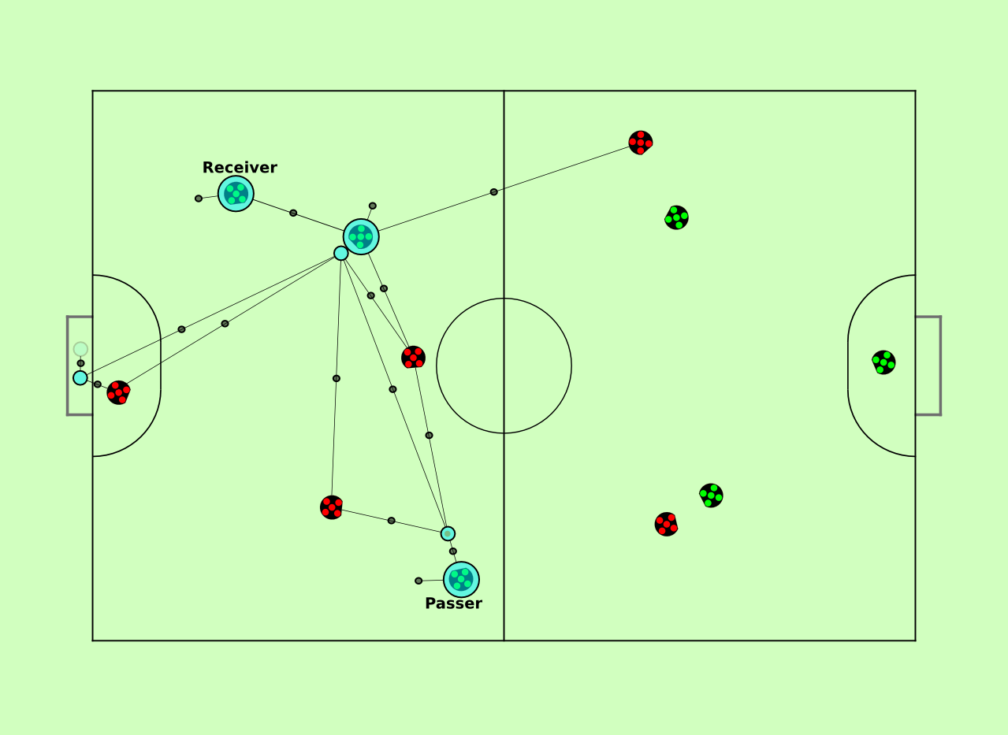
Optimization Factor Graph

Slide 10
Low-Level Control
To execute actions, we reuse low-level behaviors and motion controllers
  Movement: Executed using an RRT-based controller, with manual path and velocity control available
  Kicking: Uses a mix of commands to aim and shoot the ball when ready
These controllers have been tuned to provide effective control using more detailed motion models

Slide 11
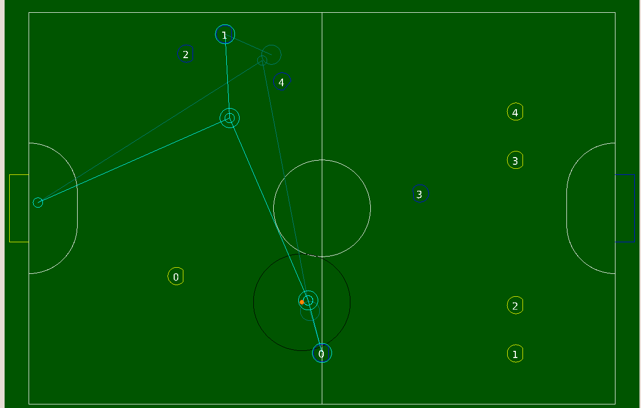
Results

Slide 12
Results
Video of execution of pass with static opponent.

Slide 13
Results
Video of execution with our old team as the opponent.

Slide 14
Conclusions and Future Work
The multi-stage planner allows evaluation of plans we would not have been able to find otherwise
While the current optimization approach uses a simpler cost function, the system is very scalable
We need to improve the interactions between the low-level control and the planner outputs

Slide 15
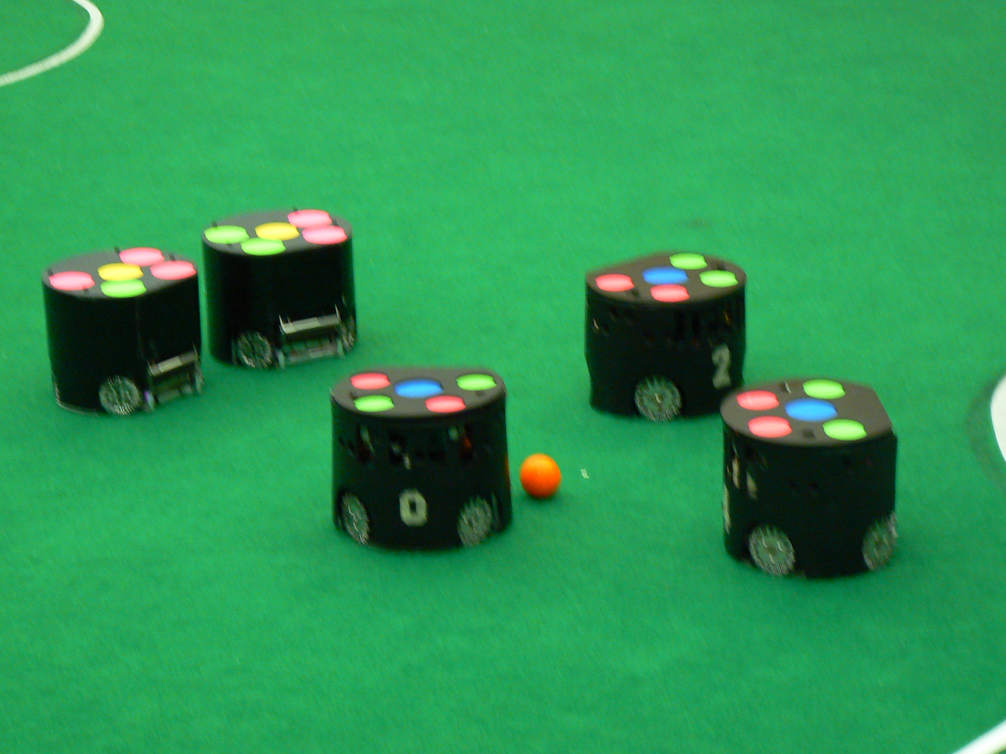
Questions?

Slide 16
Title: 48pt Calibri
Regular text: 32pt Calibri
Smaller text: 32pt Calibri
Template page

Slide 17
Title: 48pt Calibri
Regular text: 32pt Calibri
Smaller text: 32pt Calibri
Template page

