Slide 1


Predicting energy consumption at an hourly frequency for San Diego Gas & Electric (SDGE) utility region

Slide 2
Problem statement
Electricity cannot be stored in large amounts, so supply and demand should always be matched.
Load/energy demand forecasting is fundamental for an energy utility’s decision making mechanism to avoid:
- Grid failures or Wastage of energy
- Costs of under or over cutting
Notes:
- The energy companies need to know how much energy to produce at any given time to avoid grid failures or wastage of energy.
- Costs of under- or over-cutting are high in an energy balancing market which can lead to huge financial losses for an utility.
- They cannot pass their cost to the customers.

Slide 3
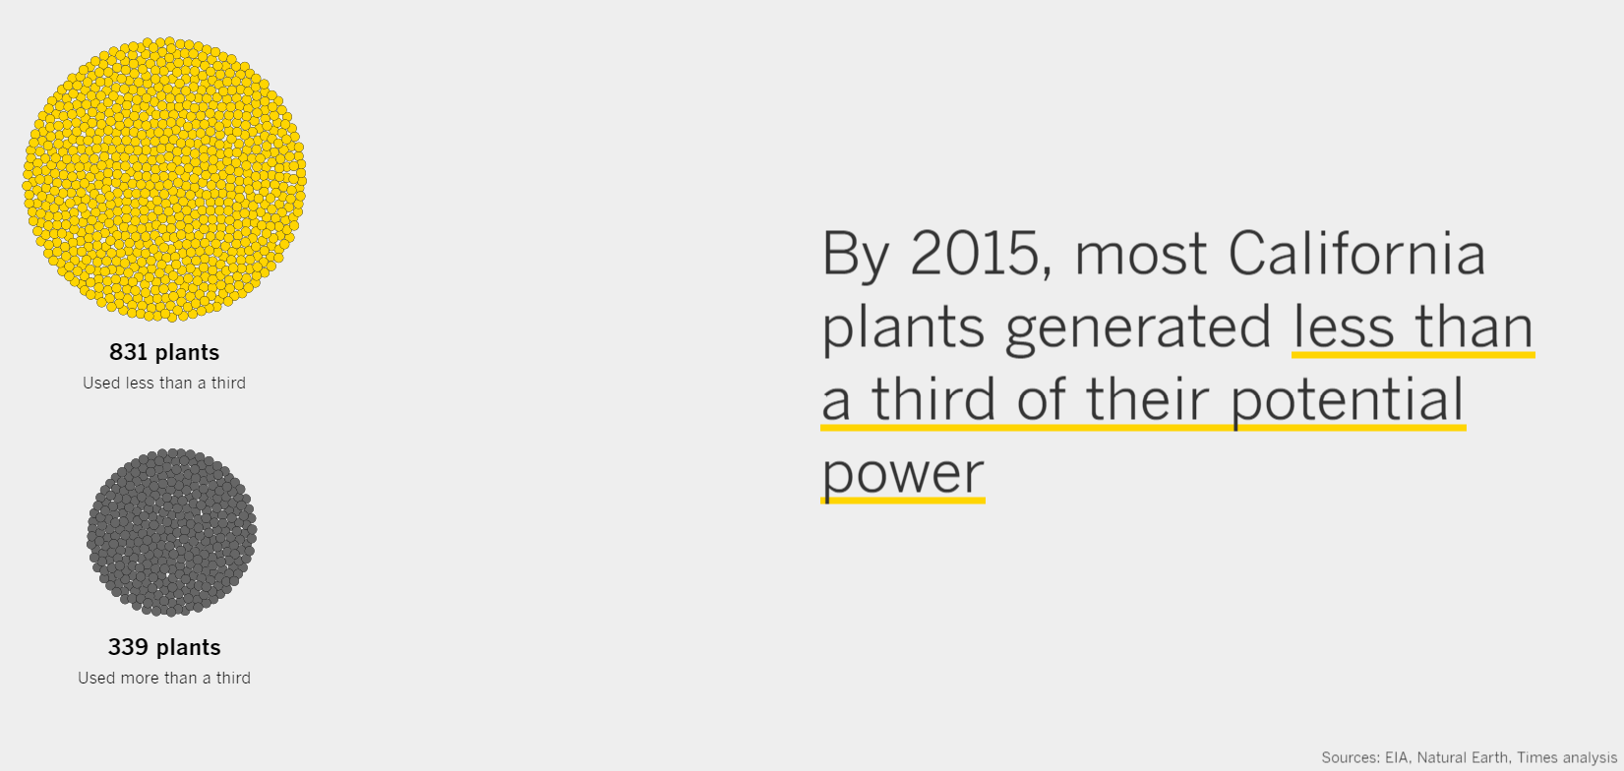
Notes:
https://www.latimes.com/projects/la-fi-electricity-capacity-graphic/

Slide 4
Load forecasting
Load -> Demand (in W) or Energy (in Wh)
For hourly data they are the same
The peak or maximum load decides the capacity of power plant

Slide 5
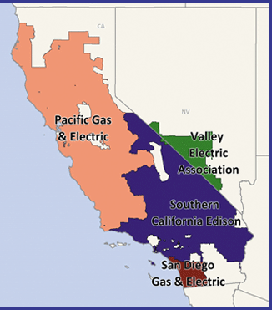
Data sources
California Independent System Operator (CAISO)
- Data link1, link2
We’ll focus on San Diego Gas and Electric utility for this project.
Small area serves better chance to use uniform weather data.
San Diego has high enough population and good distribution of residential and commercial customers.

Slide 6
Process flowchart
Importing data
Hourly energy data
Sub-hourly weather data
PV installation data
Data /cleaning/wrangling
Data /cleaning/wrangling/resampling
Data /cleaning/wrangling/resampling
Extracting features
Extracting features
Adding features
Merge
EDA
Preparing data for ML models, Feature engineering, define error metrics
ML models training & testing and comparing results

Slide 7
A couple graphs from milestone
Assumptions and observations from EDA

Slide 8
Intro to TS

Slide 9
Time series info
Stationarity, auto correlation etc.
Decomposition

Slide 10
Trying Simple Lin reg
Explaining what worked and what not

Slide 11
RF

Slide 12
Fourier terms

Slide 13
SARIMAX

Slide 14
FB Prophet

Slide 15
Elastic and RF with Fourier terms

Slide 16
XG Boost

Slide 17
XG Boost + Fb Prophet

Slide 18
Conclusion

