Slide 1
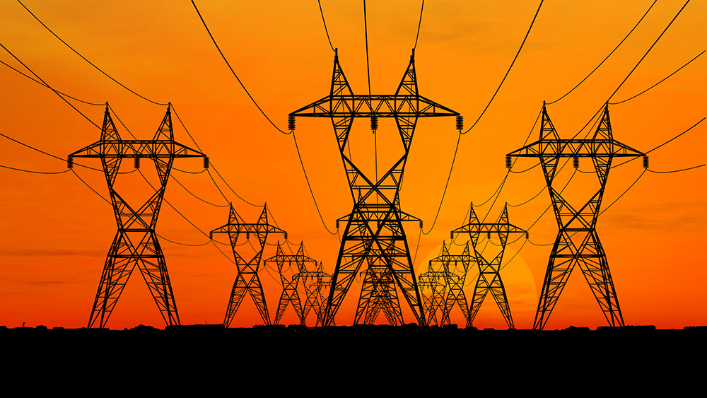
Predicting energy consumption at an hourly frequency for San Diego Gas & Electric (SDGE) utility region

Slide 2
Problem statement
Electricity cannot be stored in large amounts, so supply and demand should always be matched.
Load/energy demand forecasting is fundamental for an energy utility’s decision making mechanism.
The energy companies need to know how much energy to produce at any given time to avoid grid failures or wastage of energy.
Costs of under- or over-cutting are high in an energy balancing market which can lead to huge financial losses for an utility.
They cannot pass their cost to the customers.

Slide 3
Load forecasting (electric load forecasting, electric demand forecasting)
Although "load" is an ambiguous term, in load forecasting the "load" usually means demand (in W) or energy (in Wh) and since the magnitude of power and energy is the same for hourly data, usually no distinction is made between demand and energy.
The basic quantity of interest is typically the hourly total system (or zonal) load. However, load forecasting is also concerned with the prediction of hourly, daily, weekly and monthly values of load and of the peak load.
The peak load (even if it lasts for only 15 minutes) during a given period of time matters more because it decides the capacity of the power plants that should be operated.
Notes:
Load forecasting involves the accurate prediction of both the magnitudes and geographical locations over the different periods of the planning horizon.

Slide 4
Process flowchart
Importing data
Hourly energy data
Sub-hourly weather data
PV installation data
Data /cleaning/wrangling
Data /cleaning/wrangling/resampling
Data /cleaning/wrangling/resampling
Extracting features
Extracting features
Adding features
Merge
EDA
Preparing data for ML models

Slide 5
Energy Data source
California Independent System Operator (CAISO) is a non-profit Independent System Operator serving California. It oversees the operation of California's bulk electric power system, transmission lines, and electricity market generated and transmitted by its member utilities.
CAISO is one of the largest ISOs in the world, delivering 300 million megawatt-hours of electricity each year and managing about 80% of California's electric flow.
Notes:
The system operator (SO) is responsible for managing the security of the power system in real time, coordinating the supply of and demand for electricity, and avoiding frequency fluctuations and interruptions of supply. As the amount of distributed and renewable energy fed into the grid increases, the work of the SO is becoming more complex — a trajectory that is set to continue.
* California Independent System Operator (CAISO) forecasts electrical demand and dispatches the lowest-cost generator to meet demand from 30 million customers. Technology lies at the heart of CAISO's command and control center, and it has invested considerable resources into its sophisticated computer systems, which update the forecasts every five minutes.

Slide 6
Energy data
The hourly energy consumption data for the 4 utilities- PGE (Pacific Gas and Electric), SCE (Southern California Edison), SDGE (San Diego Gas and Electric) and VEA (Valley Electric Association, which actually covers some parts of Nevada)- under the CAISO is available on CAISO’s website in the form of .csv files. The most recent data for 2019 and 2018 is available on http://www.caiso.com/planning/Pages/ReliabilityRequirements/Default.aspx and previous data up to 2014 is available in the archive folder here: http://www.caiso.com/Pages/documentsbygroup.aspx?GroupID=8879C382-6EA8-4357-B752-D4F571388958.

Slide 7
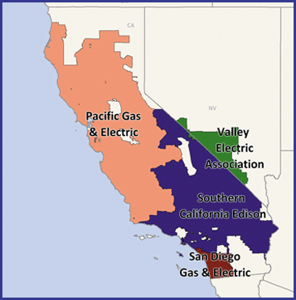
Energy data
CAISO map ->
We’ll focus on San Diego Gas and Electric utility for this project.
Small area serves better chance to use uniform weather data.
San Diego area has high enough population and good distribution of residential and commercial customers.

Slide 8
Energy data cleaning
Importing data directly from URLs and storing it in pandas dataframe.
Cleaning the data and bringing it in uniform format by visualizing the data and using descriptive statistics to check for any potential errors.
Checking for and filling in any null values (the missing values were filled with the average values of the matching month and weekday for the same hours from the rest of the data for that year.)

Slide 9
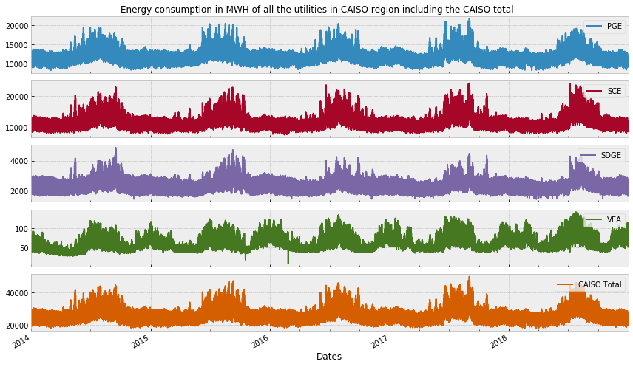
Historical energy data plot for CAISO

Slide 10
Adding features to energy data
Adding the following features to the data:
- year, month, day, hour, weekday, season, holiday, non-working ('non-working' days include weekends and holidays).
- Based on the data on SDGE's site -> https://www.sdge.com/whenmatters#how-it-works months from June to October are denoted as 'summer' and months from November to May as 'winter'.

Slide 11
Extracting time related features
 | Dates | SDGE | Date | year | month | day | hour | weekday | season | holiday | non_working
0 | 2014-01-01 00:00:00 | 2096.0 | 2014-01-01 | 2014 | 1 | 1 | 0 | Wednesday | winter | 1 | non-working
1 | 2014-01-01 01:00:00 | 1986.0 | 2014-01-01 | 2014 | 1 | 1 | 1 | Wednesday | winter | 1 | non-working
2 | 2014-01-01 02:00:00 | 1936.0 | 2014-01-01 | 2014 | 1 | 1 | 2 | Wednesday | winter | 1 | non-working
3 | 2014-01-01 03:00:00 | 1896.0 | 2014-01-01 | 2014 | 1 | 1 | 3 | Wednesday | winter | 1 | non-working
4 | 2014-01-01 04:00:00 | 1899.0 | 2014-01-01 | 2014 | 1 | 1 | 4 | Wednesday | winter | 1 | non-working
SDGE -> Hourly energy consumption data in MWH
Holiday -> national holidays as per US calendar
Non-working -> Holiday + Weekend

Slide 12
Weather data
To see the impact of weather (specifically the temperature) on the energy consumption, we'll import the hourly temperature data from https://www.ncei.noaa.gov/metadata/geoportal/rest/metadata/item/gov.noaa.ncdc:C00684/html.
There are two or more weather stations in San Diego for which the weather data is available. Since weather data at airports is more accurate and not biased by nearby buildings and industries we'll use the San Diego International airport data for this project. (we can always add in data from more stations and use them to see if it helps in the forecast).

Slide 13
Features from weather data
Only a few columns from the weather data were imported and used for this project.
'STATION’ -> the weather station id at which the data was recorded. Since we are using airport data we will have only station id.
'DATE’ -> the date and time of recording.
'HourlyDryBulbTemperature’ -> the outside temperature in ℉.
Degree days are defined as the number of degrees by which the average daily temperature is higher than 65°F ('DailyCoolingDegreeDays') or lower than 65°F ('DailyHeatingDegreeDays'). Degree days reflect changes in climate and are used as a proxy for the energy demand for heating or cooling buildings.
Initially we'll focus on using only the temperature data but cleaning other columns nonetheless for future purposes.

Slide 14
Resampling weather data
Since the weather data is captured every 7 minutes and the energy consumption data is hourly data, resampling the weather data in hourly intervals and calculating average temperature for each hour.
 | STATION | DailyCoolingDegreeDays | DailyHeatingDegreeDays | HourlyDryBulbTemperature
DATE
2014-01-01 00:00:00 | 72290023188 | 0.0 | 7.0 | 51.0
2014-01-01 01:00:00 | 72290023188 | 0.0 | 7.0 | 51.5
2014-01-01 02:00:00 | 72290023188 | 0.0 | 7.0 | 51.8
2014-01-01 03:00:00 | 72290023188 | 0.0 | 7.0 | 50.0
2014-01-01 04:00:00 | 72290023188 | 0.0 | 7.0 | 48.8

Slide 15
Merging energy and weather data
Merging the energy data and weather data on the Dates column of both the dataframes and using the method 'outer' to check if any of the two dataframes has values which are missing in the other dataframe.
No null values were found, all the rows from the energy dataframe were matched with the resampled weather dataframe rows on their respective date columns.

Slide 16
PV installation data
After some initial EDA on the energy data it was observed that:
the energy consumption and peak demand have decreased over the years from 2014 to 2018 (plots are shown later in the ppt).
This can be due to stricter energy efficiency measures being mandated, or increase of incentives for different categories of ratepayers (residential, commercial, agriculture, etc.) to install self-generation resources like solar, wind, etc. and/or energy storage in their premises to avoid peak loads and decrease overall energy consumption.
Additionally it was observed that the energy consumption decrease over the years was more dominant over the daylight hours, so we can test the theory that maybe solar capacity installed in the utility region has increased over the years and thus more and more customers are using less energy when the sun is out causing a total reduction in energy consumption. We can test this theory by importing the solar installations data in SDGE territory.

Slide 17
PV installation data source
The solar installations data was imported from https://www.californiadgstats.ca.gov/downloads/ -> 'NEM Currently Interconnected Data Set’.
This dataset contains a lots of parameters but we will focus on the 'approval date' which represents the date when the system was connected to the grid and 'System Size AC' which represents the total kW power in AC of the solar panels installed at a site.
To get more details about the data, one can check the 'NEM_CurrentlyInterconnectedDataKey.b29667e204f3.xlsx' workbook in the repo.

Slide 18
PV installation data
The imported .csv files has many columns including the following:
It's good to have the above data if in future we decide to use the county or zipcode information but for now, let's focus on the approved date, i.e. the date the system was allowed by SDGE* to start operation, and 'System Size AC', i.e. the installed system capacity of the solar panels in kW.
* Filtering data to keep rows having Utility == ‘SDGE’.
 | Application Id | Matched CSI Application Number | Application Status | Utility | Service City | Service Zip | Service County | System Size AC | App Approved Date | Electric Vehicle | Electric Vehicle Count
 | PGE-INT-106960619 | PGE-CSI-05317 | Interconnected | PGE | SAN FRANCISCO | 94107.0 | SAN FRANCISCO | 2.510 | 2013-09-10 | NaN | 0.0

Slide 19
PV installation data modification
For our modeling purpose we are not interested in how much PV capacity was installed in one day but rather we are interested in knowing how much total capacity of PV system is currently under operation in the region.
For example, if we want to forecast the energy consumption of a particular hour of any day in a year, then we want to know how much PV system capacity (operational) has been installed till that hour.
So, using a cumulative of the system size we want to see how the total solar capacity in the region increased overall.

Slide 20
Merging PV installation data with the previous weather and energy data
Truncating the PV installation data to the min and max dates' limits of the 'weather+energy’ dataframe.
Merging the both the dataframes using merge on the weather+energy dataframe because we don't want to retain the indices of our original energy dataset.
Checking the merged dataframe which now should include the energy, weather and PV installations data.
 | Dates | SDGE | Date | year | month | day | hour | weekday | season | holiday | non_working | STATION | DailyCoolingDegreeDays | DailyHeatingDegreeDays | HourlyDryBulbTemperature | AC_kW | cum_AC_kW
0 | 2014-01-01 00:00:00 | 2096.0 | 2014-01-01 | 2014 | 1 | 1 | 0 | Wednesday | winter | 1 | non-working | 72290023188 | 0.0 | 7.0 | 51.0 | NaN | NaN
1 | 2014-01-01 01:00:00 | 1986.0 | 2014-01-01 | 2014 | 1 | 1 | 1 | Wednesday | winter | 1 | non-working | 72290023188 | 0.0 | 7.0 | 51.5 | NaN | NaN

Slide 21
Cleaning the merged dataset
Since, not necessarily every single day in 5 years (2014-18) solar panels were installed, the merged dataframe didn't have all the rows matching the weather+energy dataframe which resulted in missing values in the AC_kW and cum_AC_kW columns.
We can just put a 0 in place of NaN to indicate 0 installations for that day for 'AC_kW' column (we won’t be using the AC_kW anyways).
And since the cumulative installed solar system size should remain same until the next non-NaN value is encountered, using forward fill method to fill the 'cum_AC_kW' column.

Slide 22
Cleaning the merged dataset
Forward fill worked on all the rows except the first few rows because the PV installations data didn't start at 2014-01-01 00:00:00 as our energy and weather data, so we'll have to use a different method to fill in the first few missing values.
The initial missing values should be equal to the first non-NaN ('cum_AC_kW' - 'AC_kW').
Dates | SDGE | Date | year | month | day | hour | weekday | season | holiday | non_working | STATION | DailyCoolingDegreeDays | DailyHeatingDegreeDays | HourlyDryBulbTemperature | AC_kW | cum_AC_kW
2014-01-01 00:00:00 | 2096.0 | 2014-01-01 | 2014 | 1 | 1 | 0 | Wednesday | winter | 1 | non-working | 72290023188 | 0.0 | 7.0 | 51.0 | 0.0 | 220992.227
2014-01-01 01:00:00 | 1986.0 | 2014-01-01 | 2014 | 1 | 1 | 1 | Wednesday | winter | 1 | non-working | 72290023188 | 0.0 | 7.0 | 51.5 | 0.0 | 220992.227

Slide 23
Data wrangling, Exploration and Stats
Checking how the energy consumption varies across any particular day averaged over the entire period. Typical average daily load profile would be a curve peaking at the evening time because most people return home from work during evening and turn on their lights, TV, AC, etc..
Plotting monthly average load profiles. San Diego has hot summers but the winters are not that cold so we can expect the load to be higher in summers because of the cooling load on the commercial and residential buildings.
Checking if the average monthly consumption values have increased over the years.
Checking how the energy consumption varies for weekdays vs the weekends or the holidays
Checking hourly vs weekday energy consumption map to get an overall idea of the consumption pattern during a typical week.
What is the effect of weather on the energy consumption?
Has the increasing number of solar installations behind the customer meter resulted in a decrease in total energy consumption of the entire SDGE territory?

Slide 24
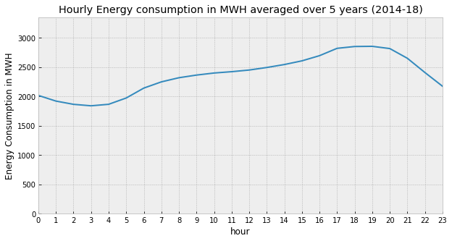
Hourly energy consumption
From the average hourly load profile graph we can observe how the load remains low over the night and then starts increasing in the late morning, and continues increasing during the office hours and peaks in the evening when everyone returns home and turns on the electrical appliances in their house.

Slide 25
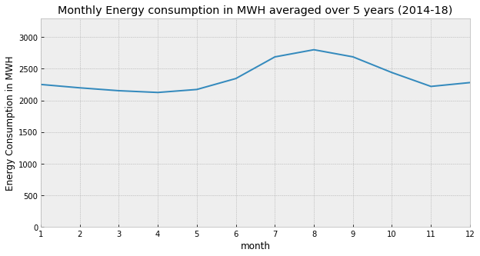
Monthly load profile
As expected the monthly load profile peaks in the summer due to high cooling (air-conditioning) loads caused by high temperatures.

Slide 26
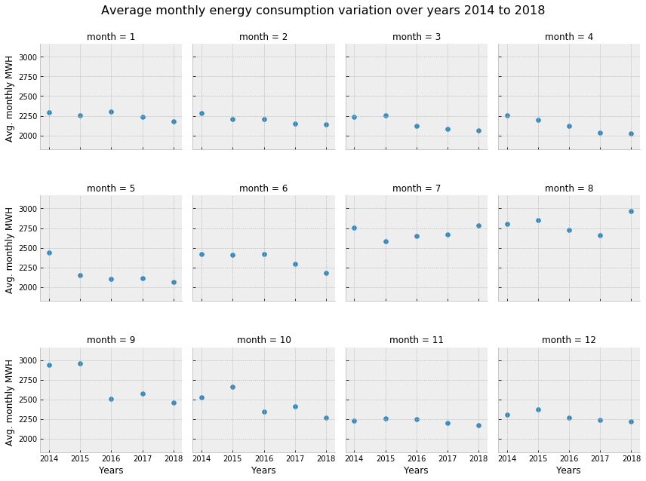
Average monthly energy consumption observed for each month over the past 5 years
A weak trend can be observed in the data, but it is different for different months. For example, April, May, June, September and October months show a considerable downward trend, whereas other months not so much.

Slide 27
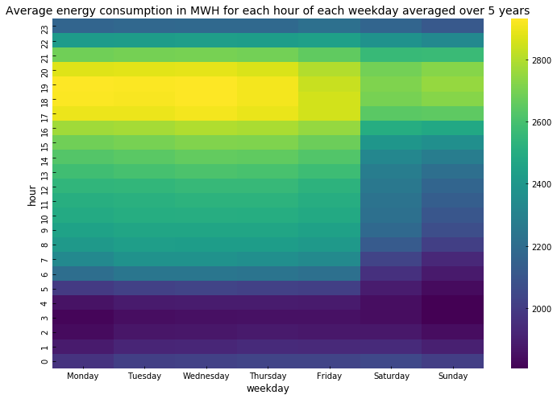
A map of hourly vs weekdays energy consumption
It can be seen that the average consumption from Monday to Friday is below 2000 in the night and it increases during the day and is at peak (>2800) during the evening time before sliding down again for the night.
And on the weekends the same pattern can be observed but the overall consumption seems lower on weekends than weekdays as expected because most of the commercial buildings don't operate on weekends (also maybe because people go out on weekends and are not usually at home?)

Slide 28
A map of hourly vs weekdays energy consumption (Contd.)
Also from all the above graphs it can be seen that the evening consumption is considerably higher than the rest of the day consumption. The reason for this, as pointed out earlier, is that people usually return home from work during evening hours (~4-9pm) and the consumption increases due to the turning on of electronic appliances like lights, TV, computers, air conditioning, etc.
And due to the exact same reason, to keep the load on the electrical grid lower during this time, SDGE (and other utilities) try to discourage people from using more electricity during these hours.
SDG&E began transitioning residential customers to Time-of-Use (TOU) pricing plans in early 2019; a TOU plan is one wherein the utility applies different rates to the customers for different time slots during the day. And in fact, SDGE applies highest rate (peak rate) during 4pm to 9pm to its customers as compared to other hours during the day. From SDGE's website: "If customers can shift some of their energy use to lower-cost time periods outside 4 p.m. to 9 p.m., they can lower their electricity bills and make better use of cleaner, renewable energy sources, like wind and solar, when they are more available."

Slide 29
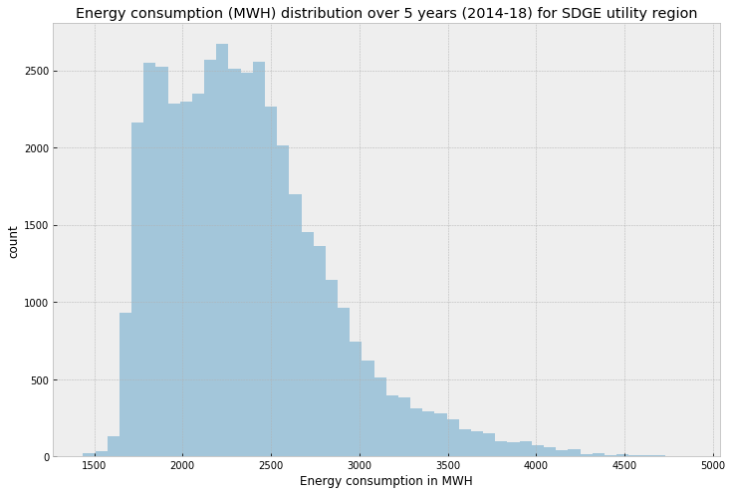
Overall distribution of the energy consumption for SDGE territory

Slide 30
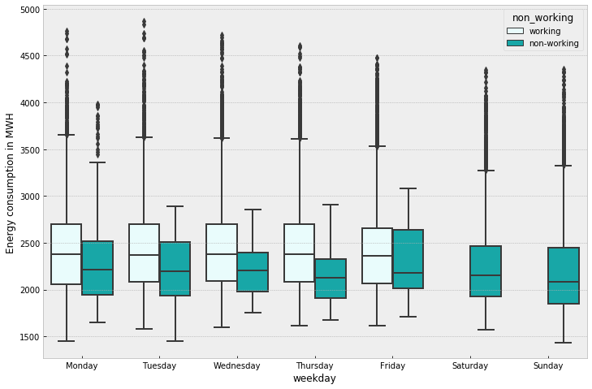
Energy distribution using box plots
It can be seen that the median energy consumption on working days remains fairly same from Monday to Friday and drops on the weekend as seen before in the heatmap.
Also, if a particular day is a holiday or non-working day (indicated in dark green) the energy consumption is much lower than if the same day was a working day as expected.

Slide 31
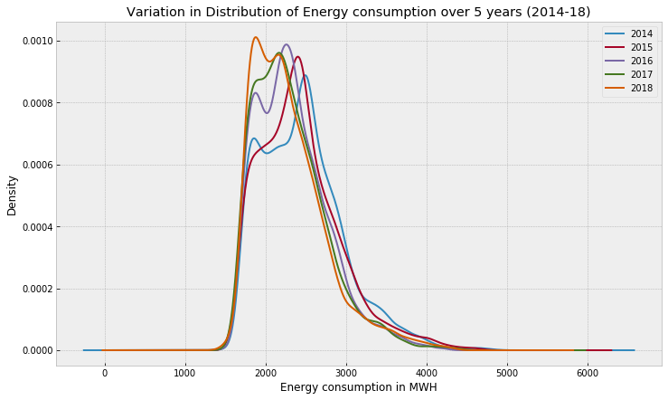
Distribution of energy consumption over different years
For all the years the distribution is kind of bi-modal and the mode values for energy consumption consistently shift towards left (towards lower energy load) each year from 2014 to 2018.
This shift can be assumed to be caused by increasing renewable energy installations at customer sites (called as behind the meter) and increasing participation of customers in demand response programs resulting in a lower peak demand on the grid.

Slide 32
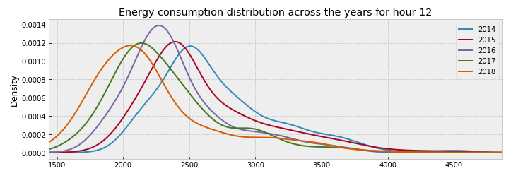
Distribution plots hourly
If we plot the above distribution plot for each hour (see an example plot below) we can see that the distribution for each hour has shifted towards lower energy consumption values from 2014 to 2018, and this effect is more dominant during the daylight hours of 8am to 5pm.
One of the reasons for this shift during daylight hours can be the addition of more renewables like solar and wind behind the customer meters. We will see later that the solar installations in the SDGE have increased considerably over the last 5 years.

Slide 33
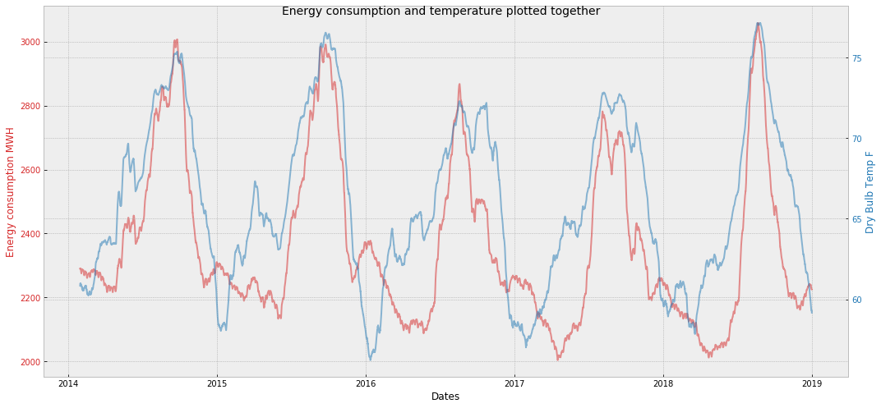
Exploring energy and weather data together

Slide 34
Exploring energy and weather data together
As suspected before, we can see that the energy consumption and temperature do kind of follow each other and seem to have some level of correlation between them.
More importantly we can see that the highest energy consumption values (peak demand) occur at highest temperatures. This, as mentioned before, is the reason of higher cooling loads at higher temperatures.

Slide 35
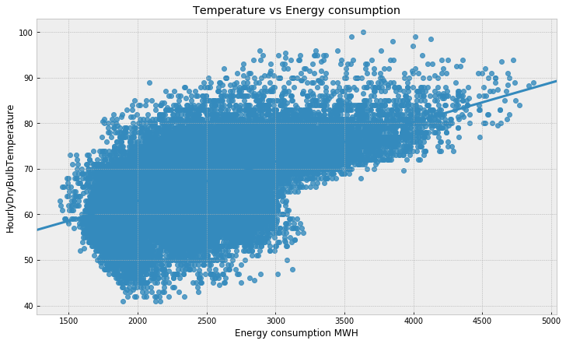
Linear regression plot between the energy consumption and temperature

Slide 36
Correlation between energy and weather data
The pearsonr correlation coefficient between the energy consumption and the temperature was observed to be +0.58 and the pvalue for observing such coefficient value was observed to be almost 0.
We can say that the correlation is not a result of random chance.
pearson correlation coefficient for winter 0.32.
pearson correlation coefficient for summer 0.65.
Notes:
We can also see the correlations using the scipy.stats.pearsonr function. The scipy.stats.pearsonr function returns the pearsonr coefficient and the pvalue of observing such coefficient if we were to assume that there was no correlation between the x and y data sets. (Let's select a signifance level of 5%, and so if the pvalue is <5%, we will assume that the correlation coefficienct returned is significant.)

Slide 37
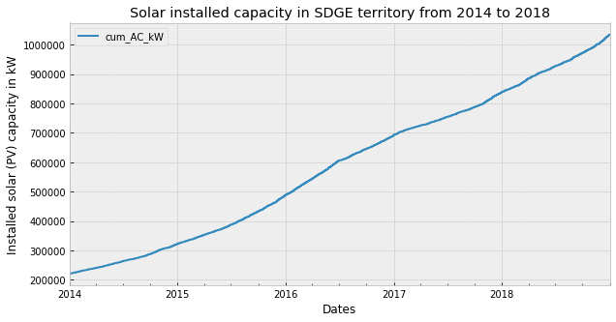
Exploring PV installations data together
It can be seen that there was a considerable increase in the solar installations in the SDGE territory over the past 5 years and the installed capacity reached the 1 MW mark at the end of 2018.

Slide 38
Exploring energy and PV installations data together
Energy consumption vs PV installed capacity: pearson correlation coefficient and pvalue for winter -0.52 and 0.0.
Energy consumption vs PV installed capacity: pearson correlation coefficient and pvalue for summer -0.34 and 0.0.
(Note: Simplified assumption used here - restricting the hours to sunlight hours, roughly 10 am to 3 pm because San Diego usually gets 5 hours of peak sunlight on an average over the entire year- ref: https://www.wholesalesolar.com/solar-information/sun-hours-us-map).
Notes:
The correlation seems to be significant for both the seasons and is much stronger for winter months. It’s a bit counterintuitive, but colder temperatures are actually better for solar panels than warm temperatures are. This relationship holds true across most types of solar panels – and has nothing to do with the installation process itself. Studies conducted in laboratories all over the world clearly show that increases in temperature have an inverse effect on the total solar output of the panels tested. In other words, the hotter it gets, the less efficient your solar PV system becomes.
Thus, all things being equal, your monthly utility bill savings will be less during June, July, August than they will be in December, February, and January. Ref: https://www.sunlineenergy.com/solar-pv-power-output-san-diegos-winter-months/

Slide 39
Future work
Build a simple model to predict the energy consumption based on just the date and time features. Treat this as the baseline model.
Add in more features like the temperature and PV installed capacity data and check if the performance improves compared to the baseline.

Slide 40
References
https://en.wikipedia.org/wiki/Energy_forecasting
https://www.ge.com/power/transform/article.transform.articles.2017.dec.energy-demand-forecasting-in-a
http://www.caiso.com/TodaysOutlook/Pages/default.aspx
http://oasis.caiso.com/mrioasis/logon.do
https://en.wikipedia.org/wiki/California_Independent_System_Operator

