Slide 1
Oasis Journal Discovering Relationships via Exploratory Analysis of Mood and Sleep using LLMs and Statistical Models (DREAMS (LLMs))
By: Darian Hamel
Instructor: Robert Guderian
Course: COMP 4560: Industrial Project

Slide 2
Introduction
Forecast mood using behavioural data and AI/ML/Statistical models
Core Question:
Can sleep, habits and journal entries reliably predict next day mood, and does emotional and event extraction improve accuracy?

Slide 3
Problem Statement
We need to predict mood on a scale of 0-4 (0 being worst and 4 being best)
We have:
Journal Entries
Sleep Scores
Mood Scores

Slide 4
Data Overview
Synthetic Dataset
Utilized for training and validation
7 Personas – 1 with 100 entries, 6 with 50 each
Real Dataset
3681 Entries
377 Unique users

Slide 5

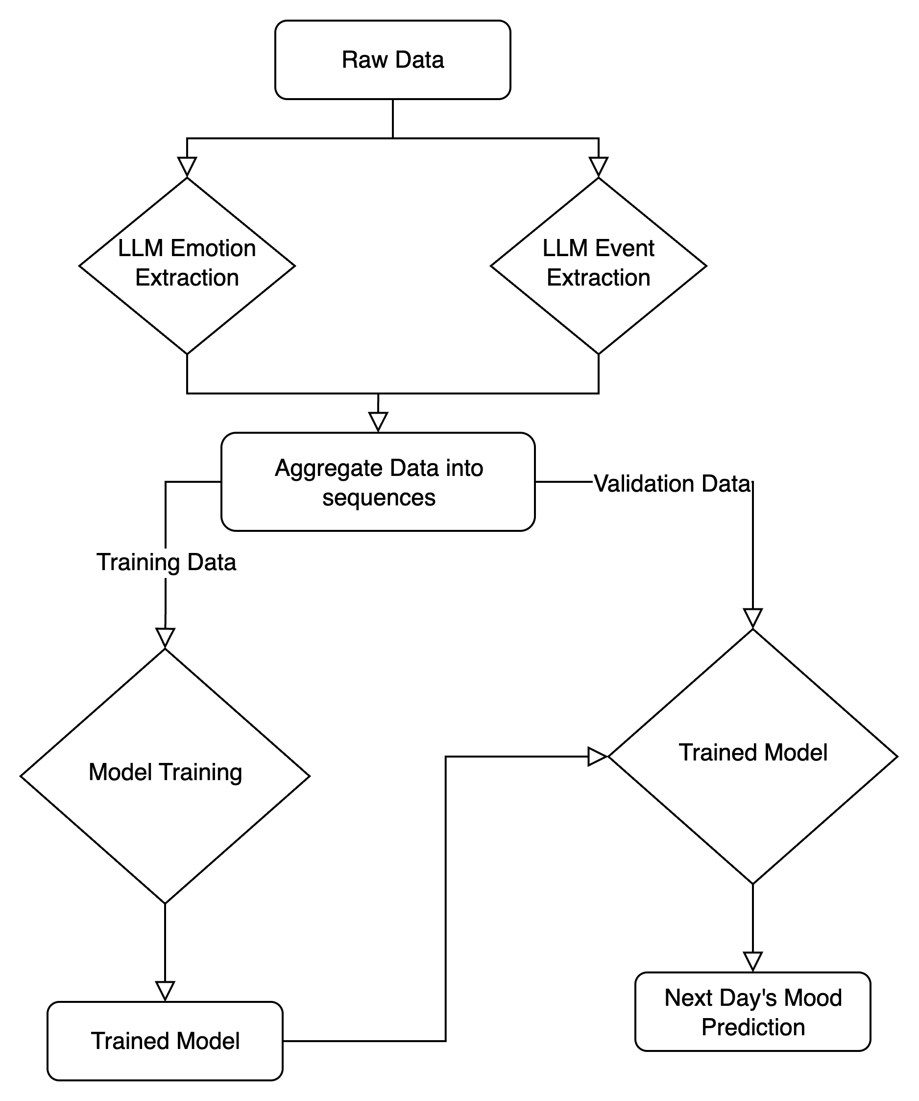
Methodology
Perform emotion and event extraction on journal entries
Combine the data
For neural networks and random forest, data is combined into a sequence of 2 day window with t and t-1 data, e.g. today mood/sleep/events/emotion and yesterday’s mood/sleep/events/emotion
Train the models
Take trained model and predict next mood (validation and prediction)

Slide 6
Results
LLM Prompting:
Near random (20% on 5 classes, 30% on 3 classes)
Random Forest: Was promising but could not improve results
16% accuracy on 5 classes of emotions, 28% on 3 classes, still worse than random
Simple Neural Network (No emotion or event extraction)
29% on 5 classes, 54% on 3 classes
Neural Network with emotion and event extraction
72% on 5 classes, 77% on 3 classes

Slide 7
Neural Network vs simple Neural Network
Non-Mapped Report:
Mapped Sentiment Report:
 | Precision | Recall | F1-Score | Support
Negative | 1.00 | 0.46 | 0.63 | 28
Neutral | 0.90 | 0.56 | 0.69 | 16
Positive | 0.71 | 1.00 | 0.83 | 52
Accuracy |  |  | 0.77 | 96
Macro Average | 0.87 | 0.68 | 0.72 | 96
Weighted Average | 0.83 | 0.77 | 0.75 | 96
 | Precision | Recall | F1-Score | Support
Negative | 0.00 | 0.00 | 0.00 | 28
Neutral | 0.00 | 0.00 | 0.00 | 16
Positive | 0.54 | 1.00 | 0.70 | 52
Accuracy |  |  | 0.54 | 96
Macro Average | 0.18 | 0.33 | 0.23 | 96
Weighted Average | 0.29 | 0.54 | 0.38 | 96
 | Precision | Recall | F1-Score | Support
Worst | 0.00 | 0.00 | 0.00 | 9
Bad | 0.75 | 0.63 | 0.69 | 19
Neutral | 0.91 | 0.62 | 0.74 | 16
Good | 0.71 | 0.96 | 0.82 | 28
Best | 0.65 | 0.83 | 0.73 | 24
Accuracy |  |  | 0.72 | 96
Macro Average | 0.60 | 0.61 | 0.59 | 96
Weighted Average | 0.67 | 0.72 | 0.68 | 96
 | Precision | Recall | F1-Score | Support
Worst | 0.00 | 0.00 | 0.00 | 9
Bad | 0.12 | 0.11 | 0.11 | 19
Neutral | 0.50 | 0.12 | 0.20 | 16
Good | 0.28 | 0.68 | 0.40 | 28
Best | 0.56 | 0.21 | 0.30 | 24
Accuracy |  |  | 0.29 | 96
Macro Average | 0.29 | 0.22 | 0.20 | 96
Weighted Average | 0.33 | 0.29 | 0.25 | 96

Slide 8
Key Findings
Mapping emotional classes to Negative/Neutral/Positive over the 5 classes improved predictions
Emotion and events are important factors of mood
More context, more better

Slide 9
Challenges
Limited real data to get real world feedback
Moods are subjective
Overfitting is easy to accomplish as neural networks get more complex

Slide 10
Conclusion
LLM preprocessing improves neural network performance
Utilizing neural networks seems to be an effective way to predict emotion
(They’re modeled after our brains! – kind of)
Future
Personalize the generalized neural network for each individual
Incorporate habit and to-dos to improve model predictions
When enough data is present, switch model to LSTM for improved trend sensitivity

