Slide 1

Client-Server Messaging
(Project Cypher 2.0)
CIS470 Data Communication

Slide 2
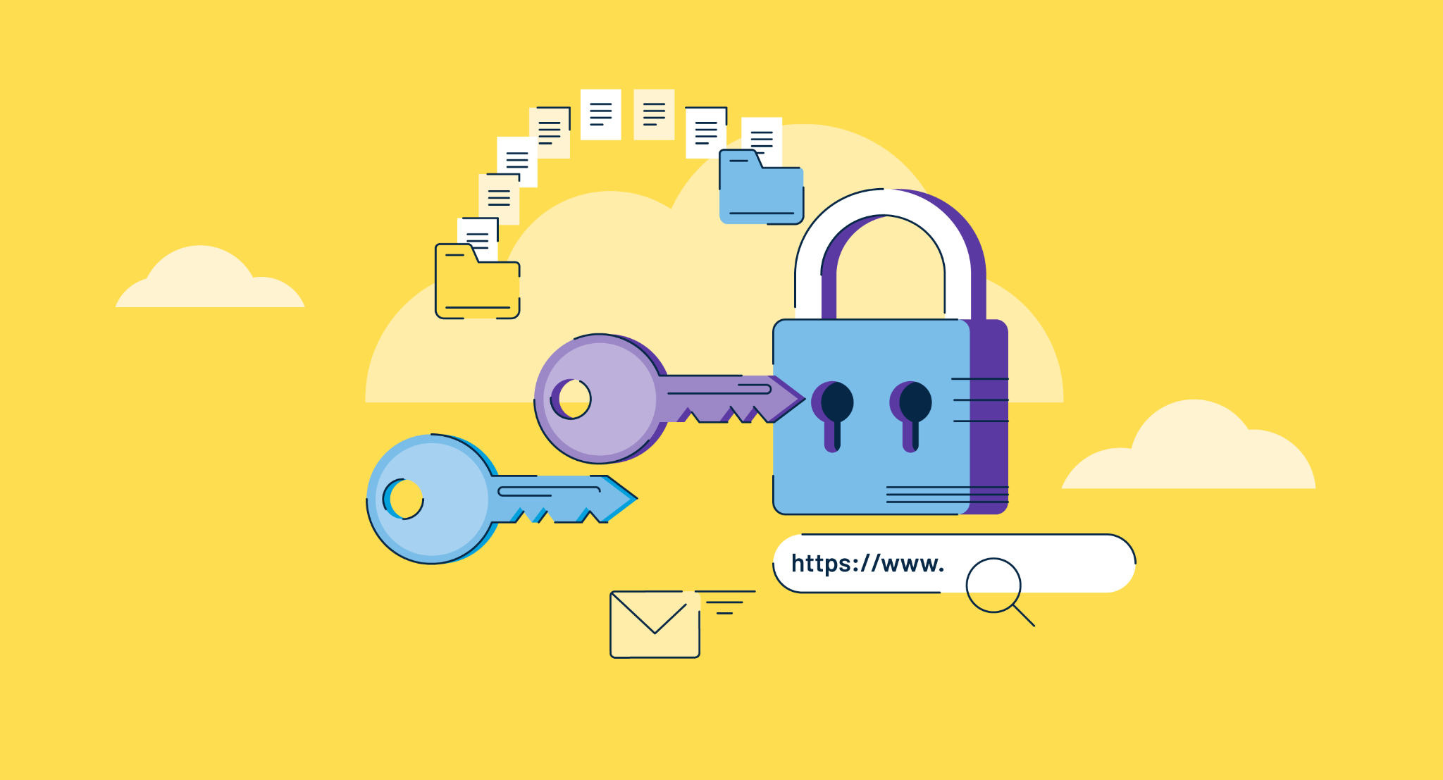
Introduction
In today's digital age, it's crucial to secure communication between client and server. Encryption plays a vital role in securing communication. The purpose of this presentation is to demonstrate a client-server interaction over a secure connection using the RSA encryption algorithm.

Slide 3
Overview of RSA Encryption Algorithm
RSA is a widely used public-key encryption algorithm. It uses a pair of keys, public key and private key, to encrypt and decrypt messages. Public keys are shared with everyone, whereas private keys are kept secret.
In this Project, the server will encrypt a message using RSA encryption and send it to the client, and the client will then decrypt the message using the corresponding private key. This process ensures the confidentiality and integrity of the message transmission over the network, as it is encrypted and can only be decrypted by the authorized client using their private key.

Slide 4
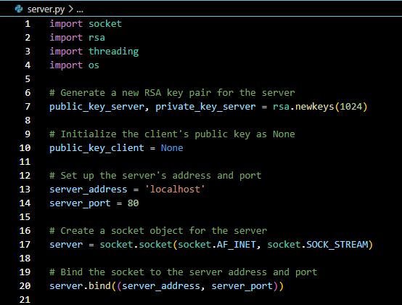
Setting up the Server
Let's move on to how we set up the server. First, we needed to generate the public and private keys for the server using the RSA algorithm. Then, we had to bind the server to a specific IP address and port:

Slide 5
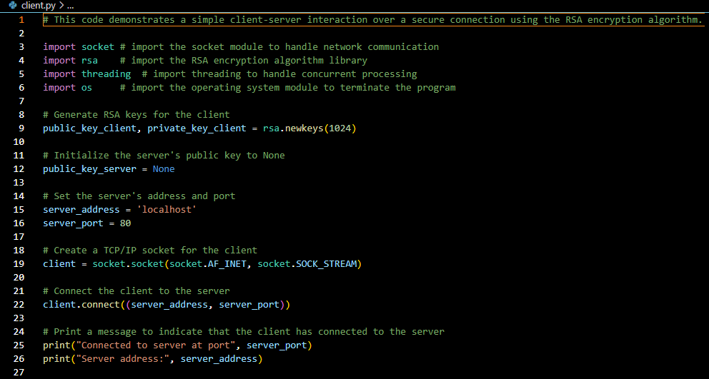
Setting up the Client
Now, we set up the client. We needed to load the public key of the server and connect to the server using the IP address and port:

Slide 6
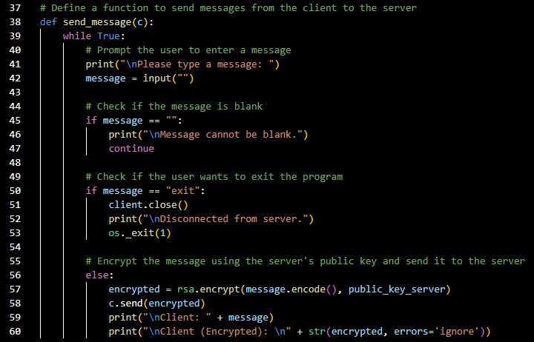
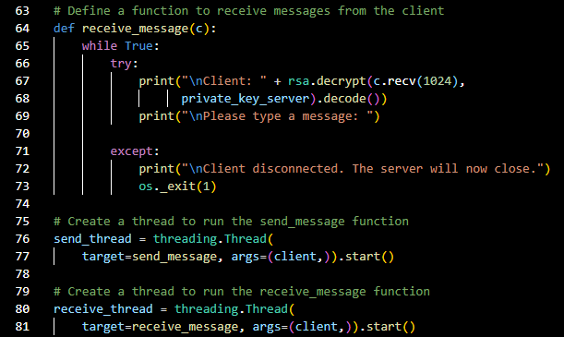
Establishing a Secure Connection
We've set up the client and server. Now, we have to establish a secure connection between client and server using the RSA algorithm. We'll encrypt messages on the client side using the server's public key and decrypt them on the server side using its private key and vice versa:

Slide 7

LIVE Code!
We will now provide a live demonstration to showcase the functionality of the code, specifically highlighting how it encrypts and decrypts messages.

Slide 8
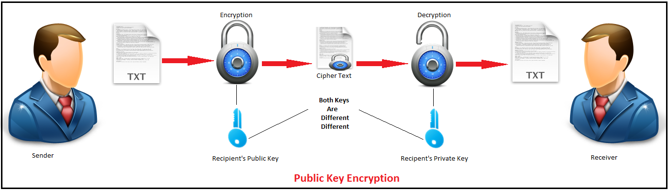
Conclusion
In summary, this project has demonstrated how RSA encryption can be used to secure client-server communication. While encryption is crucial for protecting sensitive information, it is essential to adopt a multi-layered security approach. We encourage further exploration and experimentation with encryption and security measures.

Slide 9



Resources
Applications used: Visual Studio Code, IntelliJ IDEA , and Discord
Python codes: sending and receive messages
https://stackoverflow.com/questions/57664539/how-to-send-and-receive-messages-between-client-and-server-in-python
https://www.geeksforgeeks.org/python-program-that-sends-and-recieves-message-from-client/
RSA encryption and decryption:
https://www.kite.com/python/answers/how-to-encrypt-and-decrypt-a-message-with-rsa-in-python

Slide 10

Questions?
Do you have any questions? We are happy to clarify any points from the presentation!

