Slide 1
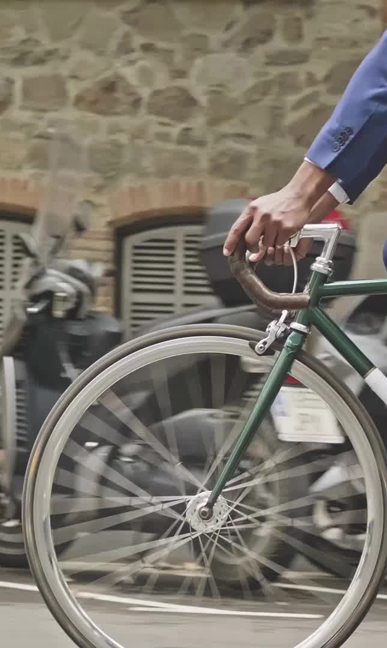
CASUAL AND MEMBER BIKE RIDERS OF CYCLISTIC
An in depth look at how Casual and Member riders differ

Slide 2
What to Look For. . .
How are casual riders using the service compared to members?
What is the difference in how often they use the bikes?
Do members use the bikes more that casual riders?
Hypothesis: Annual members use bikes more often for tasks like going to work or general transportation. Casual riders use bikes for vacation, joy riding, exercise
Notes:
Figuring out the difference will help stakeholders (Lily Moreno- marketing director/my manager) determine how to market the benefits of the membership to casual riders, enticing them to make switch to annual memberships.

Slide 3
Business Task:
Determine the difference between the casual riders and the annual members.
Create the best solutions to convert casual riders into annual members.

Slide 4
Data Source
Licensing from Motivate International
No personal identifiers
March 2020- February 2021 data
Notes:
it is not possible to know who purchased what and when it was purchased, or how many were purchased by a single customer

Slide 5
Columns Provided
rider id
start and end times
start and end stations and their respective ids if available
the type of bike used
the start and end longitude and latitude
casual or member bike user

Slide 6
Clean Data
Checked spelling
No duplicates
Added ride_length and day_of_the_week columns
Changed ride_id to String
Remove inaccurate start/end times

Slide 7
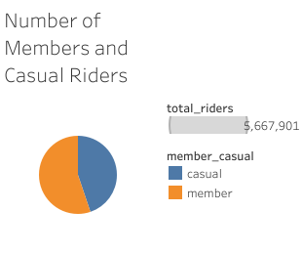
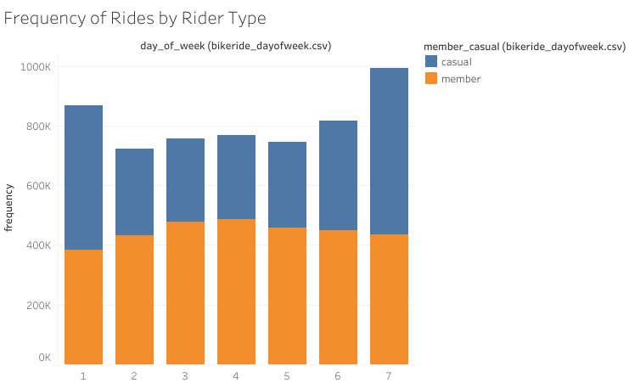
Who Rides When?
Members > Casual riders
Members consistently ride
Casuals ride more on weekends
Notes:
There are more members than casual riders, which is noticeable during the week, but more casuals ride bikes during the weekends. Members have no significant difference in riding throughout the week.

Slide 8
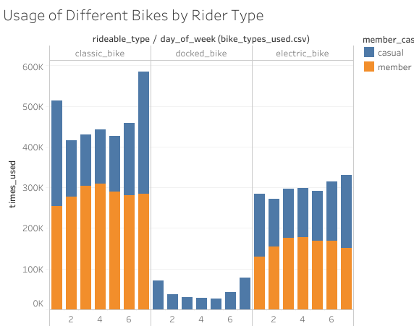
Who Rides What?
Classic bikes are most popular
Only casuals ride docked bikes
Notes:
Casual riders ride all three bike types, but the classic bikes are more popular amongst everyone. Only casual riders used the docked bikes.

Slide 9
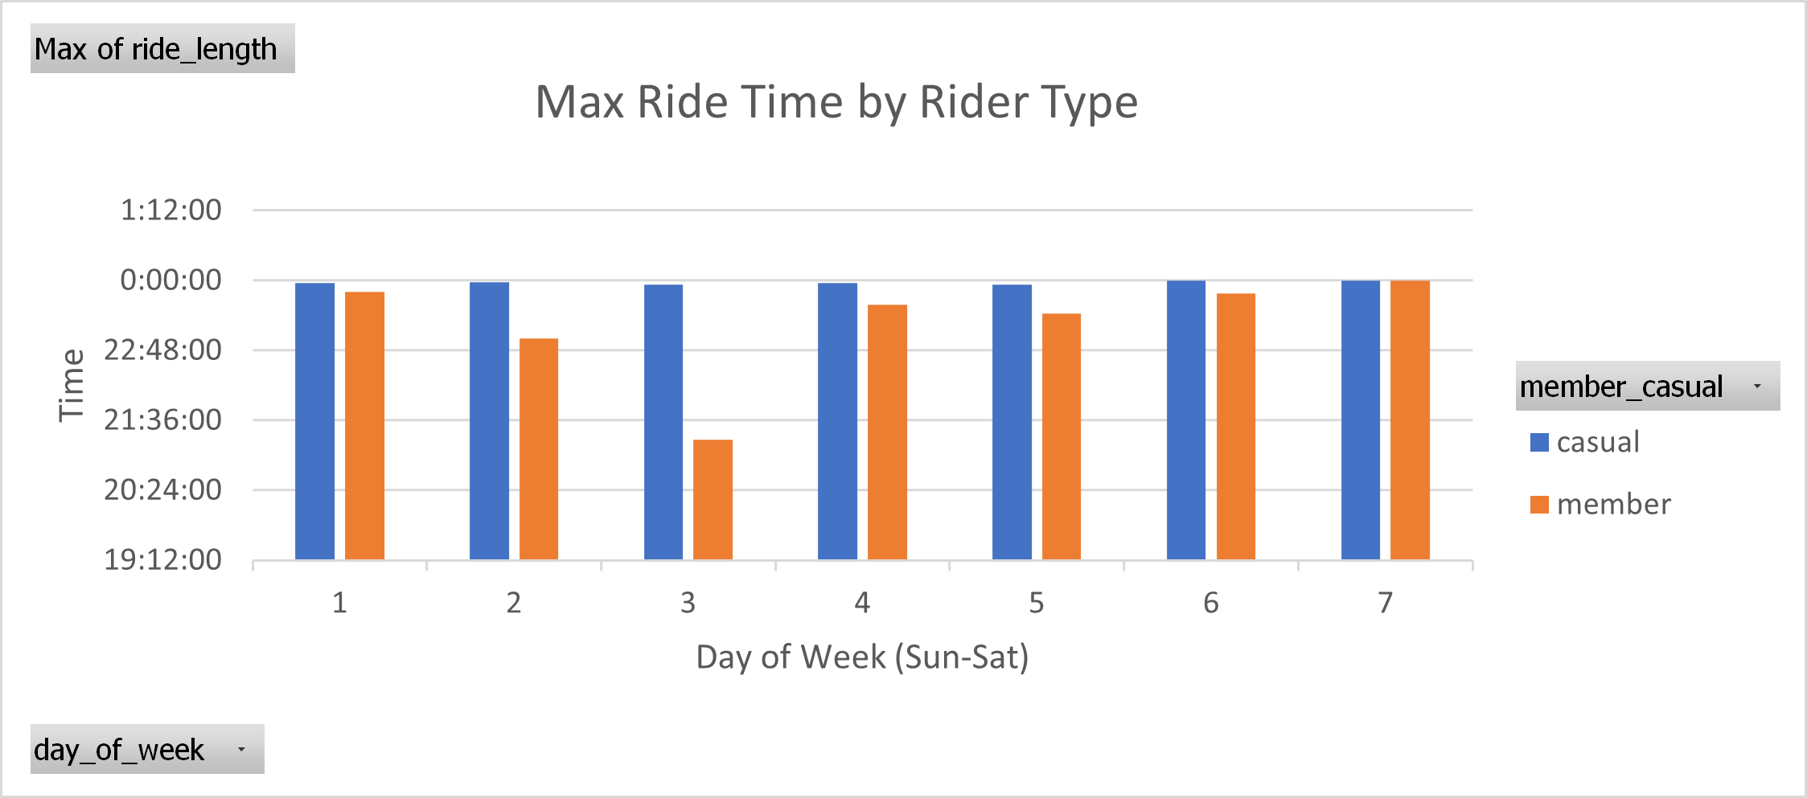
Who Rides Most?
Both types have riders who use bikes over 20 hours
Casual members ride longer
Notes:
There seem to be riders use use bikes for long amounts of time no matter what day of the week. There aren’t many members who take long rides during the week, especially on Tuesdays.

Slide 10
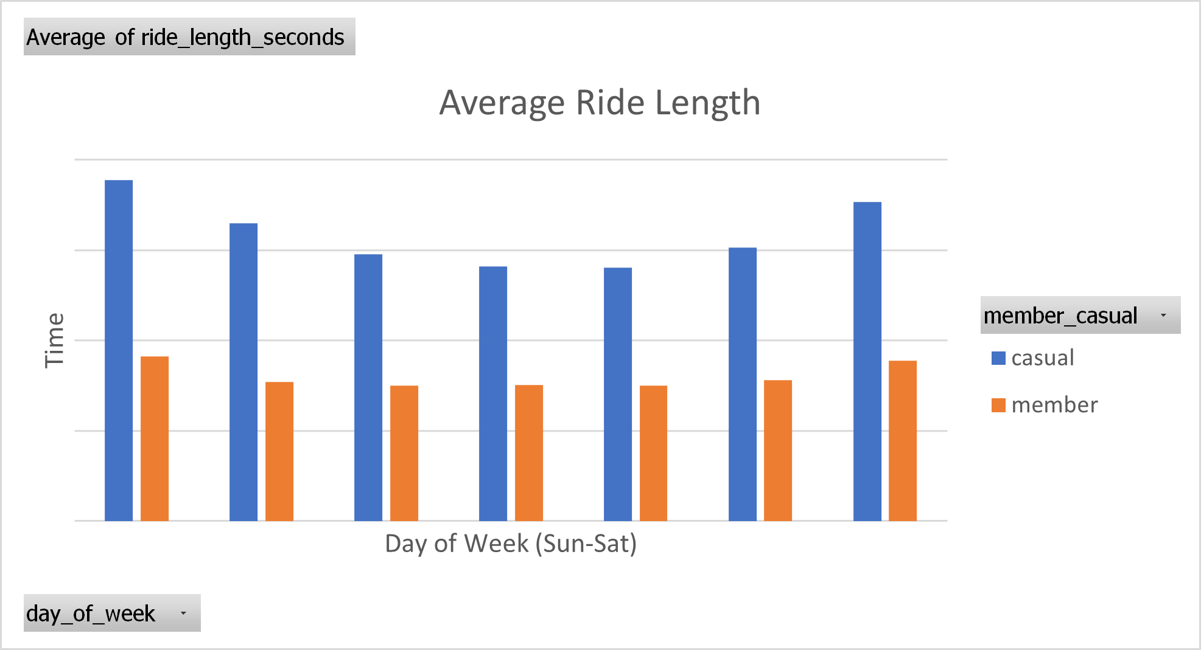
Who Rides How Much?
Casual riders use bikes longer on average
Notes:
Possibly due to the purpose of the riders. Members could be using them for transportation purposes, while casual riders may be more for leisure.

Slide 11
How to Benefit?
Give casual riders reward for miles /minutes on bike
Capitalize on weekend use: passes
Unique features for docked bike users
Notes:
Rewarding casual riders for the length of their rides could give incentives for those who already ride long distances. Creating something like an unlimited weekend pass could capitalize on the increase of casual riders. Providing features for those who use the docked bikes could entice them to be more frequent users of Cyclistic’s bikes.

