Slide 1
ID16B
Secondary
Slits
DCM
Source
DWM
30 m
35 m

Slide 2
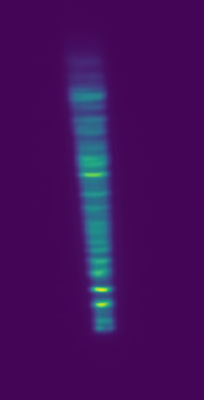
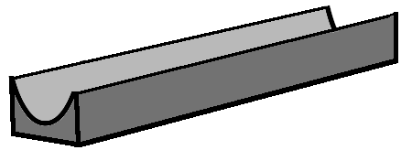
Layout ID09
Screen
xeye
Primary slits
Toroidal mirror
HPI27
55.84 m
44.54 m
Source
0 m
27.066 m
H - 1.0 mm x V - 1.0 mm
Configs: 19.905 keV, Toroidal mirror: Pd, 2.489 mrad & 2.989 mrad, Sagittal radius: 46.07 mm, Meridional radius: 14 km

Slide 3
Layout – ID09
Screen
xeye
Toroidal mirror
Primary slits
Monochromator
55.84 m
IVU17
44.54 m
31.4 m
Source
0 m
27.066 m
Configs: 19.905 keV, Toroidal mirror: Pd, 2.489 mrad & 2.989 mrad, Sagittal radius: 46.07 mm, Meridional radius: 14 km

Slide 4
Layout - PANOSC
HPPS @
27.340 m
Diamond filter @ 28.190 m
0.5 mm
Source
HHLM @ 31 m
WB transfocator entrance
@ 28.525 m
FE-diamond window (0.3 mm)
WB Stop @ 32.375 m

Slide 5
Layout considered for this study – ID17
LOW ENERGIES CONFIGURATION (30-50 keV)
Front End
OH1
Side View
Be Window
COOLED CF100
Be Window
COOLED CF100
Primary
Slits
No attenuators on OH1
Source
Be Filter
Be Window
0.3 mm
0.5 mm
0.5 mm
0.5 mm
Distance to source:
23.3 m
23.7 m
28.1 m
30.3 m
30.5 m
Sat. Build.
PS: H 35 mm / V 1.5 mm
Secondary
Slits
Vitreous
Carbon (Cv)
Al
Al
Attenuators in Satellite building
@ 138.5 m from source:
Filter 1: Carbon 0.8 mm
Filter 2: Al 0.5 mm
Filter 3: Al 2.0 mm
Continuation
SS: H 150 mm / V 5 mm
0.8 mm
0.5 mm
2 mm
137.6 m
1.51 g/cm³
138.5 m

Slide 6
ID19 In-line Monochromator layout
0.8 mm
Diamond
Window
HPPS
Transfocator
Image
U22
30.075 m
Pinhole
37.075 m
28.58 m
H - 1.34 m x V - 1.34 m

Slide 7
ID29
Front End
0.3 mm
Diamond
Window
Secondary
Slits ?
Chopper
KBs
Source
DMM
31.5 m
105m (10-20keV)
112.3m (35keV)
35m

Slide 8
ID18 Nano
Source:
2.5m CPMU18.6
DMM
(Horizontal)
29.54 m

