Slide 2


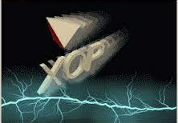
Modelling synchrotron radiation beamlines with
OASYS
Transport of power in a Beamline
Manuel Sanchez del Rio
srio@esrf.fr
Advanced Analysis & Precision Unit, MEG/ISDD, ESRF
March 21st 2025
XOPPY

Slide 3
Transport of power in a Beamline
Outline:
Source emission: Flux and power spectra.
Optical elements: characteristics and absorbed power.
Flux and power that arrive to the sample
XOPPY

Slide 4
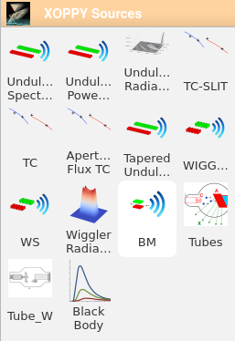
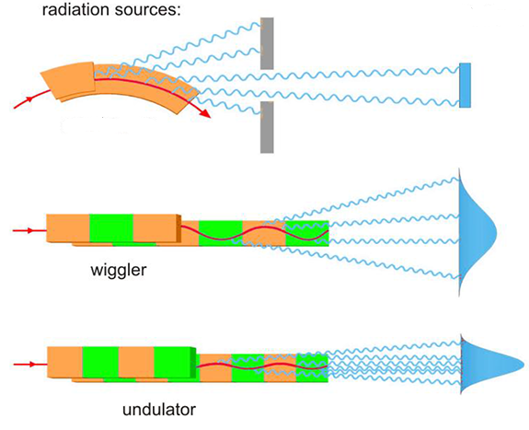
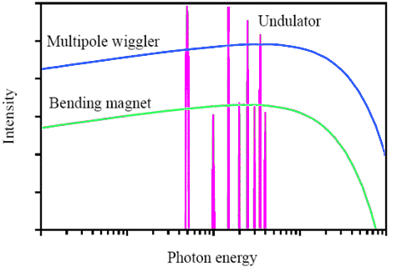
Simulation of source emission
Source spectrum (Photon flux or power vs Energy)
XOPPY
Undulator
Wiggler
bending magnet
Bending
magnet

Slide 5
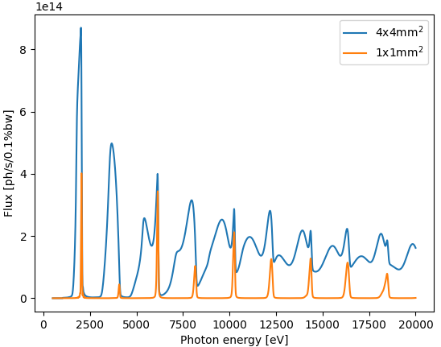
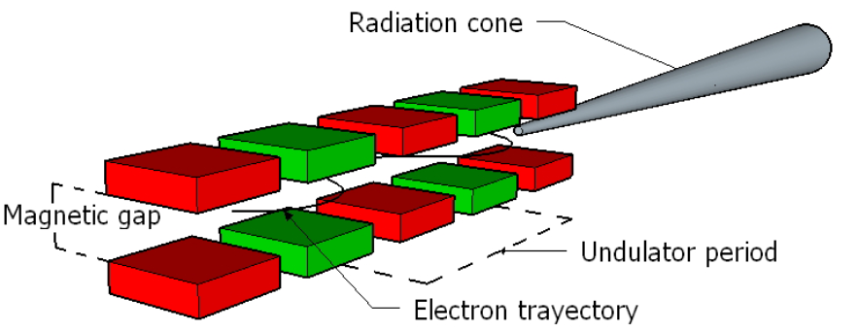

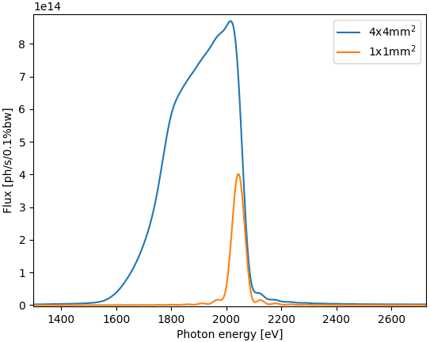

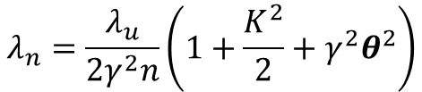


Undulator emission simulation
XOPPY
$$K ≡\frac{eB_{0}λ_{u}}{2πmc}=0.9337B_{0}[T]λ_{u}[cm]$$
$$λ_{n}=\frac{λ_{u}}{2γ^{2}n}\left(1+\frac{K^{2}}{2}+γ^{2}θ^{2}\right)$$
Slit
U42
$$θ$$
30 m

Slide 6
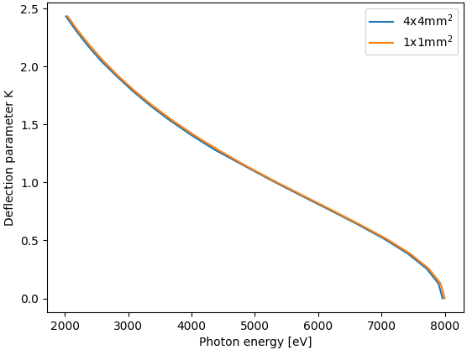

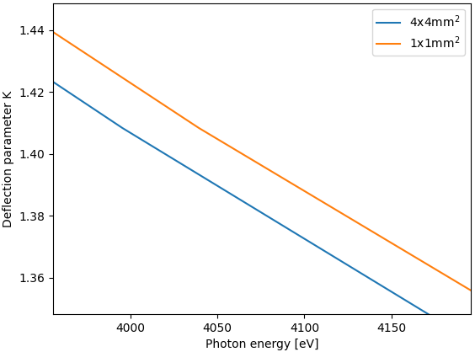
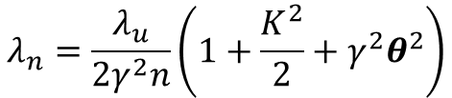
Undulator emission simulation
XOPPY
1st harmonic
$$λ_{n}=\frac{λ_{u}}{2γ^{2}n}\left(1+\frac{K^{2}}{2}+γ^{2}θ^{2}\right)$$
~50 eV
U42
Slit
$$θ$$
30 m

Slide 7
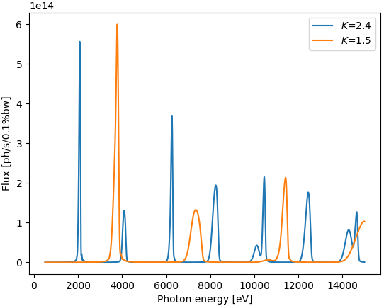

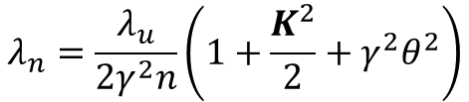

Undulator emission simulation
XOPPY
$$λ_{n}=\frac{λ_{u}}{2γ^{2}n}\left(1+\frac{K^{2}}{2}+γ^{2}θ^{2}\right)$$
U42
$$K$$

Slide 8

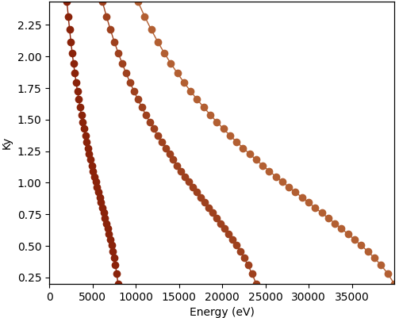

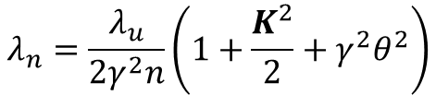
Undulator emission simulation
XOPPY
$$λ_{n}=\frac{λ_{u}}{2γ^{2}n}\left(1+\frac{K^{2}}{2}+γ^{2}θ^{2}\right)$$
U42
$$K$$

Slide 9
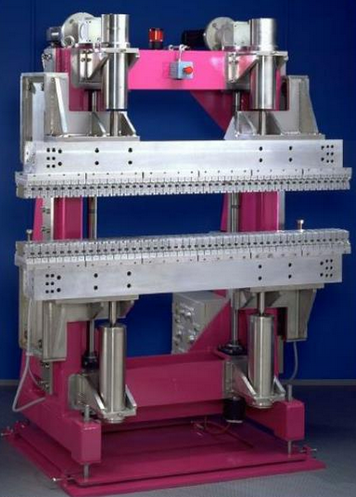

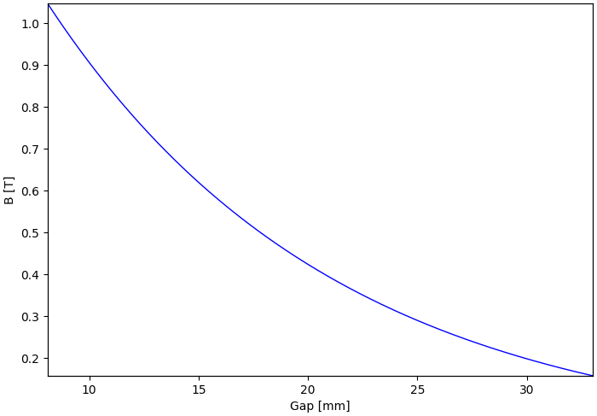




Undulator emission simulation (gap)
$$e^{−}$$
Gap
$$K=0.9337B_{0}[T]λ_{u}[cm]$$
$$B_{0}=a∗e^{(−bπ∗\frac{gap}{λ_{u}})}$$
For ID21 U42b:
a=1.9395
b=1.0164

Slide 10
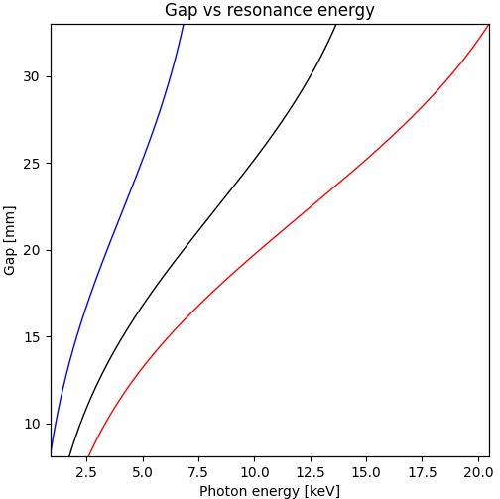
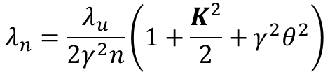




Undulator emission simulation
$$e^{−}$$
Gap
$$λ_{u}$$
Reducing
the gap
larger wavelength
(lower energy)
incrementing K
$$B_{0}=a∗e^{(−bπ∗\frac{gap}{λ_{u}})}$$
$$K=0.9337B_{0}[T]λ_{u}[cm]$$
$$λ_{n}=\frac{λ_{u}}{2γ^{2}n}\left(1+\frac{K^{2}}{2}+γ^{2}θ^{2}\right)$$

Slide 11
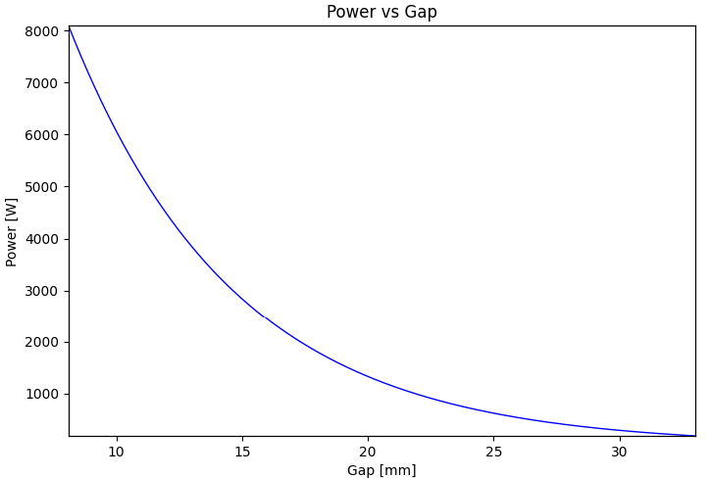

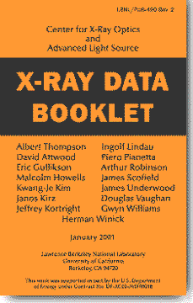
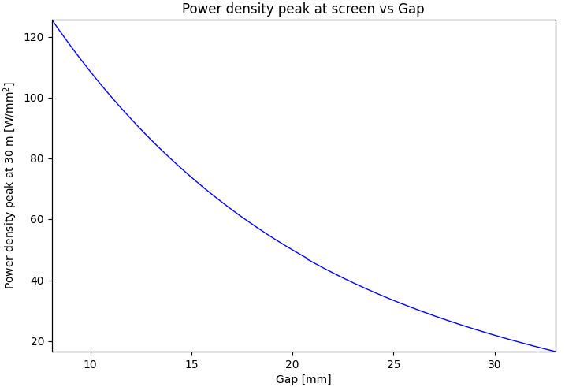
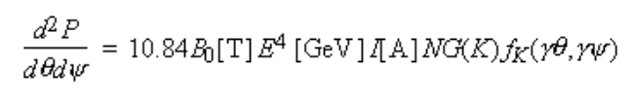


Undulator emission simulation
$$e^{−}$$
Gap
$$λ_{u}$$
Reducing
the gap
More power
Ref:
Central cone flux
On-axis flux

Slide 12
Simulation of source emission
Undulator power density (power vs x, y)
Undulator spectral flux density (flux/power vs x, y, E)
Wiggler spectral flux density (flux/power vs x, y, E)

Slide 13
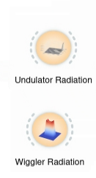
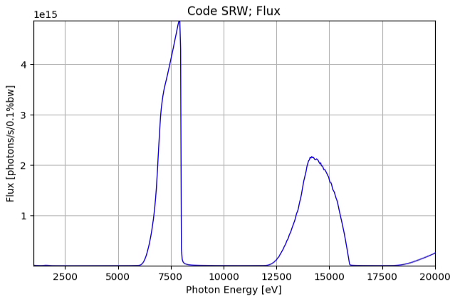
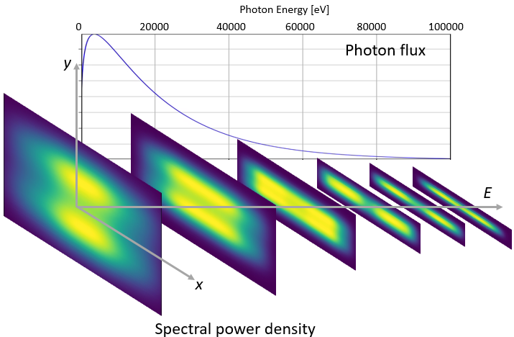
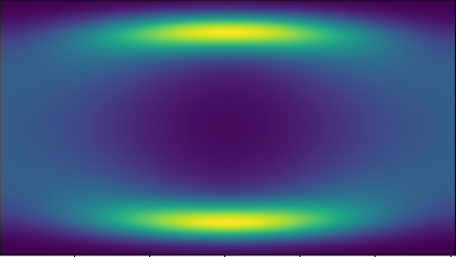
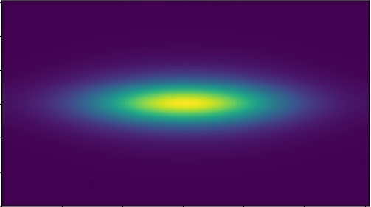
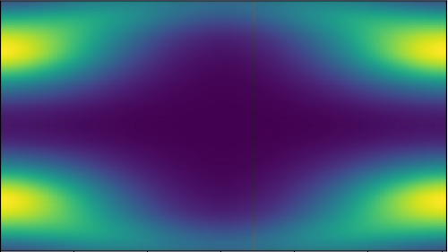
Simulation of source emission
Undulator spectral flux density
(flux/power vs x, y, E)
Wiggler spectral flux density
(flux/power vs x, y, E)
Photon Energy [eV]
1000 5000 10000 15000 20000
y
Photon flux
E
x

Slide 14
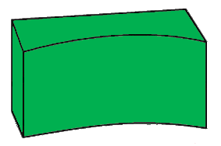
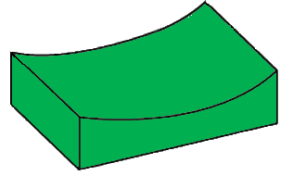
Power transport on a beamline
Optical components that could be present in a beamline:
Focusing system
Front end
Primary slits
Monochromator
Source
Sample
Primary mirrors
KB mirrors
Water-cooled
slits
Windows

Slide 15

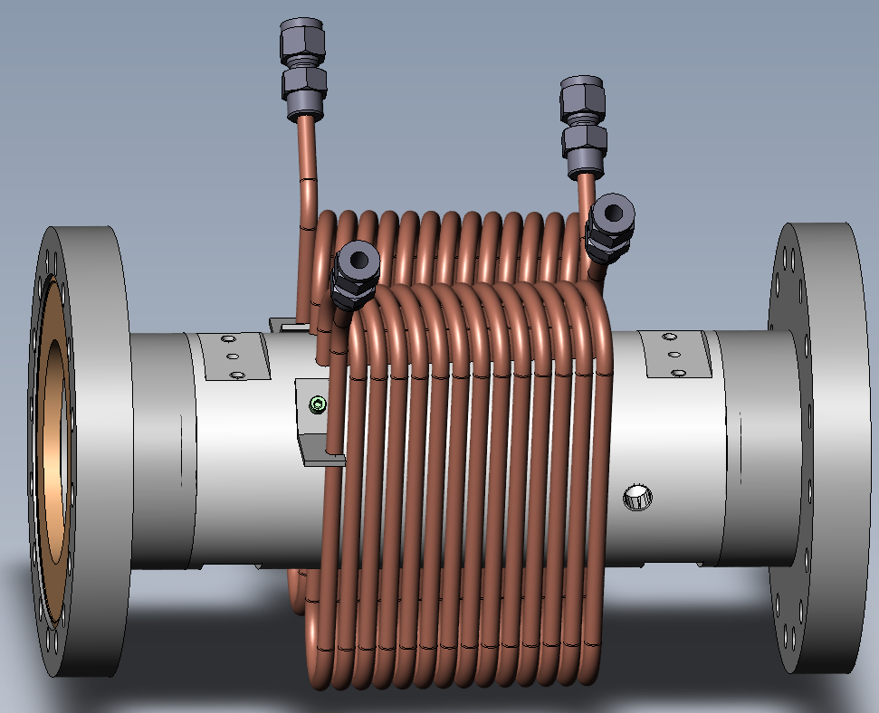
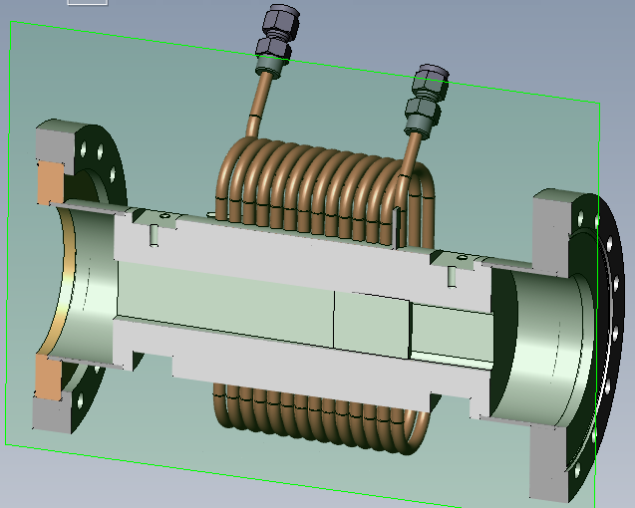
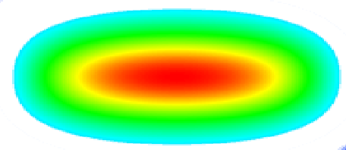
Undulator power density (Power vs x, y)
For example, this tool is very useful to get the heat load on a slit:
Water cooled beamline slit
undulator

Slide 16
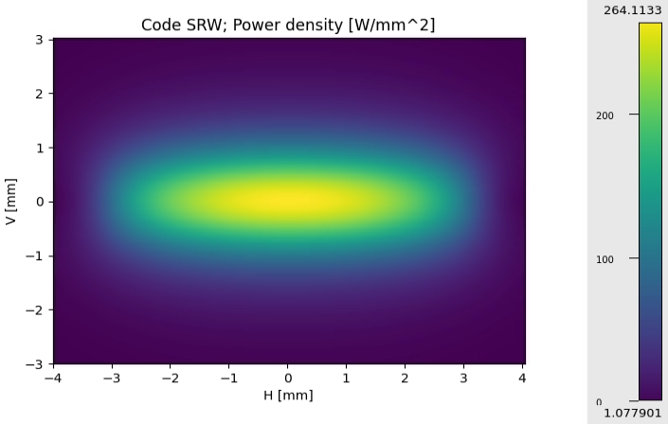
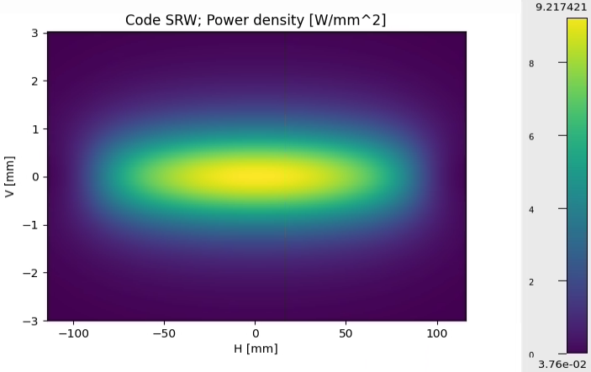

Undulator power density (Power vs x, y)
In most of the beamlines at the ESRF the are horizontal slits at 16 m from the source:
Perpendicular to the beam
Project over the slit surface (2º angle)
X-ray beam
Finite element analysis

Slide 17

Power transport on a beamline
Optical components that could be present in a beamline:
Focusing system
Front end
Primary slits
Monochromator
Source
Sample
Primary mirrors
KB mirrors
Water-cooled
slits
Windows
Slit 1
Aperture (a)
Source
Projected size at
downstream element (A)
Distance from the source (d)
Distance from the source (D)
$$A= \frac{D}{d}a$$

Slide 18
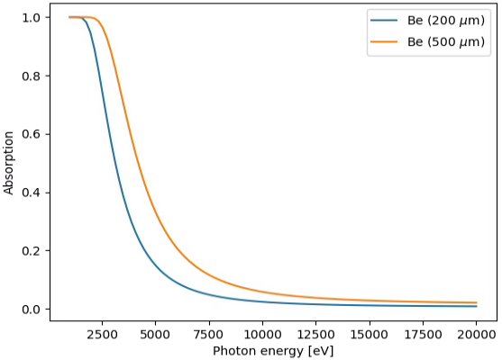
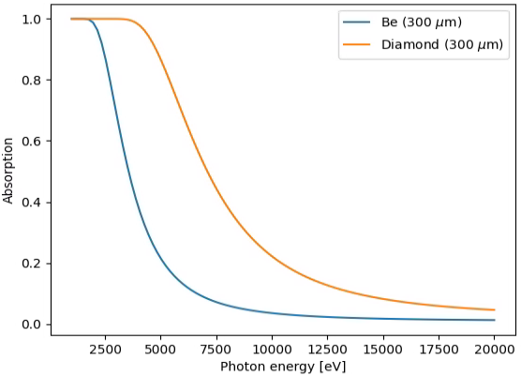

Filter (window) absorption
Filters of different thickness
Filters of different materials

Slide 19

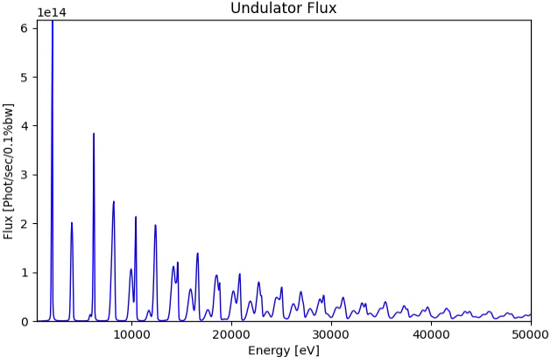
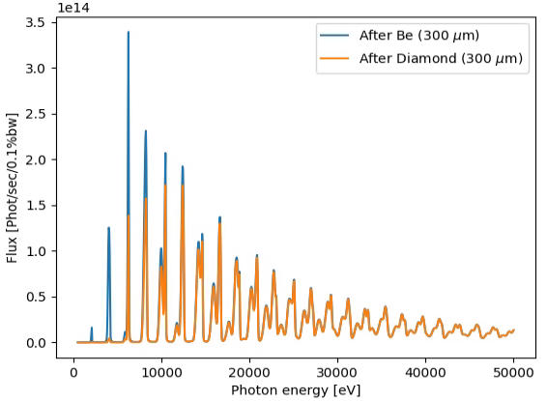
Power absorbed by a filter
Heat load on filters @ 23 m with a projection of 2 mm x 1 mm:
U42-EBS
thickness
Material | Thickness [μm] | Absorbed Power [W]
Be | 300 | 19
Diamond | 300 | 40
X-ray beam
material & density

Slide 20

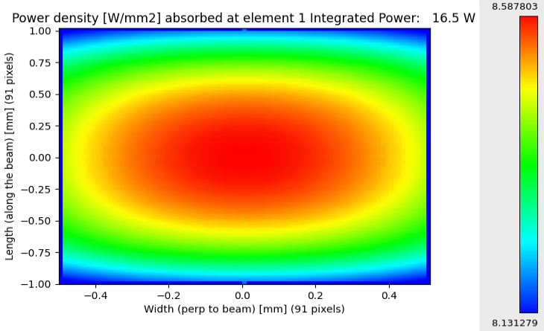
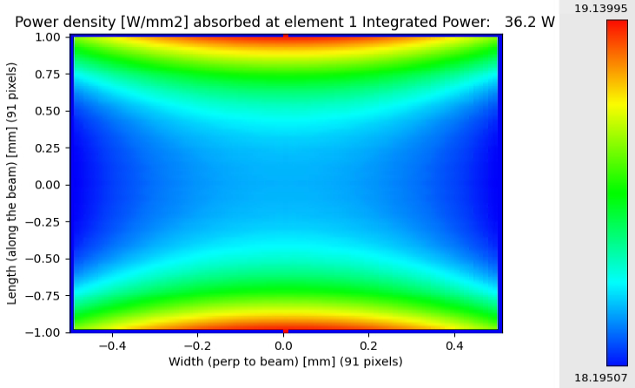
Power absorbed by a filter
Heat load on filters @ 23 m with a projection of 2 mm x 1 mm:
Be (300 μm)
Diamond (300 μm)

Slide 21
Power transport on a beamline
Optical components that could be present in a beamline:
Focusing system
Front end
Primary slits
Monochromator
Source
Sample
Primary mirrors
KB mirrors
Water-cooled
slits
Windows
Absorption by filters
Slit 1
Aperture (a)
Source
Absorption power by mirror

Slide 22
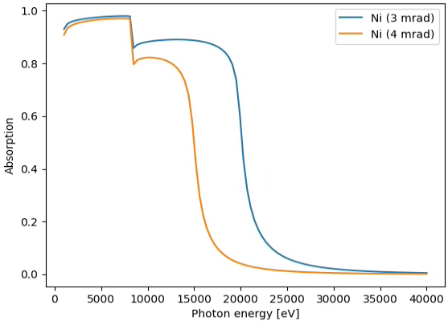
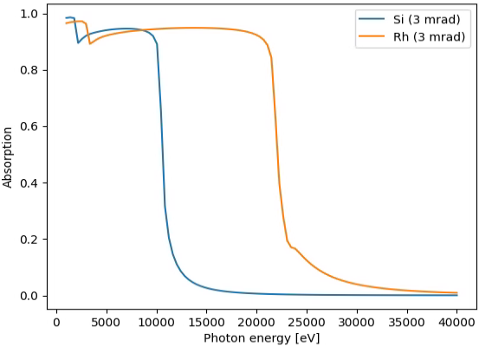
Mirror absorption
Same material, different angles
Same angle, different coatings
Reflectivity
Reflectivity

Slide 23
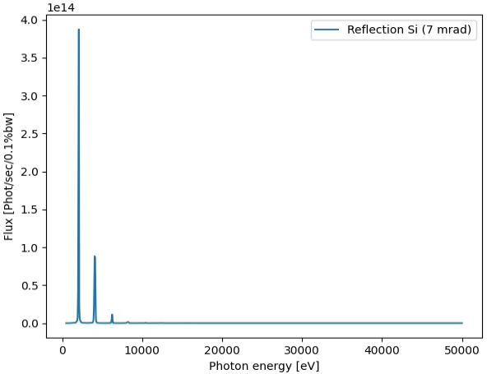
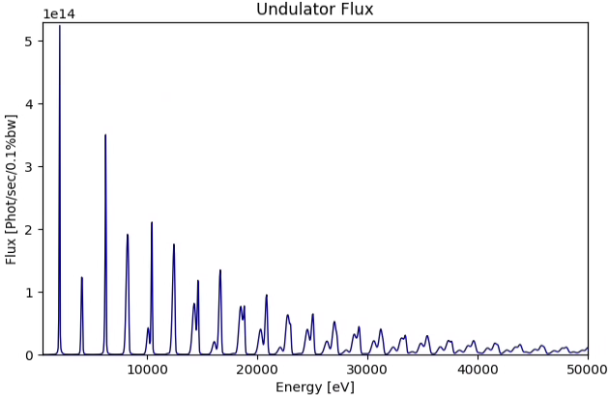
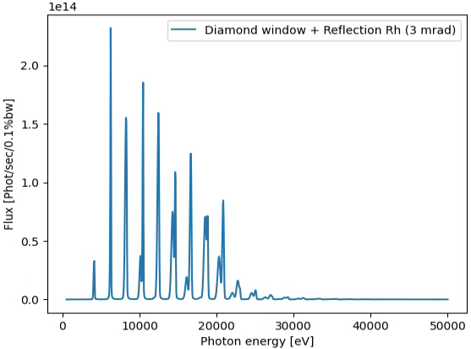
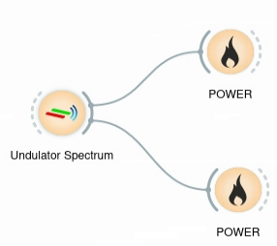
Mirror absorption
1st Harmonic
Example of reflection, primarily mirrors @ 30 m
Absorbed power 113 W
1st Harmonic
3rd Harmonic
3rd Harmonic
Absorbed power 52 W

Slide 24
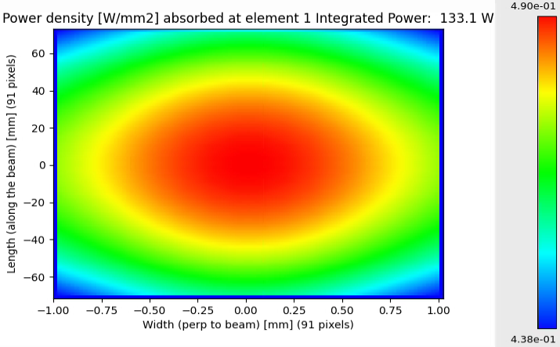
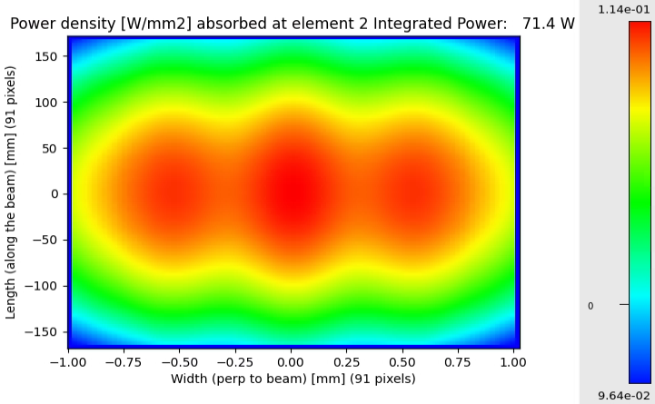
Power absorbed by a mirror
Heat load on mirrors @ 30 m:
Si (7 mrad)
Diamond (100 μm) + Rh (3 mrad)

Slide 25






Other optical elements in XOPPY
Multilayers
[W(2.5)/Si(2.5)]₅₀
1.4º
$${mλ =2d}_{M}senθ\sqrt{1−\frac{2\overline{δ}}{{sen}^{2}θ}}$$

Slide 26




Other optical elements in XOPPY
Bragg or reflection
Crystals
Double crystal monochromator
Rocking curve
Si (111)
22 keV

Slide 27
Calculation of flux at the sample position
Exercise: estimate the photon flux at the sample position.
KB slits
51 m
Si (111)
Focusing system
Ni coated 7 mrad
Monochromator
Source
Sample
Primary mirrors
KB mirrors
ESRF-ID21
5 keV
Slits aperture 1 mm x 1 mm
Ni coated
6 mrad

Slide 28

Calculation of flux at the sample position
Exercise: estimate the photon flux at the sample position.
KB slits
51 m
Si (111)
Focusing system
Ni coated 7 mrad
Monochromator
Source
Sample
Primary mirrors
KB mirrors
ESRF-ID21
5 keV
Slits aperture 1 mm x 1 mm
Ni coated
6 mrad

