Slide 2
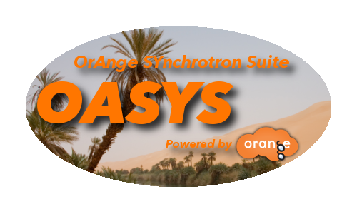

Modelling synchrotron radiation beamlines with
OASYS
Introduction
Juan Reyes Herrera
juan.reyes-herrera@esrf.fr
Advanced Analysis & Precision Unit, MEG/ISDD, ESRF
March 15th & 17th 2022

Slide 3
Introduction to OASYS
Outline:
What is OASYS? What is its structure?
What kind of simulations can be performed with it
Expected outcome of this OASYS tutorial

Slide 4
What is OASYS?
OASYS (Orange Synchrotron Suite) is graphical environment for modelling synchrotron beamlines.
In OASYS, we can perform visual programing: using “boxes and arrows” to recreate a photon beamline
OASYS integrates different simulation strategies via the implementation of adequate simulation tools for X-ray Optics
https://www.aps.anl.gov/Science/Scientific-Software/OASYS

Slide 5
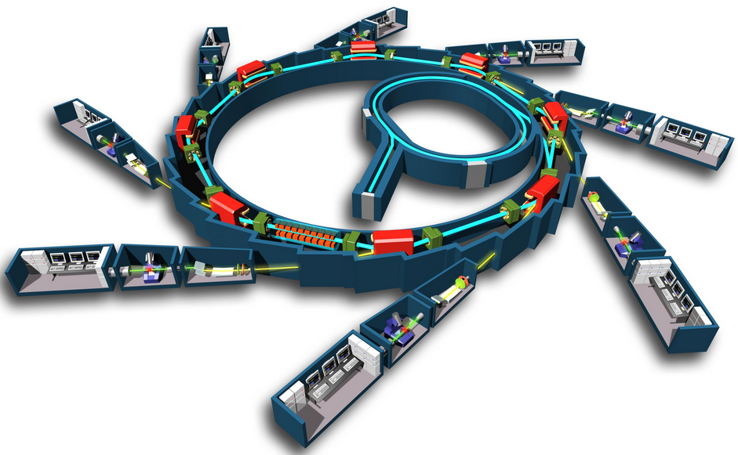
Modelling a beamline
A synchrotron beamline is the instrumentation that transports the synchrotron radiation to the sample (experimental end station)
Insertion device
Optics hutch
Control hutch*
Experimental hutch
Electron beam
Hutch or cabin*
Beamline
Photon beam

Slide 6
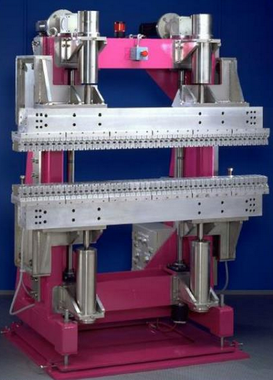
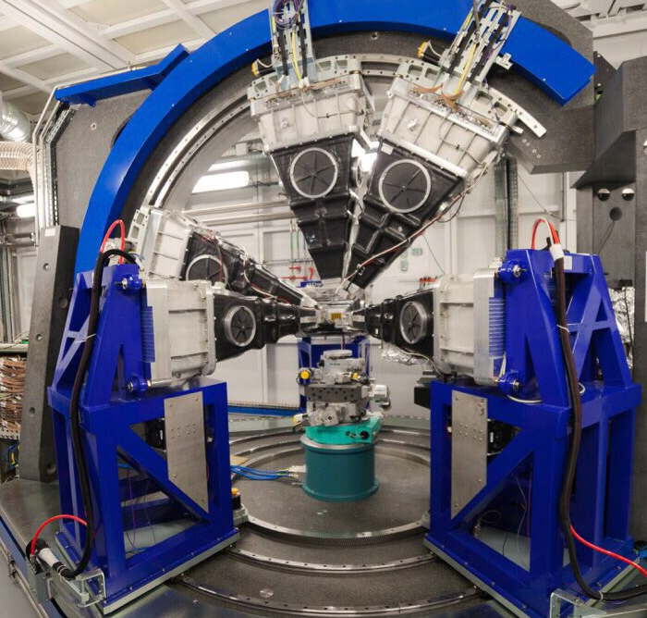
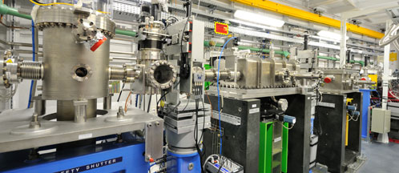
Modelling a beamline with OASYS
Main components of the beamline:
Optics
Experimental station
Source
Slits, mirrors, crystals, filters, refractive lens, Fresnel lens, multilayers, etc.
Bending magnet, wiggler or undulator
Sample, detectors, etc.

Slide 7
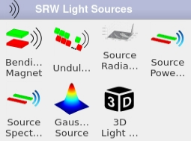
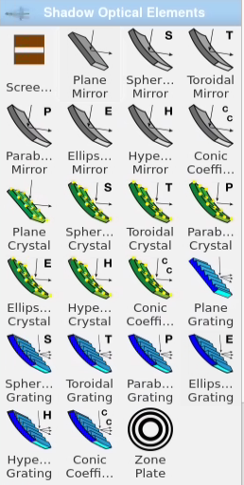
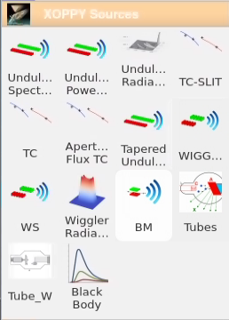
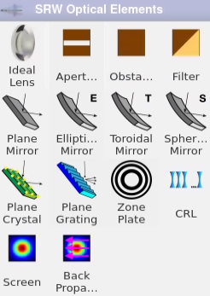
Modelling a beamline with OASYS
The visual programing boxes, in OASYS, are called Widgets and they represent optical components, including a wide variability of tools, example:
Sources:
Optics:
Allowing to get at the
Sample:
Energy distribution, intensity (photon flux), beam size and divergence, etc.

Slide 8
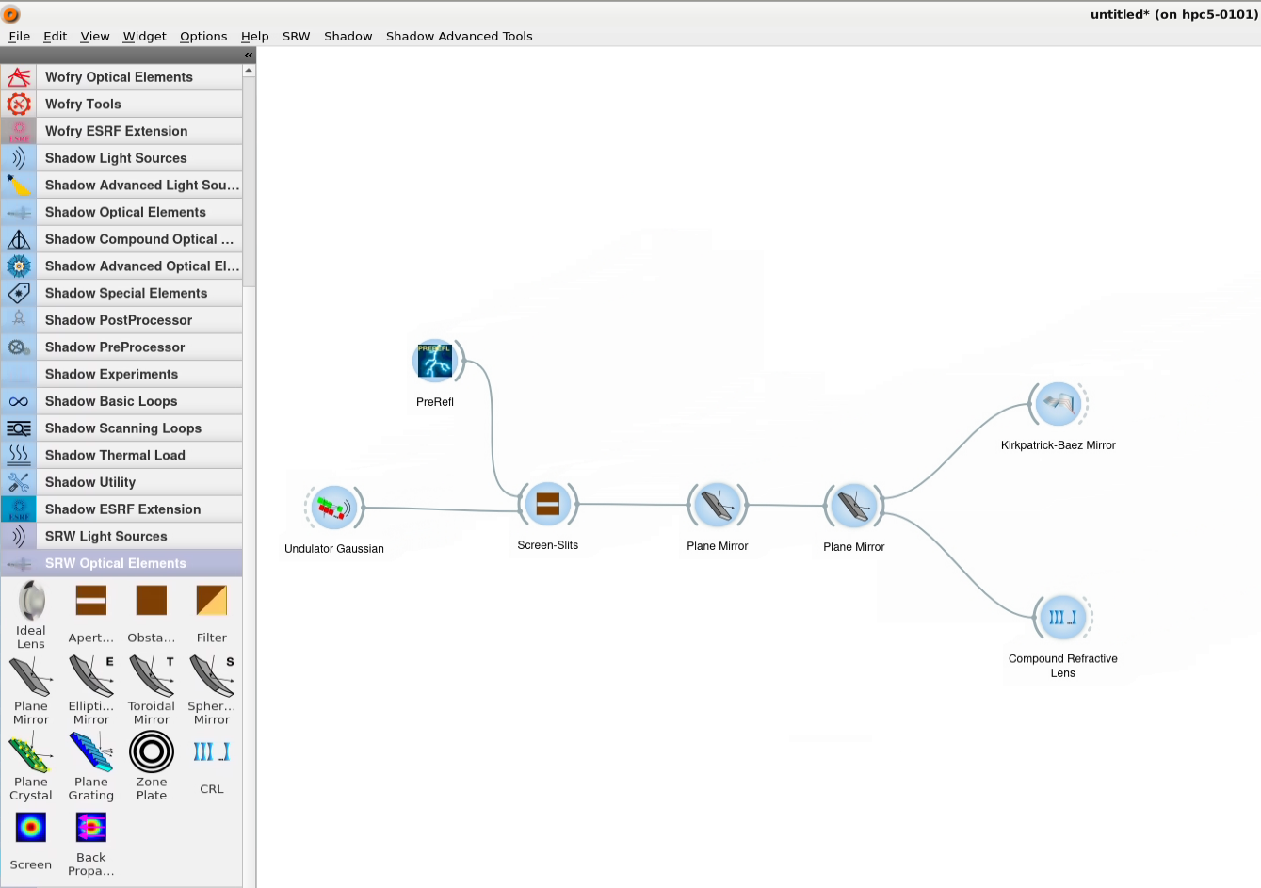
Modelling a beamline with OASYS
The Widgets are connected as a workflow (or dataflow) in the OASYS canvas:
Canvas
OASYS Workflow
Widgets
Connectors
Toolbox

Slide 9
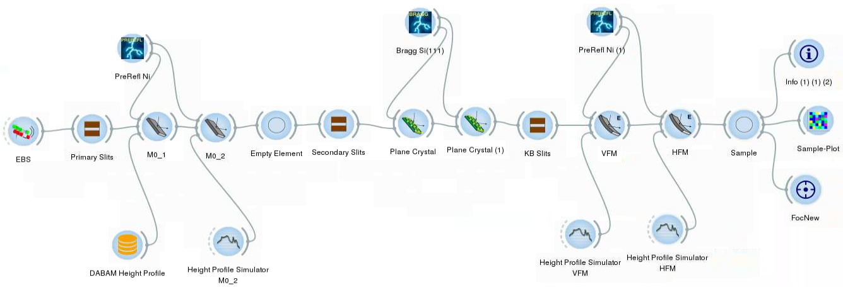
Full beamline model
Double Crystal
Monochromator
ESRF-ID21
Higher Harmonic Rejection Mirrors
KB Mirrors system

Slide 10
Introduction to OASYS
Computer simulation of light sources and optical components is a mandatory step in the design and optimization of synchrotron and FEL radiation beamlines
different codes for numerical simulations are available, implementing different physical approaches
RAY-TRACING
WAVEFRONT
PROPAGATION
Shadow
RAY
SRW
PHASE
COMSYL
XRT
McXtrace
WISE
WOFRY
Incoherent X-ray beams Fully coherent X-ray beams

Slide 11

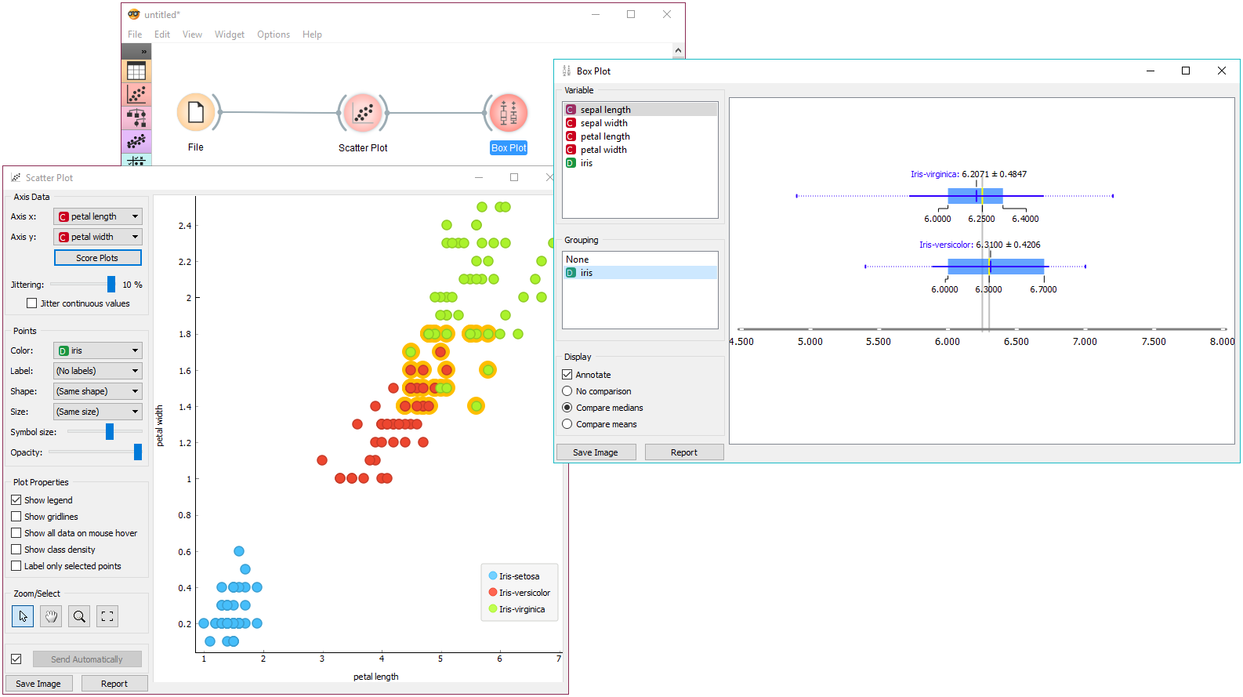
ORANGE
Orange is a component-based visual programming software package for data visualization, machine learning, data mining, and data analysis. [1].
[1] Demšar, J., Curk, T., and Erjavec, A. "Orange: Data Mining Toolbox in Python," Journal of Machine Learning Research 14, 2349−2353 (2013). https://orange.biolab.si

Slide 12



OrAnge SYnchrotron Suite
XOPPY
SRW
WOFRY
SHADOWOUI
SYNED
Orange
Luca Rebuffi (ANL) & Manuel Sánchez del Río (ESRF)
COMSYL
L. Rebuffi, M. Sanchez del Rio, "OASYS (OrAnge SYnchrotron Suite): an open-source graphical environment for x-ray virtual experiments”, Proc. SPIE 10388, 103880S (2017)​​​​​. DOI: 10.1117/12.2274263.
Utilities

Slide 13
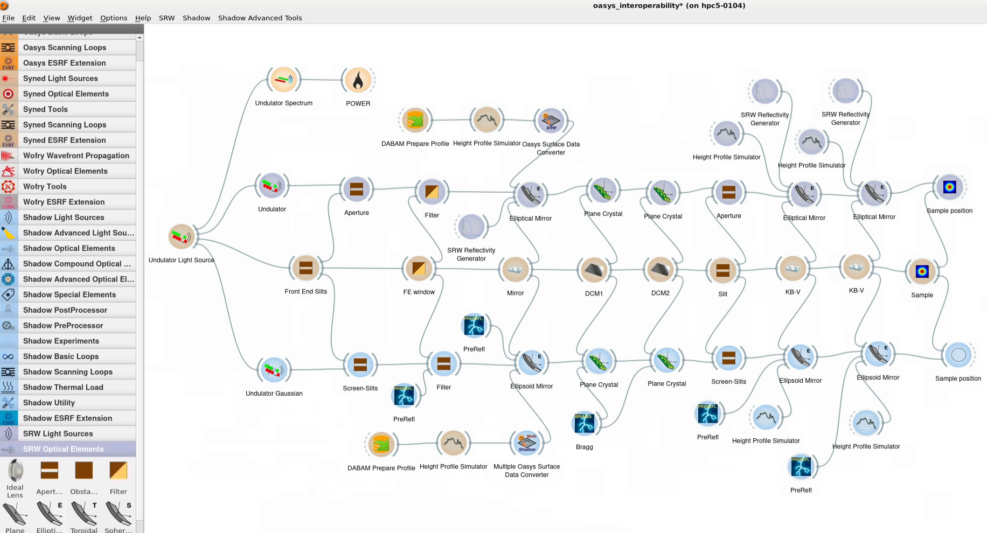
OASYS interoperability
XOPPY
SRW
SYNED
SHADOW
DABAM

Slide 14
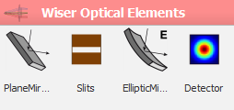

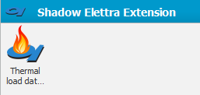
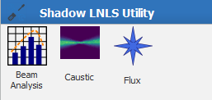
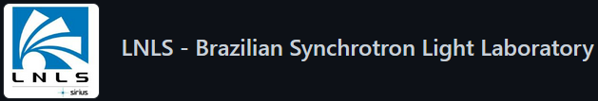
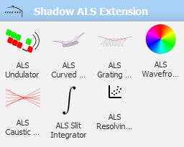
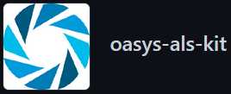
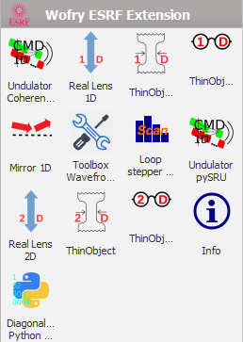
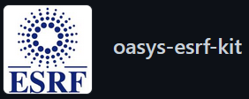
Other OASYS features
Open Source, many synchrotron facilities are developing their own customized widgets, Add-ons, for example:
https://github.com/oasys-elettra-kit
https://github.com/oasys-lnls-kit
https://github.com/oasys-als-kit
https://github.com/oasys-esrf-kit *
* Add-ons installation example

Slide 15
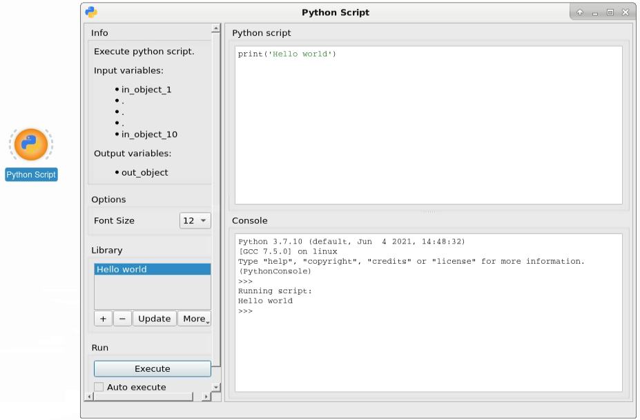
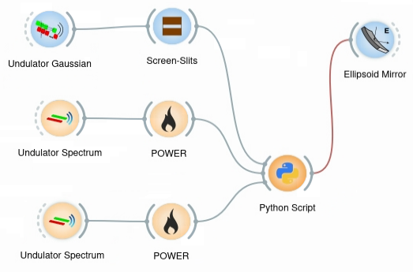
Other OASYS features
Python has been chosen as the main programming language, and code can be included in the workflow

Slide 16
Outcome from this tutorial
Calculate main characteristics of synchrotron source (Bending magnets and Insertion devices).
Calculate the heat-load on different beamline components.
Simulating beamline optics by ray-tracing to obtain main parameters of the beam, e. g., size and divergence, energy resolution, intensity/flux.
Understand basic principles of X-ray optics: Mirrors and Crystals.
Basic concepts about coherence

