Slide 2


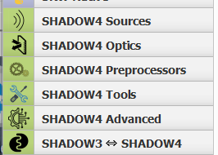
Modelling synchrotron radiation beamlines with
OASYS
Transport of photons in a Beamline
Manuel Sanchez del Rio
srio@esrf.fr
Advanced Analysis & Precision Unit, MEG/ISDD, ESRF
March 21st 2025
SHADOW4

Slide 3
Transport of photons in a Beamline
Outline:
Introduction to ray tracing
Simulation of a beamline:
Mirror focusing (KB): size at sample
Effect of aberrations
Source dimensions
Double-crystal monochromator
Energy resolution
Crystal coupling: (+,-) (+,+)
Full beamline: Flux and power that arrive to the sample
SHADOW4

Slide 4
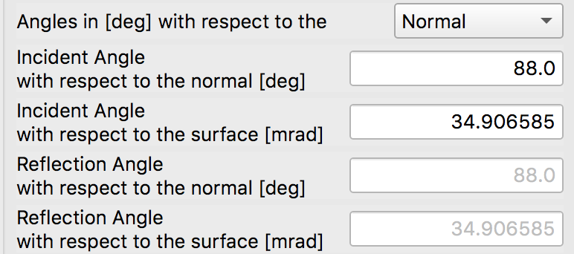
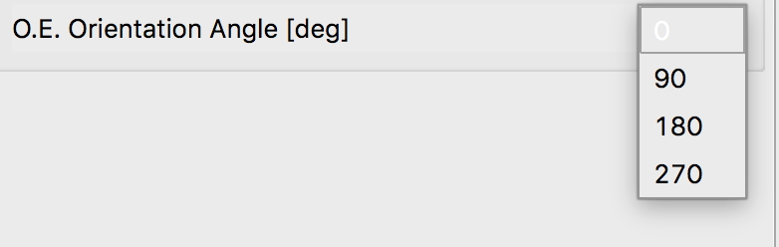



RAY TRACING (SCHEMATIC)
z
$${\vec{x}}_{0}=(x_{0},y_{0},0) \\ \vec{v}=(v_{x},v_{y}≈1,v_{z})$$
$${\vec{k}}_{o}={\vec{k}}_{i}−2\left({\vec{k}}_{i}⋅\vec{n}\right)\vec{n}$$
Energy, Intensity
y
x
z
z
p
q
x
$$\vec{x}={\vec{x}}_{0}+t\vec{v} \\ z=0$$
y
x

Slide 5
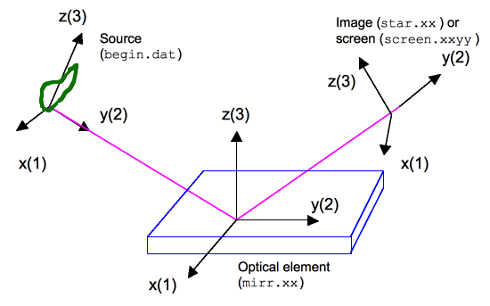
REFERENCES AND Continuation planes
Optical axis
Image Plane for O.E.1
Source Plane for O.E.2
Source Plane for O.E.1
O.E.1
O.E.2
Note that (VERY IMPORTANT!):
The y (column 2) coordinate is along the beam direction
The position (Source Plane Distance), orientation (O.E. Orientation Angle) of any o.e. is always referred to the previous one
Source Plane and Image Plane for each optical element are the “Continuation Planes”
The frame is rotated if one o.e. is rotated

Slide 6
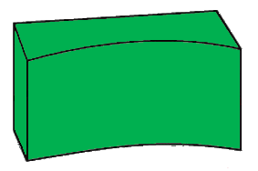
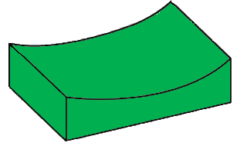
The beamline
Optical components that could be present in a beamline:
Monochromator
Double crystal
Si 111
Focusing system
Front end
Primary slits
Sample
KB mirrors
Source
U42 @ 5keV
Primary mirrors
Plane Ni 7 mrad
KB slits
27.2 m
51 m
51.5 m
51.59 m
51.65 m

Slide 7
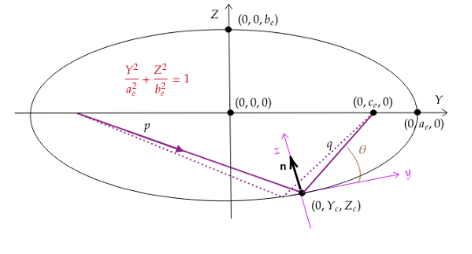
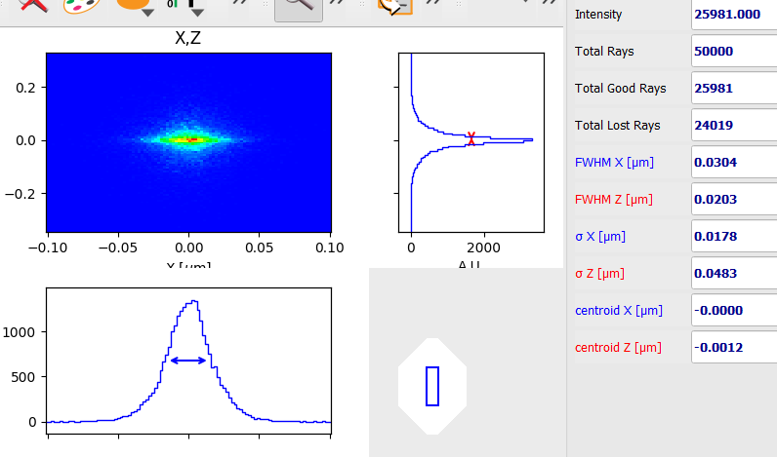
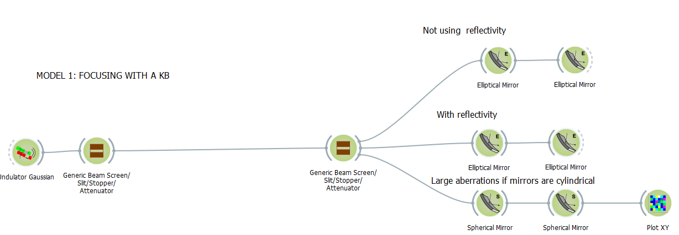
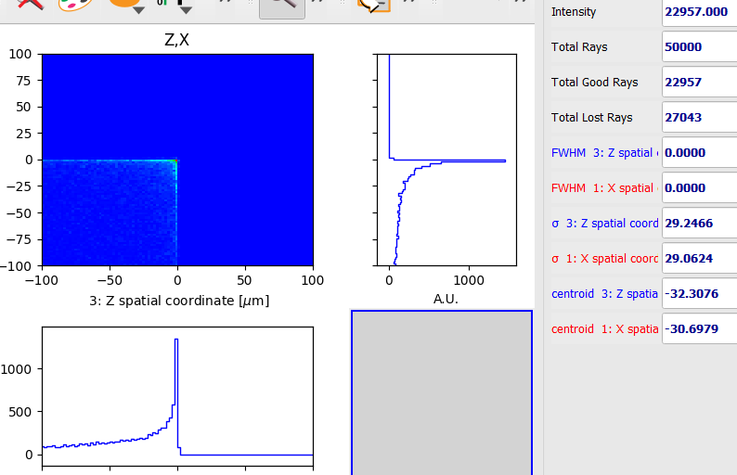
Mirror focusing Kirkpatrick-Baez (MODEL 1)

Slide 8
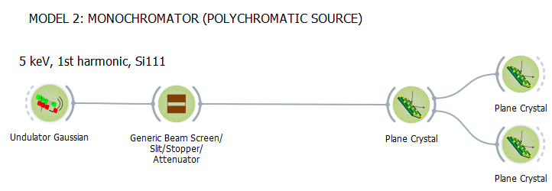
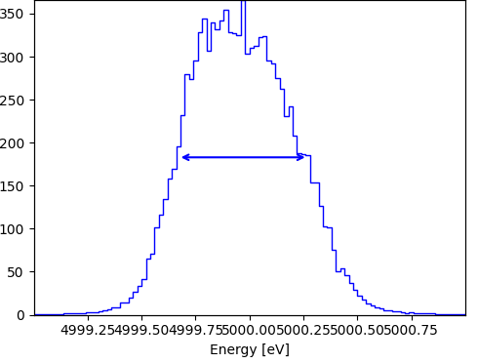
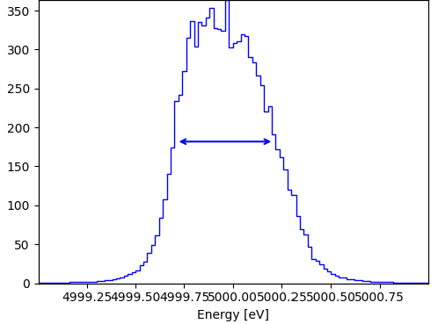
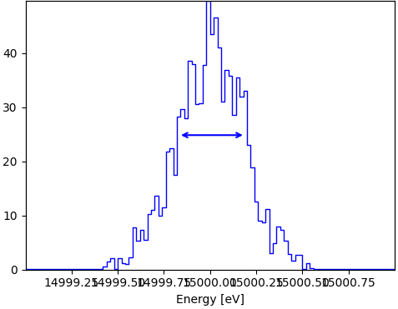
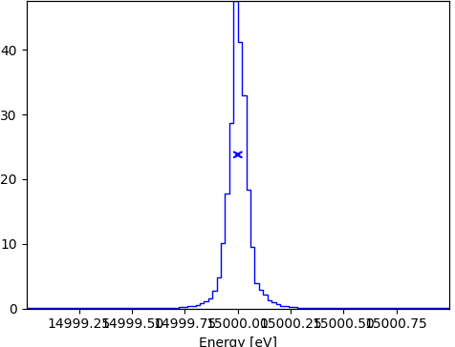
Monochromator (MODEL 2)
(+,-)
(+,+)
Si 111 (+,-) @ 5keV Si 111 (+,+) @ 5keV Si 333 (+,-) @ 15keV Si 333 (+,-) @ 15keV
0.60 eV
0.50 eV
0.36 eV
0.06 eV

Slide 9
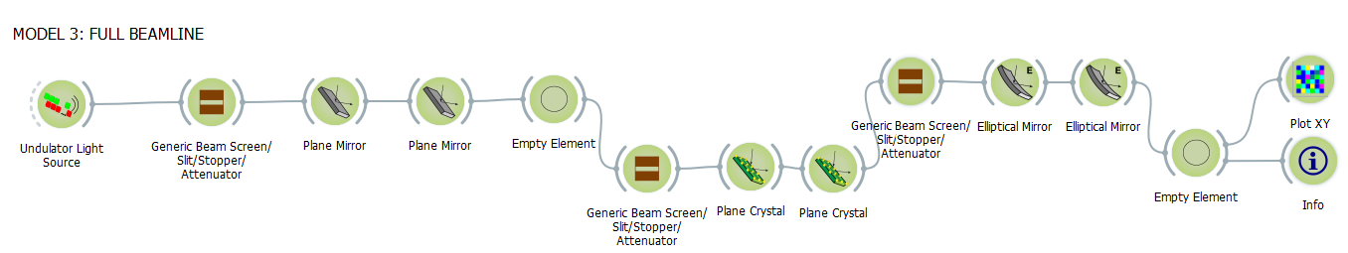
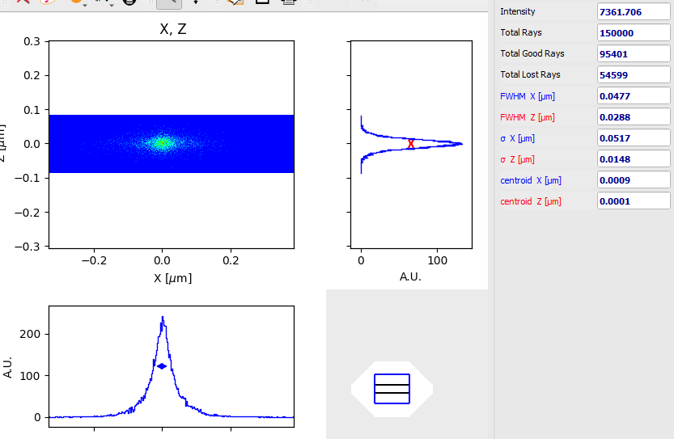
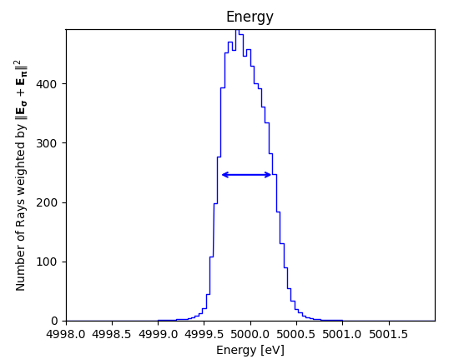
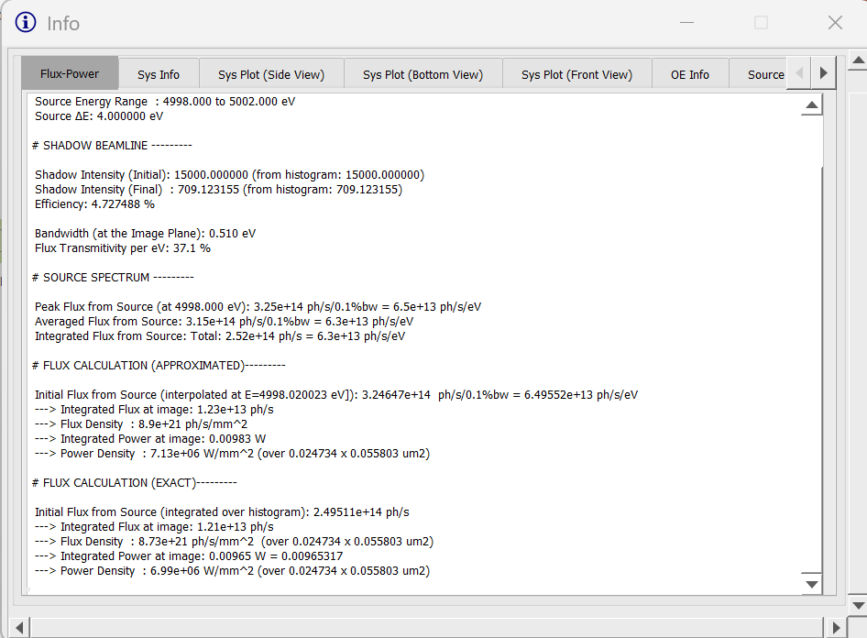
Full beamline (MODEL 3)
SIZE RESOLUTION FLUX
0.6 eV
---> Integrated Flux : 1.21e+13 ph/s

Slide 10
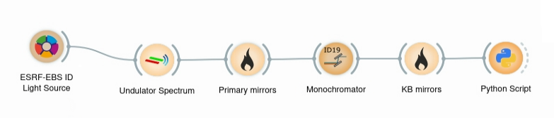
Comparison with XOPPY [consistency] (MODEL 4)
Optical components that could be present in a beamline:
Monochromator
Double crystal
Si 111
Focusing system
Primary slits
Sample
KB mirrors
Source
U42 @ 5keV
Primary mirrors
Plane Ni 7 mrad
KB slits
1 x 1 mm²
51 m
1.32 x 10¹³ photons/s
5 KeV

Slide 11
RESOURCES
You have more material here:
the ShadowOuiTutorial: https://github.com/oasys-kit/ShadowOui-Tutorial
The OASYS Schools: https://github.com/oasys-kit/oasys_school
We did not treat important issues like:
Surface errors in mirrors [see tutorial example 20]
Focusing with lenses [CRLs, transfocators] [see tutorial example 24]
Hybrid ray tracing [to include coherence effects]
Wave optics calculations using the SRW code

Slide 12
Additional Slides

Slide 13
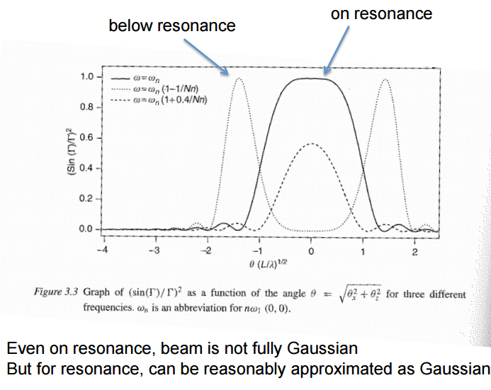
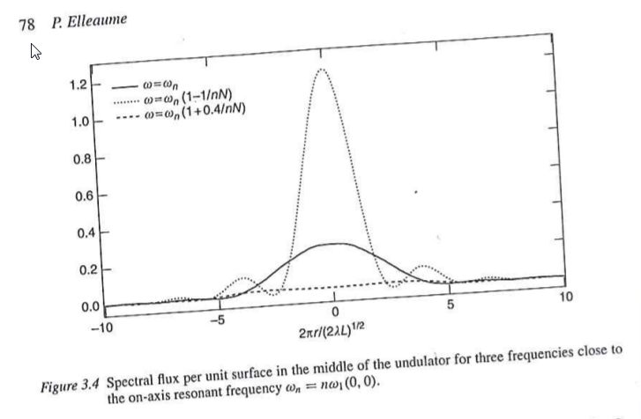
Approximating emission at resonance by Gaussians Onuki & Elleaume Undulators, Wigglers and their applications, CRC press, 2002
Undulator radiation approximated by Gaussians (at resonances) are not Fourier pairs (like beams following the Gaussian Shell-model)

Slide 14
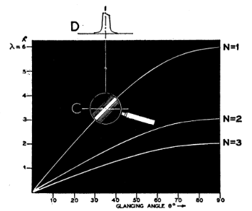
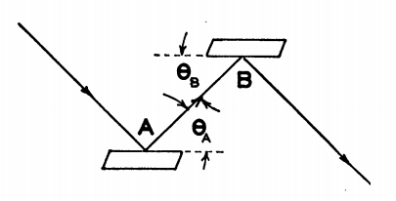
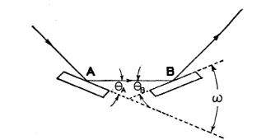
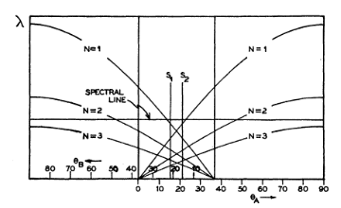
Du Mond diagrams
(+,+)
(+,-)
All rays accepted by the first crystal are also accepted (same angle) at the second crystal
Out of axis rays on the first crystal are incident at different angles on the second crystal.
J. W. M., DuMond, Phys. Rev. 52, 1937, 872-883.

