Slide 2


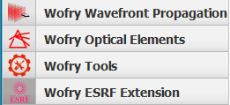
Modelling synchrotron radiation beamlines with
OASYS
Transport of coherence in a Beamline
Manuel Sanchez del Rio
srio@esrf.fr
Advanced Analysis & Precision Unit, MEG/ISDD, ESRF
March 21st 2025
WOFRY

Slide 3
Transport of coherence in a Beamline
Outline:
Introduction coherence in X-ray beams
Simple cases of diffraction by slits
Partial coherence concepts
Coherence Fraction
Coherent Mode Decomposition
Example
WOFRY

Slide 4
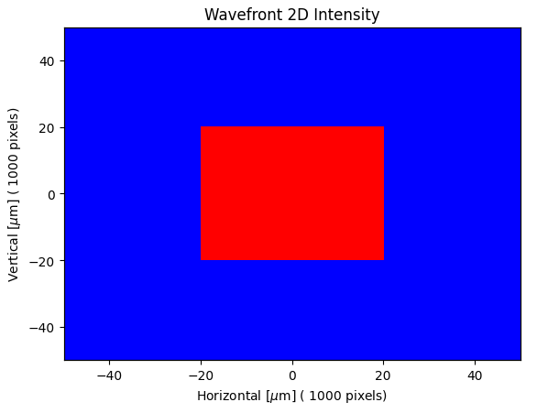
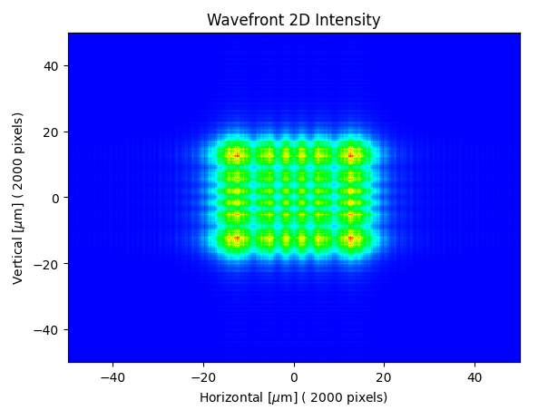
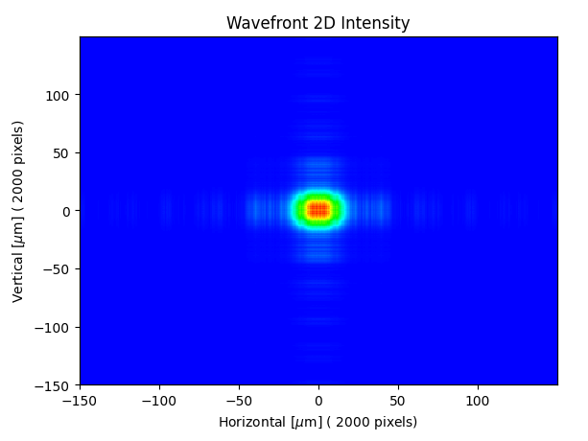
Coherence – Basic concepts
Ray tracing
1 m
15 m
MODEL 1
Coherence: is the ability of a beam to be diffracted by objects (e.g. slits) producing a “diffraction pattern”
Diffraction pattern results from the interference of propagated electric fields

Slide 5
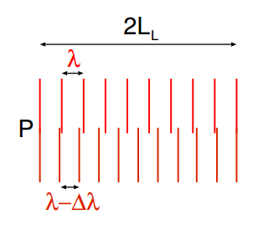

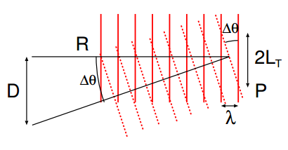

Coherence – Longitudinal and transversal
We need at least TWO waves for defining coherence parameters
Longitudinal or Temporal Coherence: depends on the monochromaticity of the source (describes the correlation or predictable relationship between waves observed at different moments in time)
Transversal Coherence: Depends on the source geometry (correlation between waves at different points in space)

Slide 6
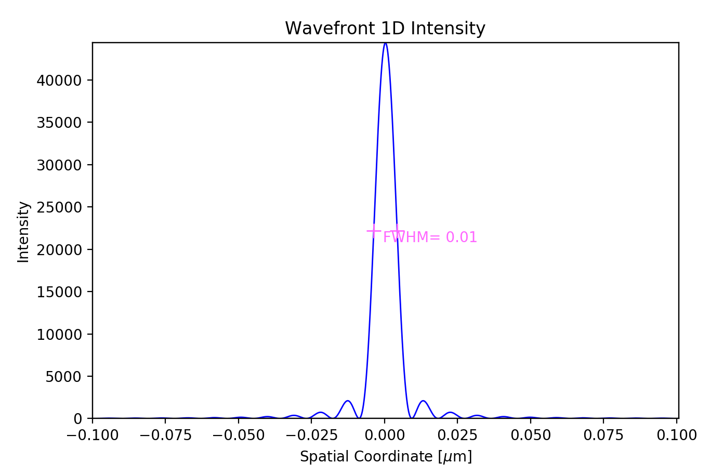
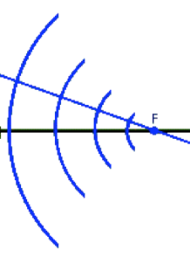
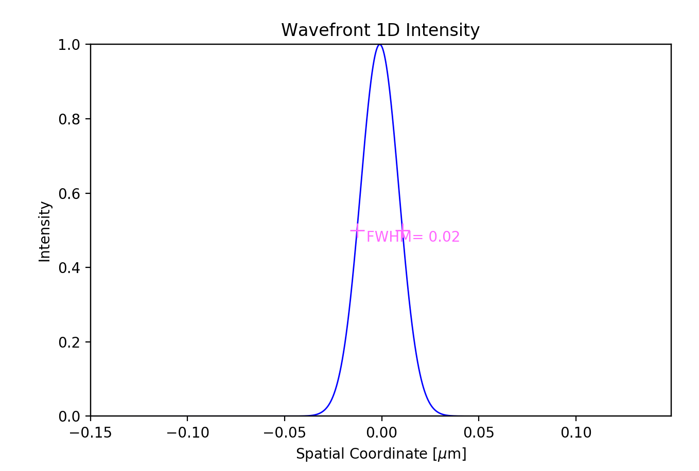



Diffraction by slits (fully coherence)
Aperture=0.4 mm, Ε=17225 eV, D=5cm
MODEL 2.1
Converging spherical +
Propagation (D)
MODEL 2.2
Plane + Lens (F=D)+ Propagation (D)
$$\frac{1}{F}=\frac{1}{∞}+\frac{1}{D}$$
F=D
MODEL 2.3
$$\frac{1}{F}=\frac{1}{D}+\frac{1}{D}$$
Spherical divergent+ Lens (F=D/2)+ Propagation (D)
F=D/2
MODEL 2.4
Gaussian+ Propagation(D)+ Lens (F=D/2)+ Propagation (D)
F=D/2

Slide 7
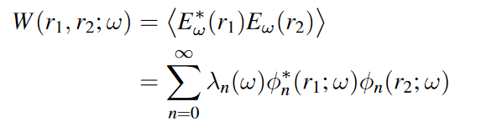
Coherent Fraction (partial coherence)
CF: Ratio of the good photons (coherent) over the total amount of photons
CF=1 for a coherent source and 0 for an incoherent one
Beams are treated with:
“wave optics” if they are coherent
“ray tracing” if they are incoherent
“coherent mode decomposition”¹ if they are partially coherent
The CF can be calculated:
From the ratio of the phase space: “coherent source” / “actual source”
Occupation of the first coherent mode
Consequences:
Storage ring with zero emittance has CF=1 (Diffraction Limited Storage Ring)
Small emittance implies better coherence
CF decreases when photon energy increases
It was CF~10⁻³, 10⁻⁴ for ESRF1 and CF~10⁻² FOR EBS

Slide 8
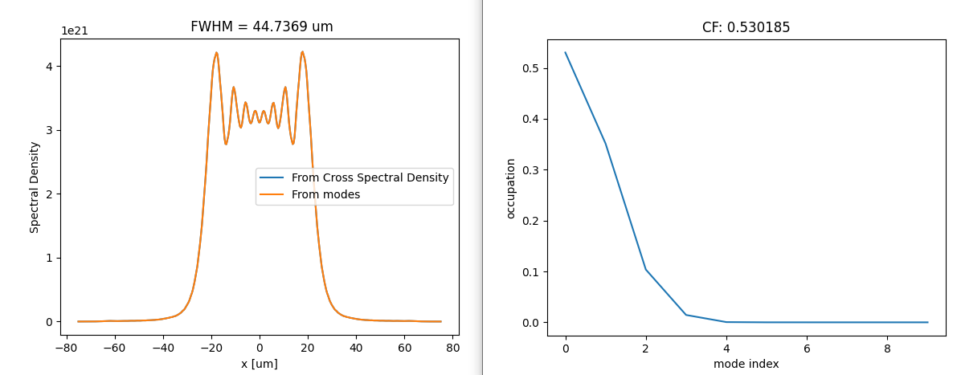
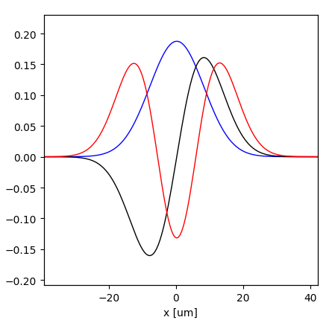
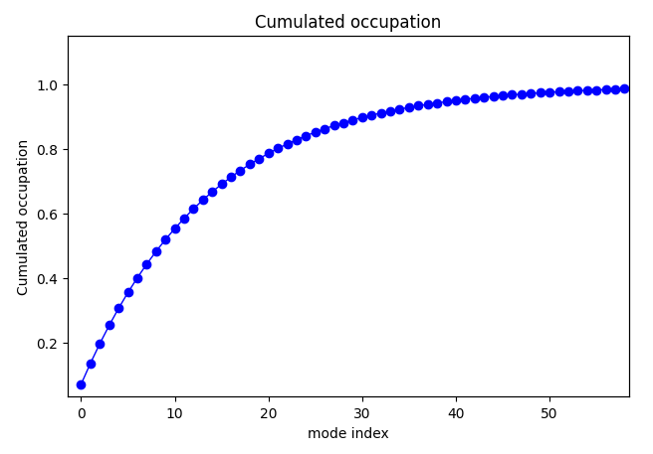
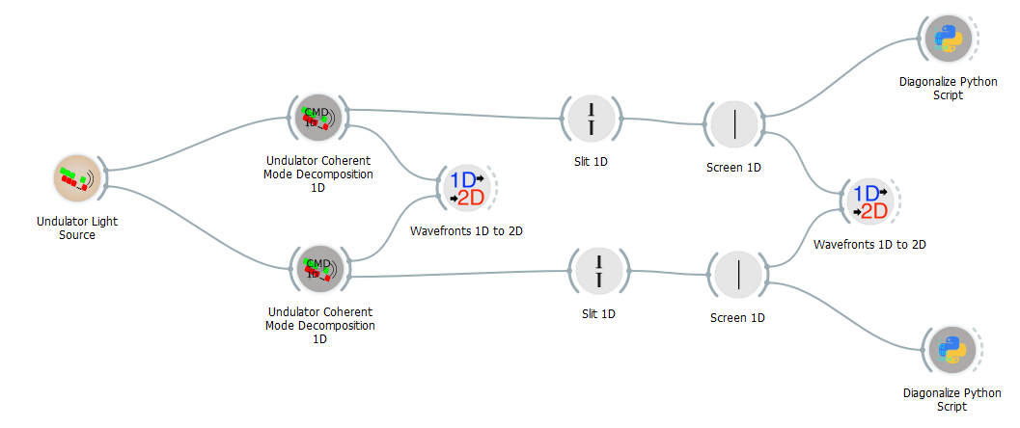
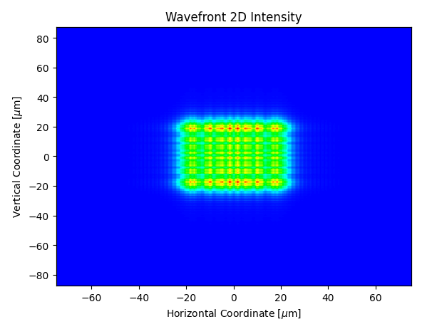
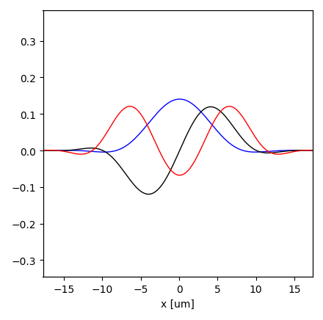
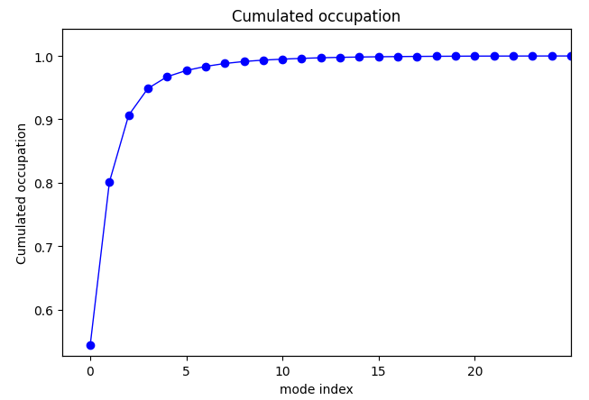
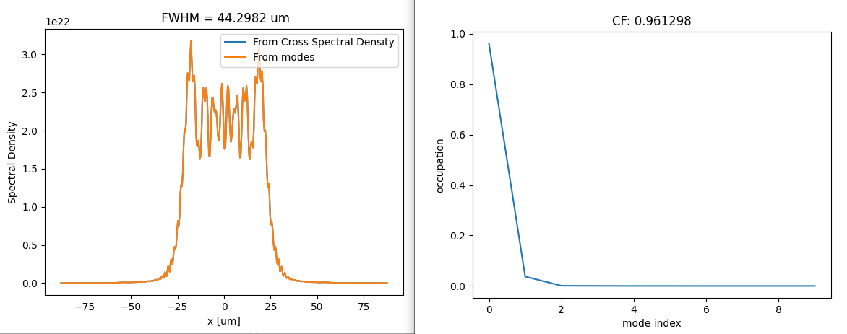
Example: U17 @ 15 keV
MODEL 3
CFh=0.53
Modes Cumulated occupation
CFh=0.07
Horizontal
50x50 μm²
Vertical
Modes Cumulated occupation
CF= CFh x CFv:
Source: 0.038
Image: 0.51
CFv=0.97
CFv=0.54

Slide 9
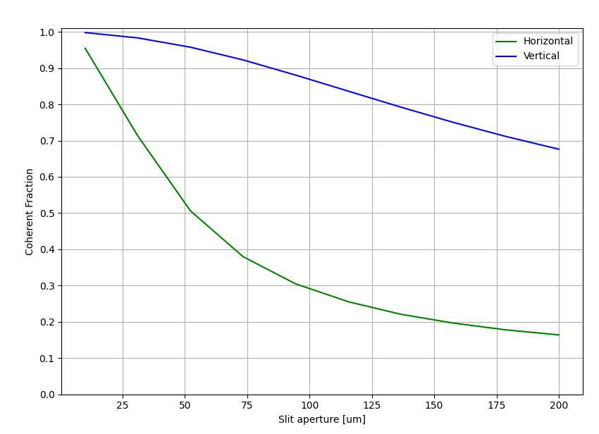
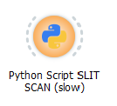
Example: U17 @ 15 keV Coherence gain by closing slit

Slide 10
CFh=0.53
Additional slides

Slide 11
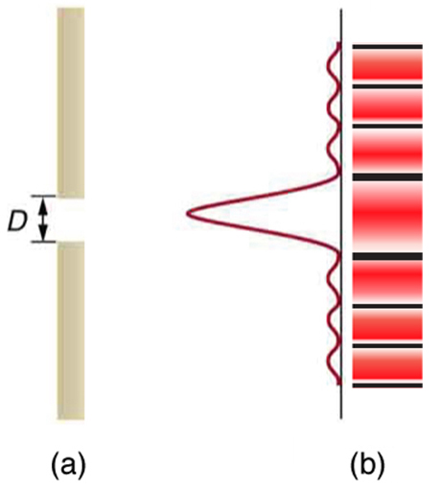
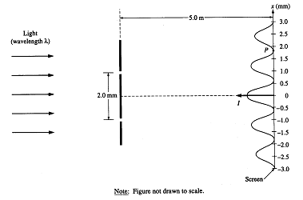
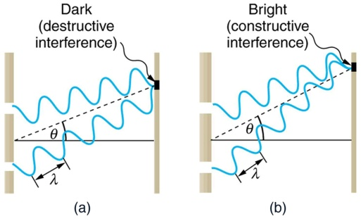
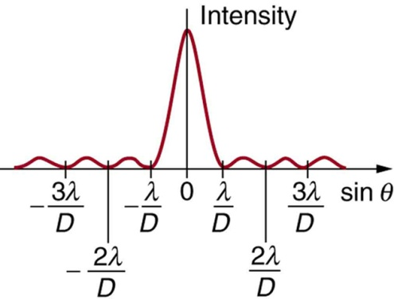
Coherent radiation produces interference patterns
INTERFERENCE DIFFRACTION

Slide 12
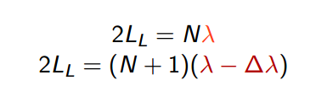
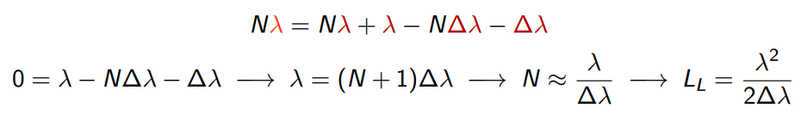
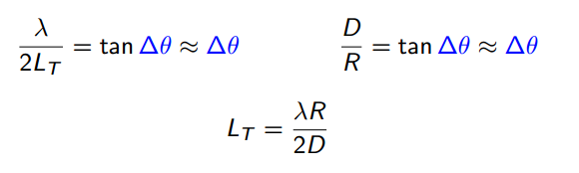
Coherence – Longitudinal and transversal
Starting with TWO well defined (thus coherent) waves with THE SAME intensity:
LONGITUDINAL (TEMPORAL) COHERENCE LENGTH L_{L}
Distance over which two waves from the same source point with slightly different wavelengths will completely dephase.
TRANSVERSE COHERENCE LENGTH L_{T}
The lateral distance along a wavefront over which there is a complete dephasing between two waves of the same wavelength, which originate from two separate points in space
COHERENT LENGTHS - TWO WAVES http://www.csrri.iit.edu/~segre/phys570/10F/lecture_04.pdf

Slide 13
LONGITUDINAL COHERENCE for a typical synchrotron
the synchrotron beam is not formed by two single monochromatic plane waves
But we give some approximated values…
Imagine that a typical monochromator:
Produces a typical of ∆λ/λ = 10⁻⁴ (Si 111) peak distribution (Gaussian)
For main wavelength of λ = 1Å we select two lines thus separated its width ∆λ = 10⁻⁴ Å
The wavefronts of these two monochromatic waves are plane and identical
STATIONARY: This correlation time is much smaller than “bunch time” ~ 15 10⁻³ / c ~10⁻¹² s~ ps

Slide 14
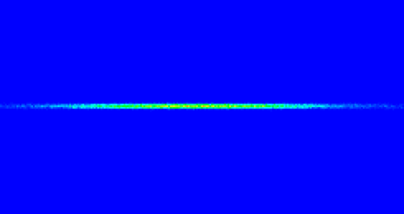
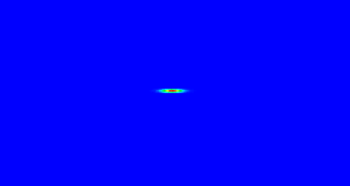
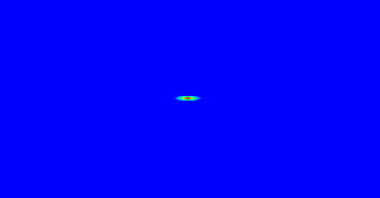
LONGITUDINAL COHERENCE for a typical synchrotron
An experiment takes place typically at R = 30 m from the source
For the transversal coherence length we need some “source size”. We suppose two point sources separated by D=FWHM and R>>D in such a way that wavefronts from these two points are plane waves
L_{T} =λ R / (2D)
1 mm
Hβ
 | sigma um | FWHM um | LT um
V Hbeta | 3.5 | 8.2 | 182.4
V Lbeta | 3.5 | 8.2 | 182.4
V EBS | 3.4 | 8.0 | 187.7
H Hbeta | 388 | 911.8 | 1.6
H Lbeta | 37 | 87.0 | 17.3
H EBS | 27 | 63.5 | 23.6
Lβ
EBS

Slide 15
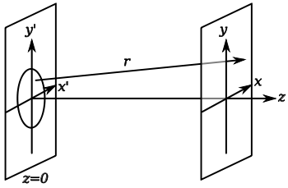

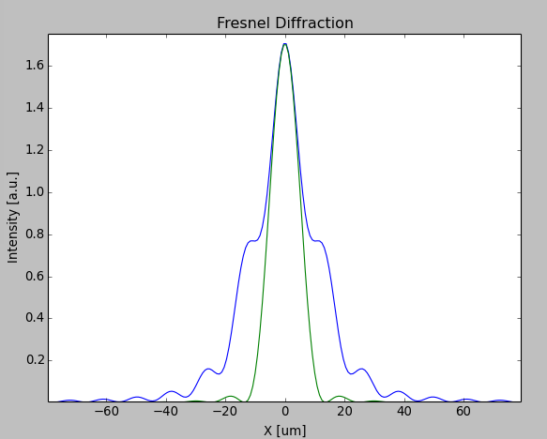


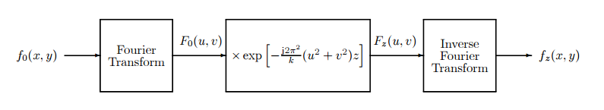
FRESNEL DIFFRACTION
Numeric calculation: convolution with a Gaussian kernel
CONVOLUTION

